Slide 1

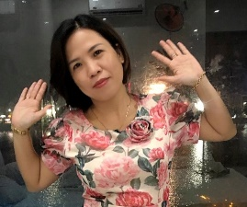
UNIT 3
WEATHER
LESSON: 1.1

Slide 2
Table of contents
01
02
03
Warm Up
Vocabulary
Grammar

Slide 3
Warm Up
01

Slide 4


Slide 5
04
Vocabulary

Slide 6


sunny

Slide 7

rainy

Slide 8
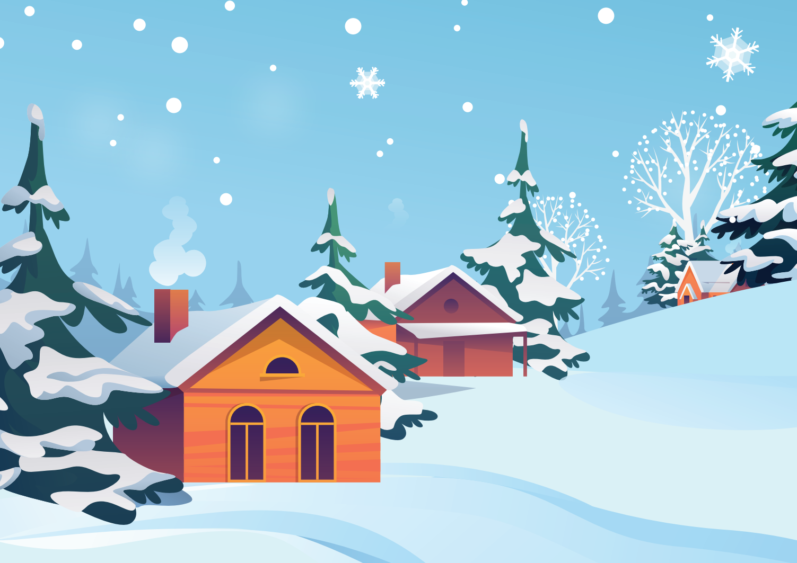
snowy

Slide 9

cloudy

Slide 10

windy

Slide 11

foggy

Slide 12
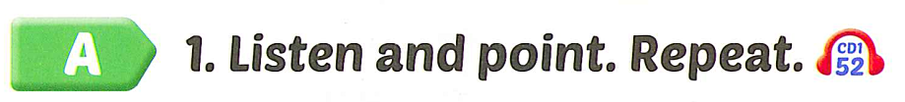
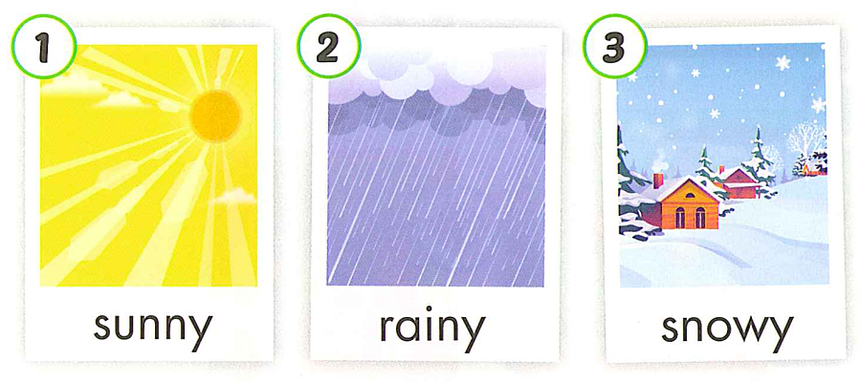
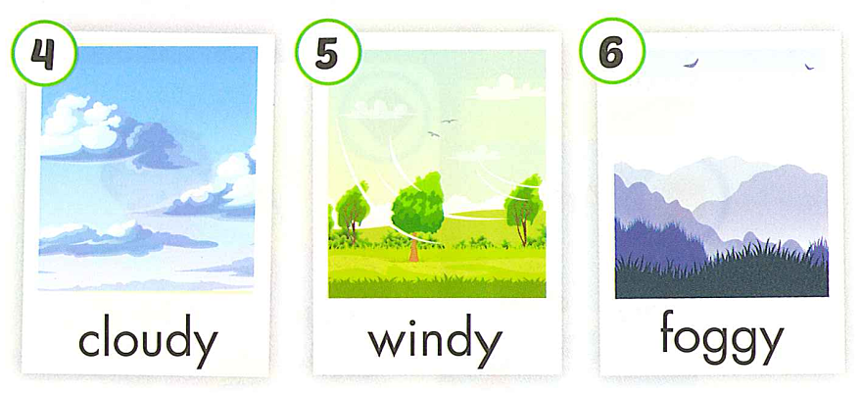

Slide 13
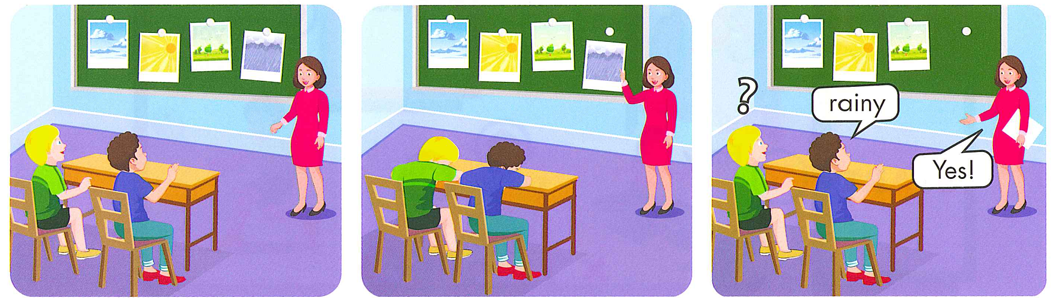

Slide 14
Review
Vocabulary

Slide 15
rai
Next
Look and choose
a
a. ne
b. ny
c.yn
A
B
C

Slide 16
listen
Next
Look and choose
a.
snowy
b.
foggy
c.
windy
A
B
C

Slide 17



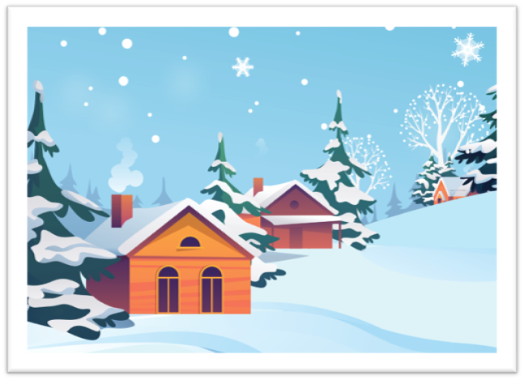
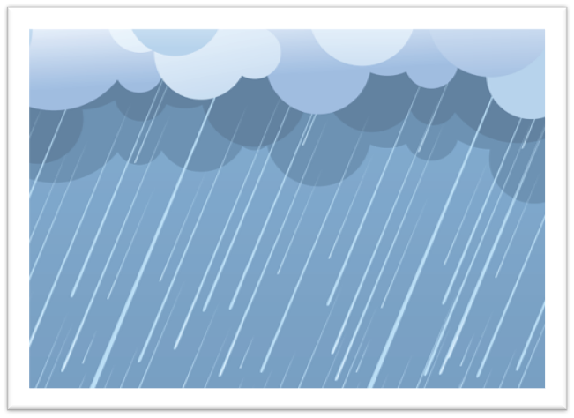
foggy
Next
Look and choose
a
b
c
A
B
C

Slide 18

Listen
Next
Look and choose
a.
windy
b.
cloudy
c.
sunny
A
B
C

Slide 19
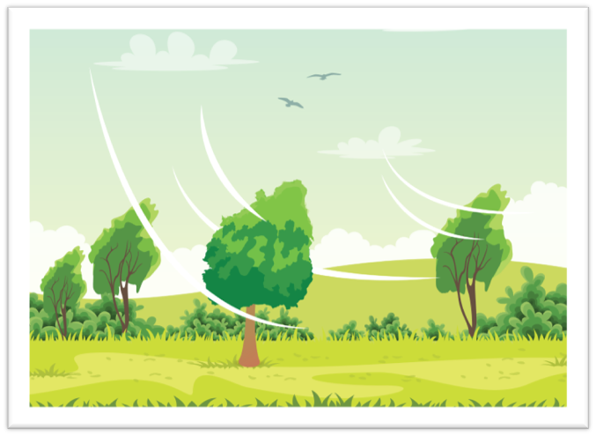
snowy
Next
Look and choose
a
a.
b.
c.
A
B
C

Slide 20
win
Next
Look and choose
a. dy
b. gy
c. ny
A
B
C

Slide 21
03
Grammar

Slide 22


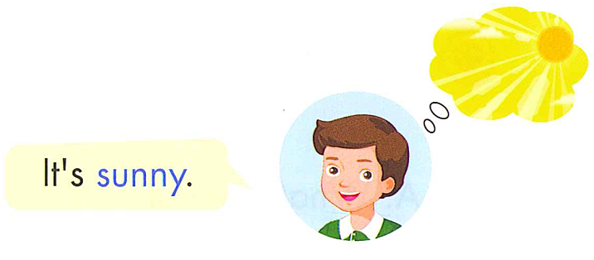

Slide 23
What’s the weather like today ?
It’s +……

Slide 24
Review Grammar

Slide 25

BALLOONS
GAMES
START

Slide 26




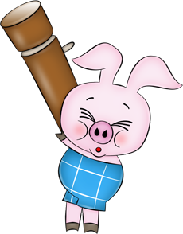
a.
windy
b.
rainy
c.
snowy
What’s the weather like today?
It’s…

Slide 27
a
b
c
What’s the weather like today?
It’s rainy.

Slide 28
b. What’s are you doing ?
a.What’s the weather like today?
C. What time is it ?
It’s sunny

Slide 29
What’s like today the weather?
What’s the weather like today?
What’s today the weather today?
like/ weather/ the/ today?/ What’s

Slide 30
b.
a
a.
the
c.
is
What’s…weather like today?

Slide 31
b.
What’s
the like weather today ?
a.
What’s
weather the like today ?
c.
What’s
the weather like today ?
Reorder : What/the/ ’s/ like/ weather/today?

Slide 32
a. I like sunny weather.
c. I sleep in snowy weather.
b. It’s foggy.
What’s the weather like ?
………………….

Slide 33

Practice

Slide 34

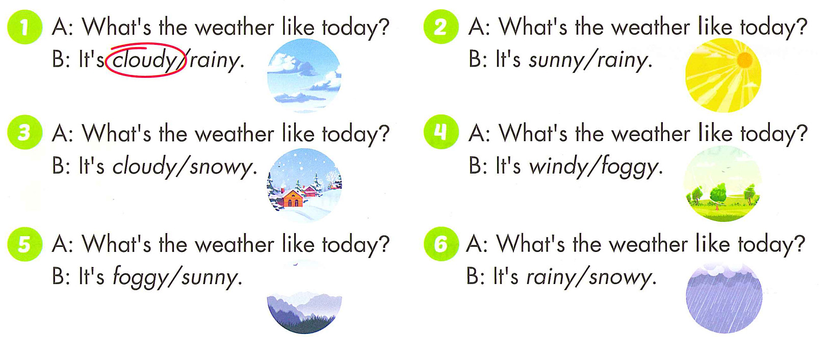

Slide 35
Good Bye

