Slide 1

Unit 4: HOME
Lesson 2.1
Page 55

Slide 2

WARM UP

Slide 3
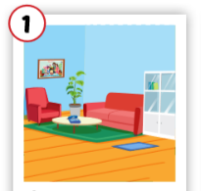
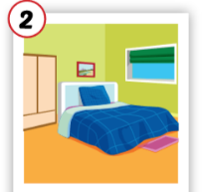
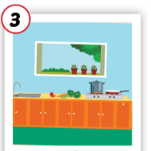
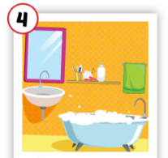
Crossword puzzles
3
k
1
l
i
o
b
r
4
2
e
Notes:
Students play the crossword puzzles. They practice spelling.

Slide 4
Crossword puzzles
3
k
1
l
i
v
i
n
g
r
o
o
m
b
r
4
2
e

Slide 5
Crossword puzzles
3
k
1
l
i
v
i
n
g
r
o
o
m
b
r
4
2
b
e
d
r
o
o
m

Slide 6
Crossword puzzles
3
k
1
l
i
v
i
n
g
r
o
o
m
b
t
r
4
c
h
2
b
e
d
r
o
o
m
n

Slide 7
Crossword puzzles
3
k
1
l
i
v
i
n
g
r
o
o
m
b
a
t
h
r
o
o
m
4
c
h
2
b
e
d
r
o
o
m
n

Slide 8

It’s time to learn …

Slide 9
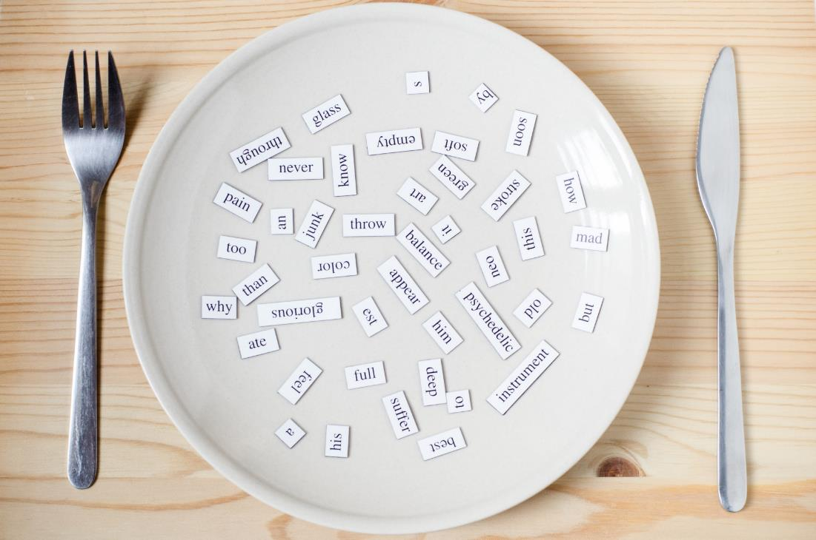
New words
cleaning, playing,
eating,
sleeping, cooking.

Slide 10

Presentation

Slide 11

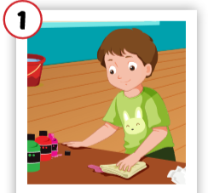
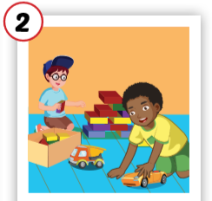
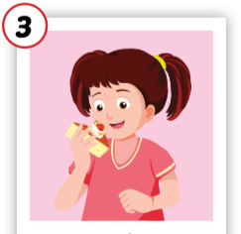
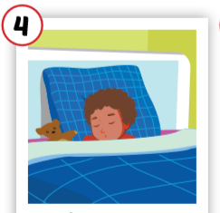
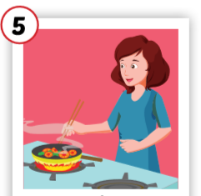
Click each English word to hear the sound.
cleaning
playing
eating
sleeping
cooking
/kliːnɪŋ/
đang lau chùi
/pleɪɪŋ/
đang chơi
/iːt ɪŋ /
đang ăn
/sliːp ɪŋ /
đang ngủ
/ˈkʊk ɪŋ /
đang nấu nướng

Slide 12
Click each English word to hear the sound.
cleaning
/kliːnɪŋ/
đang lau chùi

Slide 13
Click each English word to hear the sound.
playing
/pleɪɪŋ/
đang chơi

Slide 14
Click each English word to hear the sound.
eating
/iːt ɪŋ /
đang ăn

Slide 15
Click each English word to hear the sound.
sleeping
/sliːp ɪŋ /
đang ngủ

Slide 16
Click each English word to hear the sound.
cooking
/ˈkʊk ɪŋ /
đang nấu nướng

Slide 17

Practice

Slide 18
Click each English word to hear the sound.
cleaning
playing
eating
sleeping
cooking
/kliːnɪŋ/
đang lau chùi
/pleɪɪŋ/
đang chơi
/iːt ɪŋ /
đang ăn
/sliːp ɪŋ /
đang ngủ
/ˈkʊk ɪŋ /
đang nấu nướng

Slide 19
Slap the board

Slide 20

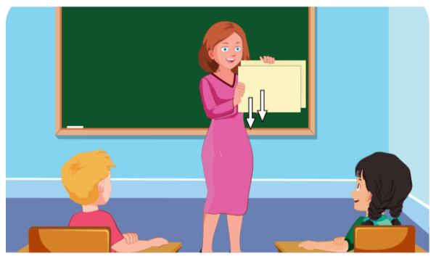
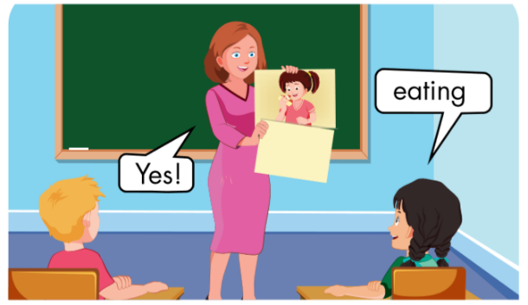

Slide 21

Yes!
cleaning
playing
No!

Slide 22

cleaning

Slide 23

sleeping

Slide 24

Yes!
cooking
cooking
eating
No!

Slide 25
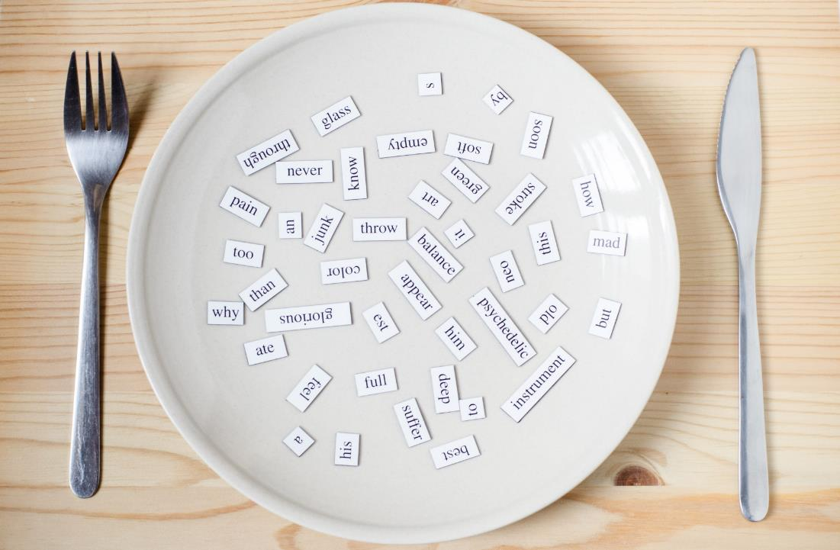
Structures
What’s he doing? He’s sleeping.

Slide 26
Presentation

Slide 27





Slide 28
Practice

Slide 29

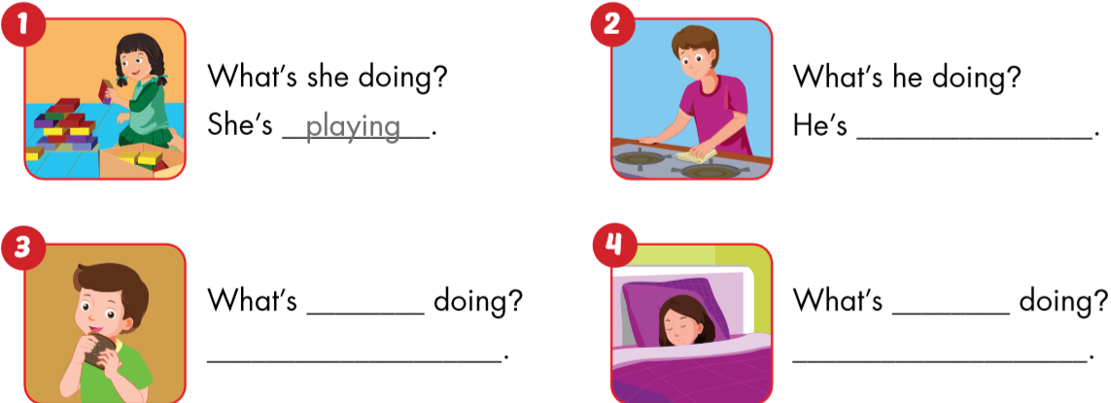
playing.
cleaning.
he
she
He’s eating.
She’s sleeping.

Slide 30
Ask and answer.
What’s he doing?
What’s she doing?
What’s she doing?
He’s sleeping.
She’s eating.
She’s cooking.
Notes:
Giáo viên có thể thay chủ ngữ bằng tên người (ở số ít)

Slide 31

Workbook
p. 40

Slide 32

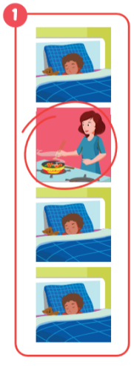
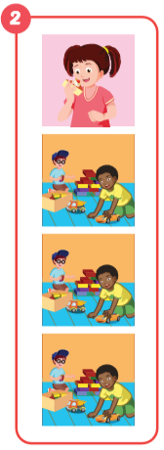
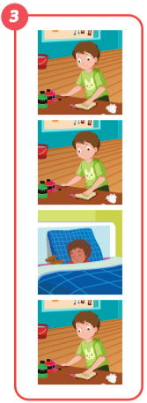
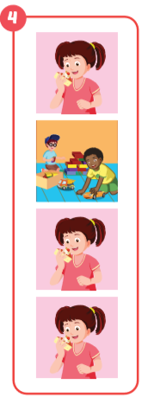
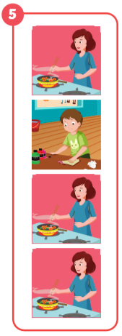
cooking
eating
sleeping
playing
cleaning

Slide 33

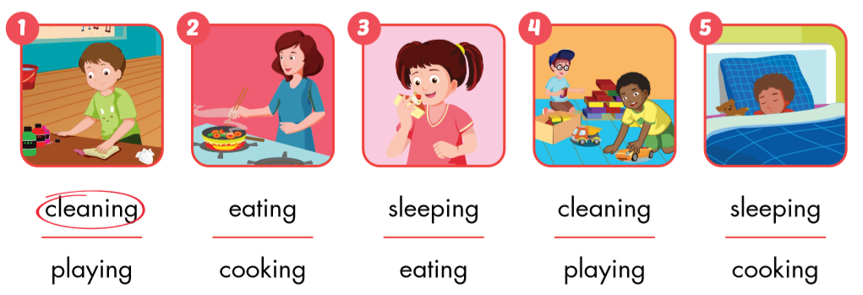

Slide 34
Early
Production

Slide 35




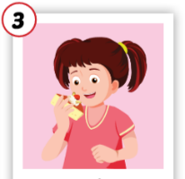
1
4
4
1
2
What’s he/she doing?
SPIN
5
2
He’s / she’s …………
3
4
3
5

Slide 36

CONSOLIDATION

Slide 37
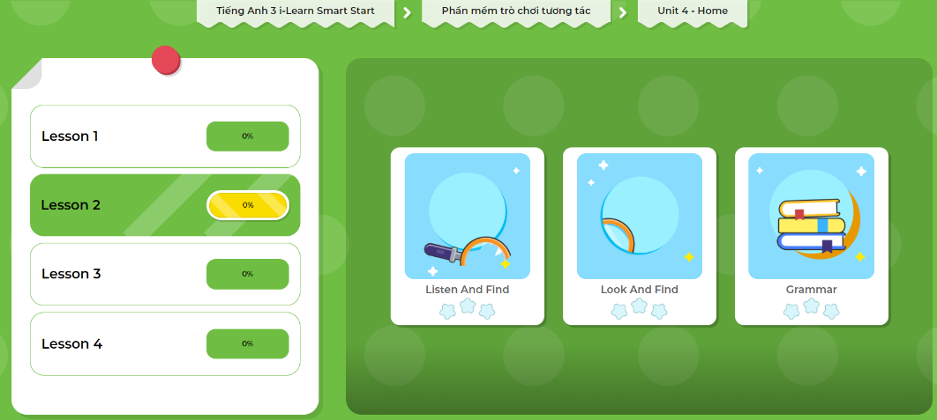
Extra Practice
DHA App
Let’s play!
Click here to play the game

Slide 38
o g
s e ping
cooking
sleeping
ea g
eating
la ing
cleaning
playing
c a g

Slide 39
Click each English word to hear the sound.
cleaning
playing
eating
sleeping
cooking
/kliːnɪŋ/
đang lau chùi
/pleɪɪŋ/
đang chơi
/iːt ɪŋ /
đang ăn
/sliːp ɪŋ /
đang ngủ
/ˈkʊk ɪŋ /
đang nấu nướng

Slide 40
Make sentences.
sleeping
eating
cooking
He’s sleeping.
She’s eating.
She’s cooking.
Notes:
Giáo viên có thể thay chủ ngữ bằng tên người (ở số ít)

Slide 41

WRAP-UP

Slide 42
Lesson 3
Today’s lesson
Vocabularies
cleaning, playing,
eating,
sleeping, cooking.
Structures/ Sentence patterns
What’s he doing?
He’s sleeping.

Slide 43
Homework
Review the vocabularies and sentence patterns. Make sentences using them.
Do the exercises on page 40 (WB)
Prepare the next lesson (page 56 SB)
Play consolidation games in Tiếng Anh 3 i-Learn Smart Start DHA App on www.eduhome.com.vn
Do the exercise in Tiếng Anh 3 i-Learn Smart Start Notebook (page 29)

Slide 44

Enjoy your day!

