Slide 1
Unit 1: Animals
Lesson 1.1
Page 6

Slide 2
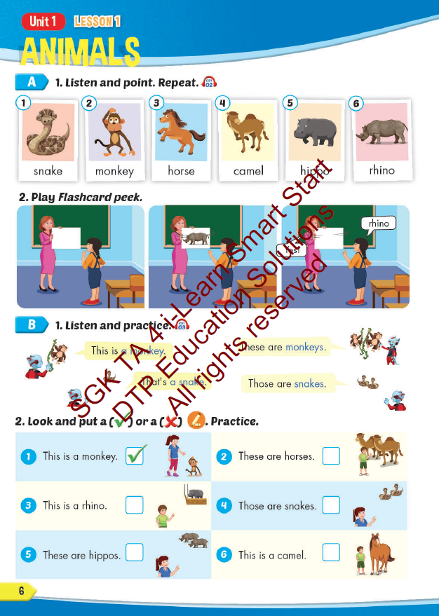
Lesson Outline
Warm-up
Vocabulary
Structure
Consolidation
Wrap-up

Slide 3
Objectives
By the end of this lesson, students will be able to…
Vocabulary: Pronounce and use the words related to the topic properly: snake, monkey, horse, camel, hippo, rhino.
Structure: This is a monkey. - These are monkeys.
That's a snake. - Those are snakes

Slide 4
WARM UP

Slide 5
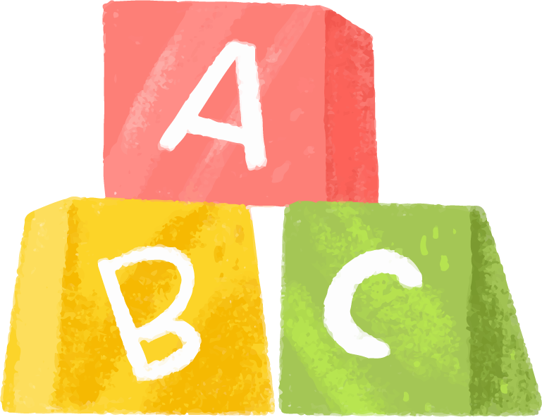
Click on the characters and choose the number to see the questions
Game: Finding the way home.

Slide 6
1
3
4
2
5
7
6
8

Slide 7
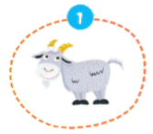
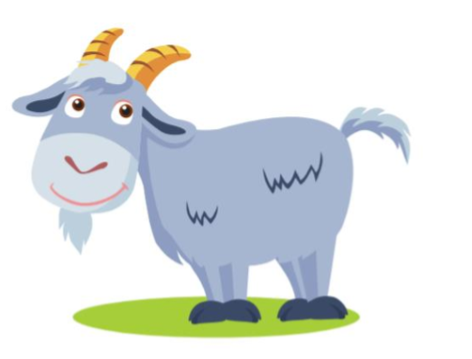
It’s a …..
It’s a goat.

Slide 8
It’s a …..
It’s a bird.

Slide 9
It’s a ….
It’s a mouse.

Slide 10
It’s a ….
It’s a dog.

Slide 11
It’s a ….
It’s a cat.

Slide 12
It’s a …..
It’s a cow.

Slide 13
It’s a …..
It’s a duck.

Slide 14
It’s a …..
It’s a pig.

Slide 15
It’s time to learn …

Slide 16
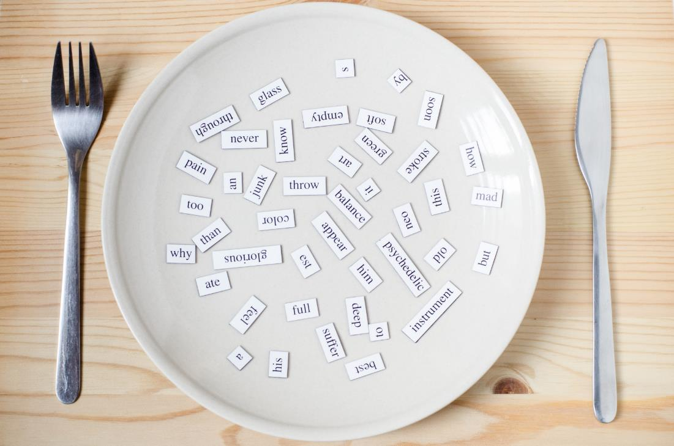
New words
snake, monkey, horse,
camel, hippo, rhino

Slide 17
Presentation

Slide 18
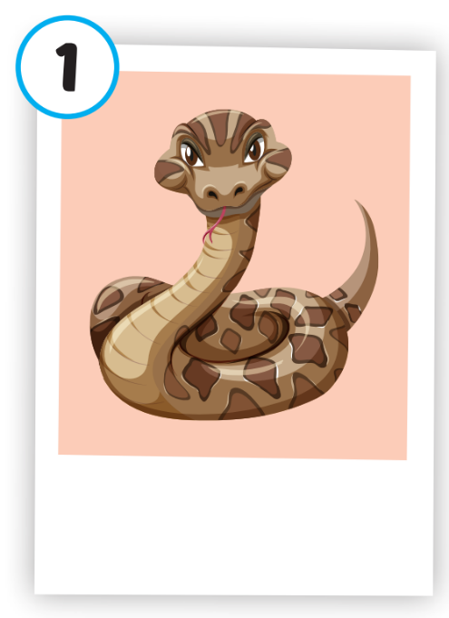
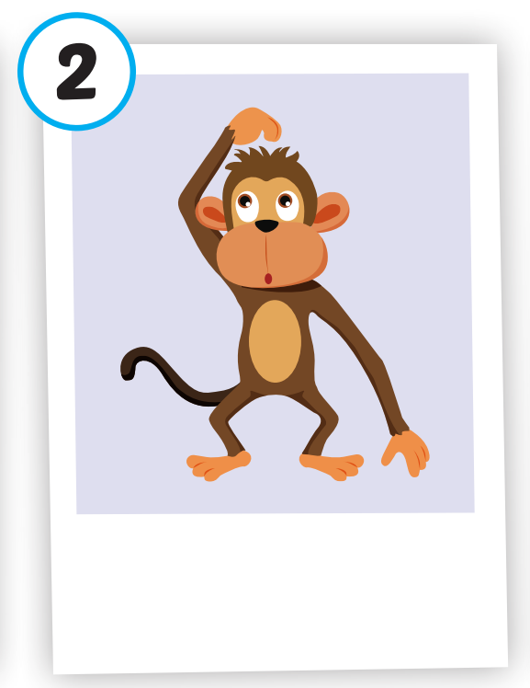
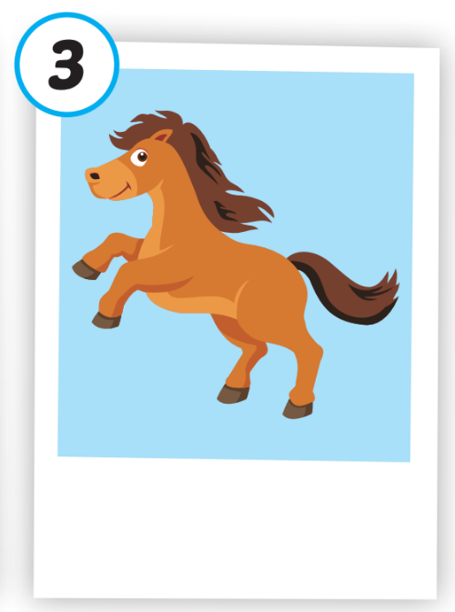
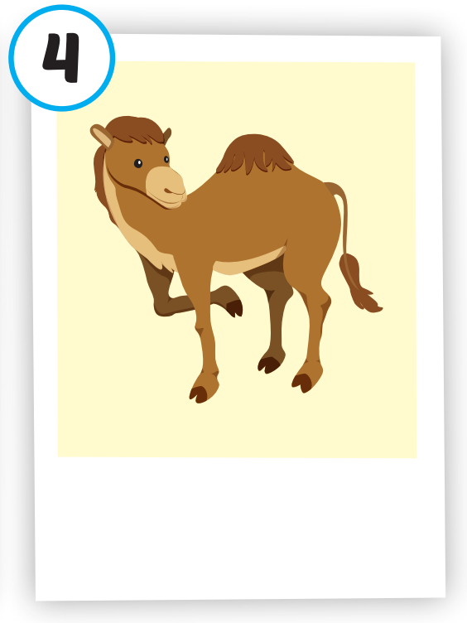
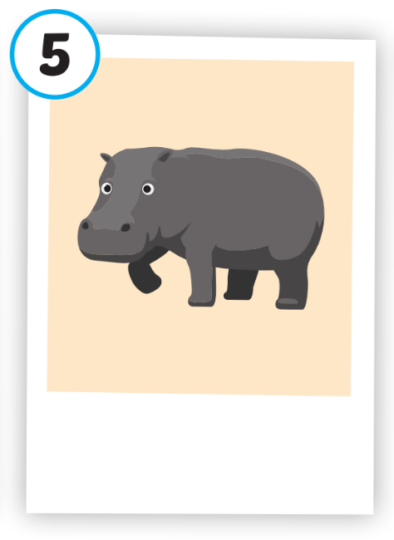
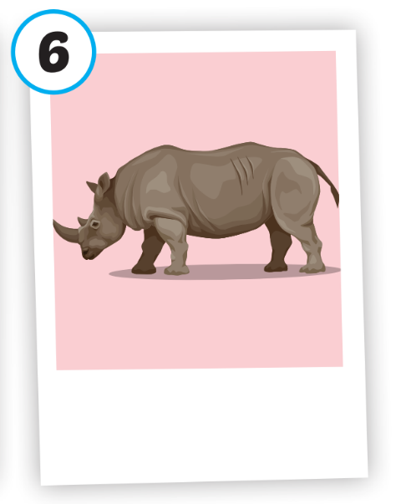
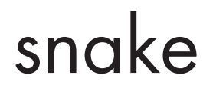
Click on each picture to hear the sound.
/hɔːrs/
con ngựa
/ˈkæməl/
con lạc đà
/ˈhɪpoʊ/
con hà mã
/ˈraɪnoʊ/
con tê giác
/sneɪk/
con rắn
/ˈmʌŋki/
con khỉ
Notes:
Click vào hình A. 1. Listen and point. Repeat để cho cả audio full chạy

Slide 19
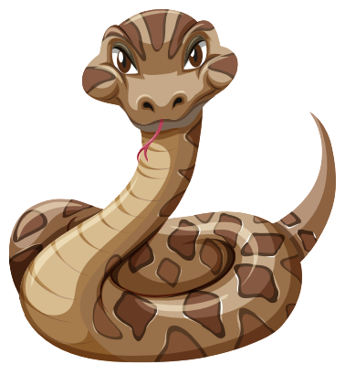
Click on each picture to hear the sound.
/sneɪk/
con rắn

Slide 20
Click on each picture to hear the sound.
/ˈmʌŋki/
con khỉ

Slide 21
Click on each picture to hear the sound.
/hɔːrs/
con ngựa

Slide 22
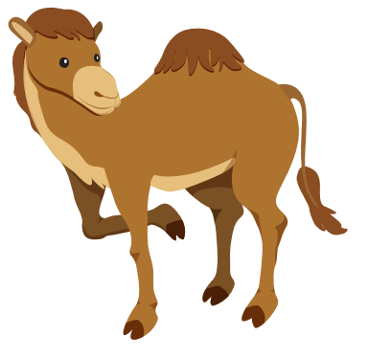
Click on each picture to hear the sound.
/ˈkæməl/
con lạc đà

Slide 23
Click on each picture to hear the sound.
/ˈhɪpoʊ/
con hà mã

Slide 24
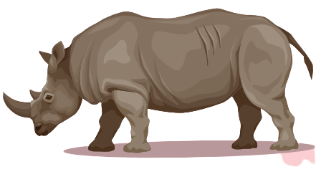
Click on each picture to hear the sound.
/ˈraɪnoʊ/
con tê giác

Slide 25
Practice

Slide 26
Check your memory

Slide 27
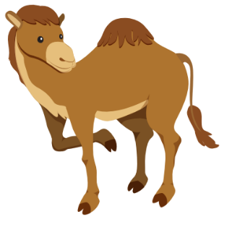
Listen and choose
A
B
C

Slide 28
Listen and choose
A
B
C

Slide 29
Listen and choose
A
B
C

Slide 30
Listen and choose
A
B
C

Slide 31
Listen and choose
A
B
C

Slide 32
Listen and choose
A
B
C

Slide 34
Structure
This is a monkey.
These are monkeys.
That's a snake.
Those are snakes

Slide 35
Presentation

Slide 36
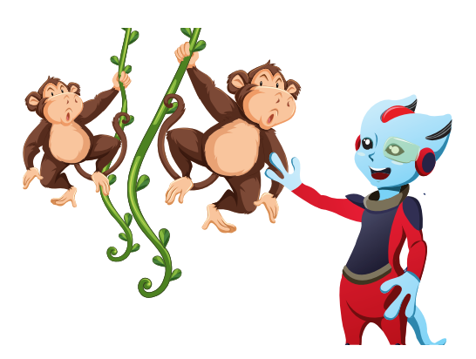
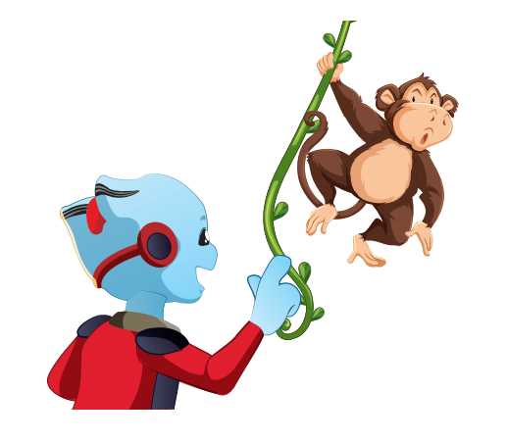
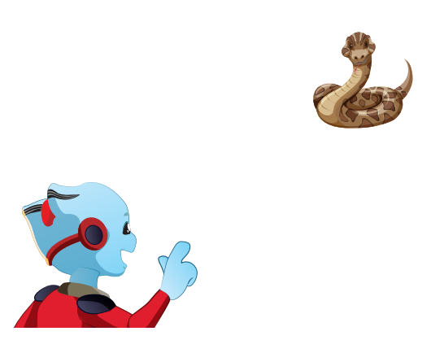
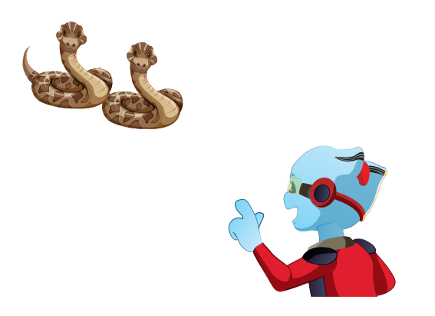
Structure
Click on the sentences to hear.

Slide 37
Practice

Slide 39
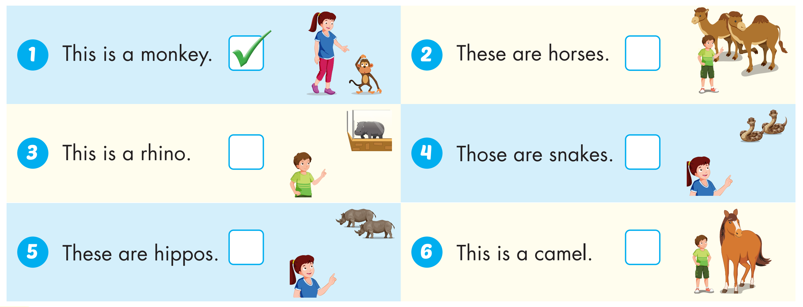

Slide 40
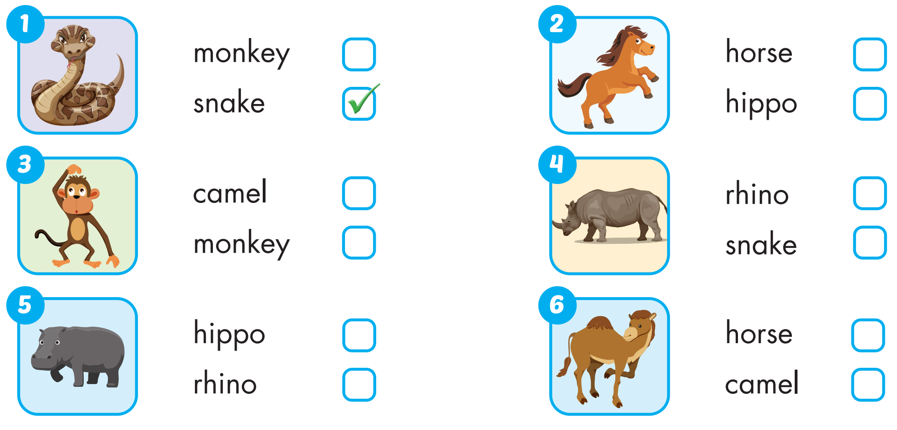
Extra Practice
WB, page 2

Slide 41
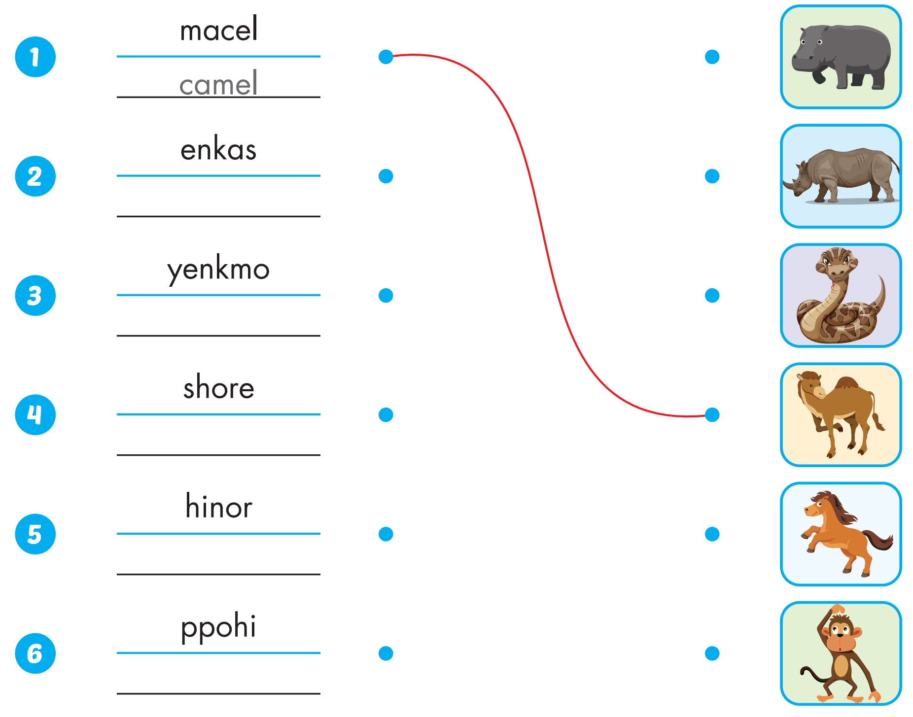
Extra Practice
WB, page 2
snake
monkey
horse
rhino
hippo

Slide 42
Production

Slide 43
CONSOLIDATION

Slide 44
WRAP-UP

Slide 45
Today’s lesson
Vocabularies
snake, monkey, horse, camel, hippo, rhino.
Structures/ Sentence patterns
This is a monkey.
These are monkeys.
That's a snake.
Those are snakes

Slide 46
Homework
Practice the vocabularies and structure, and make sentences using them.
Do the exercises in Tiếng Anh 4 i-Learn Smart Start WB (page 2)
Do the exercises in Tiếng Anh 4 i-Learn Smart Start Notebook (page 4)
Prepare the next lesson (page 7 SB)
Play the consolidation games in Tiếng Anh 4 i-Learn Smart Start DHA App on www.eduhome.com.vn

Slide 47
Enjoy your day!

Slide 48
Lesson 3
Stay positive and have a nice day!

