Slide 1

HOAI HAO, MARCH 19, 2025

Slide 2

WARM-UP

Slide 3


Slide 4





1
3
?
2
4

Slide 5





1
3
?
2
4

Slide 6

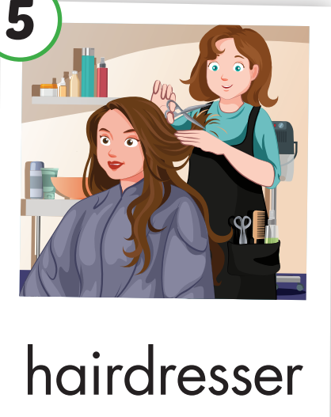



1
3
?
2
4

Slide 7

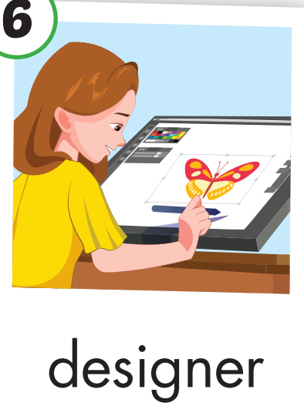



1
3
?
2
4

Slide 8





1
3
?
2
4

Slide 9

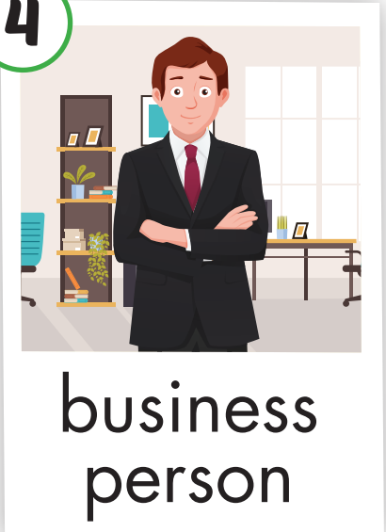



1
3
?
2
4

Slide 10
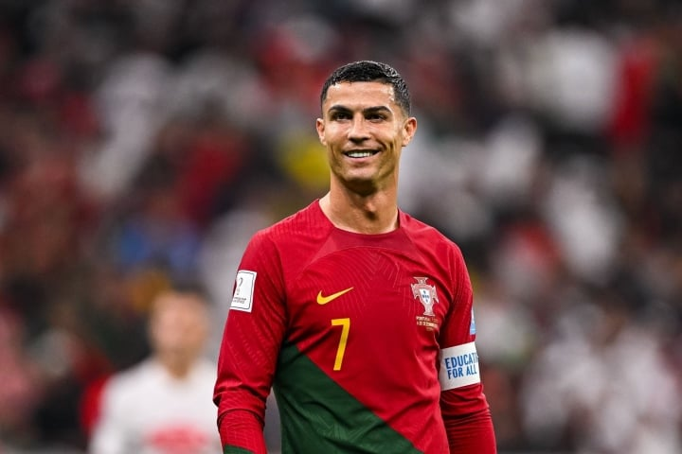
Who’s he?
?

Slide 11

Unit 7: JOBS
Lesson 2.1
Page 95

Slide 12

It’s time to learn …

Slide 13
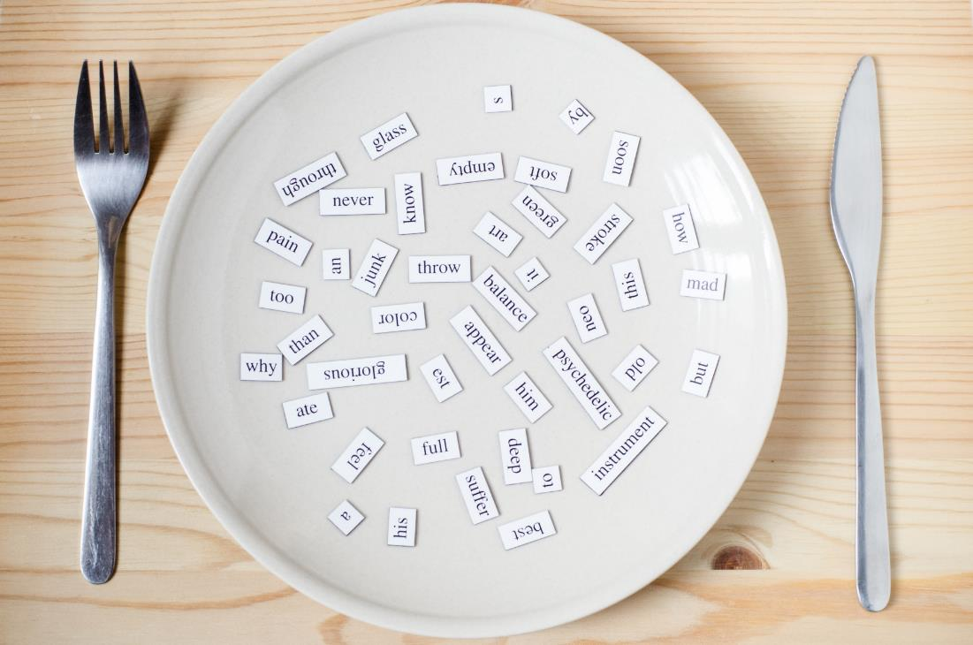
New words
soccer player,
singer,
nurse,
driver,
police officer,
actor.

Slide 14

Presentation

Slide 15


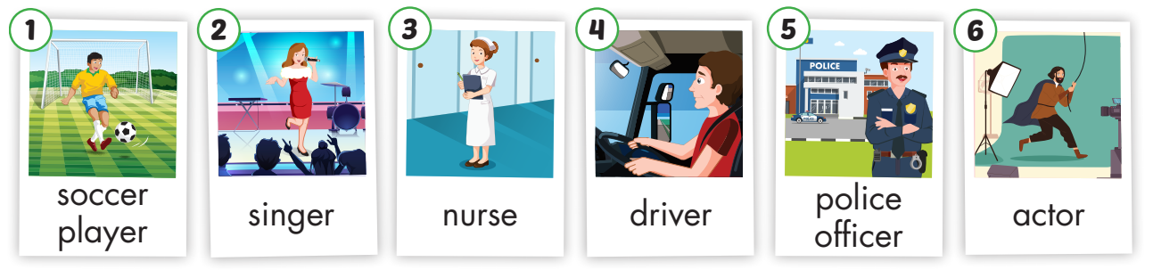
← Click on the title to hear the sound.
/ˈsɑːkər ˈpleɪər/
cầu thủ
/ˈsɪŋər/
ca sĩ
/nɜːrs/
y tá
/ˈdraɪvər/
tài xế
/pəˈliːs ɑːfɪsər/
cảnh sát
/ˈæktər/
diễn viên

Slide 16
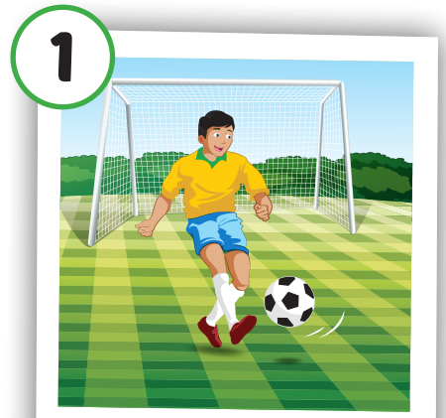
Click on the picture to hear the sound.
soccer player
/ ˈsɑːkər ˈpleɪər /
cầu thủ

Slide 17
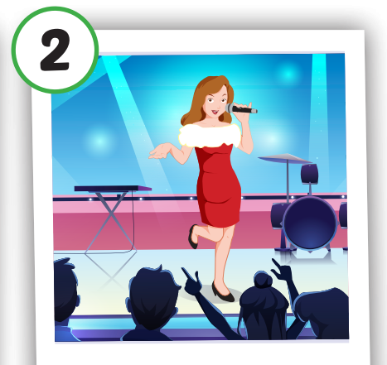
Click on the picture to hear the sound.
singer
/ ˈsɪŋər /
ca sĩ

Slide 18

Click on the picture to hear the sound.
nurse
/ nɜːrs /
y tá

Slide 19
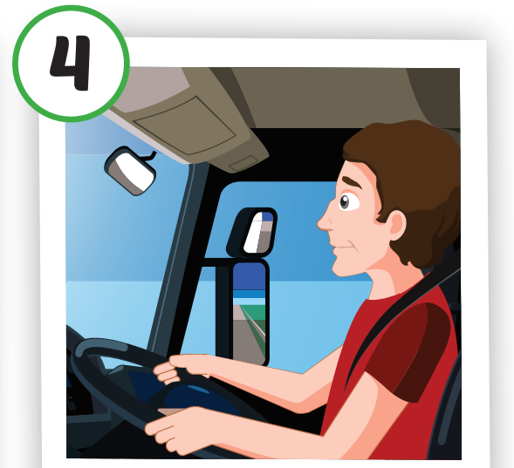
Click on the picture to hear the sound.
driver
/ˈdraɪvər /
tài xế

Slide 20

Click on the picture to hear the sound.
police officer
/ pəˈliːs ɑːfɪsər /
cảnh sát

Slide 21
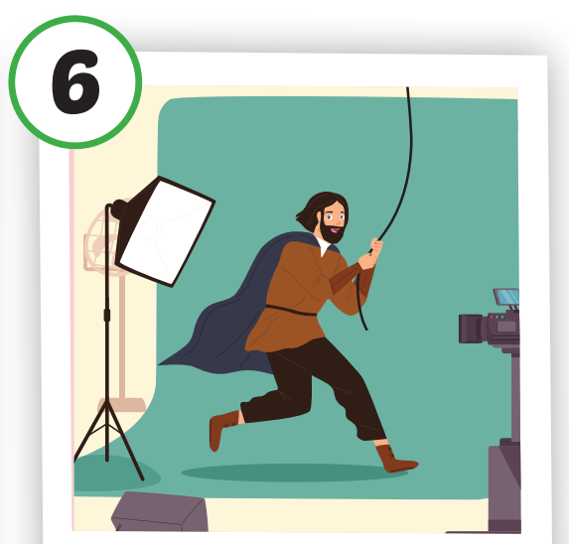
Click on the picture to hear the sound.
actor
/ ˈæktər /
diễn viên

Slide 22
Practice

Slide 23
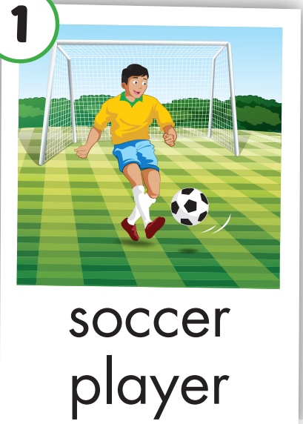

Slide 24


Slide 25


Slide 26
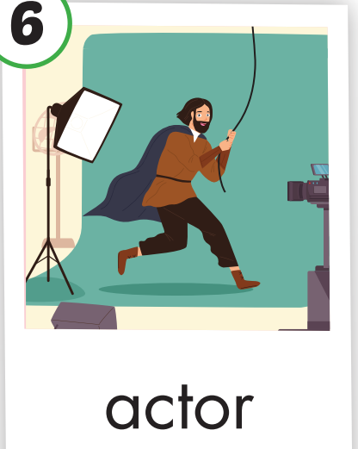

Slide 27
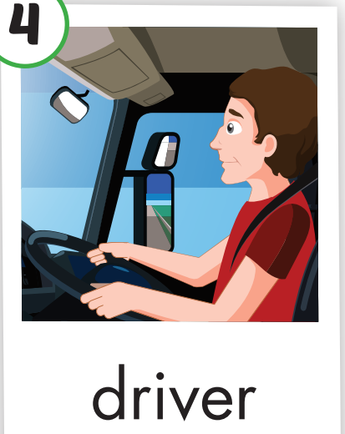

Slide 28
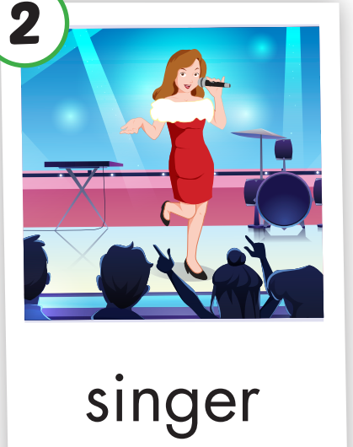

Slide 29
Structure
Tom likes sports. I think he’ll
be a soccer player

Slide 30
Presentation

Slide 31
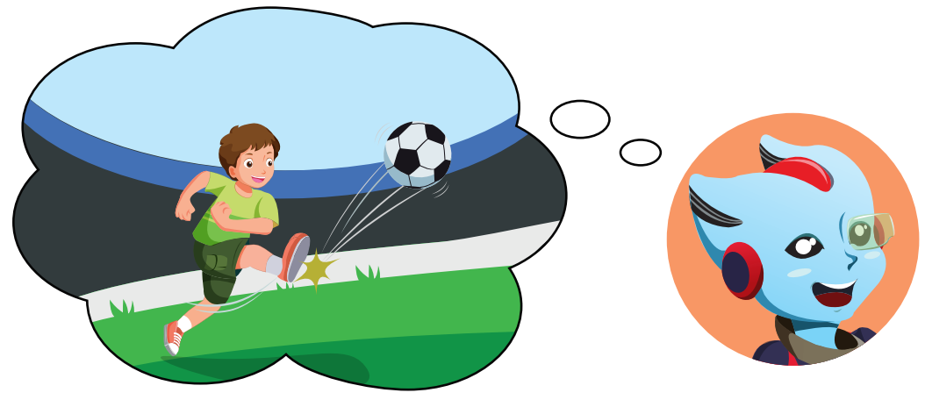
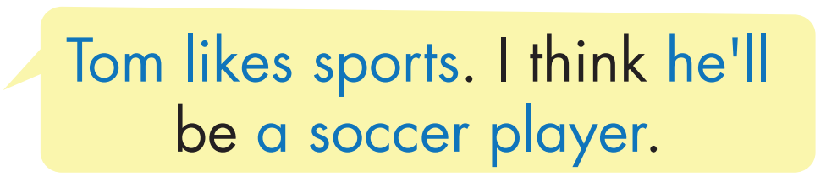
Structure
Click on the picture to hear the sound.

Slide 32

Practice

Slide 33

Click on the picture to hear the sound.

Slide 34


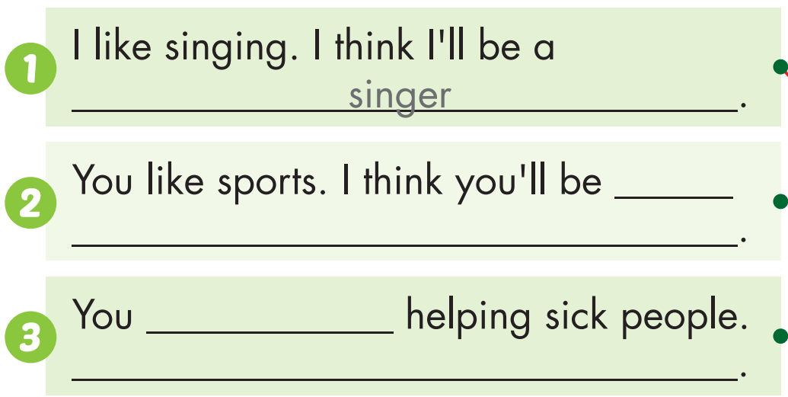
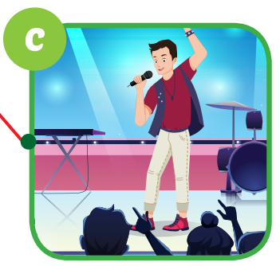
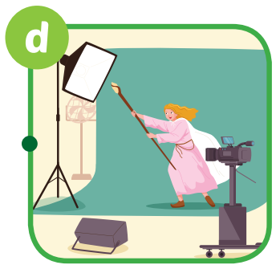


a soccer player
like
I think you’ll be a nurse

Slide 35
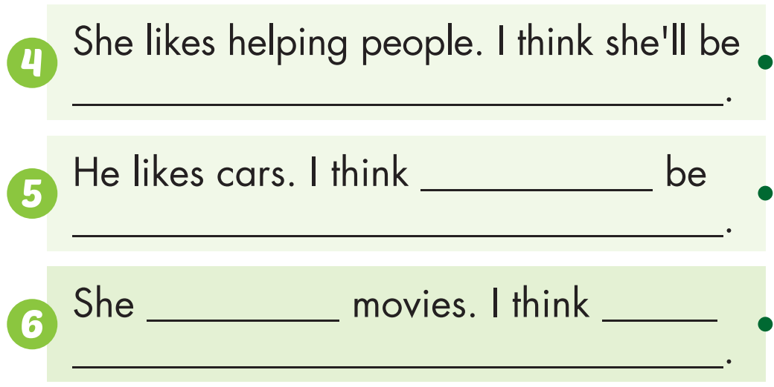
a police officer
he’ll
a driver
likes
She’ll be an actor

Slide 36

Production

Slide 37
Match two halves
I think he’ll be
1.
A.
You like music.
a soccer player.
She likes helping
B.
2.
I think you’ll be a singer.
sick people.
I think you’ll be
3.
C.
You like helping people.
police officer.
4.
D.
He likes sports.
I think she’ll be a nurse.
D
C
A
1 - 2 - 3 - 4 -
B

Slide 38

CONSOLIDATION

Slide 39
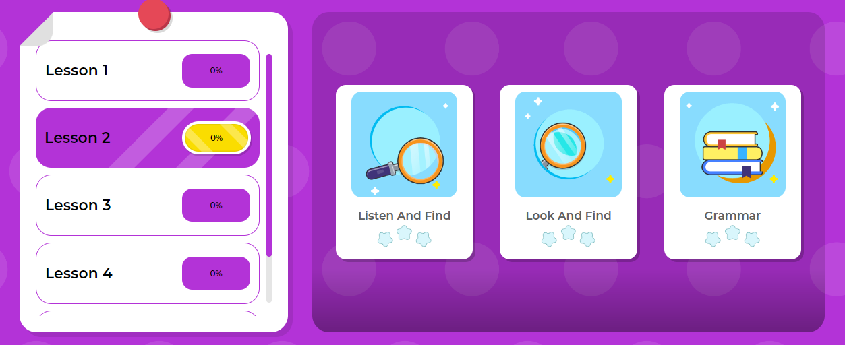
Play the game on DHA on Eduhome – Unit 7 – Lesson 2

Slide 40

WRAP-UP

Slide 41
Today’s lesson
Vocabularies
soccer player, singer, nurse, driver, police officer, actor.
Structures/ Sentence patterns
Tom likes sports. I think he’ll be a soccer player.

Slide 42
Homework
Practice the vocabularies and structure, and make sentences using them.
Do the exercises in Tiếng Anh 5 i-Learn Smart Start WB (page 64).
Do the exercises in Tiếng Anh 5 i-Learn Smart Start Notebook.
Prepare the next lesson (page 96 SB).
Play the consolidation games in Tiếng Anh 5 i-Learn Smart Start DHA App on www.eduhome.com.vn

Slide 43

Enjoy your day!

Slide 44

Lesson 3
Stay positive and have a nice day!

