Slide 1

Unit 6: Clothes
Lesson 3.1
Page 88
Class: 3A1
Hoai Hao, February 24, 2025

Slide 2
Objectives
By the end of this lesson, students will be able to ask and answer about their clothes.
Vocabulary: belt, scarf, sweater, pajamas, skiing.
Structure: Is that your belt? Yes, it is./No, it isn’t
Are those your pajamas? Yes, they are./No, they aren’t.

Slide 3

WARM UP

Slide 4
Let’s play!

Slide 5
Say
the clothes
Click on
the number
Say
the number

Slide 6

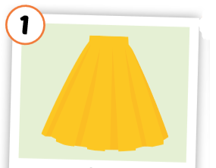
1
2

Slide 7
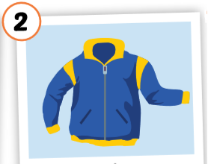
2
1
3

Slide 8
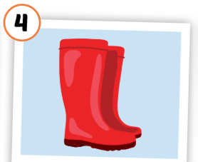
1
4
3
2

Slide 9
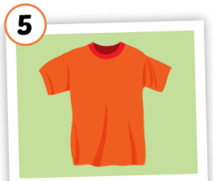
3
1
2
5
4

Slide 10
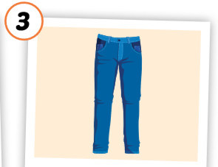
2
1
3

Slide 11
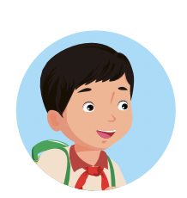
Good job!

Slide 12

It’s time to learn …

Slide 13
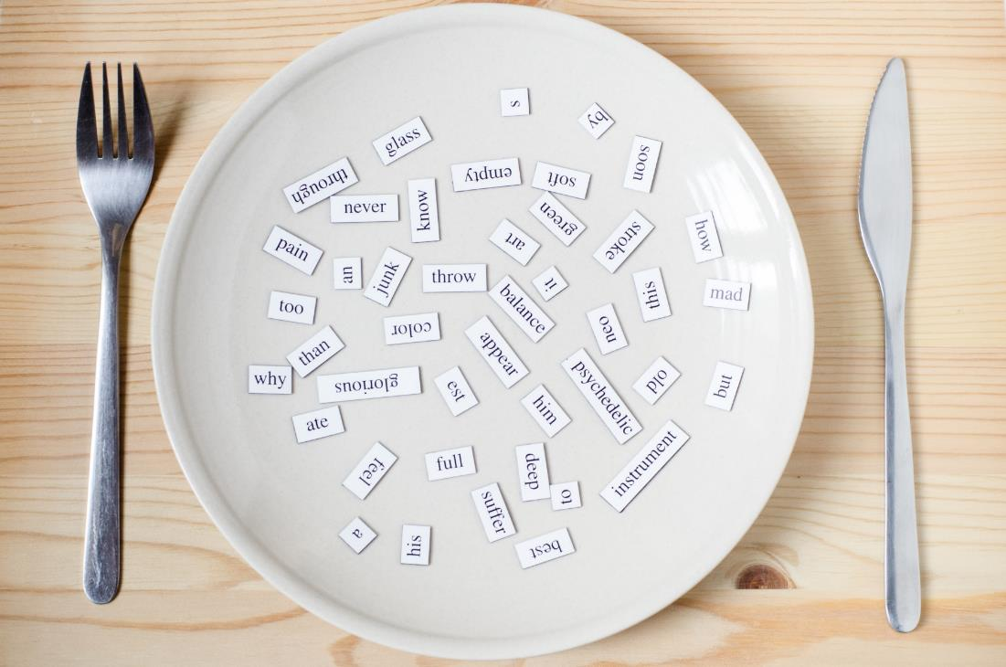
New words
belt,
scarf,
sweater,
pajamas,
skiing.

Slide 14


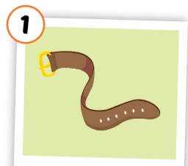
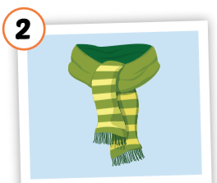
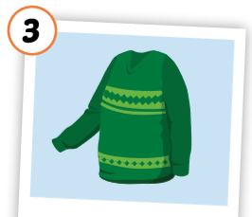
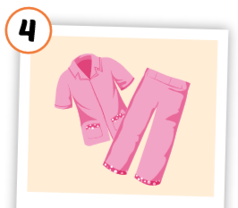
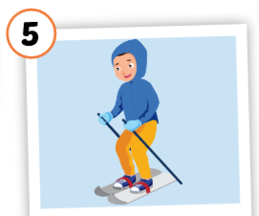
Click each English word to hear the sound.
belt
scarf
sweater
pajamas
skiing
/belt/
thắt lưng
/ skɑːrf /
khăn choàng
/ ˈswetər /
áo len
/ pəˈdʒæməz /
quần áo ngủ
/skiːɪŋ/
trượt tuyết
Notes:
GV giới thiệu từ vựng, CCQ

Slide 15
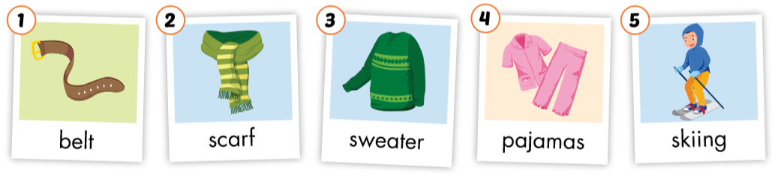

Slide 16
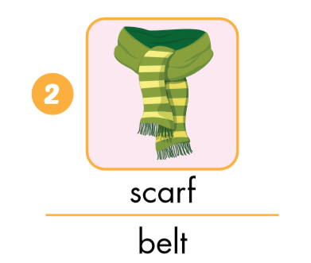
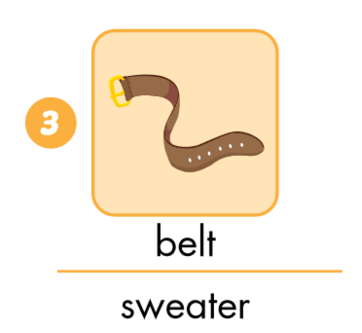
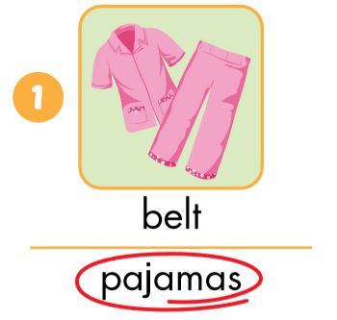
Look and circle.

Slide 17
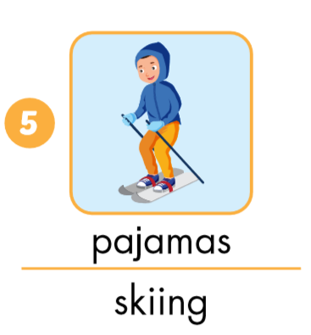
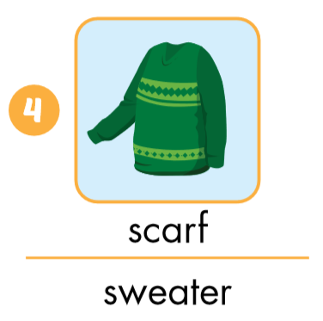
Look and circle.

Slide 18

Put the pictures in the right group.
◆
❖
is
are

Slide 19

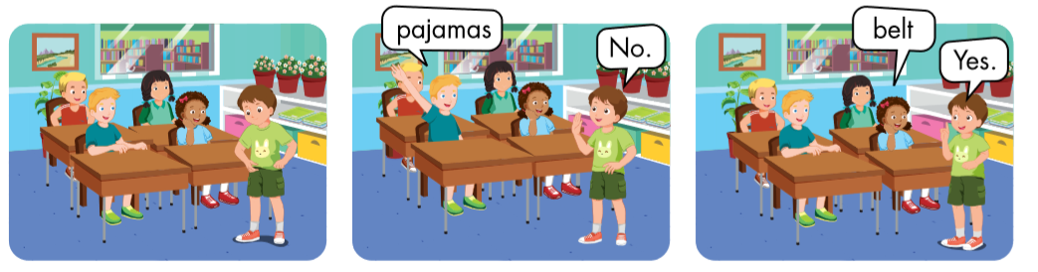

Slide 20
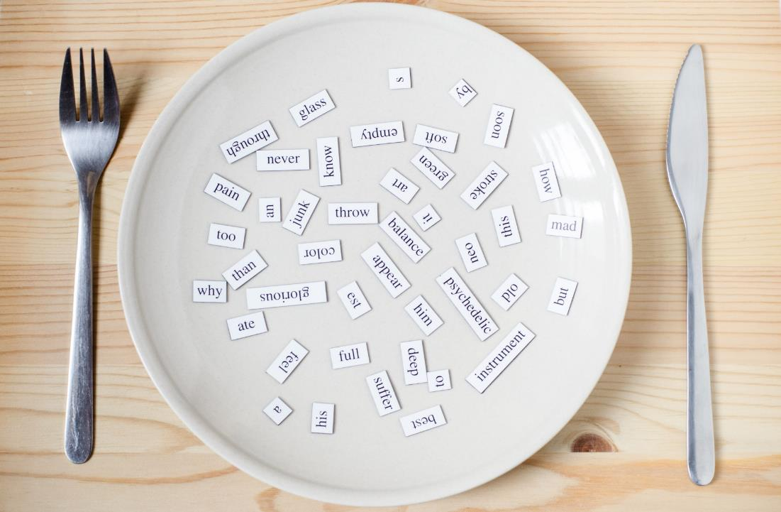
Structures
Is that your belt? Yes, it is./No, it isn’t
Are those your pajamas?
Yes, they are./
No, they aren’t.

Slide 21

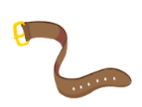
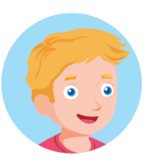
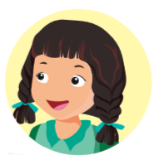
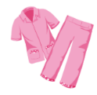
Click on the earphone to hear the sound.
Is that your belt?
Yes, it is. /No, it isn’t.
Are those your pajamas?
Yes, they are./No, they aren’t.

Slide 22

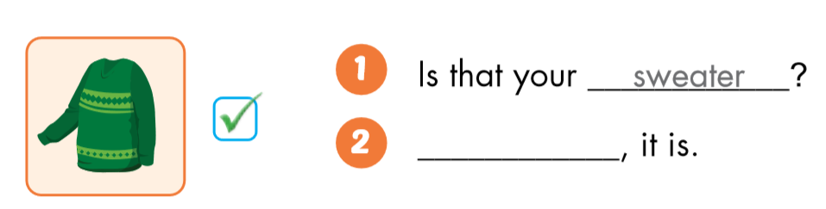
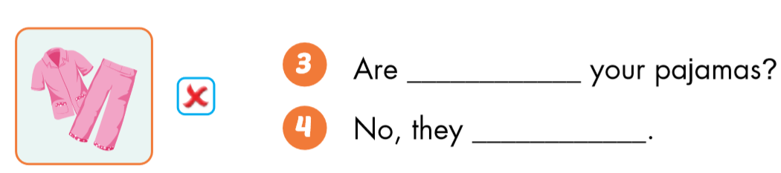
sweater
Yes
those
aren’t

Slide 23

Workbook
p. 59

Slide 24

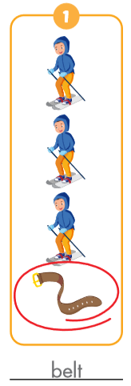
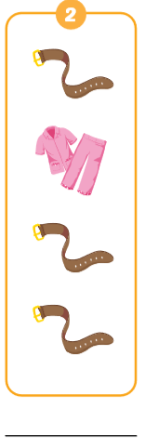
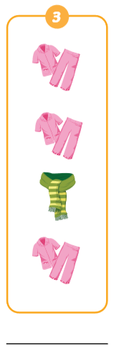
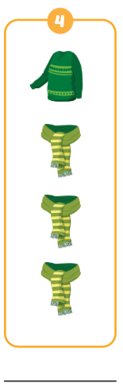
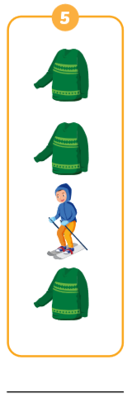
v
belt
pajamas
scarf
sweater
skiing

Slide 25

Enjoy your day!

