Slide 1
Unit 3: Weather
Lesson: 2

Slide 2
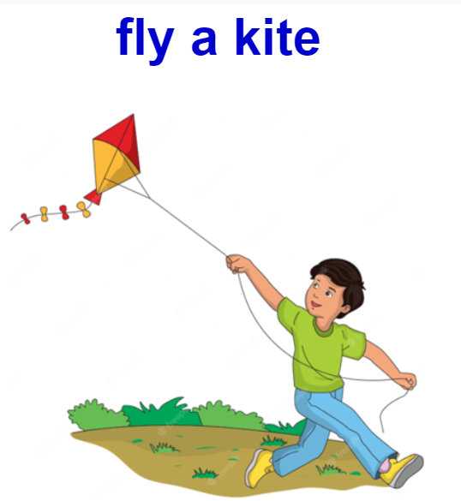
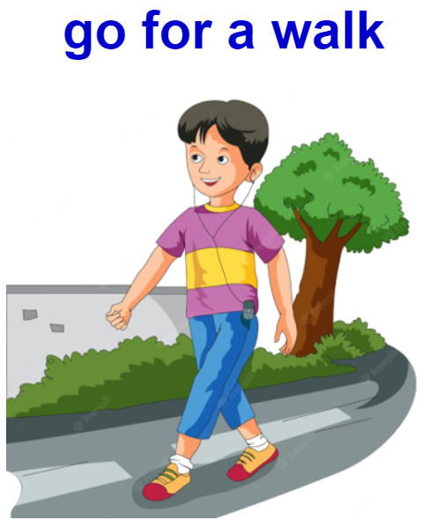
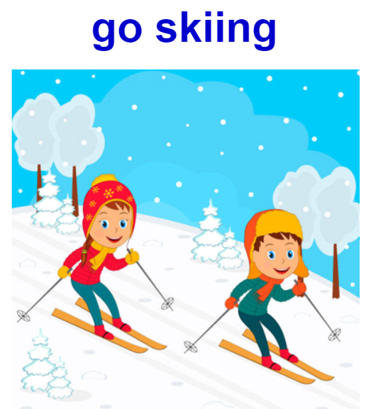
I, Review

Slide 3
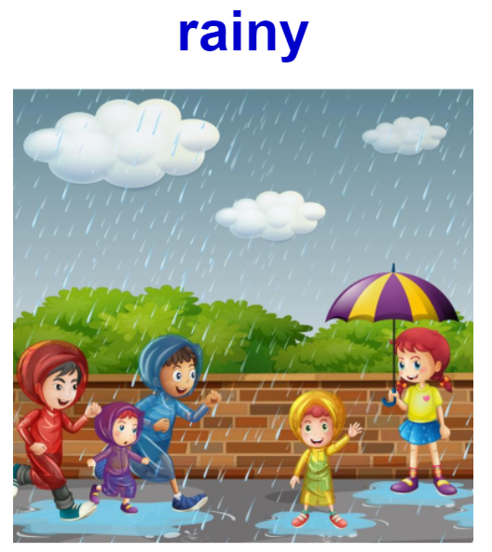
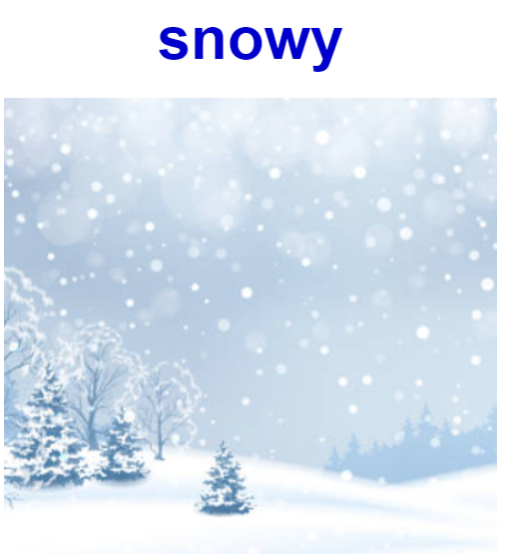
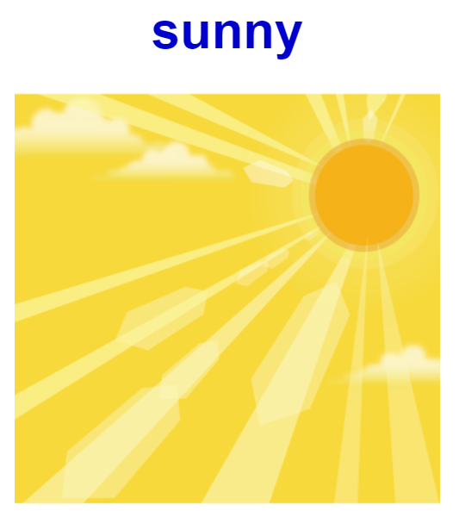

Slide 4
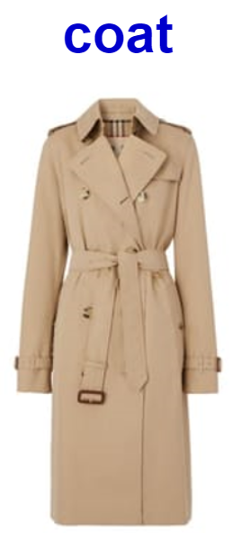
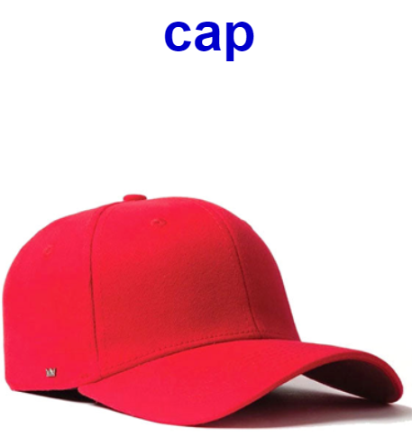
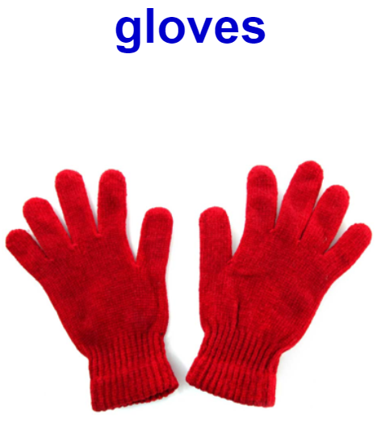
II, New words
Áo khoác
Mũ lưỡi trai
Găng tay
Cái ô

Slide 5
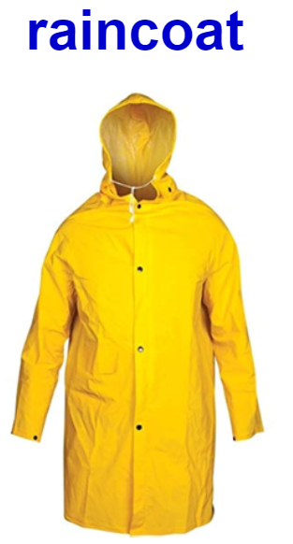
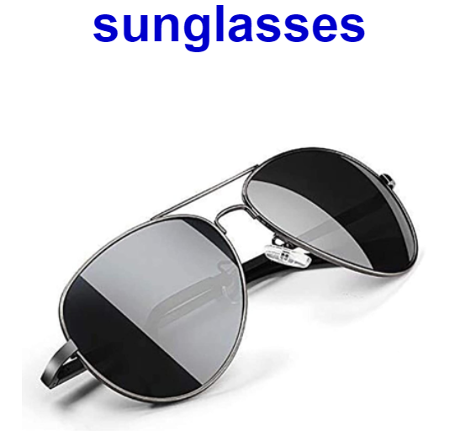
Áo mưa
Kính râm
Ô

Slide 6
III, Structure
A: Bring your ..........., because it’s ..........today
(Mang.....đi bởi vì .......)
B: Ok, Thank you.
(Vâng, được, Cảm ơn
Tom: Bring your coat, because it’s windy today
Jack: Ok, Thank you
Example:

Slide 7
Bring your ….. because it’s …… today.
OK, thank you.

Slide 8
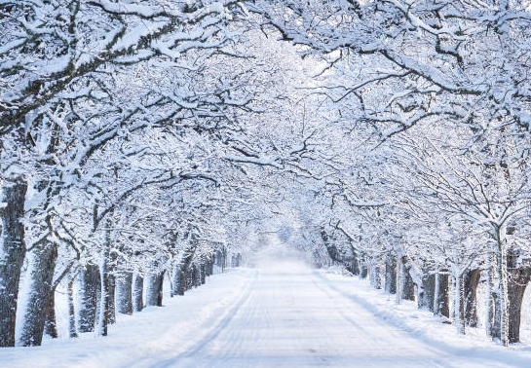
Bring your ….. because it’s …… today.
OK, thank you.

Slide 9
Bring your ….. because it’s …… today.
OK, thank you.

Slide 10
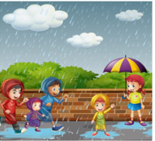
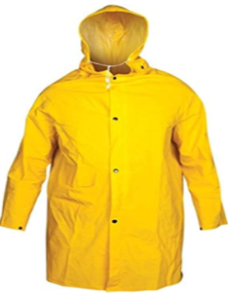
Bring your ….. because it’s …… today.
OK, thank you.

Slide 11
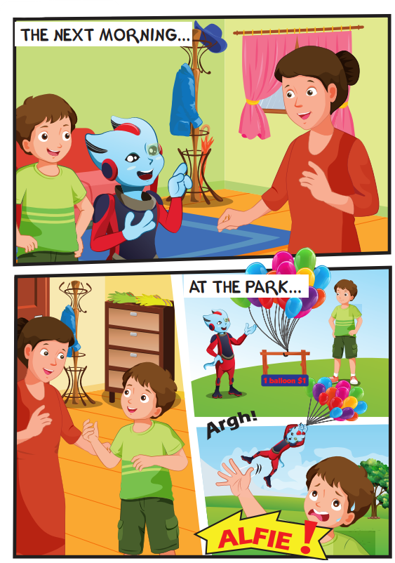
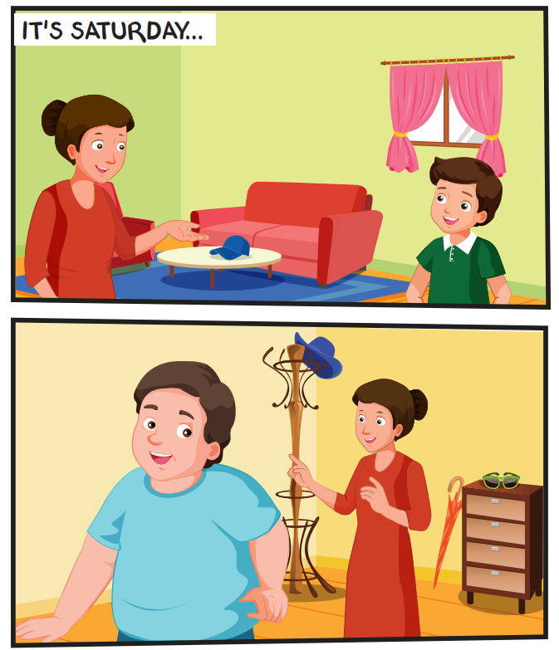

Slide 12
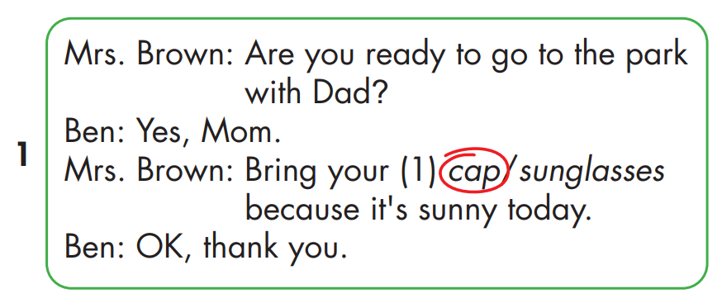
Cap /

Slide 13
Sunglasses

Slide 14
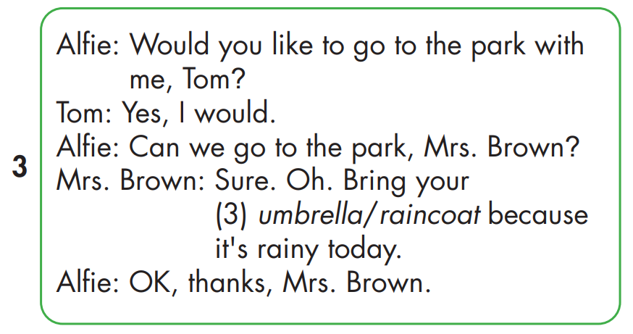

Slide 15
