Slide 1




The Memory Game

Slide 2
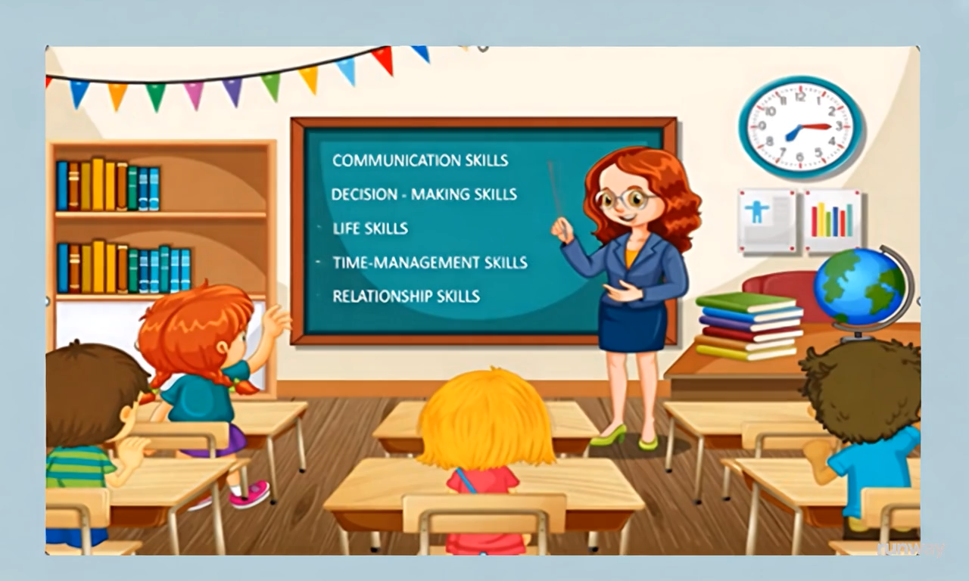


Slide 3
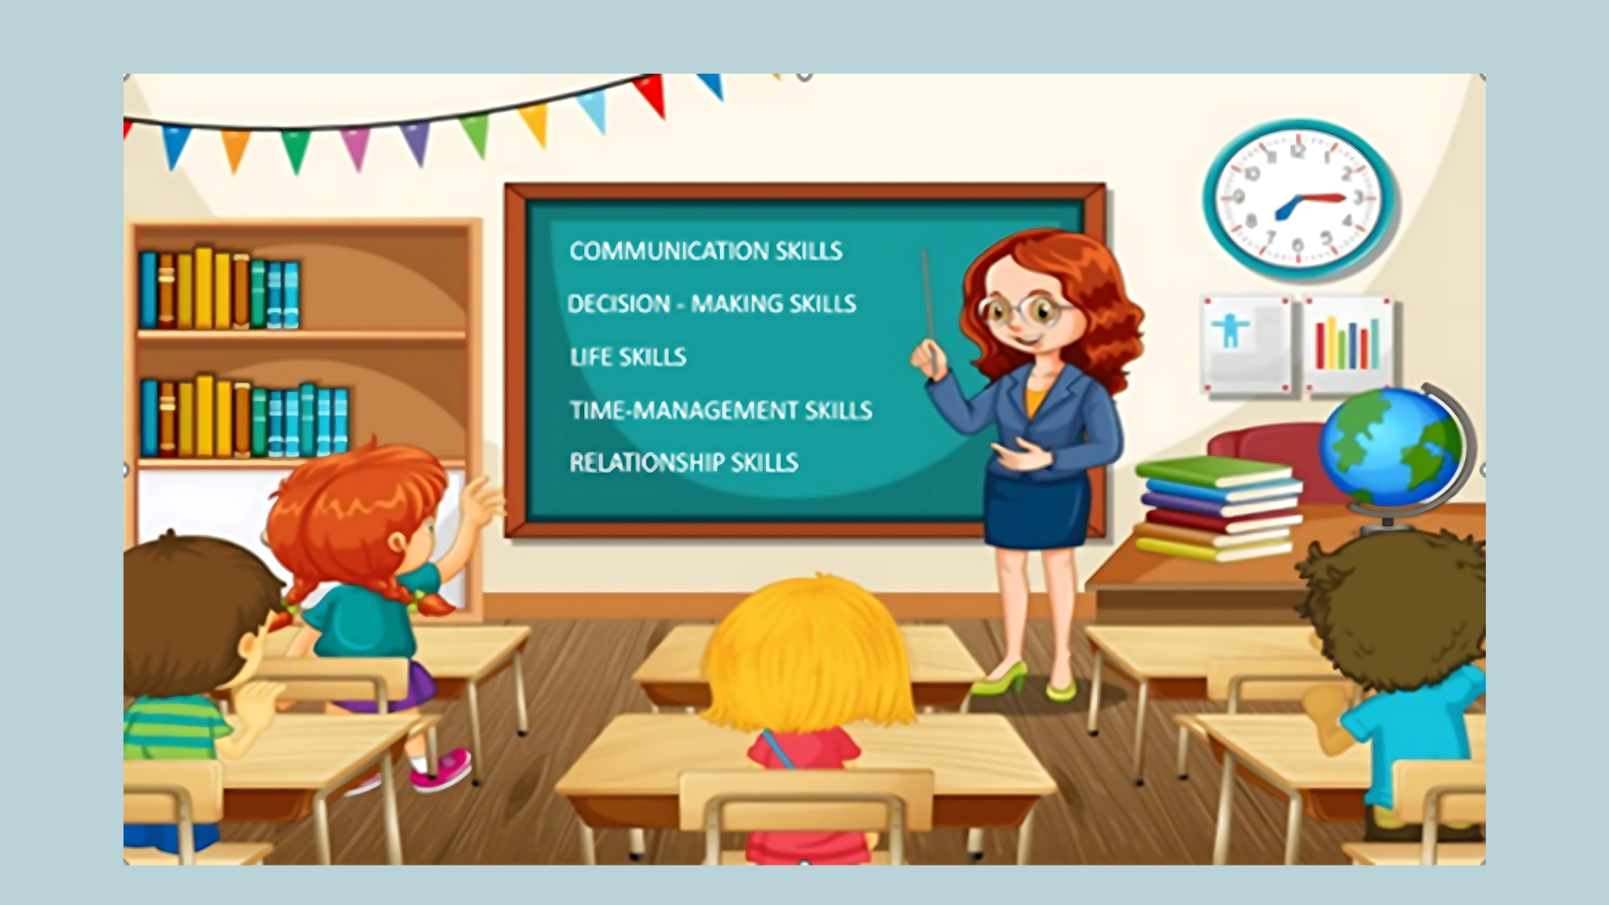
1. How many students are sitting in the classroom?
1
2
4
3
Four

Slide 4
2. What subject is the teacher teaching?
English

Slide 5
3. What color is the teacher's dress?
Blue

Slide 6
4. How many skills are written on the board?
Five

Slide 7
5. What skills is written first on the board?
Communication skills

Slide 8

1. Listen and complete the conversations with the expressions in the box. Then practise them in pairs.
A. Same to you B. Have a great time C. Happy New Year D. Thanks so much
1. Nam: Hey, I heard that you‘re going on a trip to Singapore tomorrow. (1) ______________!
Mike: Yep. (2) ______________.
2. Kevin: Hi, Mai. (3) ______________! Wishing you a great year ahead!
Mai: Thanks, Kevin. (4) ______________! Hope all your dreams come true!
B. Have a great time
D. Thanks so much
C. Happy New Year
A. Same to you

Slide 9
Useful expressions
Expressing wishes | Responding to wishes
Have a good/great...! Best wishes/Good luck! I wish you a happy and healthy new year./Happy New Year!/Happy holidays! I wish you best of luck/every success in your new… Get well soon!/Hope you feel better soon/make a speedy recovery. | Thanks so much. Thank you (all) for your wishes. Thanks. Happy New Year to you too! (The) same to you! Thanks.

Slide 10
2. Work in pairs. Use the models in 1 to make similar conversations for these situations. One of you is Student A, the other is Student B. Use the expressions below to help you.
Useful expressions
Expressing wishes | Responding to wishes
Have a good/great...! Best wishes/Good luck! I wish you a happy and healthy new year./Happy New Year!/Happy holidays! I wish you best of luck/every success in your new… Get well soon!/Hope you feel better soon/make a speedy recovery. | Thanks so much. Thank you (all) for your wishes. Thanks. Happy New Year to you too! (The) same to you! Thanks.
  Student A is going to take an exam. Student B is expressing his/her wishes for Student A’s success.
  Student B is not feeling well. Student A is expressing his/her wishes for Student B’s recovery.

Slide 11


vocabulary
1. required /rɪˈkwaɪəd/ (adj)
necessary according to the rules or for a particular purpose
For example:
Wearing a uniform is required at your school.

Slide 12
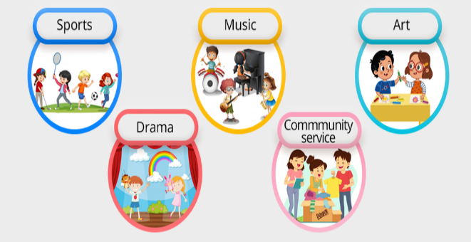
vocabulary
(of activities or subjects) not part of the usual school or college course.
2. extracurricular /ˌekstrəkəˈrɪkjələ(r)/ (adj)

Slide 13

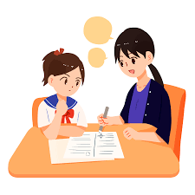
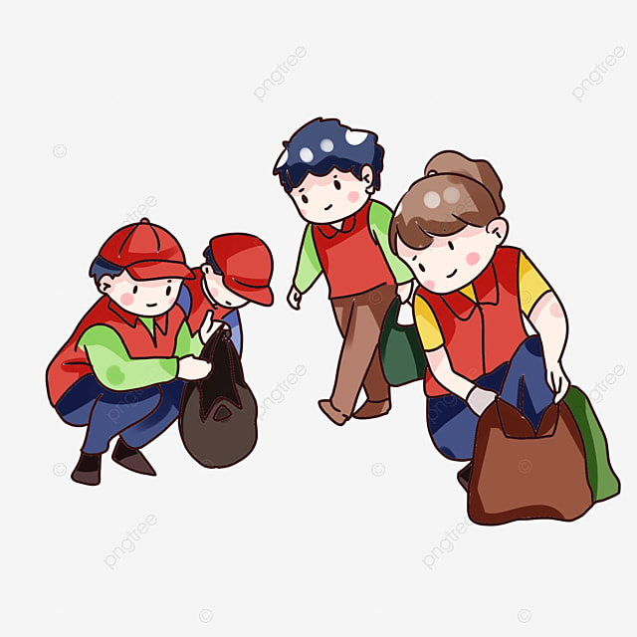

vocabulary
If you work part-time or do part-time work, you work for only some of the day or the week.
3. part-time job
/ˌpɑːtˈtaɪm//dʒɒb/ (n.p)
Name some part-time jobs you know.
Server
Tutor
Volunteer
Cashier

Slide 14
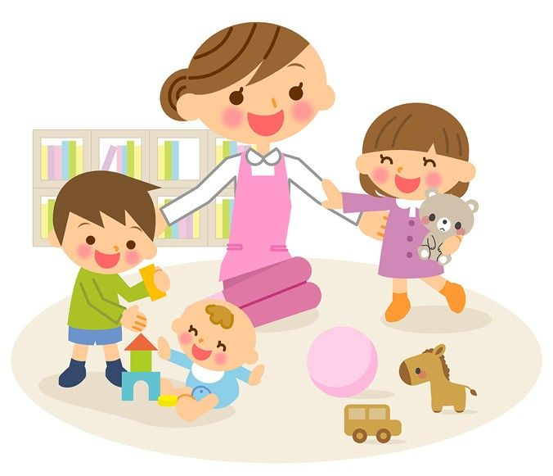
vocabulary
4. babysitting
/ˈbeɪ.biˌsɪt.ɪŋ/ (n)

Slide 15
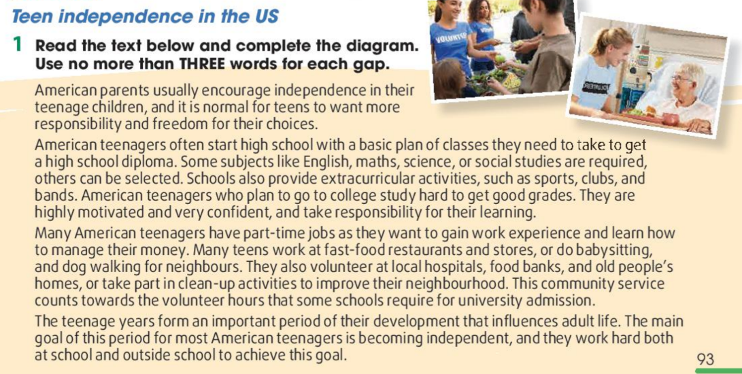

Slide 16
Required subjects: (1) ____________, science, social studies
At school
Extracurricular activities: (2) ___________, and bands
Becoming independent
Part-time jobs: working at (3) ________________ and stores, babysitting, dog walking
Outside school
Volunteer work: at (4) _____________, food banks, and old people’s homes; clean-up activities

Slide 17
Required subjects: (1) ____________, science, social studies
English, math
At school
Extracurricular activities: (2) ___________, and bands
Becoming independent
Part-time jobs: working at (3) ________________ and stores, babysitting, dog walking
Outside school
Volunteer work: at (4) _____________, food banks, and old people’s homes; clean-up activities

Slide 20
Required subjects: (1) ____________, science, social studies
English, math
At school
Extracurricular activities: (2) ___________, and bands
sports, clubs
Becoming independent
Part-time jobs: working at (3) ________________ and stores, babysitting, dog walking
Outside school
Volunteer work: at (4) _____________, food banks, and old people’s homes; clean-up activities

Slide 22
Required subjects: (1) ____________, science, social studies
English, math
At school
Extracurricular activities: (2) ___________, and bands
sports, clubs
Becoming independent
Part-time jobs: working at (3) ________________ and stores, babysitting, dog walking
fast-food restaurants
Outside school
Volunteer work: at (4) _____________, food banks, and old people’s homes; clean-up activities

Slide 24
Required subjects: (1) ____________, science, social studies
English, math
At school
Extracurricular activities: (2) ___________, and bands
sports, clubs
Becoming independent
Part-time jobs: working at (3) ________________ and stores, babysitting, dog walking
fast-food restaurants
Outside school
Volunteer work: at (4) _____________, food banks, and old people’s homes; clean-up activities
local hospitals

Slide 26

2. Work in groups. Discuss the following questions.
- Do American teenagers learn to become independent in the same way as Vietnamese teenagers?
- What are the similarities and differences?

Slide 27
HOMEWORK
- Review the vocabulary
- Do the exercises in the workbook
- Prepare for the next lesson: Looking back.

