Slide 1








Sharp eye, sharp mind

Slide 2
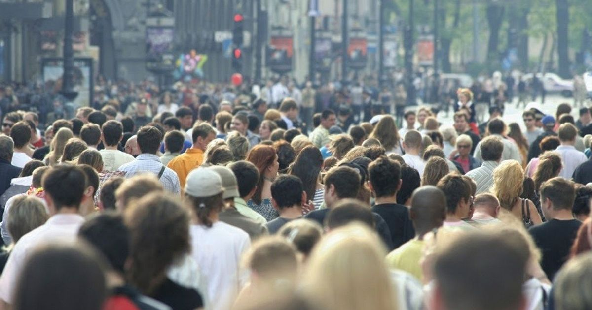
1
A. Gender inequality
B. Climate change
C. Childhood obesity
D. Overpopulation

Slide 3
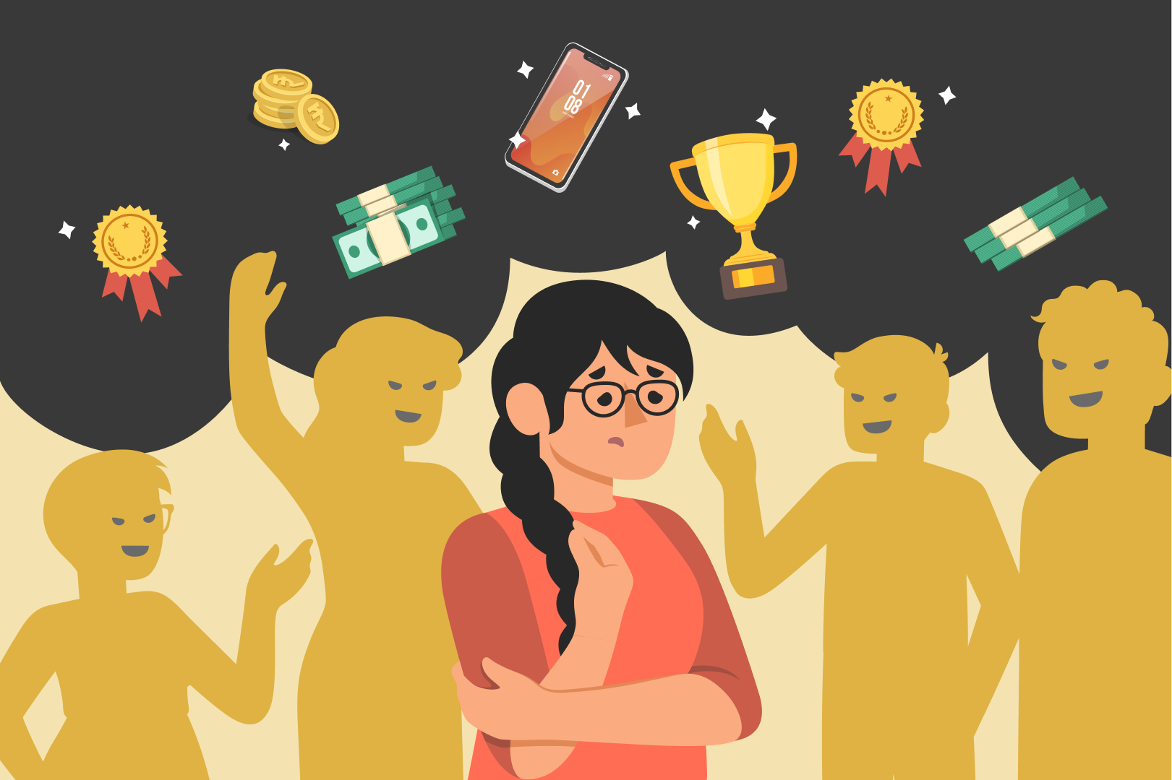
2
A. Civil rights
B. Bullying
C. Peer pressure
D. Gender inequality

Slide 4
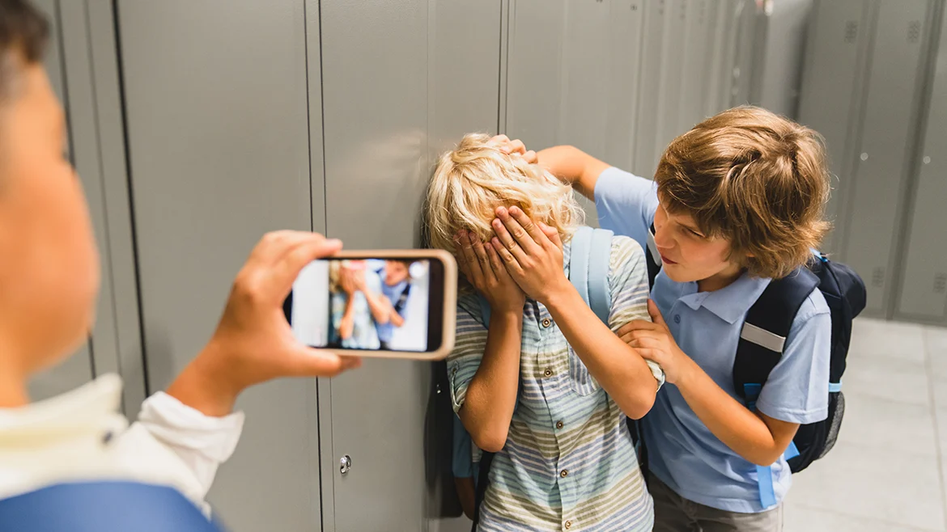
3
A. School violence/ bullying
B. Healthcare
C. Gender inequality
D. Overpopulation

Slide 5
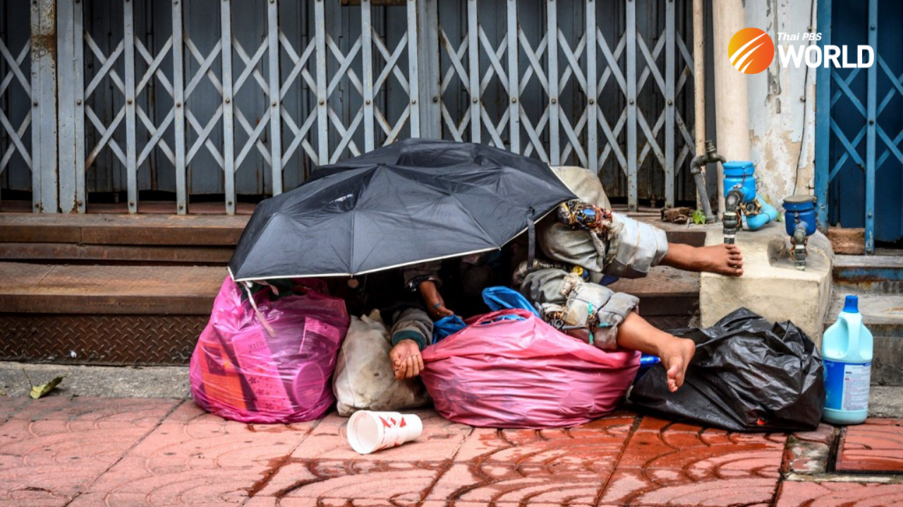
4
A. Gender inequality
B. Climate change
C. Childhood obesity
D. Homelessness

Slide 6
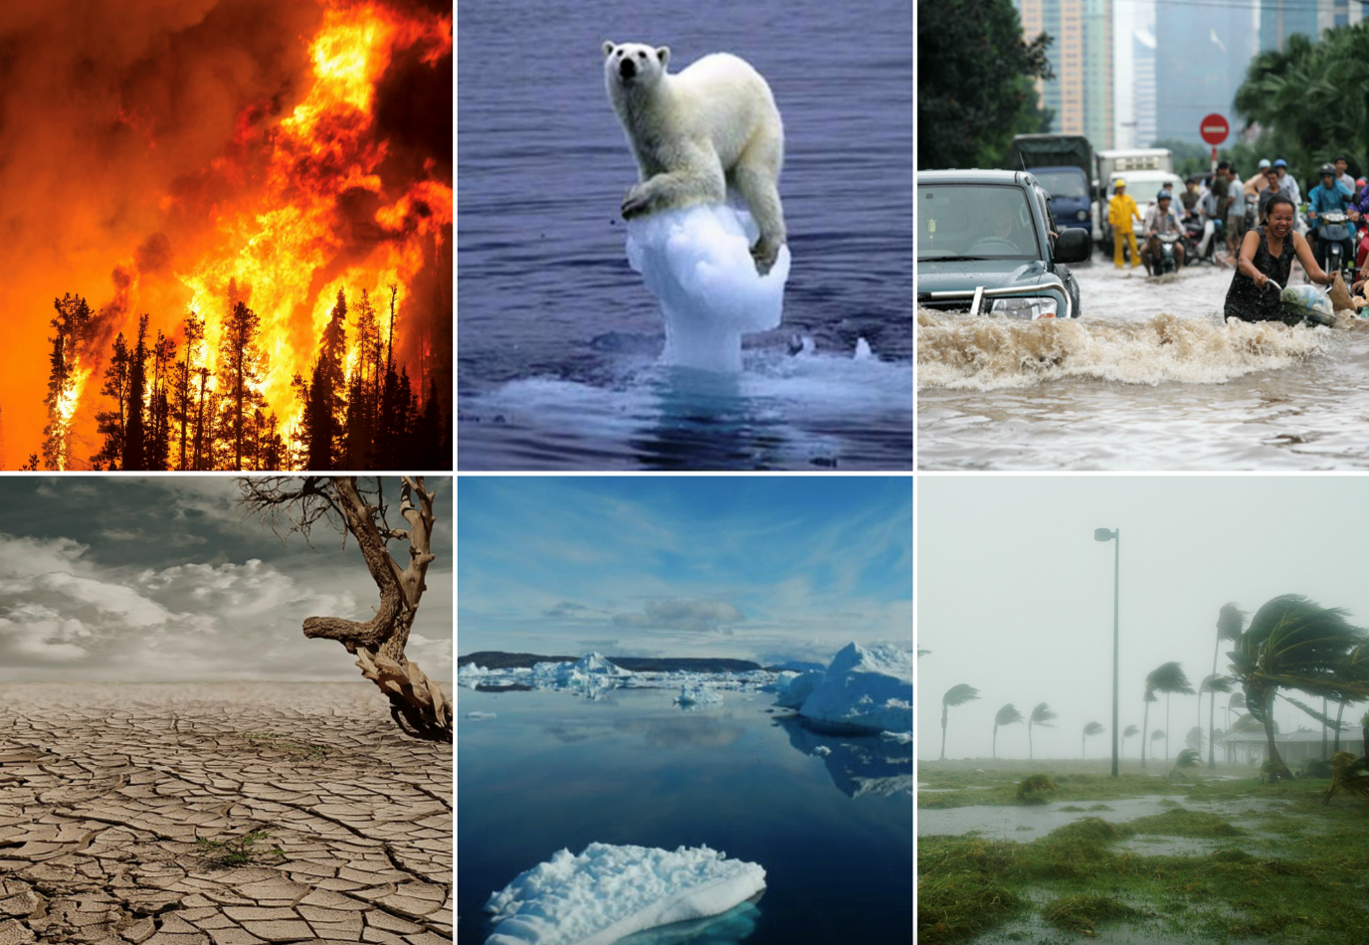
5
A. Civil rights
B. Bullying
C. Climate change
D. Gender inequality

Slide 7
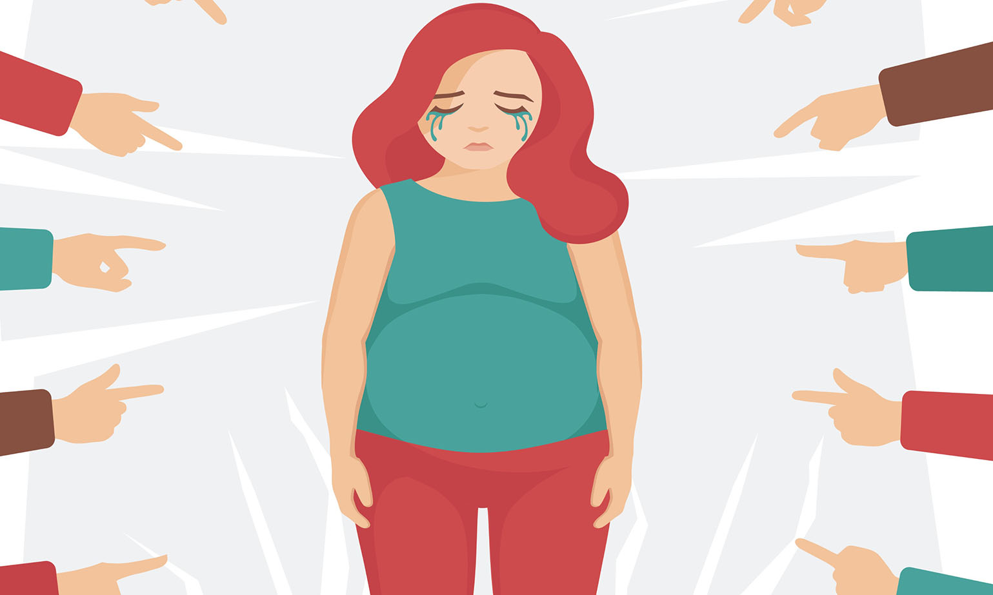
6
A. Climate change
B. Body shaming
C. Homelessness
D. Gender inequality

Slide 8

UNIT 9: SOCIAL ISSUES
Lesson 1: Getting Started
A social awareness club meeting

Slide 9
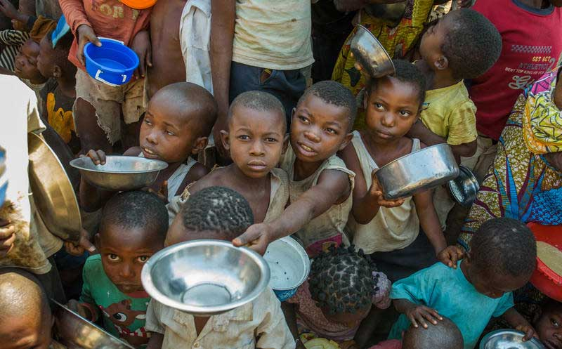
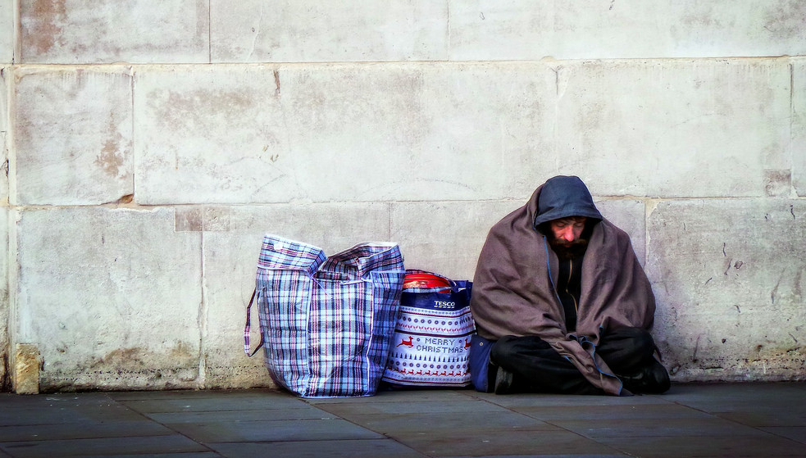
4
social issues (n)
/ˈsoʊ.ʃəl ˈɪʃ.uːz/

Slide 10
4
awareness (n)
/əˈwernəs/
Definition: Knowledge or understanding of a particular subject or issue.

Slide 11

struggle with (phrasal verb)
/ˈstrʌɡ.əl wɪð/

Slide 12


crime (n)
/kraɪm/
Definition: A crime is something that breaks the law and can be punished by the government.

Slide 13
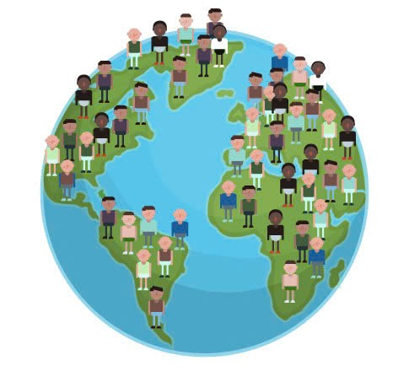
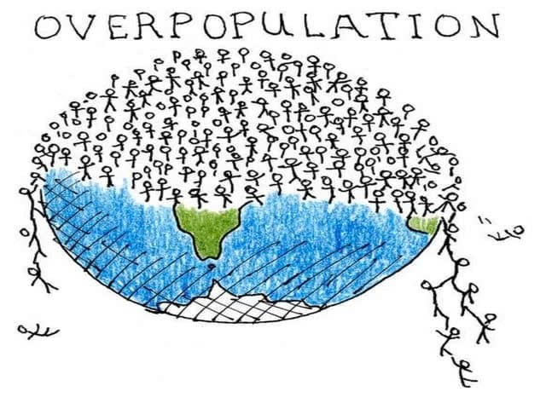
4
overpopulation (n)
/ˌəʊvərˌpɑːpjuˈleɪʃn/
2003
2025

Slide 14
peer pressure (n)
/ˈpɪr ˌpreʃ.ɚ/
Have you ever felt like you had to do something just because your friends did it, even though you didn't really want to?

Slide 15

bully (v)
/ˈbʊli/

Slide 16
Fill in the gaps by using the following words
peer pressure
bully
overpopulation
struggle with
awareness
social issues
crime
1. Many communities face __________ that affect education, healthcare, and employment opportunities.
2. Young people often _________ balancing school, work, and personal life.
3. To reduce __________ , cities are investing in better infrastructure and public services.
4. It’s important to raise __________ about environmental conservation to protect our planet.
5. Governments are working to reduce _________ by improving law enforcement and community programs.
6. Sometimes, students feel __________ from their friends to do things they don't want to do.
7. It is not okay to ______ others just because they are different.

Slide 17
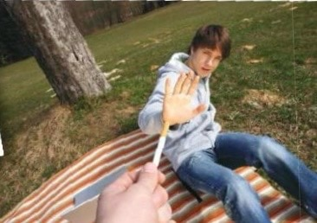
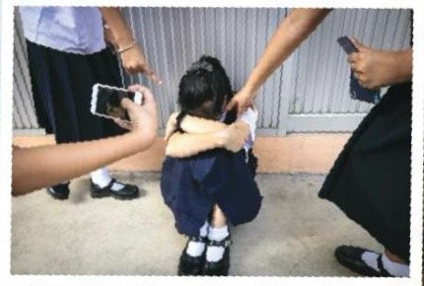
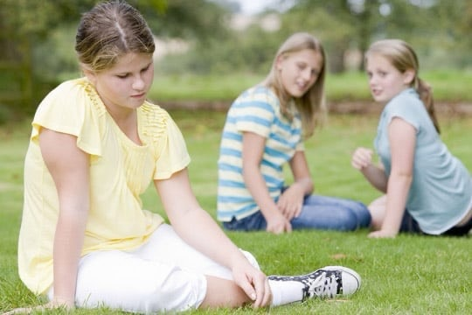
2
1
3

Slide 18
Task 1: Listen and read

Slide 19
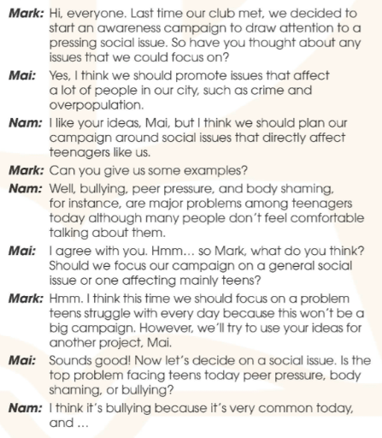


Slide 20
Task 2: Who suggests the following ideas ? Tick (✓) the correct box.
Notes:
Yes they’re discussing social issues and each person has their opinions, so we will move on task 2 to find out what they are?

Slide 21
 | Mark | Mai | Nam
1. Issues that have an effect on many people in the city
2. Problems that have a direct impact on teens
3. An issue that teens face in their everyday life

Slide 22
 | Mark | Mai | Nam
1. Issues that have an effect on many people in the city
2. Problems that have a direct impact on teens
3. An issue that teens face in their everyday life

Slide 23
 
 | Mark | Mai | Nam
1. Issues that have an effect on many people in the city |   |  
Yes, I think we should promote issues that affect a lot of people in our city, such as crime and overpopulation.

Slide 24
 
 | Mark | Mai | Nam
2. Problems that have a direct impact on teens |   |  
I like your ideas, Mai, but I think we should plan our campaign around social issues that directly affect teenagers like us.

Slide 25
 
 | Mark | Mai | Nam
3. An issue that teens face in their everyday life |   |  
Hmm. I think this time we should focus on a problem teens struggle with every day because this won't be a big campaign.

Slide 26
Task 3: Find five social issues in 1 and write them under correct pictures. Use the hints below to help you.
Notes:
So how many social issues are there in the conversation ? 5 right! Now we will move to task 3 to find out what they are

Slide 27
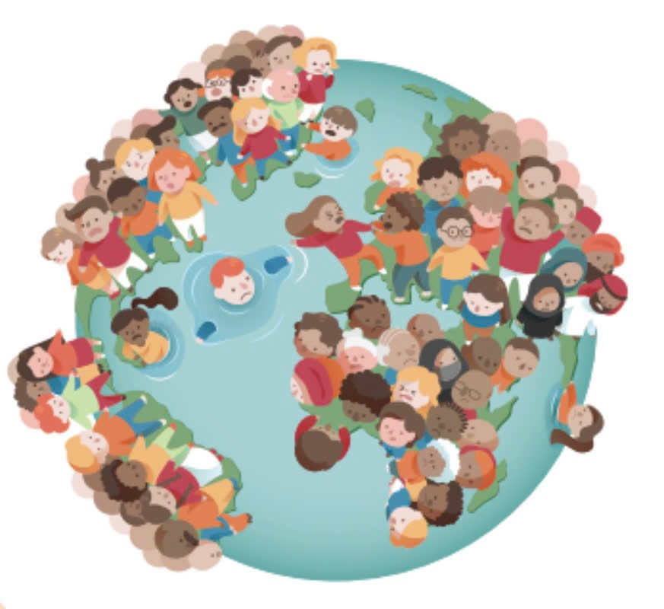
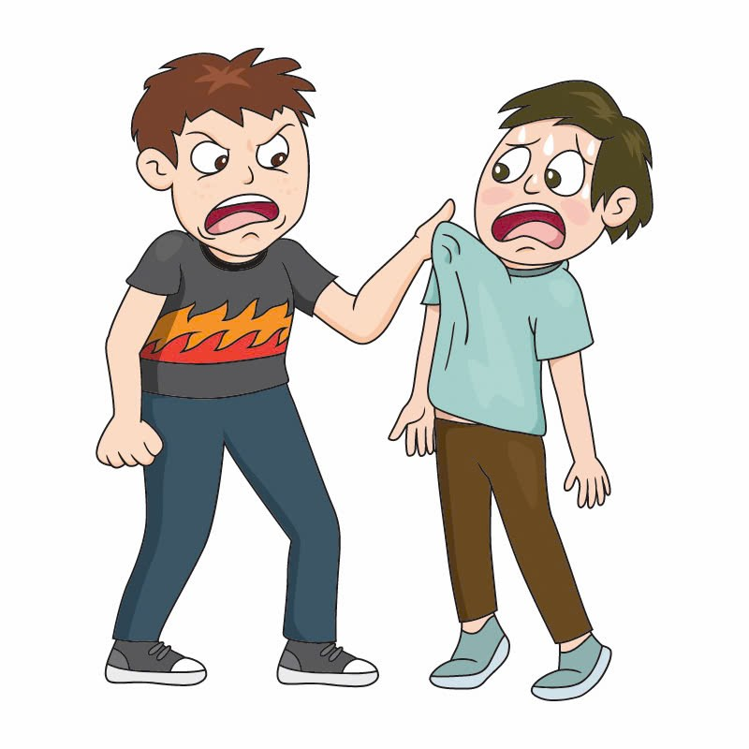
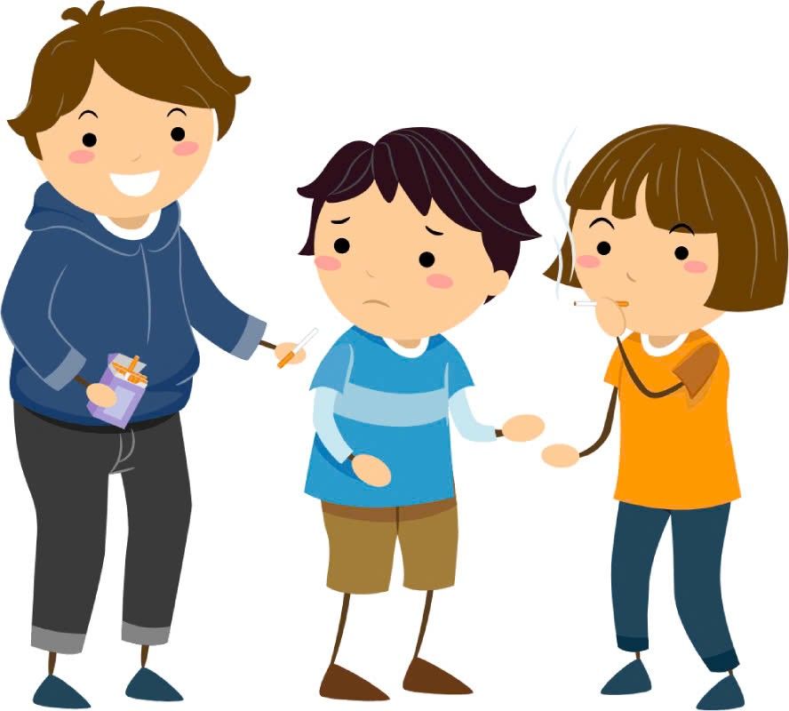
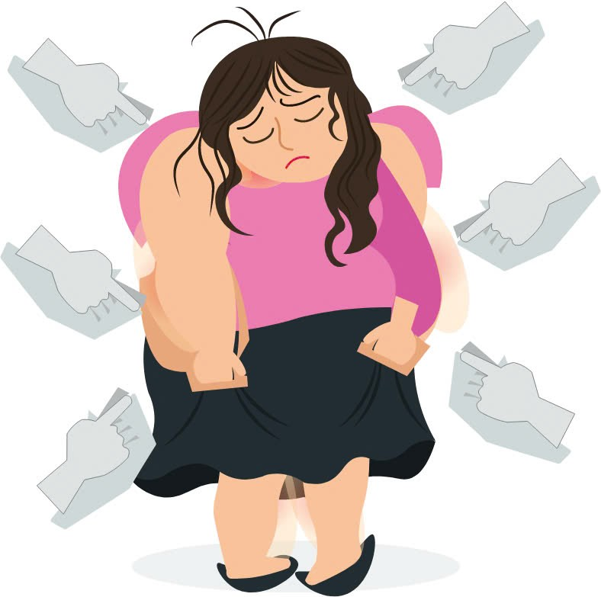
2. o___________
verpopulation
3. b___
ully
4. p___ p_____
haming
5. b___ s______
eer
ressure
ody
Notes:
Ok so in this task, u need to read the conversation again and find out social issues related to these pictures, remember to pay attention to these hints while reading.

Slide 28
Task 4: Complete the summary with words from 1.

Slide 29
Nam believes that there are major teen problems today (1)_______ many people don't feel comfortable talking about them. Mai agrees with him. Mark thinks they should focus on a problem teens struggle with every day. (2)______, they'll try to use Mai's ideas for another project. Finally, Nam suggests focusing their campaign on bullying (3)______ this issue is very common among teenagers these days.
although
However
because

Slide 30
Task 5: Can you think of other issues that exist in your school ? What can we do to stop them or help the victims?
Notes:
Ok so Nam mark mai decided to start an awareness campaign to solve bullying,

Slide 31
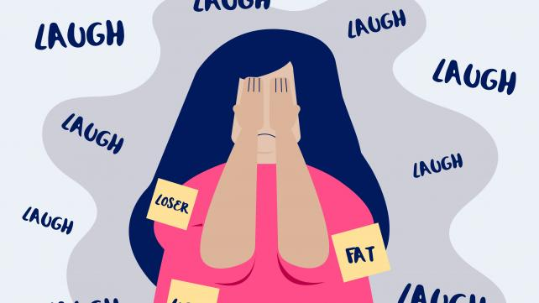
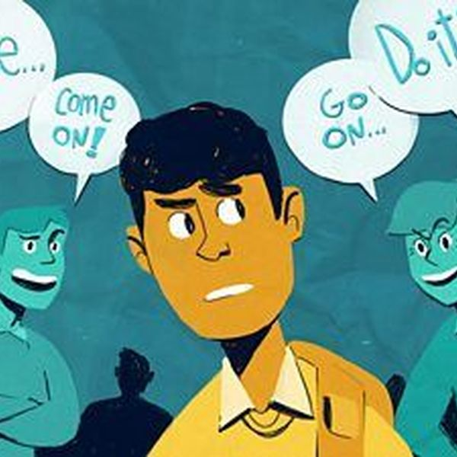
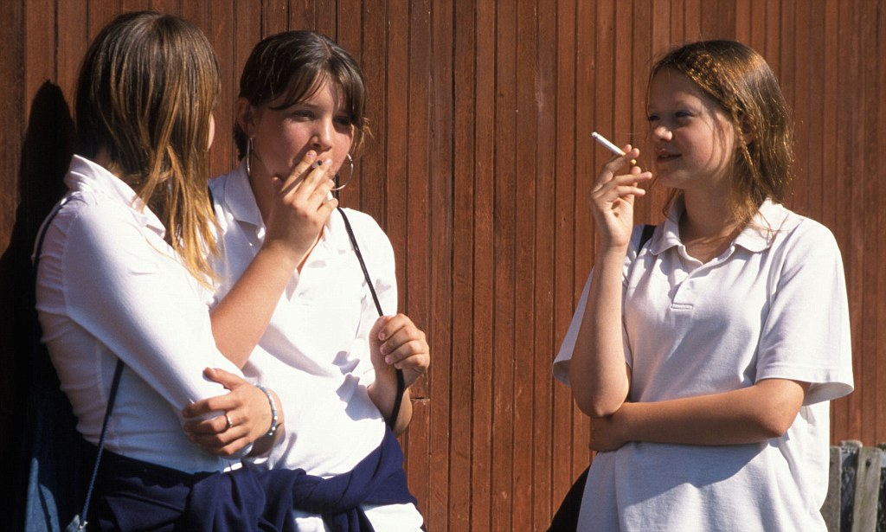
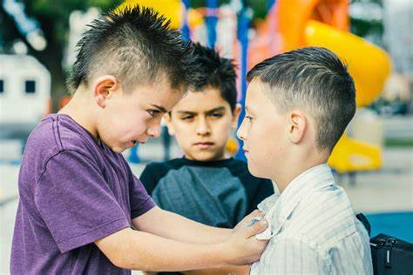

Slide 32
HOMEWORK
Learn new words by heart.
Prepare for the next lesson.

