Slide 1


Slide 2


UNIT 8:
NEW WAYS TO LEARN
Lesson: Language

Slide 3


WARM-UP
TO
PIC WORD

Slide 4





RULES
POINTS

Slide 5


WIN!!!!!
The team gains more star points.

Slide 6

FIND
(4 letters)

Slide 7

UPLOAD
(6 letters)

Slide 8

(6 letters)
SCHOOL

Slide 9

HOME
(4 letters)

Slide 10

TRADITIONAL
_____________ LEARNING
(11 letters)

Slide 11

_________ LEARNING
ONLINE
(6 letters)

Slide 12


Slide 13
UNIT 8:
NEW WAYS TO LEARN
Lesson: Language

Slide 14

01
PRONUNCIATION
Sentence stress

Slide 15


Example:
We should finish the project for our history class.
finish
We should ‘finish the ‘project for our ‘history ‘class.
project
class
history
Verb:
Noun:

Slide 16
Remember:
Verbs, nouns, adjectives, adverbs.
CONTENT WORDS
Basic rule: content word are stressed

Slide 17
1. Listen and repeat.
1. We should ‘finish the ‘project for our ‘history ‘class.
2. 'Peter is re'vising for his e'xam 'next 'week.
3. 'Students will 'spend more 'time 'working with 'other 'classmates.
4. I 'like to 'watch 'videos that 'help me 'learn ‘new 'things.
5. I have in'stalled some 'apps on my 'phone.

Slide 18
2. Read and underline the stressed words.
1. Our teacher often gives us videos to watch at home.
2. I never read books on my tablet at night.
1. Our teacher often gives us videos to watch at home.
2. I never read books on my tablet at night.

Slide 19
Homework:
3. It is a new way of learning and students really like it.
4. You can find a lot of useful tips on this website.
5. They should make an outline for their presentation.

Slide 20



02
Vocabulary
Different ways of learning

Slide 21








1. Match.
a
an intended plan to achieve a specific purpose.
1
b
face-to-face (adj)
a way of learning that combines online materials with traditional classroom methods.
2
prepare (for) (v)
c
close together and facing each other
3
strategy (n)
4
d
online learning (n)
To make things ready to be used
5
blended learning (n)
e
a way of learning that happens on the Internet

Slide 22
2. Complete the sentences.
1. ___________learning allows us to communicate with teachers immediately and directly.
2.One benefit of _____________ is that you can learn anytime and anywhere.
3. Our teachers always encourage us to lessons ___________ before class.
4. You need a specific _______ to improve your English speaking skills.
5. _______________ combines online videos with traditional classroom methods.
face-to-face
prepare (for)
strategy
online learning
blended learning

Slide 23
2. Complete the sentences.
1. Face-to-face learning allows us to communicate with teachers immediately and directly.
2.One benefit of online learning is that you can learn anytime and anywhere.
3. Our teachers always encourage us to lessons
prepare for before class.
4. You need a specific strategy to improve your English speaking skills.
5. Blended learning combines online videos with traditional classroom methods.
1. ___________learning allows us to communicate with teachers immediately and directly.
2.One benefit of _____________ is that you can learn anytime and anywhere.
3. Our teachers always encourage us to lessons ___________ before class.
4. You need a specific _______ to improve your English speaking skills.
5. _______________ combines online videos with traditional classroom methods.

Slide 24

03
GRAMMAR
Relative clauses

Slide 25
1. Match.
1. Mr Smith was talking to the students
2. The film which we saw yesterday
3. The speaker, who will share new learning activities in our workshop,
4. We often go to Da Nang
5. My cousin gave me an instruction book
a. that explains how to use voice recorders.
b. is Laura.
c. which is in the middle of Viet Nam
d. whose presentations were really impressive.
e. was quite interesting.

Slide 26
1. Mr Smith was talking to the students whose presentations were really impressive.
2. The film which we saw yesterday was quite interesting.
3. The speaker, who will share new learning activities in our workshop, is Laura.
4. We often go to Da Nang which is in the middle of Viet Nam.
5. My cousin gave me an instruction book that explains how to use voice recorders.
1. Mr Smith was talking to the students whose presentations were really impressive.
2. The film which we saw yesterday was quite interesting.
3. The speaker, who will share new learning activities in our workshop, is Laura.
4. We often go to Da Nang which is in the middle of Viet Nam.
5. My cousin gave me an instruction book that explains how to use voice recorders.

Slide 27
Example:
Relative clauses
A defining relative clause gives essential information about the person or thing mentioned
My uncle is a famous doctor.
The man is a famous doctor.
My uncle is a famous doctor.
The man is a famous doctor.
The man who visited us yesterday is a famous doctor.
My uncle, who visited us yesterday, is a famous doctor.
A non-defining relative clause gives extra information about the person or the thing mentioned. It is often placed between commas.
Defining relative clause
Non-defining relative clause

Slide 28
2. Join the following sentences.
1. My brother teaches me how to use a laptop. He is good at computers.
2. Peter is a friend of mine. His sister is taking an online maths course.
3. Lan has read the book. I lent her the book.
4. The boy has designed this invention. He is only 10 years old.
5. That app is easy to use. It can help improve your English pronunciation.

Slide 29
Example
My brother teaches me how to use a laptop.
He is good at computers.
      My brother, who is good at computers, teaches me how to use a laptop.

Slide 30
2. Join the following sentences.
2. Peter is a friend of mine. His sister is taking an online maths course.
→ Peter ._______________________________________
3. Lan has read the book. I lent her the book.
→ Lan ._________________________________________
4. The boy has designed this invention. He is only 10 years old.
→ The boy ._____________________________________
5. That app is easy to use. It can help improve your English pronunciation.
→ That app ._____________________________________

Slide 31
2. Join the following sentences.
2. Peter , whose sister is taking an online maths course, is a friend of mine.
3. Lan has read the book which/that I lent her.
4. The boy who had designed this invention is only 10 years old.
5. That app , which can help improve your pronunciation, is easy to use.

Slide 32
WRAP-UP
Pronunciation: Sentence stress.
  * Content words.
Vocabulary: Some new ways to learn.
  * Online learning.
  * Blended learning.
Grammar: Relative clauses.
  * Defining relative clauses.
  * Non defining relative clauses.

Slide 33
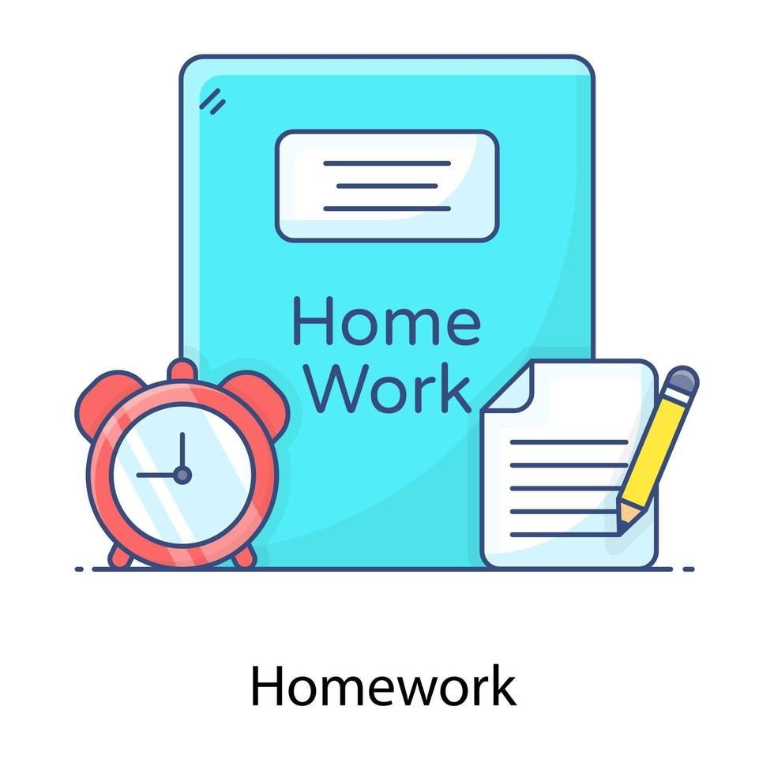
HOMEWORK
Practice the exercises in the workbook.
Prepare for the new lesson.

Slide 34


