Slide 1
WARM UP

Slide 2
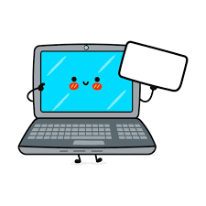
Laptop
SHOW

Slide 3

Board
SHOW

Slide 4
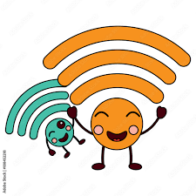
Wifi / Internet
SHOW

Slide 5
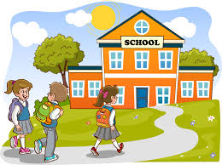
School
SHOW

Slide 6
School
SHOW

Slide 8
UNIT 8:
NEW WAYS TO LEARN
Lesson 3: Reading

Slide 9
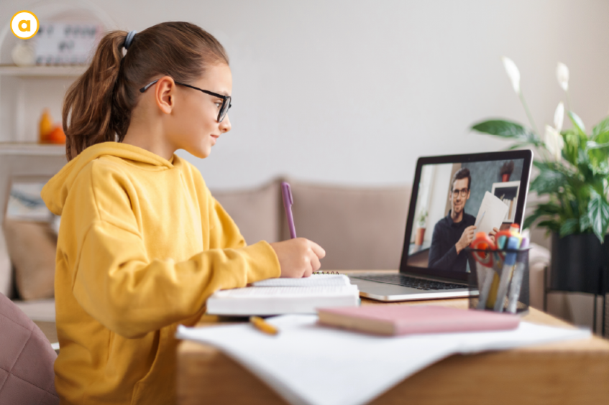
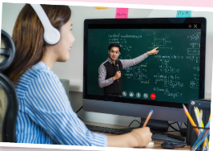
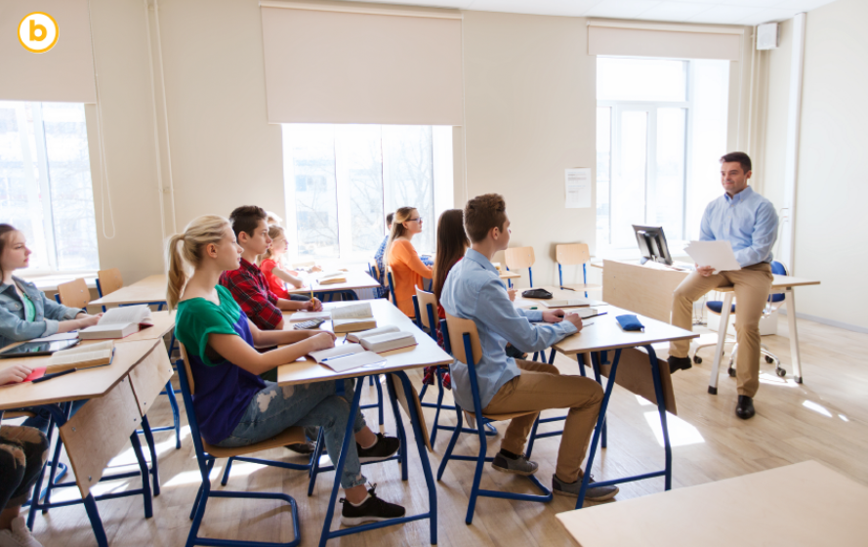
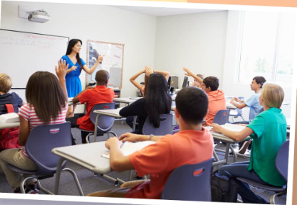
Task 1: Answer the questions:
A
B

Slide 11

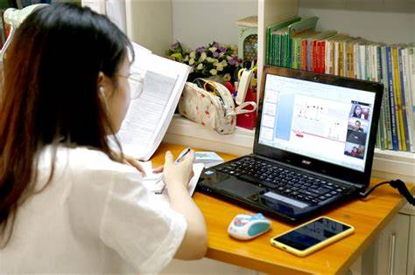
Task 2: Read and choose the correct answer.
KIM
LAURA

Slide 12
KIM
I think face-to-face learning is better than online learning because I can communicate with teachers and other classmates immediately and directly when I have questions. In class, I can work in groups and discuss with friends. This helps me understand the lessons better. When I have a problem, I can ask for answers or help immediately. I can't do this in online classes. I have to email my teachers and wait for their reply. Learning in a traditional classroom also has fewer distractions than learning online. My teachers have many strategies to keep us focused on the lessons. I really enjoy my lessons and learn a lot.
A. Ways of helping students
B. Ways of learning
LAURA
I think online learning has more advantages than disadvantages. My school is trying to change from face-to-face to blended learning, so sometimes we have online classes. I don't have to go to school, but I don't feel I'm missing any lessons by taking online classes. Furthermore, I think I learn online as much as I learn in a traditional class. I can't talk to my teacher and classmates, but I can email them at any time. I also have an online discussion board where I can exchange comments and ideas about my projects with my classmates. The only disadvantage is I really need to have a fast Internet connection.
C. How to enjoy learning

Slide 13
Task 3: Read and put a tick (✓).
This person... | Kim | Laura
1.thinks that online learning isn’t as good as face-to-face learning.
2.gains the same knowledge in both ways of learning.
3.has more direct conversations and discussions
4.uses emails to contact classmates.
5.can pay more attention in class.
6.needs to have access to high-speed Internet.

Slide 14


Slide 15











TRÒ CHƠI
XÉ TÚI MÙ

Slide 16






CHỌN 1 TÚI MÙ

Slide 17


1. This person thinks that online learning isn’t as good as face -to-face learning.
A. KIM
B. LAURA

Slide 18




2. This person gains the same knowledge in both ways of learning.
A. KIM
B. LAURA

Slide 19
3. This person has more direct conversations and discussion.
A. KIM
B. LAURA

Slide 20
4. This person uses emails to contact classmates.
A. KIM
B. LAURA

Slide 21
5. This person can pay more attent in class.
A. KIM
B. LAURA

Slide 22
6. This person needs to have access to high-speed Internet.
A. KIM
B. LAURA

Slide 23





CHÚC MỪNG BẠN ĐƯỢC THÊM 1 LƯỢT

Slide 24


NHƯỜNG LƯỢT CHƠI CHO ĐỘI BẠN

Slide 25
Task 3: Read and put a tick (✓).
This person... | Kim | Laura
1.thinks that online learning isn’t as good as face-to-face learning.
2.gains the same knowledge in both ways of learning.
3.has more direct conversations and discussions
4.uses emails to contact classmates.
5.can pay more attention in class.
6.needs to have access to high-speed Internet.
R
R
R
R
R
R

Slide 26
Read the text and fill in gaps
Fill-in-the-gap exercise:
Kim prefers face-to-face learning because she can ask questions (1) ________________and directly. Working in (2) __________ with classmates helps Kim understand the lessons better.
Laura can’t talk directly to my teacher and classmates, but she can (5)________ them anytime. The only disadvantage is needing a fast (6) __________ connection.
immediately
groups
email
internet

Slide 27
 | Advantages | Disadvantages
Online learning | - Cost savings - Flexibility (time and place) - Wide variety of courses | - Requiring self-motivation - Technological issue - Eyes problem
Face-to-face learning | - Human interaction - Real-time feedback - Enhanced group work | - More expensive - Limited flexibility - Limited access to resources

Slide 28
Which way of learning do you think is better? Why?
Discuss the question:

Slide 29
Wrap-up: Choose the best answers
1. ______ learning may not be effective if students have problems with the Internet.
A. Face-to-face B. Traditional C. Online
2. Many teachers have tried to change their_____classrooms into a modern learning environment.
A. blended B. traditional C. material
3. We are often asked to_____materials at home and make a presentation in class.
A. prepare B. choose C. watch

Slide 30
Homework:
- Write down your opinion about the way of learning you prefer.
- Prepare for the next lesson Unit 8: Speaking.

