Slide 2
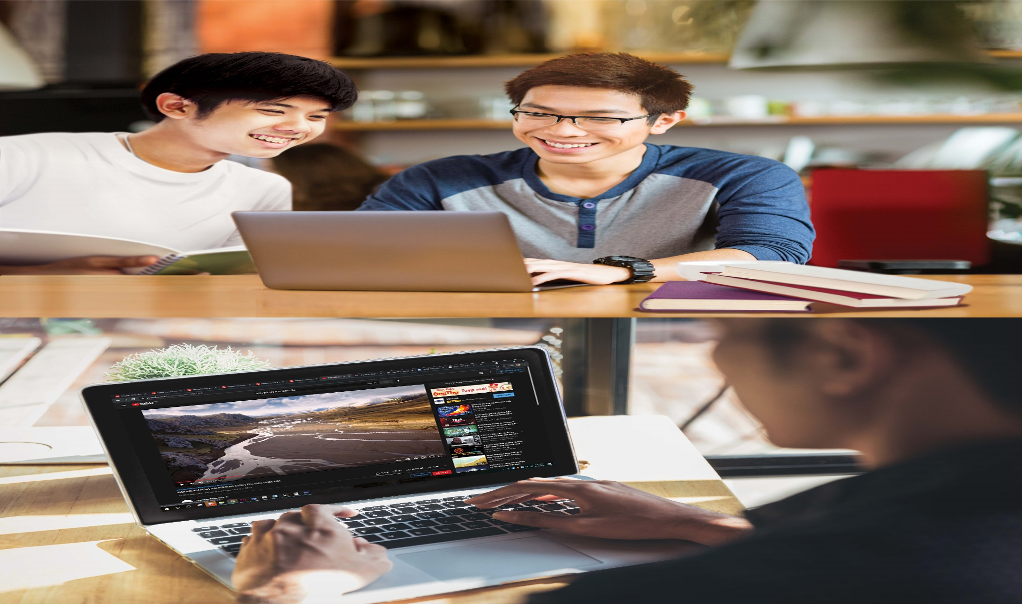
What can you see in the picture?

Slide 3
Unit
8
1
FAMILY LIFE
Unit
NEW WAYS TO LEARN
LESSON 1
GETTING STARTED
New learning activities

Slide 4
Vocabulary:
Đăng tải
Upload /ˌʌpˈləʊd/ (v)
→ Upload a video
Geography /dʒiˈɒɡrəfi/ (n)
Global Warming/ˌɡləʊ.bəl ˈwɔː.mɪŋ/ (n.phr)
Information /ˌɪnfəˈmeɪʃn/ (n)
→ find/ search for/look for + more information
Interesting/ˈɪntrəstɪŋ/ (adj)
→ Sound interesting
Project /ˈprɒdʒ.ekt/ (n)
Địa lý
Sự nóng lên toàn cầu
Thông tin
Dự án

Slide 5
- Take note: - Be not good at /biː nɒt gʊd æt/(v.phr)/ → I’m not good at taking notes in class. - Presentation /ˌpreznˈteɪʃn/ (n) - Debate /dɪˈbeɪt/ (n) - Prefer (v) /prɪˈfɜː(r)/ : → Prefer A to B. Example: I prefer presentation to debate. - Face-to-face learning /feɪs-tuː-feɪs ˈlɜːnɪŋ/ (n.phr): - Online learning/ˈɒnˌlaɪn ˈlɜːnɪŋ/(n.phr): - Chance/tʃæns/ (n) = opportunity: → Give someone a chance
Ghi chép
Không giỏi về…
Thuyết trình
Tranh luận
Thích
Học trực tiếp
Học trực tuyến
Cơ hội

Slide 6
(Task3) “ Filling the missing word”
1………… a video
2.…… information
3…........ a project
Upload
Find
Do

Slide 7
5………… materials
4. …......... notes
Prepare
Take

Slide 8
PRESENTATION
1
Listen and read.
New learning activities (page 86)
Long: Hi, Nick. What are you doing?
Nick: I’m watching the video that my geography teacher uploaded on Eclass.
Long: Really? What is it about?
Nick: It’s about global warming. My teacher asked us to watch the video and find more information about this topic.
Long: So, is watching the video part of your homework?
Nick: Yes, then next week, we’ll work in groups and discuss the topic in class.
Long: Sounds interesting. You can watch the video many times and also search for more information at home.
Nick: You’re right. I’m not good at taking notes in class, you know. So I prefer this way of learning. It gives me a chance to discuss with my classmates, who may have original ideas on the topic.
Long: Does your teacher often ask you to prepare materials at home and discuss in class, Nick?
Nick: Yes, she does. We’re doing a lot of projects that help us understand the lessons better. This way of studying, which gives us more control over our own learning, is quite useful.
Long: You’re lucky. My teachers use very traditional methods of teaching at my schools. I wish I could try these new learning activities.
What are Long and Nick talking about???

Slide 9
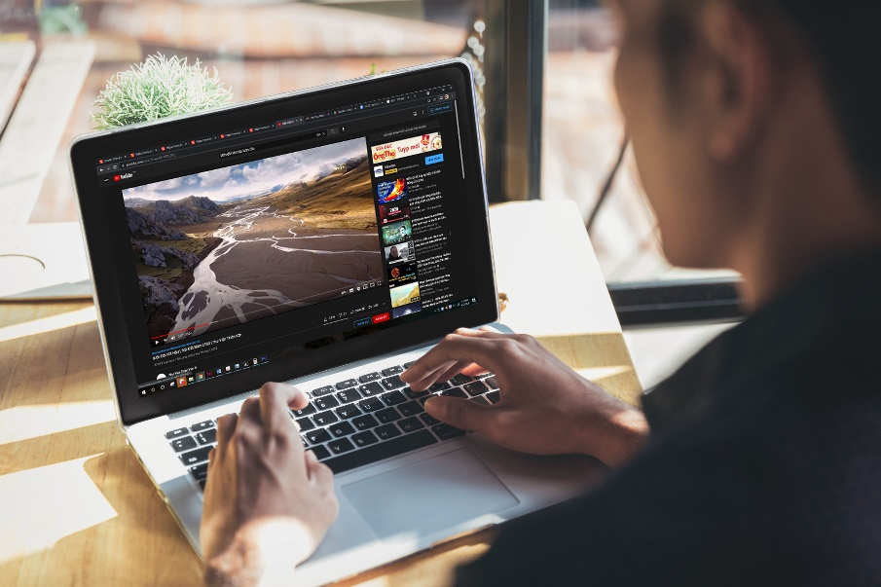
PRACTICE
1
Listen and read.
New learning activities (page 86)
Long: Hi, Nick. What are you doing?
Nick: I’m watching the video that my geography teacher uploaded on Eclass.
Long: Really? What is it about?
Nick: It’s about global warming. My teacher asked us to watch the video and find more information about this topic.
Long: So, is watching the video part of your homework?
Nick: Yes, then next week, we’ll work in groups and discuss the topic in class.
Long: Sounds interesting. You can watch the video many times and also search for more information at home.
Nick: You’re right. I’m not good at taking notes in class, you know. So I prefer this way of learning. It gives me a chance to discuss with my classmates, who may have original ideas on the topic.
Long: Does your teacher often ask you to prepare materials at home and discuss in class, Nick?
Nick: Yes, she does. We’re doing a lot of projects that help us understand the lessons better. This way of studying, which gives us more control over our own learning, is quite useful.
Long: You’re lucky. My teachers use very traditional methods of teaching at my schools. I wish I could try these new learning activities.
They are talking about:
- Nick's geography homework about global warming.
- their ways of learning: watching a video, working in groups, doing projects...

Slide 10
PRACTICE
2
Read the conversation in pairs and tick () T (True) or F (False). (part 2, p.87)
STATEMENT | TRUE | FALSE
1. Nick is preparing for his next geography class.
2. Nick’s note taking skills are quite good.
3. Nick’s class is working on many projects now.

Slide 11
PRACTICE
4
Match steps to do 'TRUE or FALSE' task:
......???........
STEP 1
.......???.........
STEP 2
.......???.........
STEP 3
.......???.........
STEP 4
- Find SIMILAR WORDS in the text
- Identify KEY WORDS (nouns, verbs, adjectives) in the statement
- If they are the same --> True. If they are opposite --> False
- Evaluate if KEY WORDS and SIMILAR WORDS are the same or opposite

Slide 12
CORRECTION
STATEMENT | TRUE | FALSE
1. Nick is preparing for his next geography class.
✓
Long: Hi, Nick. What are you doing?
Nick: I’m watching the video that my geography teacher uploaded on Eclass.
Long: Really? What is it about?
Nick: It’s about global warming. My teacher asked us to watch the video and find more information about this topic.
Long: So, is watching the video part of your homework?
Nick: Yes, then next week, we’ll work in groups and discuss the topic in class.

Slide 13
CORRECTION
STATEMENT | TRUE | FALSE
2. Nick’s note taking skills are quite good.
not good.
✓
Long: Sounds interesting. You can watch the video many times and also search for more information at home.
Nick: You’re right. I’m not good at taking notes in class, you know. So I prefer this way of learning. It gives me a chance to discuss with my classmates, who may have original ideas on the topic.

Slide 14
CORRECTION
STATEMENT | TRUE | FALSE
3. Nick’s class is working on many projects now.
✓
Long: Does your teacher often ask you to prepare materials at home and discuss in class, Nick?
Nick: Yes, she does. We’re doing a lot of projects that help us understand the lessons better. This way of studying, which gives us more control over our own learning, is quite useful.

Slide 15
PRACTICE
4
Complete the sentences WITH ONE WORD ONLY.
1. Nick is watching the video _______ his geography teacher uploaded on Eclass.
2. This way of learning gives him a chance to discuss with his classmates, _______ may have original ideas on the topic.
3. They are doing a lot of projects _______ help them understand the lessons better.
4. That way of studying, _______ gives them more control over their own learning, is quite useful

Slide 16
CORRECTION
that
1. Nick is watching the video ________ his geography teacher uploaded on Eclass.
that
Long: Hi, Nick. What are you doing?
Nick: I’m watching the video that my geography teacher uploaded on Eclass.
Long: Really? What is it about?
Nick: It’s about global warming. My teacher asked us to watch the video and find more information about this topic.

Slide 17
CORRECTION
2. This way of learning gives him a chance to discuss with his classmates, _______ may have original ideas on the topic.
who
Long: Sounds interesting. You can watch the video many times and also search for more information at home.
Nick: You’re right. I’m not good at taking notes in class, you know. So I prefer this way of learning. It gives me a chance to discuss with my classmates, who may have original ideas on the topic.

Slide 18
CORRECTION
that
3. They are doing a lot of projects _____ help them understand the lessons better.
Long: Does your teacher often ask you to prepare materials at home and discuss in class, Nick?
Nick: Yes, she does. We’re doing a lot of projects that help us understand the lessons better. This way of studying, which gives us more control over our own learning, is quite useful.

Slide 19
CORRECTION
which
4. That way of studying, _______ gives them more control over their own learning, is quite useful.
Long: Does your teacher often ask you to prepare materials at home and discuss in class, Nick?
Nick: Yes, she does. We’re doing a lot of projects that help us understand the lessons better. This way of studying, which gives us more control over our own learning, is quite useful.
Long: You’re lucky. My teachers use very traditional methods of teaching at my schools. I wish I could try these new learning activities.

Slide 20
Long: Hi, Nick. What are you doing?
Nick: I’m watching the video that my geography teacher uploaded on Eclass.
Long: Really? What is it about?
Nick: It’s about global warming. My teacher asked us to watch the video and find more information about this topic.
Long: So, is watching the video part of your homework?
Nick: Yes, then next week, we’ll work in groups and discuss the topic in class.
Long: Sounds interesting. You can watch the video many times and also search for more information at home.
Nick: You’re right. I’m not good at taking notes in class, you know. So I prefer this way of learning. It gives me a chance to discuss with my classmates, who may have original ideas on the topic.
Long: Does your teacher often ask you to prepare materials at home and discuss in class, Nick?
Nick: Yes, she does. We’re doing a lot of projects that help us understand the lessons better. This way of studying, which gives us more control over our own learning, is quite useful.
Long: You’re lucky. My teachers use very traditional methods of teaching at my schools. I wish I could try these new learning activities.
RELATIVE PRONOUNS

Slide 21
PRACTICE
4
Talk about your favorite learning activity, choosing ONE from 6 activities below.
Pairwork
Groupwork
Debate
???
LEARNING ACTIVITIES
Online learning
Project
Presentation

Slide 22
PRACTICE
4
Talk about your favorite learning activity in 2 minutes.
1. What is it called? (debate, presentation, experiment ...)
2. In what subject have you applied this learning activity?
3. What have you learnt from this activity? (teamwork, note-taking, confidence....)
Marking criteria:
Task achievement: answer all 3 questions above
Pronunciation
Fluency
Vocabulary: use words/phrases we have learnt today
Grammar
10
✓
✓
✓
✓
✓

Slide 23
CONSOLIDATION
1
Wrap-up: What have we learnt today?
- Learn language items:
+ Words/phrases related to topic 'New learning activities'
+ Grammar: relative pronouns
- Get to know different learning activities and how they are done in and out of class.

Slide 24
CONSOLIDATION
2
Homework
- Practice the words/phrases in Vocabulary section
- Do the exercises: Unit 8 - Lesson 1, Workbook

Slide 25
Website: sachmem.vn
Fanpage: facebook.com/sachmem.vn/

