Slide 1
WARM UP
Who’s faster?

Slide 2
Warm-up: Who’s faster?
Divide class into 3 groups.
There are some pictures of some electronic devices.
You have 1 minute to remember these pictures without
noting down.
After that one student from each group goes to the board
and writes down your answers.
The group has all correct answers and finishes first is the WINNER.

Slide 3
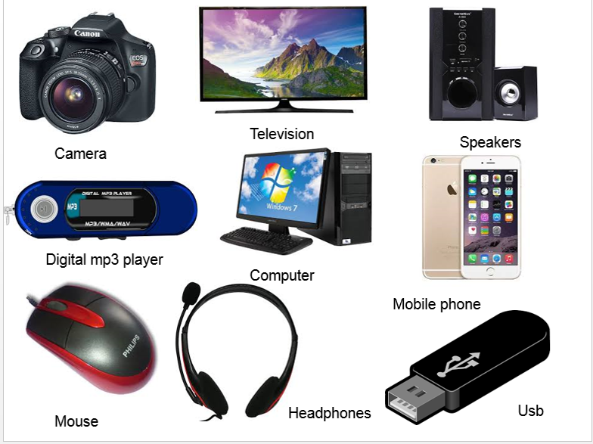

Slide 6
UNIT 8:
NEW WAYS TO LEARN
GETTING STARTED
Learning with personal electronic devices

Slide 7
Vocabulary
Electronic devices(n)
/ˌel.ekˈtrɒn.ɪk/
Thiết bị điện tử.

Slide 8
Vocabulary
2. Personal /ˈpɝː.sən.əl/ (a)
Cá nhân
Example: This is my personal computer.

Slide 9
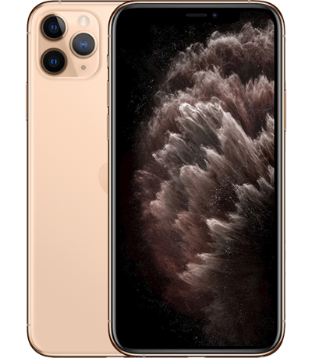
Vocabulary
3. Store (v)
Cất, giữ, lưu trữ
Example:
I store my pictures on my phone.

Slide 10
Vocabulary
4. Take notes
Ghi chép
= write something down

Slide 11
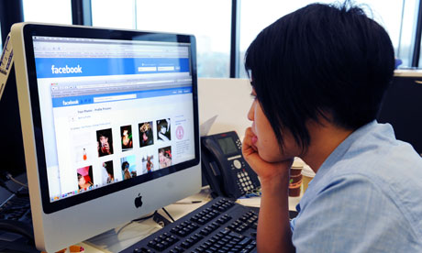
Vocabulary
5. Access /ˈæk.ses/ (v)
Truy cập
Example: Most people use their computers to access the Internet.

Slide 12
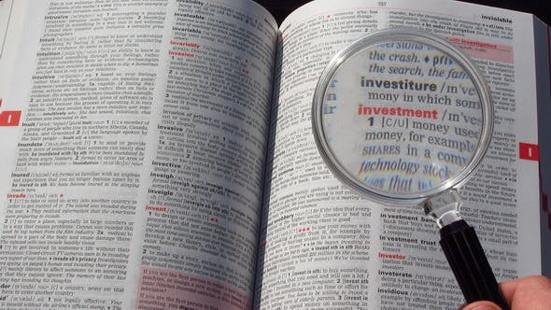
Vocabulary
6. Look something up:
Tra cứu
Example: If you're not sure what the word means, look it up in a dictionary.

Slide 13
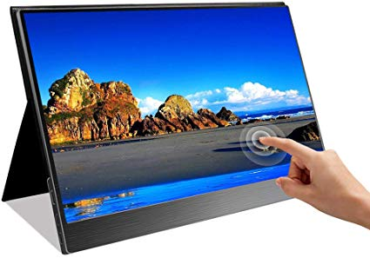
Vocabulary
7. Touch screen (n)
Màn hình cảm ứng

Slide 14
Vocabulary
1. Electronic devices (n) Thiết bị điện tử.
2. Personal (a): Cá nhân
3. Store (v): Cất, giữ, lưu trữ
4. Take notes = write something down: Ghi chép
5. Access (v) : Truy cập
6. Look something up: Tra cứu
7. Touch screen (n): Màn hình cảm ứng

Slide 15
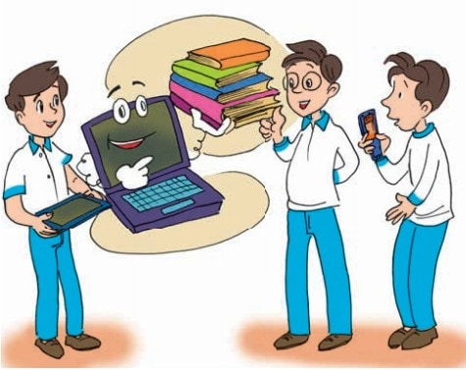
Activity 1: Listen and read

Slide 16
Activity 2
Read the conversation again and check if the following statements are
true (T), false (F) or not given (NG).

Slide 17
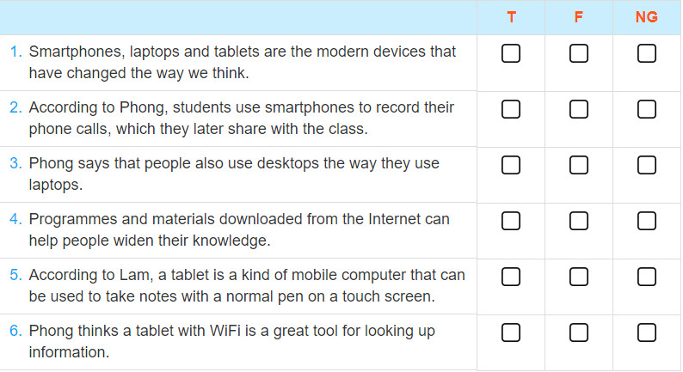

Slide 18
Activity 3
Find the adjectives which describe the devices used as learning tools
and write them down.
Hữu ích
Điện tử
Hữu ích
Cá nhân
Điện tử
Cá nhân
Hiện đại
Hiện đại
Electronic
Modern
Useful
Kĩ thuật số
Personal
Kĩ thuật số
Tuyệt vời
Digital
Tuyệt vời
Hoàn hảo
Hoàn hảo
Di động
Di động
Xuất sắc
Xuất sắc
Great
Perfect
Mobile
Excellent

Slide 19
Activity 4
Read the conversation again and answer the following questions.
1.What personal electronic devices are the speakers talking about?
2.What have these devices changed?
3.How do students use their smartphones for other things besides calls?
4.Why are laptops excellent learning tools?
5.What does Phong do on his laptop?

Slide 20
Answers:
1. They are talking about smartphones, laptops and tablet computers.
2. They have changed the way we learn.
3. They use them to take photos or record their work, which can be shared later with class.
4. Because they can be used to store information, take notes, write essays and do calculations.
5. He does his assignments, projects and studies English.

Slide 21
Homework
- Learn the new words.
- Prepare the next lesson.

Slide 22
Thank you!

