Slide 2
Unit 5
The world of work
LESSON IV
SPEAKING
Giving opinions about different jobs

Slide 3
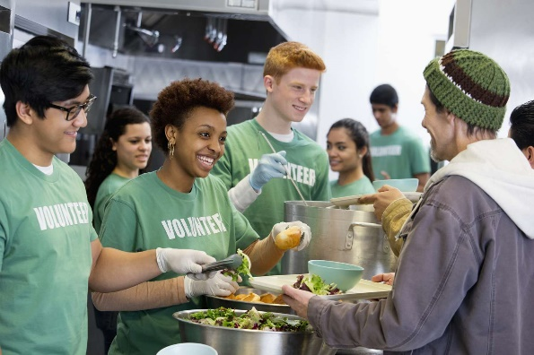
WARM-UP
What is this job?
Fast
Medium
Slow

Slide 4
WARM-UP
What is this job?
shop assistant
volunteer
babysitter
product reviewer
teaching assistant

Slide 5
CONTROLLED PRACTICE
1
Read the descriptions of the following jobs. What do you think about each job? Write the adjectives that describe the nature of the job in the table. Use the words in the box to help you.
boring challenging demanding exciting important
lonely repetitive rewarding stressful tiring
Jobs | Main responsibilities | Adjectives
Teaching assistant | supervising classroom activities, supporting teachers, and checking attendance | rewarding, interesting, fun
Event volunteer | greeting and talking to guests, and sorting donations
Product reviewer | testing product and writing reviews of them
Shop assistant | welcoming customers, arranging window displays, and selling goods.
Babysitter | looking after children while parents are away, playing with them, keeping them safe and feeding them

Slide 6
CONTROLLED PRACTICE
1
Read the descriptions of the following jobs. What do you think about each job? Write the adjectives that describe the nature of the job in the table. Use the words in the box to help you.
boring challenging demanding exciting important
lonely repetitive rewarding stressful tiring
I think working as a(n) teaching assistant is a(n) rewarding job.
interesting
fun
repetitive
Teaching assistant

Slide 7
CONTROLLED PRACTICE
1
Read the descriptions of the following jobs. What do you think about each job? Write the adjectives that describe the nature of the job in the table. Use the words in the box to help you.
boring challenging demanding exciting important
lonely repetitive rewarding stressful tiring
event volunteer

Slide 8
CONTROLLED PRACTICE
1
Read the descriptions of the following jobs. What do you think about each job? Write the adjectives that describe the nature of the job in the table. Use the words in the box to help you.
boring challenging demanding exciting important
lonely repetitive rewarding stressful tiring
product reviewer

Slide 9
CONTROLLED PRACTICE
1
Read the descriptions of the following jobs. What do you think about each job? Write the adjectives that describe the nature of the job in the table. Use the words in the box to help you.
boring challenging demanding exciting important
lonely repetitive rewarding stressful tiring
shop assistant

Slide 10
CONTROLLED PRACTICE
1
Read the descriptions of the following jobs. What do you think about each job? Write the adjectives that describe the nature of the job in the table. Use the words in the box to help you.
boring challenging demanding exciting important
lonely repetitive rewarding stressful tiring
babysitter

Slide 11
CONTROLLED PRACTICE
1
Read the descriptions of the following jobs. What do you think about each job? Write the adjectives that describe the nature of the job in the table. Use the words in the box to help you.
boring challenging demanding exciting important
lonely repetitive rewarding stressful tiring
Jobs | Main responsibilities | Adjectives
Teaching assistant | supervising classroom activities, supporting teachers, and checking attendance | rewarding, interesting, fun
Event volunteer | greeting and talking to guests, and sorting donations | rewarding, important demanding, tiring
Product reviewer | testing product and writing reviews of them | exciting, challenging, demanding, lonely
Shop assistant | welcoming customers, arranging window displays, and selling goods. | repetitive, boring, tiring, exciting
Babysitter | looking after children while parents are away, playing with them, keeping them safe and feeding them | stressful, tiring,boring exciting, challenging

Slide 12
CONTROLLED PRACTICE
2
Work in pairs. Talk about the jobs in 1 using the adjectives. Compare your answers and explain your opinions and feelings.
I think working as a teaching assistant is a very rewarding job. I can supervise classroom activities and support teachers .
I agree, but it seems like a repetitive job because you have to check attendance everyday. Personally, I’d rather be an event volunteer. I believe it’s an important job because i’m responsible for greeting and talking to guests.
Oh, I get it.

Slide 13
CONTROLLED PRACTICE
A: I think working as a teaching assistant is a very rewarding job. I can supervise
classroom activities and support teachers .
B: I agree, but it seems like a repetitive job because you have to check attendance everyday.Personally, I’d rather be an event volunteer. I believe it’s an important job because i’m responsible for greeting and talking to guests.
A: Ok, I get it.
2
Jobs | Main responsibilities | Adjectives
Teaching assistant | supervising classroom activities, supporting teachers, and checking attendance | rewarding, interesting, fun
Event volunteer | greeting and talking to guests, and sorting donations | rewarding, important demanding, tiring
Product reviewer | testing product and writing reviews of them | exciting, challenging, demanding, lonely
Shop assistant | welcoming customers, arranging window displays, and selling goods. | repetitive, boring, tiring, exciting
Babysitter | looking after children while parents are away, playing with them, keeping them safe and feeding them | stressful, tiring,boring exciting, challenging

Slide 14
LESS CONTROLLED PRACTICE
3
Work in groups. Compare your answers in 1 and 2, and report to the whole class. Use the questions below as cues.
Which is the most common adjective to describe each job in the table?
Which job do most people in your group like/dislike?
What are the most common reasons?

Slide 15
CONSOLIDATION
1
Wrap-up
What have you learnt today?
Giving opinions about different jobs: teaching assistant, event volunteer, product reviewer, shop assistant, babysitter.

Slide 16
CONSOLIDATION
2
Homework
Do exercises in the workbook.
Practice giving opinion about other jobs
Prepare for the next lesson.

Slide 17
Goodbye!

