Slide 1
WELCOME TO OUR CLASS

Slide 2
URBANISATION
UNIT 4
Lesson: Language

Slide 3
WARM-UP
He is playing the piano.

Slide 4
UNSTRESSED WORDS IN CONNECTED SPEECH
I. PRONUNCIATION
1. Articles | a, an, the
2. Prepositions: | above, for, of, to, until,…
3. Personal adjectives: | I, you, we, they, he, she, it
4. Possessive adjectives: | my, your, our, their, her, his, its
5. Auxiliary verbs: | be, have, do,…
6. Conjunctions: | and, but, or,...
7. Modal verbs: | can, will,…
8. The expressions: | there is, there are,…

Slide 5
Task 1. Listen and repeat. Pay attention to the pronunciation of the unstressed words.
I. PRONUNCIATION
1. It's been three years since your last visit.
2. Fresh air and a walk sound nice.

Slide 6
Task 2. Listen and identify the unstressed words in the following sentences. Then practise saying the sentences in pairs.
I. PRONUNCIATION
1. A new convenience store has been opened near my house.
2. There are still a lot of problems in our cities today.

Slide 7
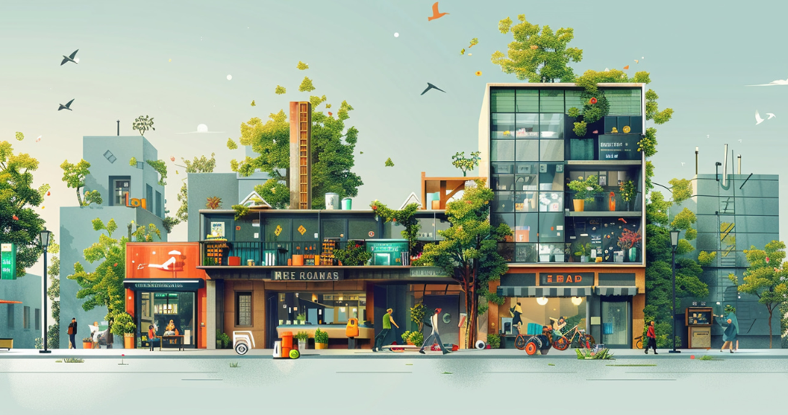
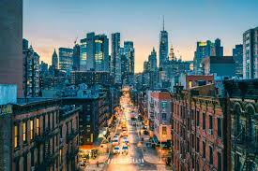
II. VOCABULARY
Rearrange
B
A
U
N
R
E
F
I
L

Slide 8
II. VOCABULARY
REARRANGE
U
R
B
A
N
L
I
F
E
URBAN LIFE

Slide 9
Task 1. Match the words with their meanings.
II. VOCABULARY URBAN LIFE
1. afford (v) | a. to become larger in size, number, or importance
2. housing (n) | b. the number of people not having a job
3. expand (v) | c. to have enough money to buy or do something
4. seek (v) | d. houses, flats, etc. that people live in
5. unemployment (n) | e. to look for something or somebody
Có khả năng chi trả
Nhà ở
Mở rộng
Tìm kiếm
Tình trạng thất nghiệp

Slide 10
Task 2. Complete the sentences using the correct forms of the words in 1.
II. VOCABULARY URBAN LIFE
afford – housing - expand – seek - unemployment
1. Higher ________________ can result in increasing crime rates in big cities.
2. Not many young couples can _________ to buy their own house in big cities.
3. There is a shortage of affordable _________ in big cities.
4. Since they started using farmland for building houses, many towns have ____________ into cities.
5. Many people are leaving the countryside in order to ________ better opportunities in big cities.
unemployment
afford
housing
expanded
seek

Slide 11
PRESENT PERFECT
III. GRAMMAR PRESENT PERFECT
S + has/have + Ved/V3
- To describe something that started in the past and is still happening now.
- To describe something that was completed in the very recent past.
- To say how many times something has happened.
Ex: This is the second time I have visited this city.
To talk about a unique experience.
Ex: That is the best meal I have ever had in this city.
It/This/That + be + the first/second time + S + has/have (done)….
It/This/That/Noun/Gerund phrase + be + the best/the worst/the only/the most beautiful…+ S + has/have (ever done)….

Slide 12
Task 1. Circle the underlined part that is incorrect in each of the following sentences. Then correct it.
III. GRAMMAR PRESENT PERFECT
1. This is the (A) first time I (B) saw such (C) a fall building (D) in my life.
2. Mount Fuji (A) in Japan is the (B) most beautiful place we (C) had ever (D) visited.
3. This (A) has been the second time my mother (B) has warned me not (C) to spend all my money (D) on clothes.
B
C
A

Slide 13
DOUBLE COMPARATIVES
III. GRAMMAR DOUBLE COMPARATIVES
To show CHANGE
S + V + Adj/Adv-ER and Adj/Adv-ER
S + V + MORE and MORE Adj/Adv
To say that TWO THINGS CHANGES TOGETHER
The + Adj/Adv-ER + S + V, the + Adj/Adv-ER + S + V.
MORE Adj/Adv MORE Adj/Adv

Slide 14
Task 2. Choose the best option to indicate the sentence that is closest in meaning to the sentence given.
III. GRAMMAR DOUBLE COMPARATIVES
1. Housing is getting more and more expensive in big cities, so many local residents can't afford to buy their own place.
Many local residents in big cities can't buy their own place because housing is becoming more expensive every day.
B. More and more local residents can't afford their own place in big cities because housing is too expensive.
C. Housing is getting affordable enough for many local people to buy their own place.
D. Housing in big cities has become the most expensive these days, so many local residents can't afford their own place.
2. The more people move into big cities, the higher the unemployment is.
The higher the unemployment is, the more people move into big cities.
B. More people moving into big cities causes higher unemployment.
C. More people move into big cities despite the high rate of unemployment.
D. More people move into big cities because there are more employment opportunities there.
3. The more houses are built, the less space we have for plants and trees.
Although more houses are built, we still have some space for plants and trees.
B. The fewer houses we build, the less space we have for plants and trees.
C. We have less space for plants and trees because more houses are built.
D. Plants and trees are the reasons why more houses can't be built.

Slide 15
Task 2. Choose the best option to indicate the sentence that is closest in meaning to the sentence given.
III. GRAMMAR DOUBLE COMPARATIVES
1. Housing is getting more and more expensive in big cities, so many local residents can't afford to buy their own place.
Many local residents in big cities can't buy their own place because housing is becoming more expensive every day.
B. More and more local residents can't afford their own place in big cities because housing is too expensive.
C. Housing is getting affordable enough for many local people to buy their own place.
D. Housing in big cities has become the most expensive these days, so many local residents can't afford their own place.
A

Slide 16
Task 2. Choose the best option to indicate the sentence that is closest in meaning to the sentence given.
III. GRAMMAR DOUBLE COMPARATIVES
2. The more people move into big cities, the higher the unemployment is.
The higher the unemployment is, the more people move into big cities.
B. More people moving into big cities causes higher unemployment.
C. More people move into big cities despite the high rate of unemployment.
D. More people move into big cities because there are more employment opportunities there.
B

Slide 17
Task 2. Choose the best option to indicate the sentence that is closest in meaning to the sentence given.
III. GRAMMAR DOUBLE COMPARATIVES
3. The more houses are built, the less space we have for plants and trees.
Although more houses are built, we still have some space for plants and trees.
B. The fewer houses we build, the less space we have for plants and trees.
C. We have less space for plants and trees because more houses are built.
D. Plants and trees are the reasons why more houses can't be built.
C

Slide 18
C:\Users\nguye\Downloads\
GAME
OPEN BLIND BAG

Slide 19
\
RULE
- Divide the class into 2 teams.
- Teams take turns selecting a blind bag.
- Open the bags and answer the questions. Get marks for correct answers; no marks for incorrect ones.
- The team with the most marks will be the winner.

Slide 20
GAME
ARE YOU READY?

Slide 21
\
GAME
CHOOSE A BLIND BAG
1
2
3
4
5
6
7
8

Slide 22
\
...
OPEN . . .

Slide 23
...
..
QUESTION
1. What's the biggest challenge that you…… …… in life so far?
10 MARKS
A. have faced
A. have faced
B. faced
B. faced
C. face
C. face

Slide 24
\
...
OPEN . . .

Slide 25
...
..
LUCKY BLIND BAG
15 marks

Slide 26
\
...
OPEN . . .

Slide 27
...
..
QUESTION
3. The ………… the urban population grows, the ………… serious the housing shortage becomes.
10 MARKS
A. largest …more
B.large … less
C. larger… more
C. larger… more

Slide 28
\
...
OPEN . . .

Slide 29
...
..
LUCKY BLIND BAG
20 mARKS

Slide 30
\
...
OPEN . . .

Slide 31
...
..
QUESTION
5. This is the first time we……… such an interesting talk about urbanisation in VietNam.
10 MARKS
A. listen to
B. had listened to
B. had listened to
C. have listened to
C. have listened to

Slide 32
\
...
OPEN . . .

Slide 33
...
..
QUESTION
6. Due to rapid urbanisation, our city is becoming ...............
15 mARKS
A. bigger and bigger
B. big and bigger
B. big and bigger
C. bigger and big
C. bigger and big

Slide 34
\
...
OPEN . . .

Slide 35
...
..
QUESTION
Starting her own business is the best decision my sister …… in her life.
10 MARKS
A. has never made
A. has never made
B. has ever made
B. has ever made
C. made
C. made

Slide 36
\
...
OPEN . . .

Slide 37
...
..
QUESTION
8. After only a month, my brother got bored at work and found his job ………… attractive.
20 MARKS
A. less and less
A. less and less
B. the least
B. the least
C. more or less
C. more or less

Slide 38
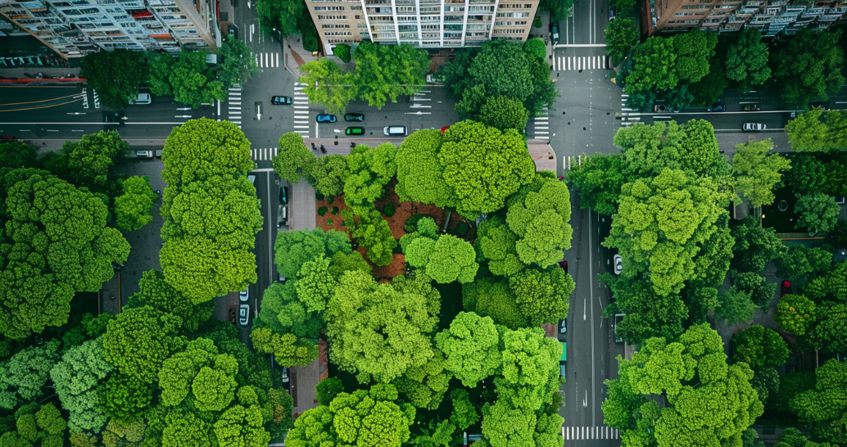
* Pronunciation: Unstressed words in the connected speech * Vocabulary: Urban life * Grammar: - Present perfect - Double comparatives
CONSOLIDATION

Slide 39
Thank You

