Slide 2
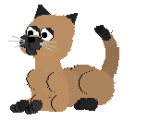
SHARK ATTACK
1
2
3
4
5
6
7
8
9
10
11
12
U
R
B
A
N
I
S
A
T
I
O
N
GUESSING THE LETTERS IN THE WORD

Slide 3
UNIT 4: URBANISATION
Lesson: Getting started – Urban development

Slide 4
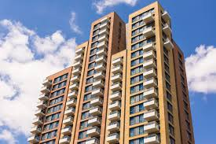
VOCABULARY
+ urban (adj)
: of or in a city or town
: đô thị, thuộc thành phố
urbanise (v)
: đô thị hóa
urbanisation (n)
: sự đô thị hóa
+ high-rise (a)
: cao tầng
+ convenient (a)
: easy to use, run,...
: tiện lợi
convenience (n)
: sự tiện lợi
+ housing (n)
: nhà ở
: buildings for people to live in

Slide 5
Task 1: Listen and read
What is the conversation about?
The changes in Nam’s neighbourhood
Nam: Hi, Mark!
Mark: Hi, Nam! Sorry I'm late. I got lost because your neighbourhood has changed a lot.
Nam: Yeah. It's been three years since your last visit. Anyway, do you want to go for a walk? I'll show you around. Fresh air and a walk sound nice. Let's go!
Mark: Nam, there used to be a rice field opposite your house, right?
Nam: Exactly, Mark. But now they have built several high-rise buildings. The city is getting bigger and bigger.
Mark: Yes, more and more people want to live in urban areas nowadays. This is part of the process of urbanisation.
Nam: That's true. There are also new public parks and people can enjoy more leisure activities. In addition to the big shopping centre, there is a convenience store on every corner. And look at our new electric buses! Do you want to go for a ride?
Mark: Sure, Nam... Wow! The bus is so quiet and comfortable! It's the first time I've been on an electric bus. Getting around is probably becoming more and more convenient for local residents.
Nam: Not really. The more crowded the area becomes, the worse traffic jams get, especially during rush hour. The cost of living is also going up. These are the changes that I don't like.
Mark: That's true, Nam. I guess urbanisation can also cause problems.

Slide 6
Task 2: Read the conversation again. Decide whether the following statements are true (T) or false (F).
 | T | F
1. The last time Mark visited Nam’s place was three years ago.
2. There used to be a park opposite Nam’s house.
3. There aren’t any new leisure or shopping facilities in Nam’s neighbourhood
4. Traffic jams and rising cost of living are the two problems that Nam mentioned

Slide 7
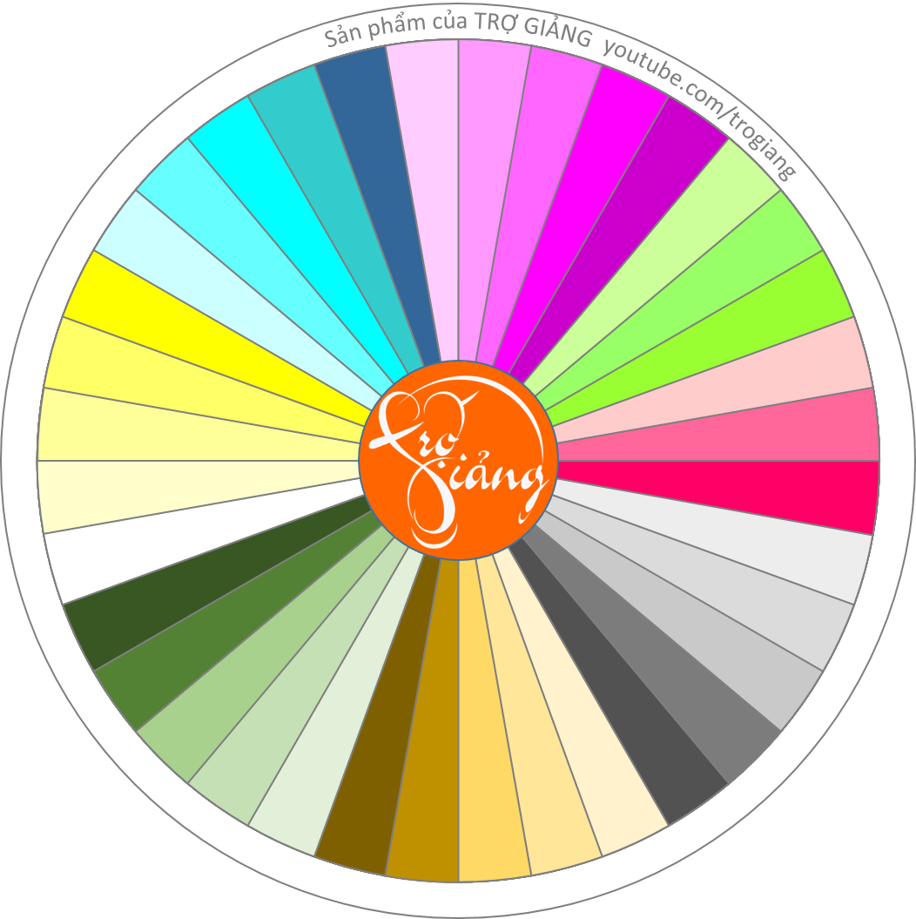
LUCKY SPINNER
Qua nội dung tiếp
TÂM
THI
ÁNH
QUỲNH
QUÂN
BẢO
N.PHƯỚC
CHÂU
H.PHƯƠC
CHIN
NƠ
TRÍ
NHƯ
DUYÊN
P.TRÂM
L.T.M.DUYÊN
NHI
T.TRÂM
NHẬT
T.ĐẠT
NGOÃN
Q.ĐẠT
THÙY
ĐẾN
MỸ
N.HÂN
MY
T.HÂN
TRANG
HIẾU
LÝ
HUYỀN
LAN
HƯƠNG
KHÁNH
THANH

Slide 8
Task 2: Read the conversation again. Decide whether the following statements are true (T) or false (F).
Nam: Hi, Mark! Mark: Hi, Nam! Sorry, I’m late. I got lost because your neighborhood has changed a lot. Nam: Yeah. It’s been three years since your last visit. Anyway, do you want to go for a walk? I’ll show you around. Mark: Fresh air and a walk sound nice. Let’s go! Mark: Nam, there used to be a rice field opposite your house, right? Nam: Exactly, Mark. But now they have built several high-rise buildings. The city is getting bigger and bigger.
 | T | F
1. The last time Mark visited Nam’s place was three years ago.
2. There used to be a park opposite Nam’s house.
✓
✓
There used to be a rice field

Slide 9
Task 2: Read the conversation again. Decide whether the following statements are true (T) or false (F).
Nam: That’s true. There are also new public parks and people can enjoy more leisure activities. In addition to the big shopping centre, there is a convenience store on every corner. And look at our new electric buses! Do you want to go for a ride? Mark: Sure, Nam … Wow! The bus is so quiet and comfortable! It’s the first time I’ve been on an electric bus. Getting around is probably becoming more and more convenient for local residents. Nam: Not really. The more crowded the area becomes, the worse traffic jams get, especially during rush hour. The cost of living is also going up. These are the changes that I don’t like.
 | T | F
3. There aren’t any new leisure or shopping facilities in Nam’s neighbourhood.
4. Traffic jams and rising cost of living are the two problems that Nam mentioned.
✓
There are also new public parks and a convenience store.
✓

Slide 10
Task 2: Read the conversation again. Decide whether the following statements are true (T) or false (F).
 | T | F
1. The last time Mark visited Nam’s place was three years ago.
2. There used to be a park opposite Nam’s house.
3. There aren’t any new leisure or shopping facilities in Nam’s neighbourhood
4. Traffic jams and rising cost of living are the two problems that Nam mentioned
✓
✓
✓
✓

Slide 11
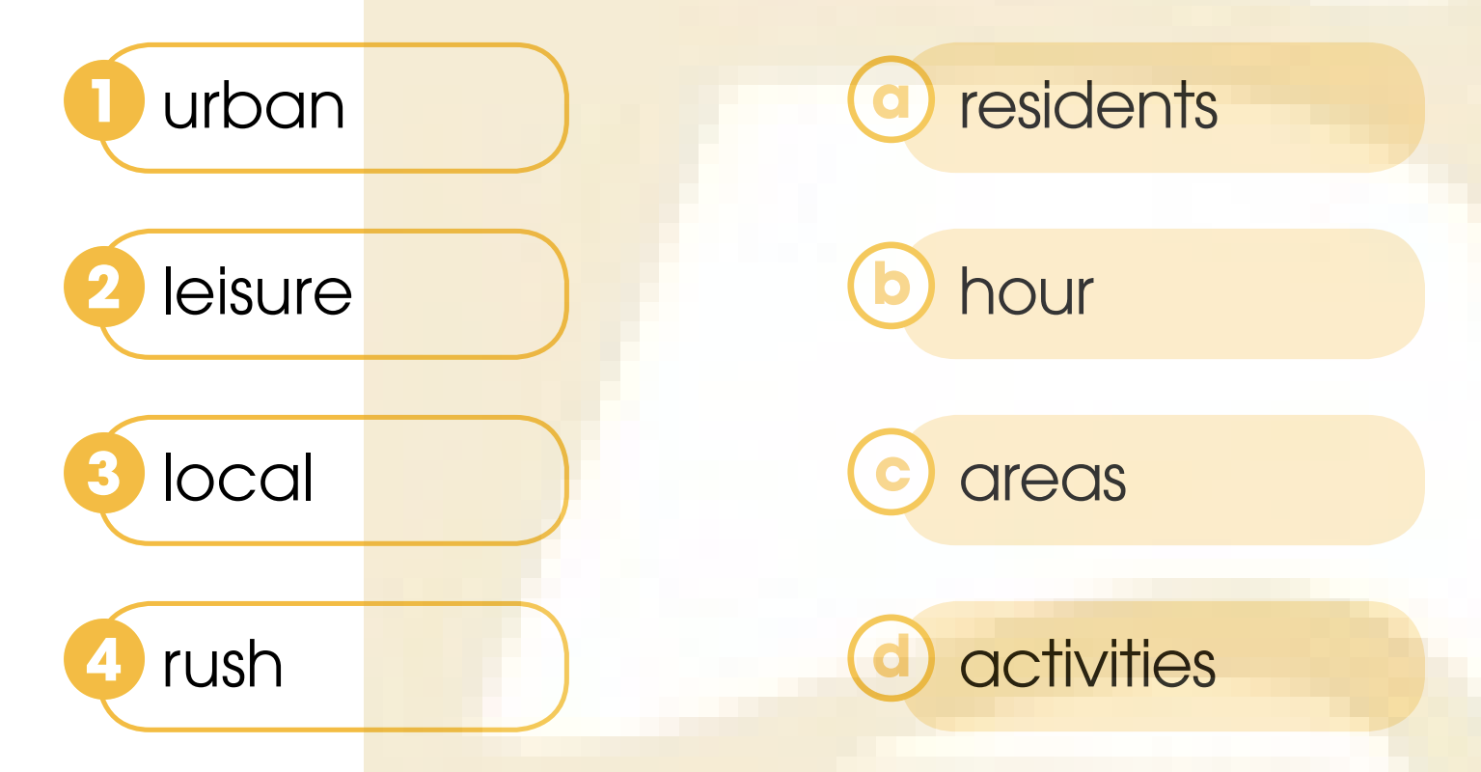
Task 3: Match the words to make phrases mentioned in 1.

Slide 12
Task 3: Match the words to make phrases mentioned in 1.

Slide 13
Task 3: Match the words to make phrases mentioned in 1.

Slide 14
Task 4: Complete the sentences using words
and a phrase from 1.
have built
They ________ several high-rise buildings opposite Nam’s house.
bigger and bigger
2. The city where Nam lives is getting ________________ .
It’s the first time
3. _______________Mark has been on an electric bus
4. ________ crowded the area becomes, ________ traffic jams get.
The more
the worse

Slide 15
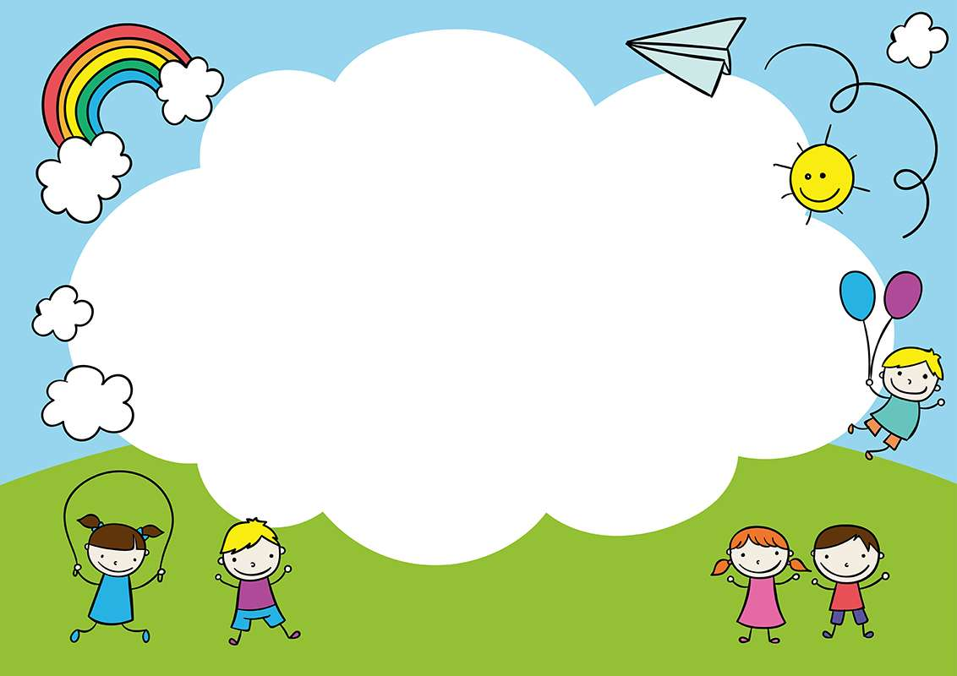
Task 5: Talk about the changes in your neighbourhood

