Slide 2
WARM-UP
Listen to an English song, then answer the questions

Slide 3
QUESTIONS
What can we do to save energy ?
2. Why do we need to save energy ?
https://www.youtube.com/watch?v=TDL3xOEjAe8

Slide 4
QUESTIONS
1.What can we do to save energy ?
2. Why do we need to save energy ?

Slide 5
1. What can we do to save energy ?
- Turn the faucet off when I’m brushing our teeth.
- Turn the light off when I’m going to sleep.
- Reuse rechargeable battery again and again.
Recycle bottles, cans, newspaper.,etc.
Reduce what we can before we throw it away.
2. Why do we need to save energy ?
- To keep the earth clean
- To reduce global warming

Slide 6
English 11
REVIEW 2
SKILLS

Slide 7
SKILLS
LISTENING
SPEAKING
READING
WRITING

Slide 8
LISTENING
Listen to a conversation between Nick and Ann.
Decide whether the following statements are true (T) or false (F).
 | T | F
1. Methane emissions from cows can be changed into usable energy.
2. Methane emissions will increase as a result of population growth.
3. Scientists think that green oceans can’t reduce the amount of CO2.
4. Nick and Ann are talking about ways to reduce greenhouse gas emissions.

Slide 9
LISTENING
Listen to a conversation between Nick and Ann.
Decide whether the following statements are true (T) or false (F).
 | T | F
1. Methane emissions from cows can be changed into usable energy.
2. Methane emissions will increase as a result of population growth.
3. Scientists think that green oceans can’t reduce the amount of CO2.
4. Nick and Ann are talking about ways to reduce greenhouse gas emissions.
✓
✓
✓
✓

Slide 10
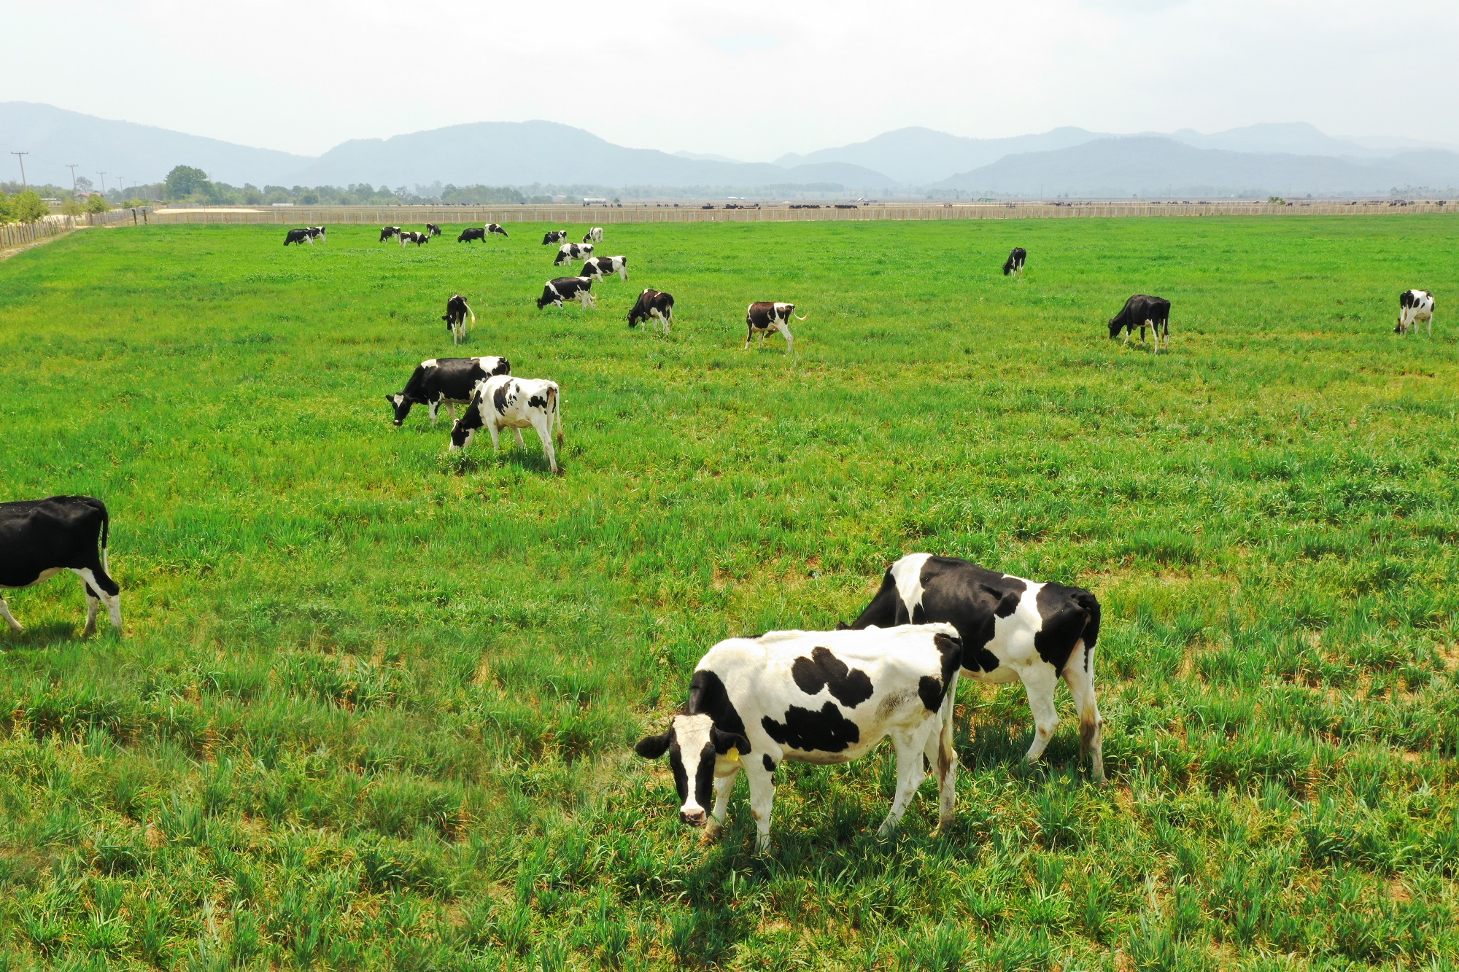
Look at the picture and answer the questions
1.What can you see from picture ?
2. Can people turn methane emissions from cows into energy ?

Slide 11
SPEAKING
WORK IN PAIR
Discuss the technologies mentioned in the Listening can be used in Vietnam with filling each gap with words from the box then practice in front of class
agree with you
remove carbon
local environment
growing plants
methane emissions
be applied
A: I think turning (1).................................... ...from cows into energy is a great technology and it can (2).......................in Viet Nam. This will help save the (3)...................................... and provide more energy sources to the people in those areas.
B: I (4) ........................... There are more dairy farms in Viet Nam now as the demand for milk and beef has increased. I also think that (5) ................................... in the ocean is worth trying. Our country has a long coastline.
A: Yes, you're right. These underwater green carpets will help (6)............................. .from the atmosphere and limit global warming.
methane emissions
be applied
local environment
agree with you
growing plants
remove carbon

Slide 13
READING
ASEAN Youth Forum AYF is a programme for young people in ASEAN, which allows them to express their opinions and fight for their right to live in a sustainable and caring regional community. Its members regularly hold meetings and workshops to discuss the problems facing young people in ASEAN and how to address them .AYF also organises Youth Open Space an online space for young Southeast Asians to meet, connect, share, and talk about current issues such as climate change, health, education, technology, and online security.
Over the past decade, AYF has had meetings in all ASEAN countries. It has connected thousands of young leaders from Southeast Asia, who meet to discuss and suggest strategies for making ASEAN a better community. These conferences aim to improve young peopleʼs leadership skills and strengthen regional unity

Slide 14
READING
Read the text and choose the correct answer
1.In what kind of community do young people in ASEAN want to live?
A. Responsible and caring
B. Sustainable and caring
C. Reliable and sustainable
2. What do AYF members regularly have?
A. Meetings and Forums
B. Meetings and workshops
C. Workshops and Forums
3. What's the name of their online platform?
A. ASEAN Youth
B. the AYF conference
C. Open Space
4.In which countries has AYF had meetings?
A. Viet Nam
B. Japan and Viet Nam
C. All ASEAN countries
5. What do the AYF conferences aim to strengthen?
A. A better community
B. International cooperation
C. Cultural awareness

Slide 15
MERRY CHRISTMAS!

Slide 16
CHRISTMAS Tree Decoration

Slide 17
RULE
- Take turns selecting a number.
- Answer questions correctly
- Receive decoration items to decorate the team’s Christmas tree.
- The team with more decorations will win.

Slide 18
1
2
3
4
5
6

Slide 19
What do AYF members regularly have?
A. Meetings and Forums
B. Meetings and workshops
C. Workshops and Forums
Back

Slide 20
In which countries has AYF had meetings?
A. Viet Nam
B. Japan and Viet Nam
C. All ASEAN countries
Back

Slide 21
What's the name of their online platform?
A. ASEAN Youth
B. the AYF conference
C. Youth: Open Space
Back

Slide 22
In what kind of community do young people in ASEAN want to live?
A. Responsible and caring
B. Sustainable and caring
C. Reliable and sustainable
Back

Slide 23
VERY MERRY CHRISTMAS
Have a cheerful holly, jolly and

Slide 24
What do the AYF conferences aim to strengthen?
A. Regional unity
B. International cooperation
C. Cultural awareness
Back

Slide 25
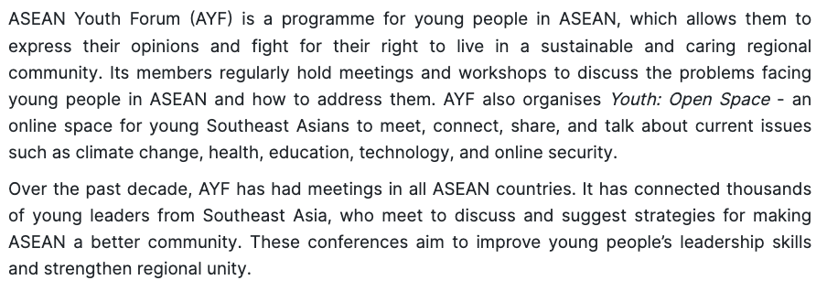
READING

Slide 26
READING

Slide 27
READING

Slide 28
READING

Slide 29
READING

Slide 30
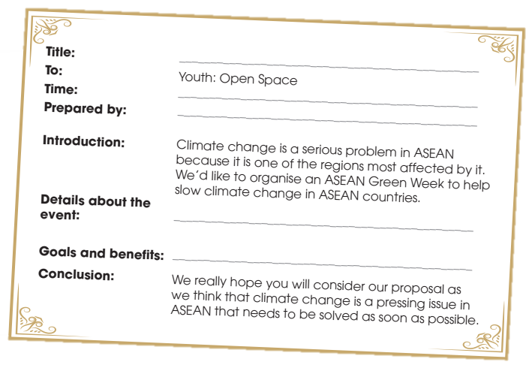
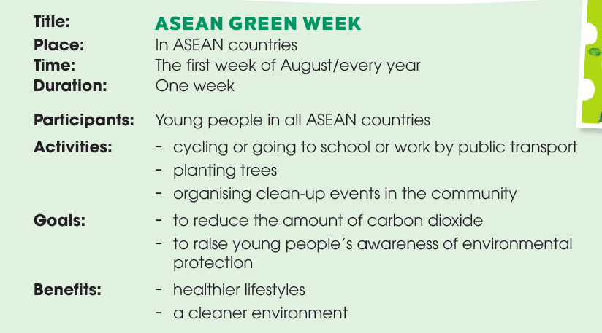
WRITING
Write a proposal (120–150 words) to Youth: Open Space for a youth event to slow climate change in ASEAN countries.

Slide 31
WRITING
Arrange these following parts to make a complete proposal
A. We really hope you will consider our proposal as we think that climate change is a pressing issue in ASEAN that needs to be solved as soon as possible.
B. Climate change is a serious problem in ASEAN because it is one of the regions most affected by it. We’d like to organise an ASEAN Green Week to help limit climate change in ASEAN countries.
C. ASEAN GREEN WEEK
D. The event will take place in all ASEAN member countries during the first week of August. The young people in ASEAN will be the main participants in this event. They will take part in activities such as cycling or going to school or work by public transport, planting trees and organising clean-up events in the community.
E. The first week of August/ every year
F. This event aims at reducing the amount of carbon dioxide, which is the main cause of global warning, and raising young people’s awareness of environmental protection in ASEAN. It will help ASEAN countries adopt healthier lifestyles and live in a cleaner environment.
G. Youth – Open Space
H. Students from Nguyen Du High school

Slide 32
WRITING
A proposal to Youth: Open Space for a youth event to slow climate change in ASEAN countries.
C. ASEAN GREEN WEEK
TITLE:
To:
Time:
Prepared by:
Intrduction:
Details about the event:
Goals and benefits:
Conclusion:
G. Youth – Open Space
E. The first week of August/ every year
H. Students from Nguyen Du High school
B. Climate change is a serious problem in ASEAN because it is one of the regions most affected by it. We’d like to organise an ASEAN Green Week to help limit climate change in ASEAN countries.
D. The event will take place in all ASEAN member countries during the first week of August. The young people in ASEAN will be the main participants in this event. They will take part in activities such as cycling or going to school or work by public transport, ................
F. This event aims at reducing the amount of carbon dioxide, which is the main cause of global warning, and raising young people’s awareness of environmental protection in ASEAN. ………
A. We really hope you will consider our proposal as we think that climate change is a pressing issue in ASEAN that needs to be solved as soon as possible.

