Slide 2
WARM-UP: GUESSING GAME
Game rules
☞ 4 hidden pictures .
From suggestions, guess the words relating these pictures.
Topic: SOCCIAL ISSUES

Slide 3
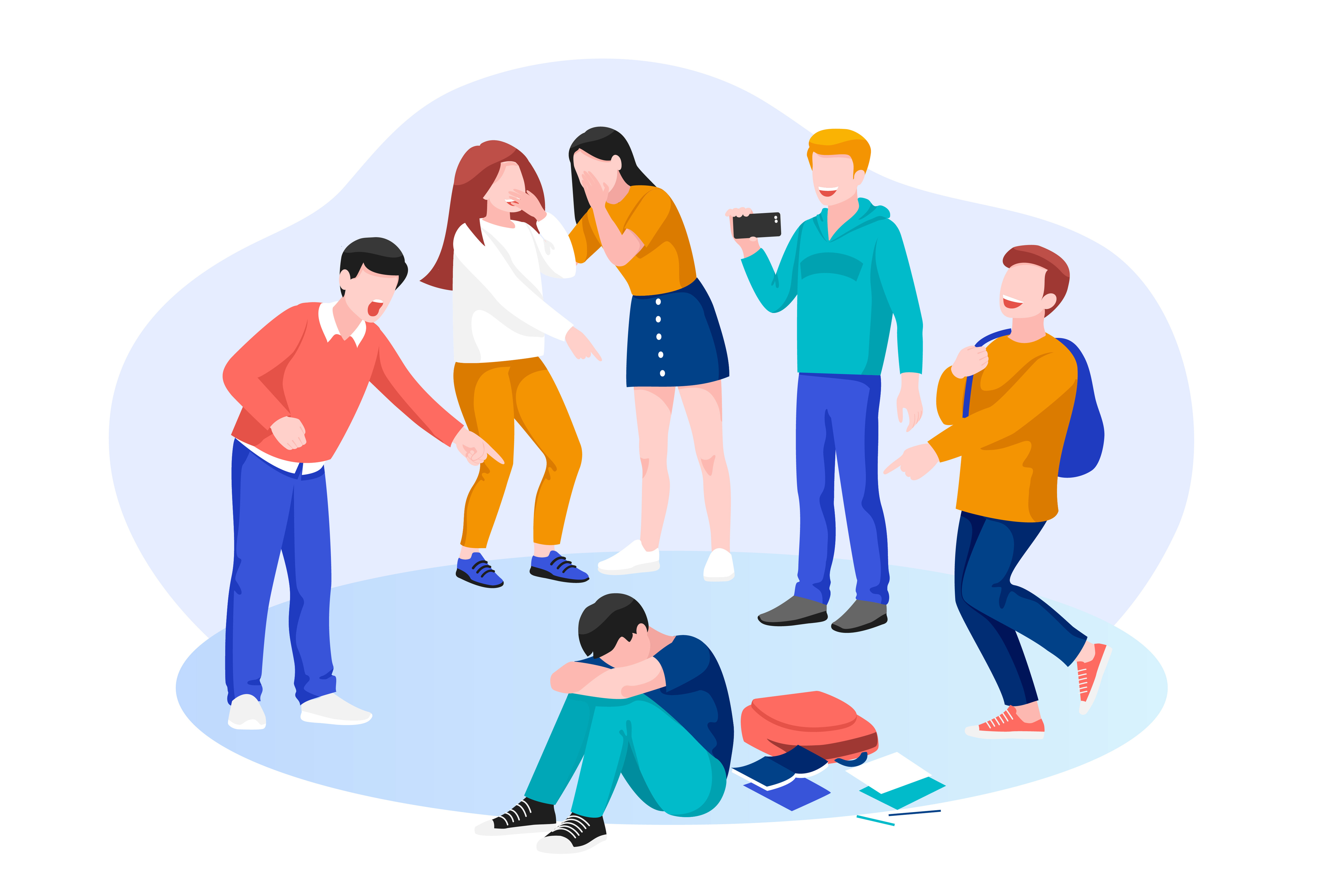
bullying

Slide 4
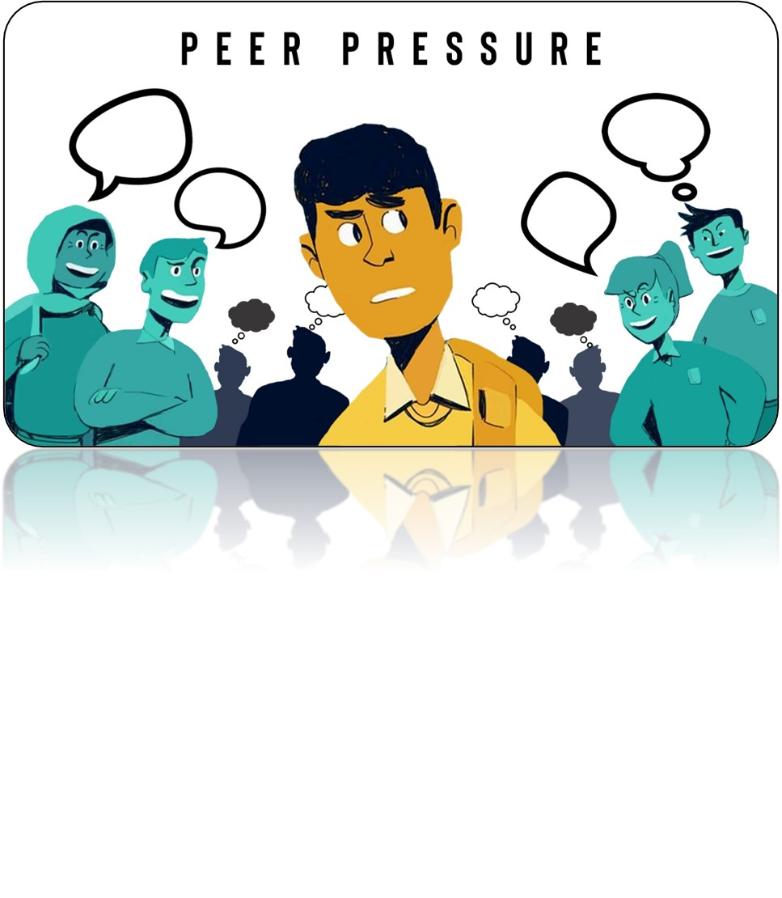

Slide 5
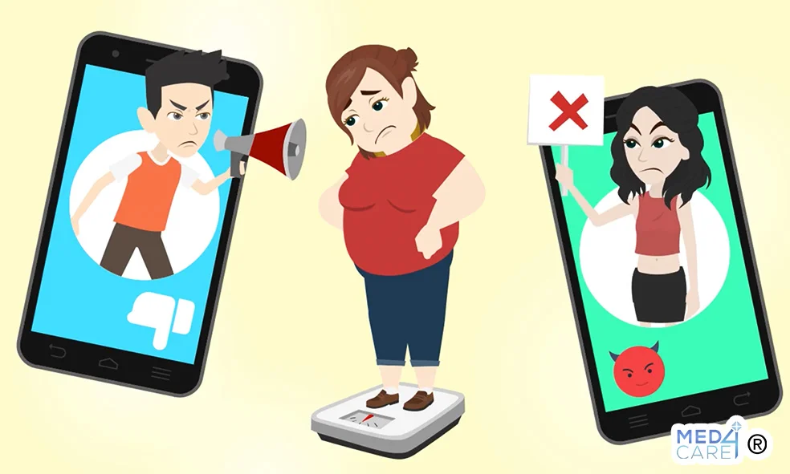
Body shaming

Slide 6
stress

Slide 7
PEER PRESSURE
Unit
9
SOCIAL ISSUES
Unit
FAMILY LIFE
LESSON 3
READING

Slide 8
LESSON 3
READING
WARM-UP
GUESSING GAME
PRE-READING
Task 1: Discuss the question.
Task 2: Match the highlighted words and phrase with their meanings.
Task 3: Which paragraph contains the following information?
Task 4: Choose the correct answer.
WHILE-READING
POST-READING
Task 5: Discussion.
CONSOLIDATION
Wrap-up
Homework

Slide 9
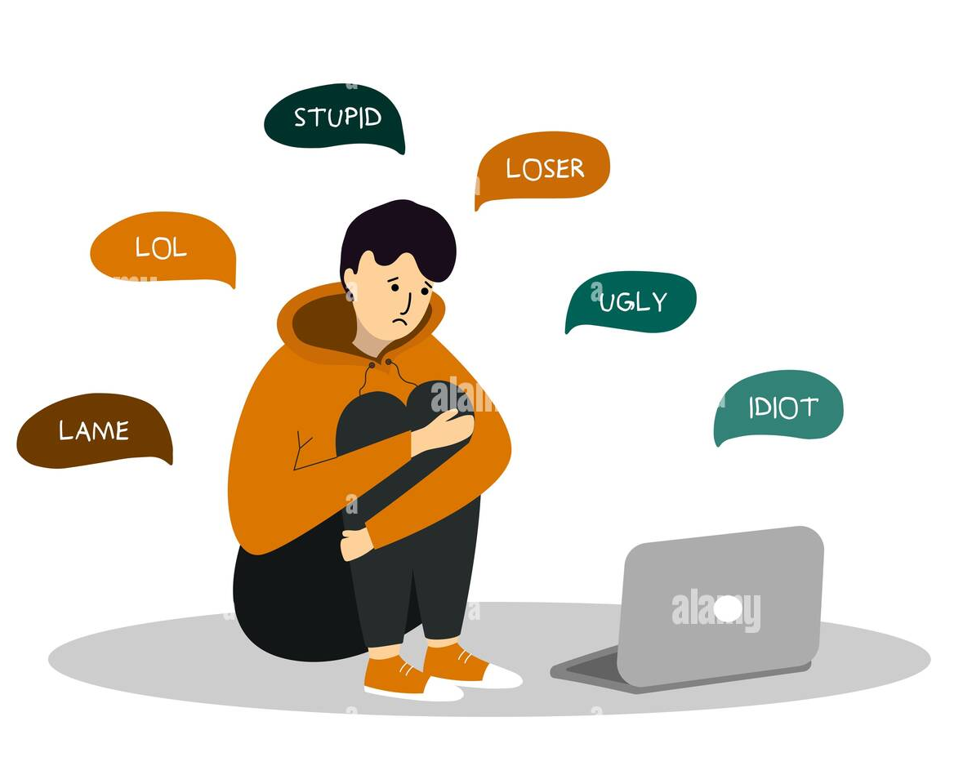
PRE-READING
1
Work in pairs. Discuss the following question.
Have your friends ever made you do something you do not like? If yes, give an example.

Slide 10
PRE-READING
depression (n)
/dɪˈpreʃən/
the state of feeling very unhappy and without hope for the future

Slide 11
PRE-READING
self-confidence (n)
/ˌselfˈkɒnfɪdəns/
the belief that you can do things well and that other people respect you

Slide 12
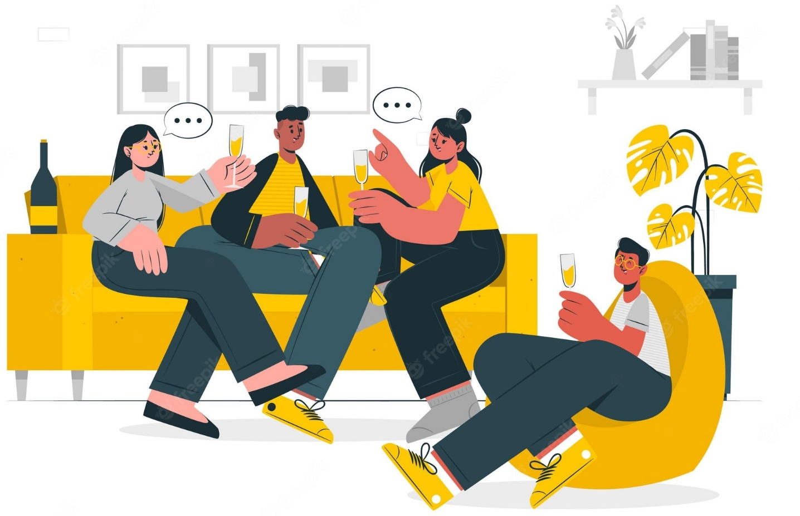
PRE-READING
hang out
/ˈhæŋ ˈaʊt/
to spend a lot of time in a place or with someone

Slide 13
PRE-READING
influence on (np)
ˌ/ˈɪnfluəns/
the power to affect people, actions or events

Slide 14
PRE-READING
the odd one out (np)
/ðiː ɒd wʌn aʊt/
a person or thing that is different from others that form a group or set

Slide 15
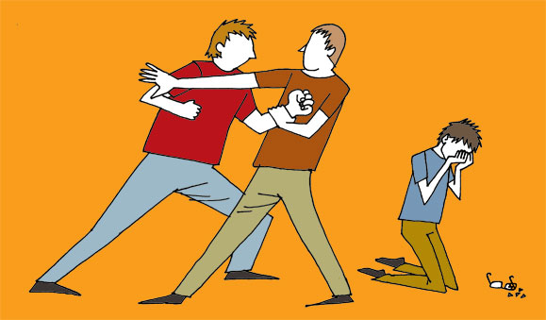
PRE-READING
stand up to (vp)
/stænd ʌp tə/
to defend yourself against a powerful person or organization when they treat you unfairly

Slide 16
9
3
hang out
7
8
2
influence
depression
5
Self- confidence
4
6
The odd one out
1
11
10

Slide 17
WHILE-READING
2
Read the article. Match the highlighted words and phrase with their meanings.

Slide 18
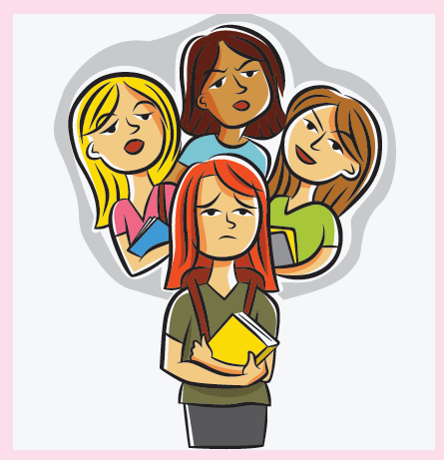
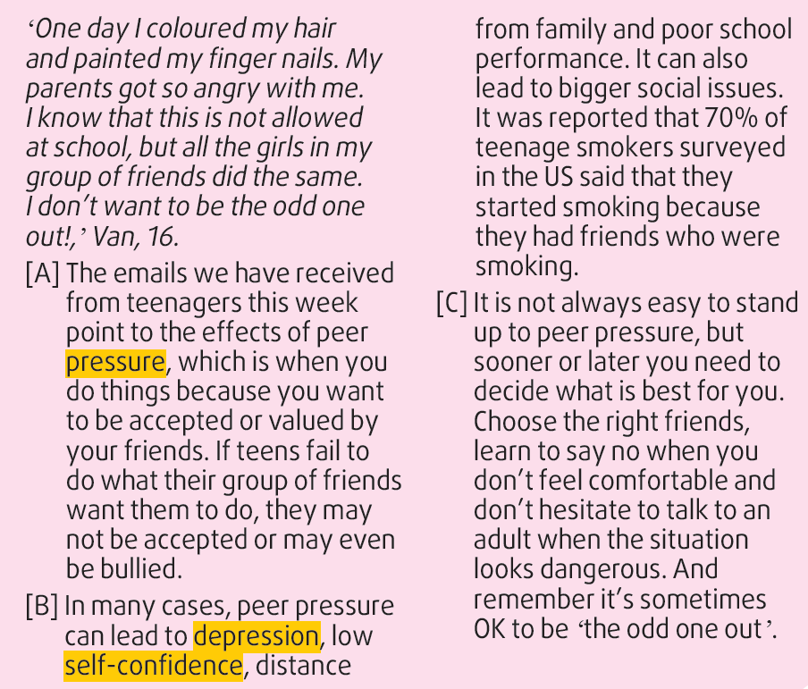
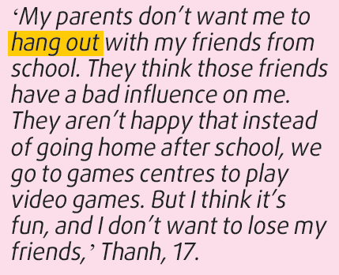
WHILE-READING
2

Slide 19
WHILE-READING
3
Read the article again. Which paragraph contains the following information? Write A, B, or C.
A
B
C
A

Slide 20
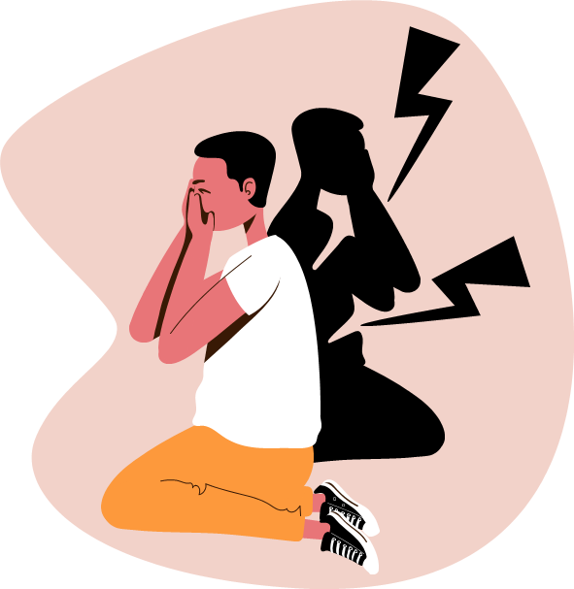
WHILE-READING
4
Read the article again and choose the correct answer A, B, or C.
1. What is the similarity between Thanh and Van?
A. They both changed their appearance.
B. They both want to be different from their friends.
C. Their parents do not approve of their behaviour.
2. Which is NOT mentioned in the article as a consequence of peer pressure?
A. Encouraging someone to fight.
B. Lack of a close relationship with family members.
C. Lack of confidence about what you can do.

Slide 21
WHILE-READING
4
Read the article again and choose the correct answer A, B, or C.
3. What was reported about the effects of peer pressure on teenagers in the US?
A. Fifty-five per cent of them started to smoke because of peer influence.
B. Seventy per cent of them were drinking alcohol with their friends.
C. More than two-thirds of teen smokers started the habit under the influence of their friends.
4. According to the article, what is one way of dealing with peer pressure?
A. Going to see the right doctor.
B. Not always saying yes to your friends.
C. Choosing friends who say no when they feel uncomfortable.

Slide 22
LUCKY WHEEL
Game rules
☞ 2 teams.
Take turns to choose the number and answer the questions.
Turn the wheel to get points.
Higher score → WINNER

Slide 23
+5
+10
1
2
3
+20
+15
4
5
6
5
-10
X2
10
SPIN

Slide 24
According to the article, what is one way of dealing with peer pressure?
A. Going to see the right doctor.
B. Not always saying yes to your friends.
C. Choosing friends who say no when they feel uncomfortable.
BACK

Slide 25
What is the similarity between Thanh and Van?
A. They both changed their appearance.
C. Their parents do not approve of their behaviour.
B. They both want to be different from their friends.
BACK

Slide 26
Which is NOT mentioned in the article as a consequence of peer pressure?
A. Encouraging someone to fight.
B. Lack of a close relationship with family members.
C. Lack of confidence about what you can do.
BACK
Notes:
german

Slide 27
What was reported about the effects of peer pressure on teenagers in the US?
A. Fifty-five per cent of them started to smoke because of peer influence.
C. More than two-thirds of teen smokers started the habit under the influence of their friends.
B. Seventy per cent of them were drinking alcohol with their friends.
BACK

Slide 28
+5
+10
+20
+15
CONGRATULATION!
+5
-10
X2
+10
BACK
SPIN

Slide 29
+5
+10
+20
+15
CONGRATULATION!
+5
-10
X2
10
BACK
SPIN

Slide 30
WHILE-READING
4
Read the article again and choose the correct answer A, B, or C.
1. What is the similarity between Thanh and Van?
A. They both changed their appearance.
B. They both want to be different from their friends.
C. Their parents do not approve of their behaviour.
2. Which is NOT mentioned in the article as a consequence of peer pressure?
A. Encouraging someone to fight.
B. Lack of a close relationship with family members.
C. Lack of confidence about what you can do.

Slide 31
WHILE-READING
4
Read the article again and choose the correct answer A, B, or C.
3. What was reported about the effects of peer pressure on teenagers in the US?
A. Fifty-five per cent of them started to smoke because of peer influence.
B. Seventy per cent of them were drinking alcohol with their friends.
C. More than two-thirds of teen smokers started the habit under the influence of their friends.
4. According to the article, what is one way of dealing with peer pressure?
A. Going to see the right doctor.
B. Not always saying yes to your friends.
C. Choosing friends who say no when they feel uncomfortable.

Slide 32
Production: Game
Notes:
Cho HS ghi ra giấy rôki, chạy lên dán bảng

Slide 33
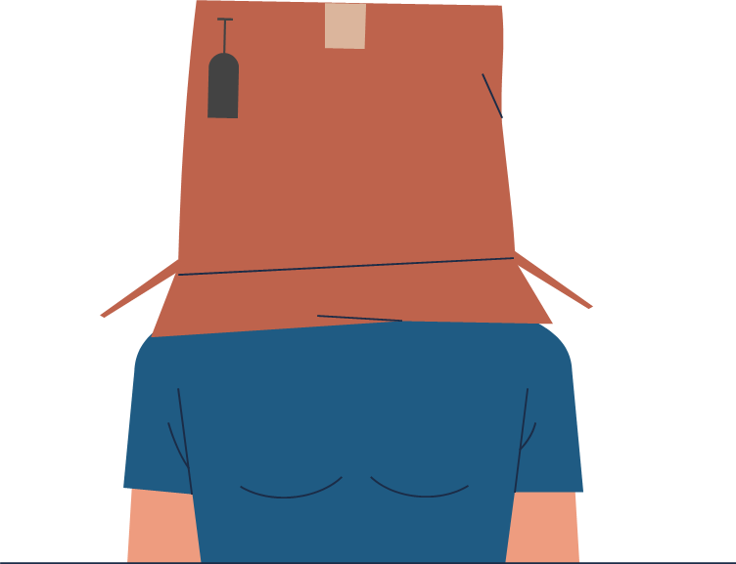
CONSOLIDATION
1
Wrap-up
What have you learnt today?
Read for main ideas and specific information in an article about peer pressure.
Talk about experiences of peer pressure and respond to peer pressure situations.

Slide 34
CONSOLIDATION
2
Homework
Do exercises in the workbook.
Prepare for Lesson 4 - Unit 9.

Slide 35
SEE YOU NEXT TIME !!

Slide 36
Website: hoclieu.vn
Fanpage: facebook.com/www.tienganhglobalsuccess.vn/

