Slide 2
Work in 2 groups.
Use body language and explanation to explain the words in 1 minute.
If you get the correct answer ➔ 1 point.
- If the answer is wrong or you don’t have the answer ➔ the chance is for the other group.
The group with more correct answers will be the winner.

Slide 3
SET 1
SET 2
CYCLE
MAKE PLANS
COOK
MANAGE TIME
WALK
MAKE DECISIONS
CLEAN
MANAGE MONEY

Slide 4
Activity 1: Tick the appropriate box to see how independent you are. Add up your points. If your total score is nine or above, you are independent. Compare with a partner.

Slide 5
Unit
8
BECOMING INDEPENDENT
Unit
FAMILY LIFE
LESSON 3
READING
How to become independent

Slide 6
Activity 2: Read the text and match the highlighted phrases in the text with their meanings.
get around
come up with
carry out
get into the habit of
made use of
a. to go or travel to different places
b. to start doing something regularly so that it becomes a habit
c. to use something to achieve a particular result or benefit
d. to perform and complete something
e. to produce or find an answer or a solution
1
2
3
4
5

Slide 7
a. to go or travel to different places
A. First, make sure you can safely get around by yourself using public transport, walking, or cycling. Second, learn to communicate well and develop good relationships with people. Do some part-time jobs and get to know how to manage your money. You should also learn to cook healthy meals for your family. Finally, help your parents with household chores like cleaning and doing laundry.

Slide 8
e. to produce or find an answer or a solution
B. To begin with, identify the problem and come up with as many solutions as possible. Write down the options, so you can review the advantages and disadvantages of each one. This will help you see which option could be the best for you. Don’t base your decision on emotion only. Once you have made your choice, create a plan of specific steps to move forward. Then carry out your plan, and think about whether you have achieved the result you wanted.
d. to perform and complete something

Slide 9
b. to start doing something regularly so that it becomes a habit
C. First of all, get into the habit of making a to-do-list every day or week. Make use of time-management tools, such as apps or diaries, to know what you need to do next. In addition, decide how much time you need for each task and always do one thing at a time to make sure you complete it. Schedule time to relax as well, and make sure you sleep at least nine hours each night. A good night's sleep is necessary for teenage brain development and good health. Becoming independent is not easy, but it is not as challenging as you may think. It’s about learning useful skills, making decisions by yourself, and knowing how to spend your time.

Slide 10
c. to use something to achieve a particular result or benefit
C. First of all, get into the habit of making a to-do-list every day or week. Make use of time-management tools, such as apps or diaries, to know what you need to do next. In addition, decide how much time you need for each task and always do one thing at a time to make sure you complete it. Schedule time to relax as well, and make sure you sleep at least nine hours each night. A good night's sleep is necessary for teenage brain development and good health. Becoming independent is not easy, but it is not as challenging as you may think. It’s about learning useful skills, making decisions by yourself, and knowing how to spend your time.

Slide 11
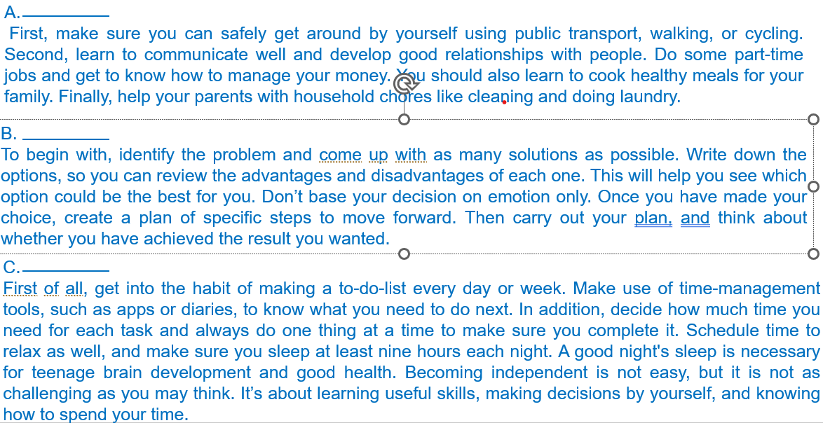
Activity 3: Read the text. Match the paragraphs (A-C) with their headings (1-5).
1. Manage your money
2. Relax and sleep well
3. Develop time-management skills
4. Improve your decision-making skills
5. Learn basic, but important life skills

Slide 12
Activity 3: Read the text. Match the paragraphs (A-C) with their headings (1-5).
1. Manage your money
2. Relax and sleep well
3. Develop time-management skills
4. Improve your decision-making skills
5. Learn basic, but important life skills
A.
First, make sure you can safely get around by yourself using public transport, walking, or cycling. Second, learn to communicate well and develop good relationships with people. Do some part-time jobs and get to know how to manage your money. You should also learn to cook healthy meals for your family. Finally, help your parents with household chores like cleaning and doing laundry.

Slide 13
Activity 3: Read the text. Match the paragraphs (A-C) with their headings (1-5).
1. Manage your money
2. Relax and sleep well
3. Develop time-management skills
4. Improve your decision-making skills
B.
To begin with, identify the problem and come up with as many solutions as possible. Write down the options, so you can review the advantages and disadvantages of each one. This will help you see which option could be the best for you. Don’t base your decision on emotion only. Once you have made your choice, create a plan of specific steps to move forward. Then carry out your plan, and think about whether you have achieved the result you wanted.

Slide 14
Activity 3: Read the text. Match the paragraphs (A-C) with their headings (1-5).
1. Manage your money
2. Relax and sleep well
3. Develop time-management skills
C.
First of all, get into the habit of making a to-do-list every day or week. Make use of time-management tools, such as apps or diaries, to know what you need to do next. In addition, decide how much time you need for each task and always do one thing at a time to make sure you complete it. Schedule time to relax as well, and make sure you sleep at least nine hours each night. A good night's sleep is necessary for teenage brain development and good health. Becoming independent is not easy, but it is not as challenging as you may think. It’s about learning useful skills, making decisions by yourself, and knowing how to spend your time.

Slide 15
Activity 3: Read the text. Match the paragraphs (A-C) with their headings (1-5).
5. Learn basic, but important life skills
A.
First, make sure you can safely get around by yourself using public transport, walking, or cycling. Second, learn to communicate well and develop good relationships with people. Do some part-time jobs and get to know how to manage your money. You should also learn to cook healthy meals for your family. Finally, help your parents with household chores like cleaning and doing laundry.
4. Improve your decision-making skills
B.
To begin with, identify the problem and come up with as many solutions as possible. Write down the options, so you can review the advantages and disadvantages of each one. This will help you see which option could be the best for you. Don’t base your decision on emotion only. Once you have made your choice, create a plan of specific steps to move forward. Then carry out your plan, and think about whether you have achieved the result you wanted.
3. Develop time-management skills
C.
First of all, get into the habit of making a to-do-list every day or week. Make use of time-management tools, such as apps or diaries, to know what you need to do next. In addition, decide how much time you need for each task and always do one thing at a time to make sure you complete it. Schedule time to relax as well, and make sure you sleep at least nine hours each night. A good night's sleep is necessary for teenage brain development and good health. Becoming independent is not easy, but it is not as challenging as you may think. It’s about learning useful skills, making decisions by yourself, and knowing how to spend your time.

Slide 16
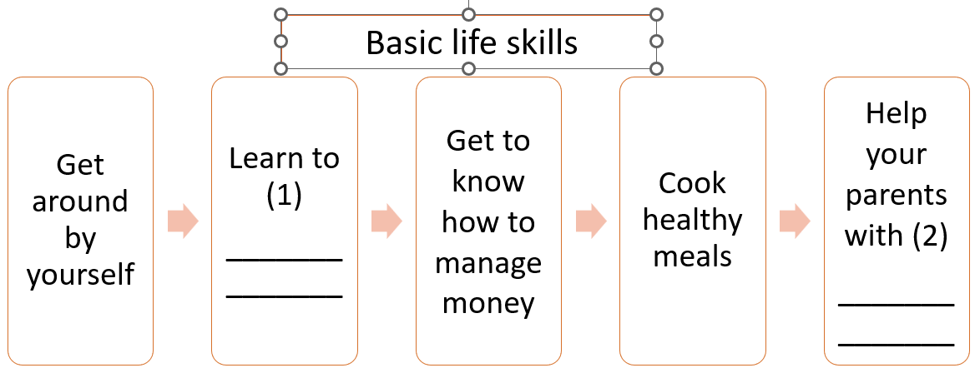
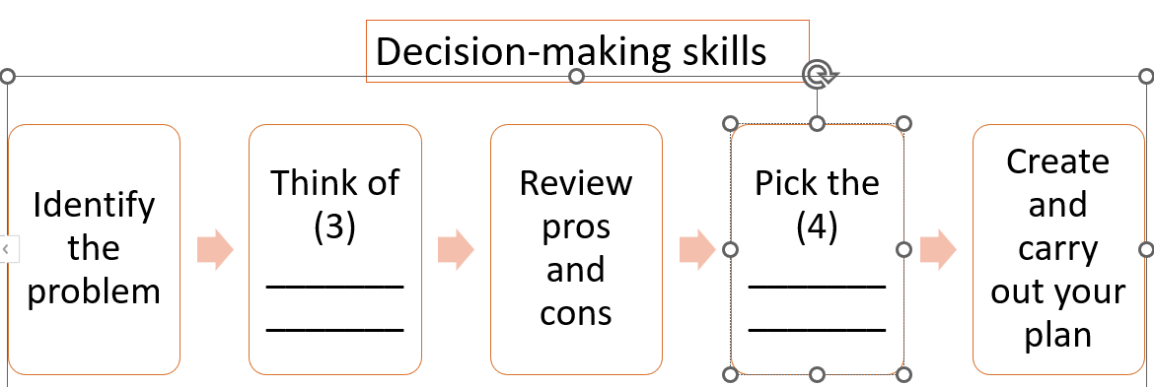
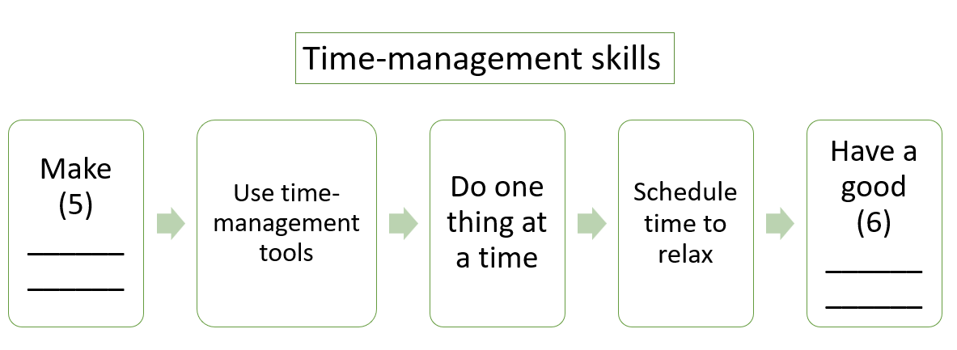
Activity 4: Complete the diagrams with information from the text.

Slide 17
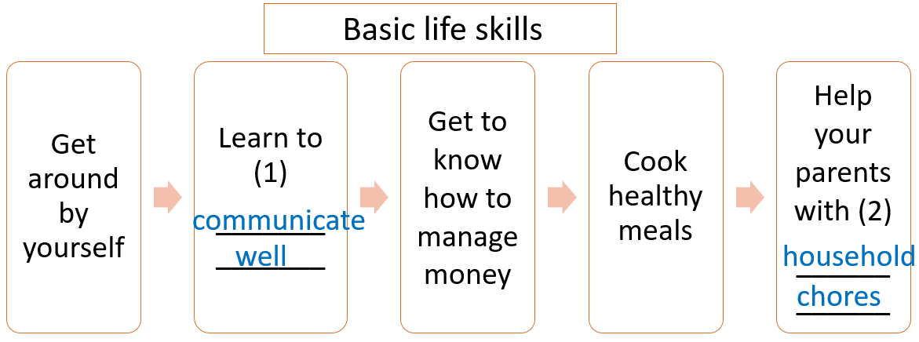
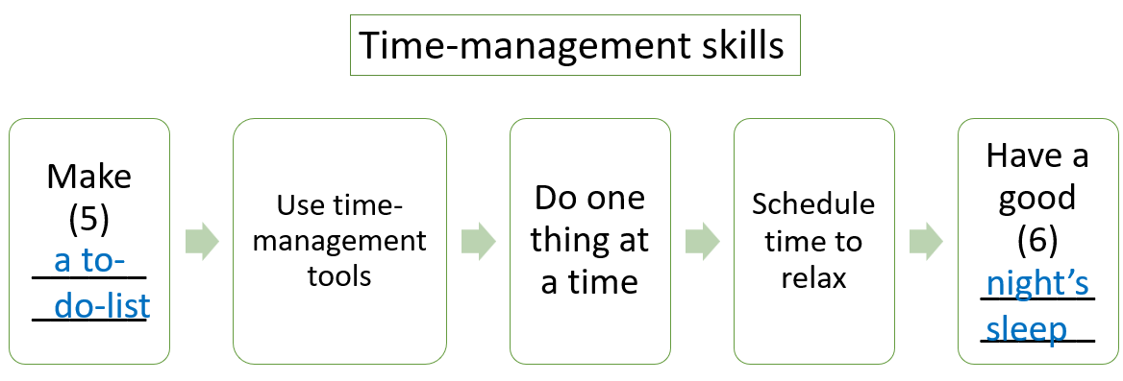
Activity 4: Complete the diagrams with information from the text.

Slide 18
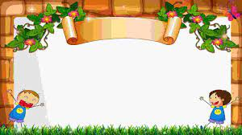
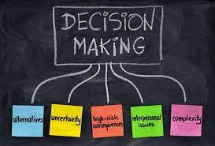
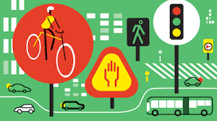
Activity 5:
Discuss the following questions
+ Which of the skills mentioned in the text do you have?
+ What other skills do you think teenagers need to
become independent?

