Slide 2
Unit
6
Preserving our heritage
Unit
FAMILY LIFE
LESSON 5
LISTENING
A trip to Trang An Scenic Landscape Complex

Slide 3
LESSON 5
LISTENING
WARM-UP
Jigsaw puzzle
PRE-LISTENING
Vocabulary
Task 1: Ask and answer the questions.
Task 2. Listen to a talk. What is the talk mainly about?
Task 3. Listen and complete the notes.
WHILE-LISTENING
POST-LISTENING
Make predictions about what the tour guide will say next.
Wrap-up
Homework
CONSOLIDATION

Slide 4
WARM-UP
JIGSAW PUZZLE
- Ss work in groups.
- There are 4 questions related to a key picture.
- Guess the word in each puzzle
- Guess the key picture behind after each puzzle is opened.
- The group which gets the correct answer of the key picture is the winner.

Slide 5
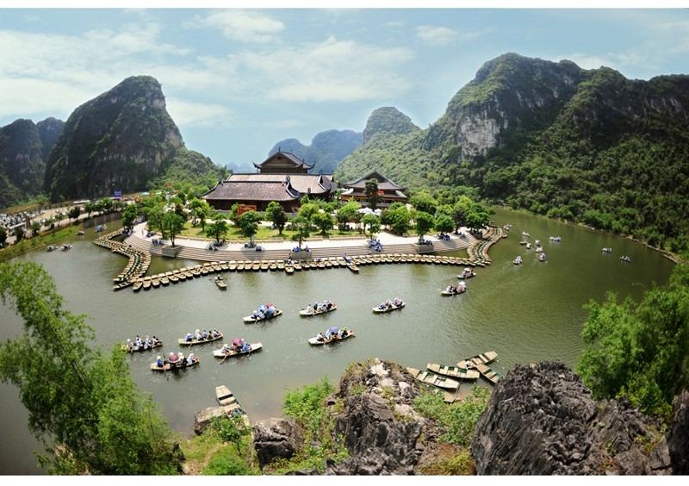
WARM-UP
Answer the question in each puzzle.
1
2
3
4

Slide 6
WARM-UP
Question 1
Who was the founding emperor of the Dinh dynasty
of Viet Nam?
➔ DINH BO LINH / DINH TIEN HOANG
BACK

Slide 7
WARM-UP
Question 2
What is a complex of Buddhist temples in Gia Vien District, Ninh Binh Province, Viet Nam?
➔ BAI DINH PAGODA
BACK

Slide 8
WARM-UP
Question 3
Which movie took place in the northern part of Viet Nam
such as Van Long and Tam Coc (Ninh Binh Province),
Ha Long Bay (Quang Ninh Province)?
➔ THE MOVIE: KONG – THE SKULL ISLAND
BACK

Slide 9
WARM-UP
Question 4
What are they?
Large holes in the side of a hill, cliff, or mountain, or one that is underground.
➔ CAVES
BACK

Slide 10
WARM-UP
Answer the question in each puzzle.

Slide 11
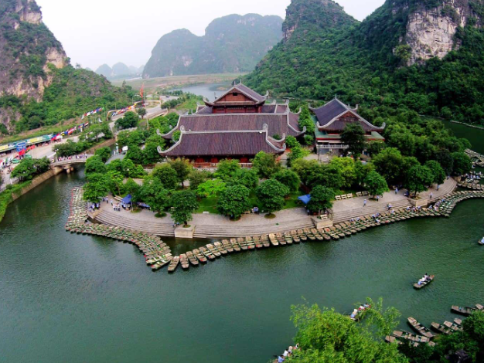
PRE-LISTENING
Discussion
+ Where is Trang An?
+ Is Trang An a World Heritage Site?
+ How big is the area?
+ Have you ever been to Trang An?
+ If yes, what did you see and do there?

Slide 12
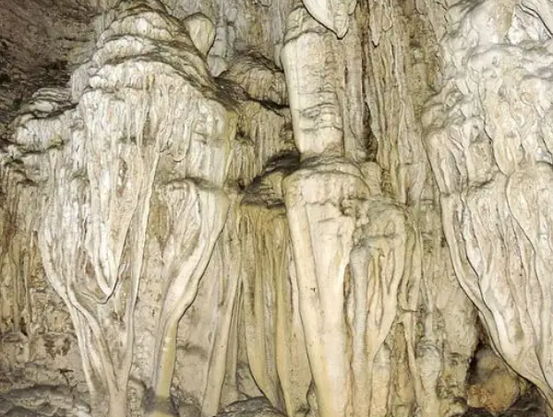
PRE-LISTENING
limestone (n)
/ˈlaɪmstəʊn/
a type of white rock that contains calcium, used in building and in making cement

Slide 13
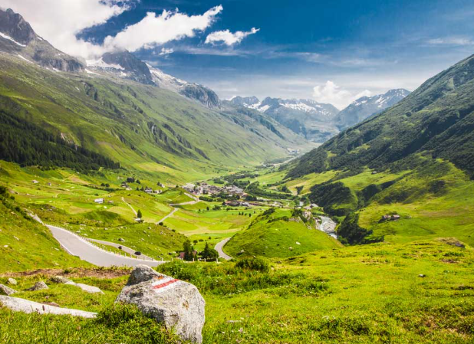
PRE-LISTENING
valley (n)
/ˈvæli/
an area of low land between hills or mountains, often with a river flowing through it

Slide 14
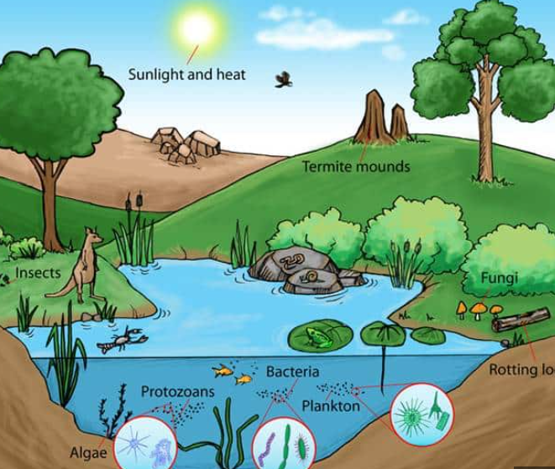
PRE-LISTENING
ecosystem (n)
/ˈiːkəʊsɪstəm/
all the plants and living creatures in a particular area considered in relation to their physical environment

Slide 15
PRE-LISTENING
interact (v)
/ˌɪntərˈækt/
if one thing interacts with another, or if two things interact, the two things have an effect on each other

Slide 16
PRE-LISTENING
original (adj)
/əˈrɪdʒənl/
existing at the beginning of a particular period, process or activity

Slide 17
Form | Pronunciation | Meaning
1. limestone (n) | /ˈlaɪmstəʊn/ | a type of white rock that contains calcium, used in building and in making cement
2. valley (n) | /ˈvæli/ | an area of low land between hills or mountains, often with a river flowing through it
3. ecosystem (n) | /ˈiːkəʊsɪstəm/ | all the plants and living creatures in a particular area considered in relation to their physical environment
4. interact (v) | /ˌɪntərˈækt/ | if one thing interacts with another, or if two things interact, the two things have an effect on each other
5. original (adj) | /əˈrɪdʒənl/ | ​ existing at the beginning of a particular period, process or activity

Slide 18
WHILE-LISTENING
2
Listen to a talk. What is the talk mainly about?
A. The tour guide is explaining why Trang An is a mixed World Heritage Site. B. The tour guide is talking about the ecosystem of Trang An and efforts to preserve it. C. The tour guide is introducing the site's natural beauty.

Slide 19
WHILE-LISTENING
3
Listen to the talk again and complete each gap in the notes with no more than three words and/or numbers.
KEY:
1. 2014
2. three protected areas
3. 600 types
4. early humans
5. natural state

Slide 20
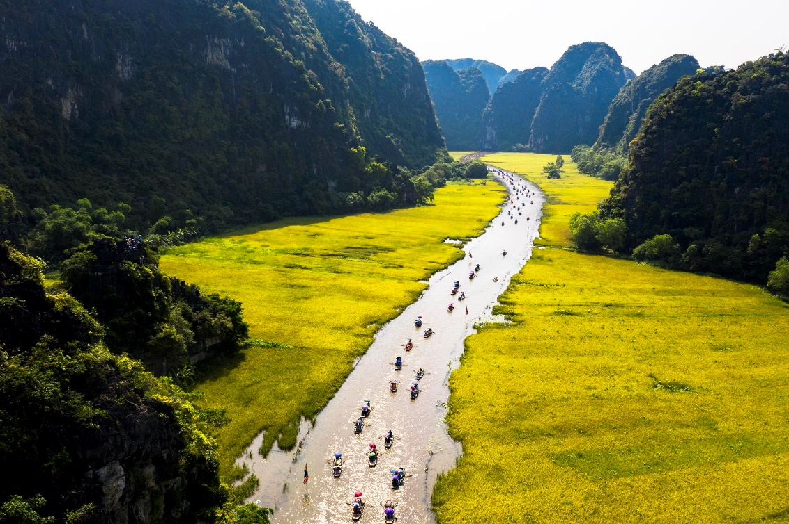
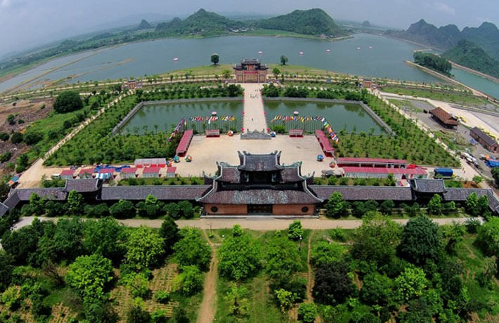
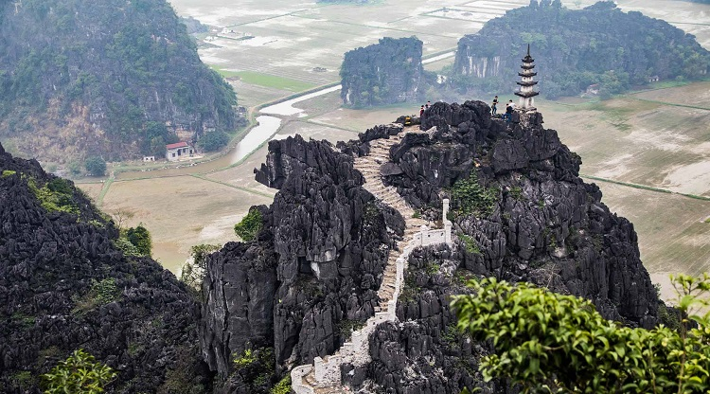
POST-LISTENING
4
Work in pairs. Make some predictions about what the tour guide will say next.

Slide 21
CONSOLIDATION
1
Wrap-up
What have you learnt today?
Trang An Scenic Landscape Complex
Listening for main ideas and specific information about preserving our heritage

Slide 22
CONSOLIDATION
2
Homework
Do exercises in the workbook.
Prepare for Lesson 6 - Unit 6.

Slide 23
Website: hoclieu.vn Fanpage: facebook.com/tienganhglobalsuccess.vn/
Website: hoclieu.vn
Fanpage: facebook.com/sachmem.vn/

