Slide 1

Labelling game

Slide 2

Students work in groups of 4
There are some news headlines and some categories: Sport, Laws, Education, etc.…
Raise your hands to get turns and choose the correct category for the headlines.

Slide 3

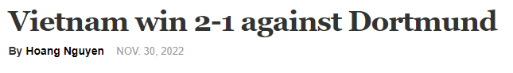
Choose the correct category for the headline.
1
Economy
Food
Politics
Sport

Slide 4
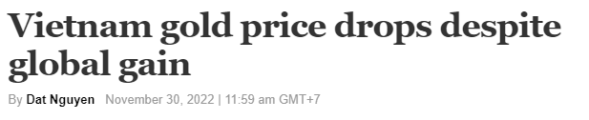
Choose the correct category for the headline.
2
Economy
Food
Politics
Sport

Slide 5
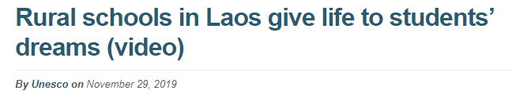
Put the news headlines in the correct category
3
Economy
Education
Politics
Sport

Slide 6

1
Work in pairs. Answer the following questions.
1. Where does the woman in the picture read the news?
A. On the internet B. In the newspaper
2. What is her favorite news section?
A. Business B. Politics

Slide 7

strengthen (v)
/ˈstreŋkθn/
to make a feeling, an opinion or a relationship stronger (làm cho mạnh, củng cố, tăng cường)

Slide 8

discussion (n)
/dɪˈskʌʃn/
the process of discussing somebody/something (cuộc thảo luận)

Slide 9

representative (n)
/ˌreprɪˈzentətɪv/
a person who has been chosen to speak or vote for somebody else or for a group of people, or to take the place of somebody else (người đại diện)

Slide 10
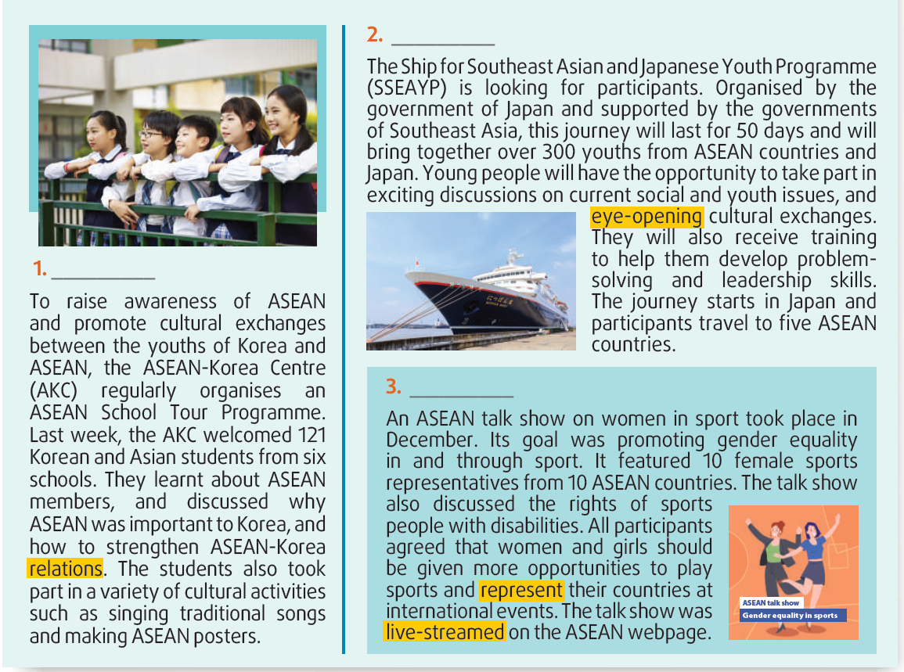

2
Work in groups of four. Read the news items and choose the most suitable headline for each one.
A
D
C
Answer key:
1. D 2. A 3. C

Slide 11
3
Mark the letter A or B to indicate the word(s) CLOSEST in meaning to the underlined word(s) in each of the following questions.
1. Young people will have the opportunity to take part in exciting discussions on current social and youth issues and eye-opening cultural exchanges.
surprising B. traditional

Slide 12
2. All participants agreed that women and girls should be given more opportunities to play sports and represent their countries at international event.
prepare for B. act for
3. The talk show was live-streamed on the ASEAN webpage
shown over the Internet
B. happening or coming after something else

Slide 13
4
3
LUCKY NUMBER GAME
1
2
3
4
5
6

Slide 14

Question 1
What will participants in SSEAYP discuss besides youth issues?
A. problem-solving skill B. leadership skill C. current social issues

Slide 15

LUCKY NUMBER

Slide 16
Question 2
How many students visited the AKC last week?
A. 121 B. 300 C. 50

Slide 17
Question 3
When did the ASEAN talk show on women in sport happen?
A. Last week B. In December C. This year

Slide 18
Question 4
How long will SSEAYP participants stay together on board the ship?
A. 10 days B. 6 days C. 50 days

Slide 19
Question 5
Where was the talk show shown live?
A. On the ASEAN webpage B. In Japan C. In Korea

Slide 20
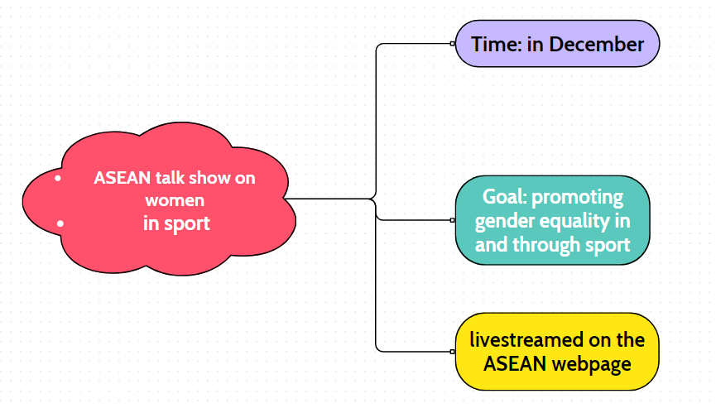

5
Talk about ASEAN talk show using the following information.
Eg: The first meeting of my school’s Go Green Club took place on 15th May in our head office. Its goals was to encourage people to adopt a greener lifestyle.

Slide 21
What have you learnt today?
Read for main ideas and specific information in news items about ASEAN countries.
New vocabulary words

Slide 22

Website: hoclieu.vn
Fanpage: facebook.com/www.tienganhglobalsuccess.vn

