Slide 2
Unit
1
A long and healthy life
Unit
FAMILY LIFE
LESSON 3
READING
How to live a long and healthy life

Slide 3
LESSON 3
READING
WARM-UP
Crossword
PRE-READING
Vocabulary
- Task 2. Read the article. Solve the crossword with words and phrases from it.
- Task 3. Match the section with the heading.
- Task 4. Complete the diagrams with information from the text.
WHILE-READING
POST-READING
Discussion
Wrap-up
Homework
CONSOLIDATION

Slide 4
WARM-UP
CROSSWORD
Work in groups.
Take turns to choose a word.
If you get the correct answer ➔ 1 point.
- If the answer is wrong or you don’t have the answer ➔ the chance is for other groups.
After 6 words you can answer the key word ➔ 5 points
If the key word is incorrect ➔ you are out of the game.

Slide 5
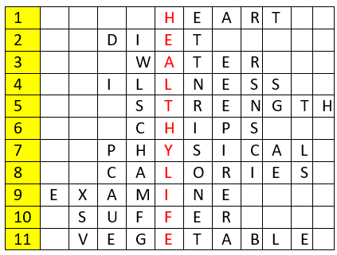
WARM-UP
KEY WORD: (11 letters)
A way of living that helps you enjoy more aspects of your life.

Slide 6
WARM-UP
Question 1
Eating too much fat can cause __________ diseases.

Slide 7
WARM-UP
Question 2
Go on a ______ means to begin a specific nutritional plan in an attempt to lose weight or achieve some other health benefits.

Slide 8
WARM-UP
Question 3
A clear liquid that has no color or taste when it is pure.

Slide 9
WARM-UP
Question 4
A disease or period of sickness affecting the body or mind.

Slide 10
WARM-UP
Question 5
The noun of ‘strong’

Slide 11
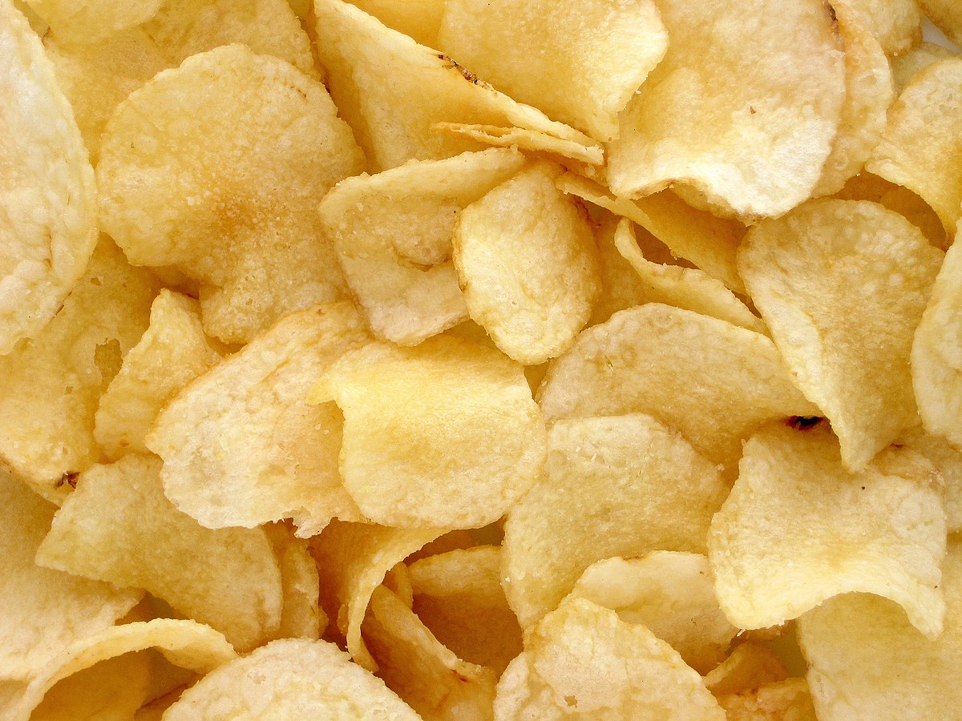
WARM-UP
Question 6
What is it?

Slide 12
WARM-UP
Question 7
The subject P.E stands for __________ Education.

Slide 13
WARM-UP
Question 8
Doing exercises can burn out many __________.

Slide 14
WARM-UP
Question 9
To look at or consider a person or thing carefully to discover something about them.

Slide 15
WARM-UP
Question 10
Do you _________ from any allergies?

Slide 16
WARM-UP
Question 11
Eating enough _____________ and fruits is good for your digestive system.

Slide 17
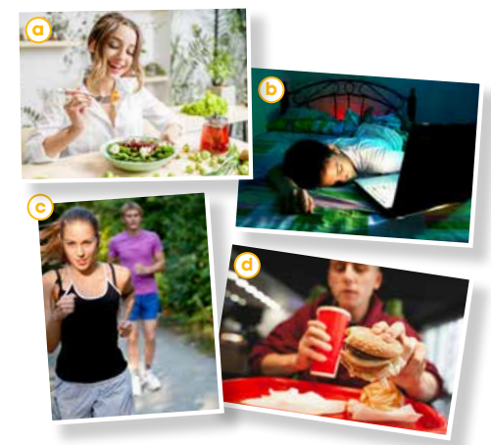
PRE-READING
1
Work in pairs. Look at the photos and discuss the questions.
Which photos show healthy habits?
Which ones show unhealthy habits?

Slide 18
PRE-READING
life expectancy (n)
/ˈlaɪf ɪkspektənsi/
the number of years that a person is likely to live

Slide 19
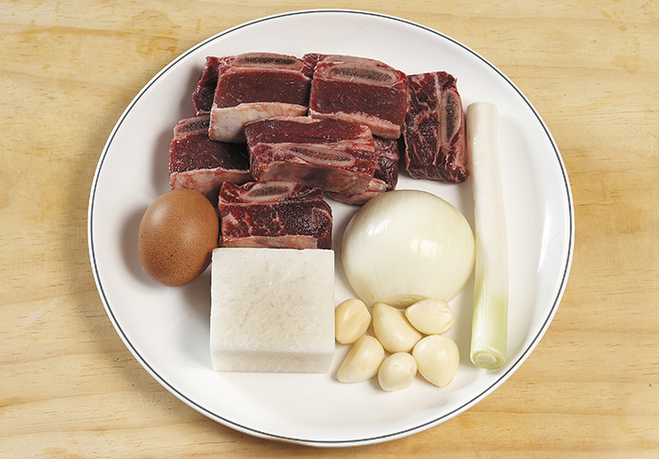
PRE-READING
ingredient (n)
/ɪnˈɡriːdiənt/
one of the things from which something is made, especially one of the foods that are used together to make a particular dish

Slide 20
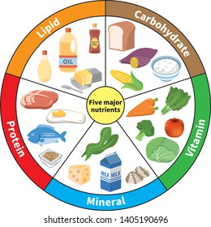
PRE-READING
nutrient (n)
/ˈnjuːtriənt/
a substance that is needed to keep a living thing alive and to help it to grow

Slide 21
PRE-READING
(to) give off
/ɡɪv ɒf/
to produce something such as a smell, heat, light, etc.

Slide 22
PRE-READING
repetitive (adj)
/rɪˈpetətɪv/
repeated many time

Slide 23
PRE-READING
Form | Pronunciation | Meaning | Vietnamese equivalent
1. life expectancy (n) | /ˈlaɪf ɪkspektənsi/ | the number of years that a person is likely to live | tuổi thọ
2. ingredient (n) | /ɪnˈɡriːdiənt/ | one of the things from which something is made, especially one of the foods that are used together to make a particular dish | nguyên liệu
3. nutrient (n) | /ˈnjuːtriənt/ | a substance that is needed to keep a living thing alive and to help it to grow | chất dinh dưỡng
4. (to) give off | /ɡɪv ɒf/ | to produce something such as a smell, heat, light, etc. | phát ra, tỏa ra
5. repetitive (adj) | /rɪˈpetətɪv/ | repeated many time | lặp đi lặp lại

Slide 24
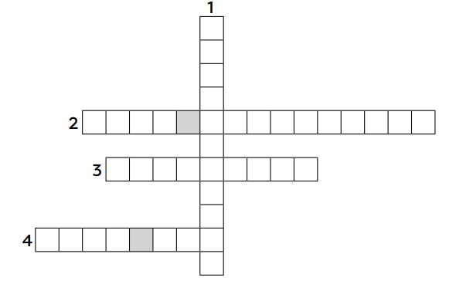
WHILE-READING
2
Read the article. Solve the crossword with words and phrases from it.
I
N
G
R
L
I
F
E
E
X
P
E
C
T
A
N
C
Y
D
N
U
T
R
I
E
N
T
S
E
N
W
O
R
K
O
U
T
S

Slide 25
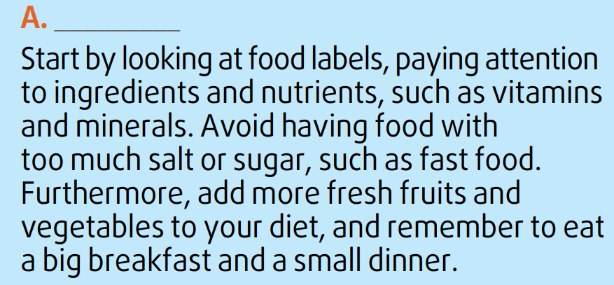
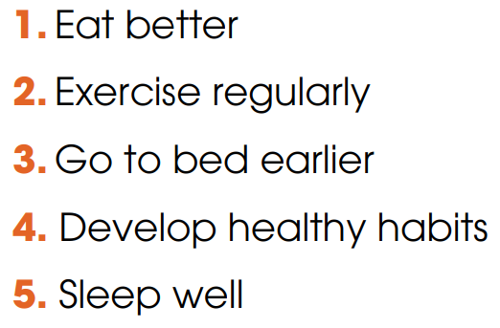
WHILE-READING
3
Read the article again. Match the section (A-C) with the heading (1-5) below. There are TWO extra headings.
1. Eat better

Slide 26
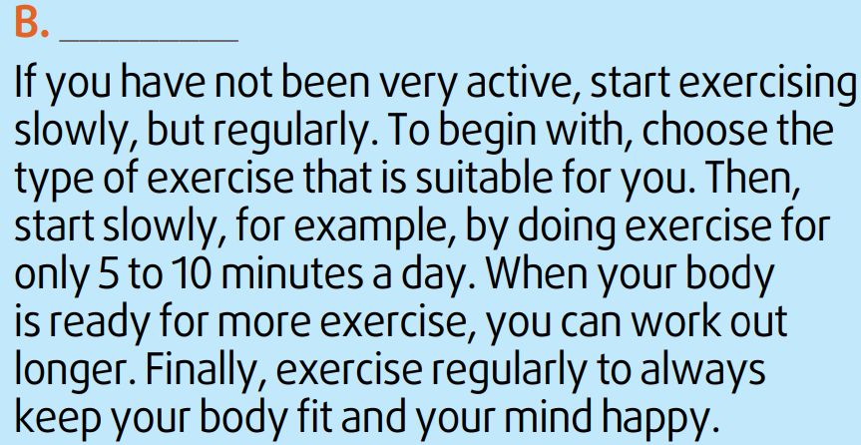
WHILE-READING
3
Read the article again. Match the section (A-C) with the heading (1-5) below. There are TWO extra headings.
2. Exercise regularly

Slide 27
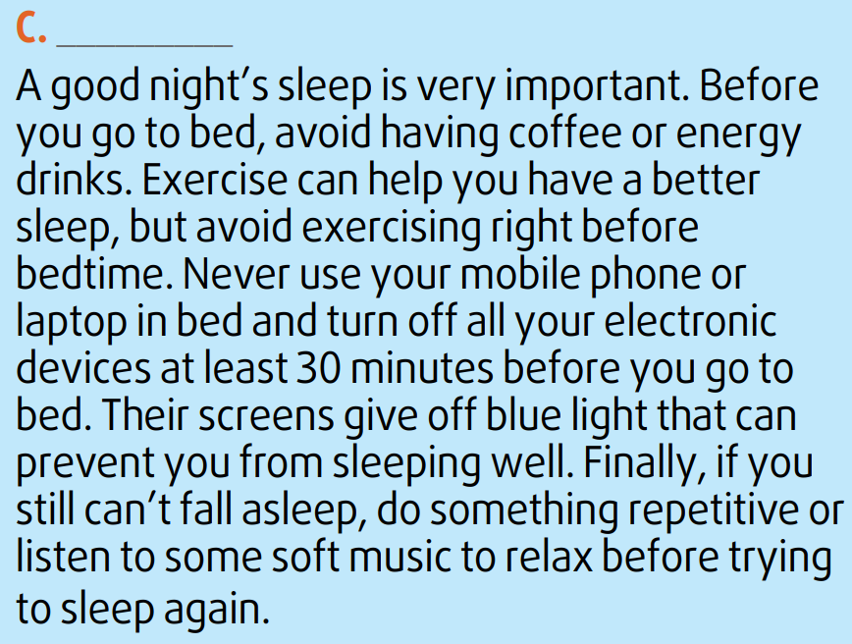
WHILE-READING
3
Read the article again. Match the section (A-C) with the heading (1-5) below. There are TWO extra headings.
5. Sleep well

Slide 28
WHILE-READING
4
Read the article again. Complete the diagrams with information from the text. Use no more than two words for each gap.
Study food labels
Avoid too much salt or sugar
Add fresh fruits and vegetables
Eat a big (1) __________
A
breakfast
Choose
(2) ________ exercise
Start slowly
Work out longer
Exercise
(3) __________
B
suitable
regularly
Before bed:
Avoid having coffee or (4) _____________________
Turn off (5) _________________
Unable to sleep: do something repetitive or listen to music
C
energy drinks / exercising
electronic devices

Slide 29
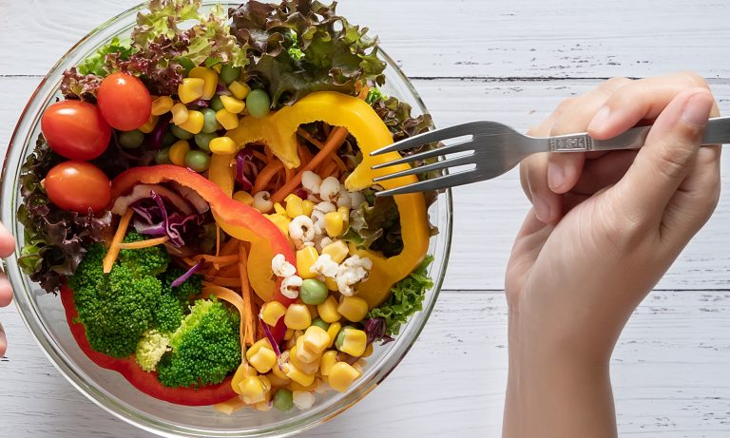
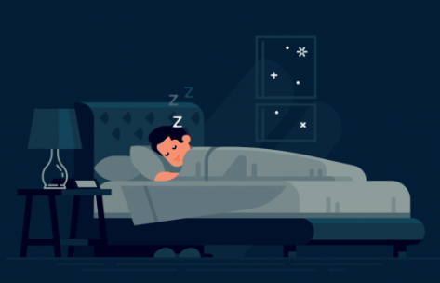
POST-READING
5
Discussion
Do you find the advice in the article useful?
Have you tried following any of the suggestions above?

Slide 30
CONSOLIDATION
1
Wrap-up
What have you learnt today?
Some lexical items about healthy lifestyle
Reading for main ideas and specific information

Slide 31
CONSOLIDATION
2
Homework
Do exercises in the workbook.
Prepare for Lesson 4 - Unit 1.

Slide 32
Website: hoclieu.vn
Fanpage: facebook.com/www.tienganhglobalsuccess.vn

