Slide 1
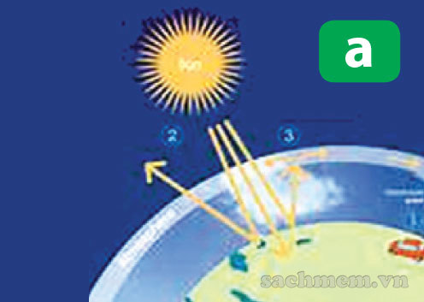
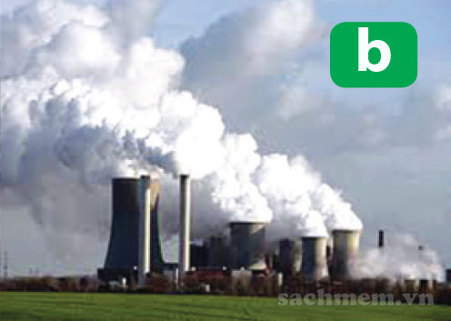
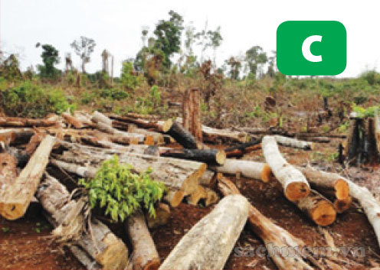
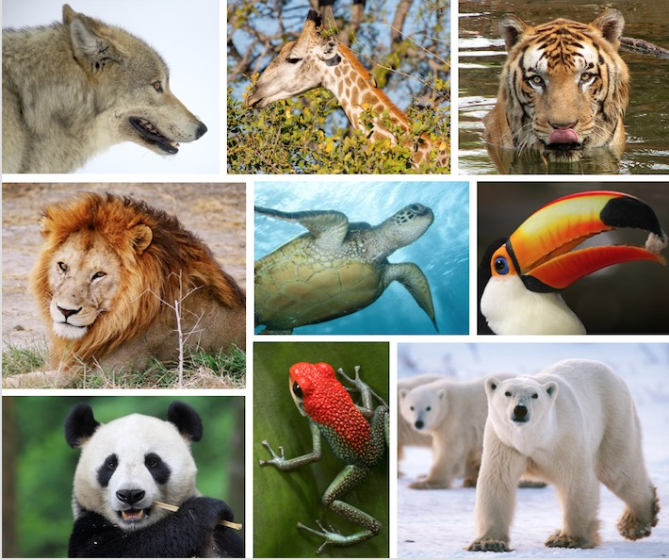
Match the photos with the appropriate words a nd . phrases
1. Air -pollution
2. Endangered animals
3. Deforestation
4. Greenhouse effect

Slide 2
Unit
9
1
Unit
FAMILY LIFE
Protecting the environment
LESSON 4
SPEAKING
Solutions to environmental problems

Slide 3
recycle (v)
/ˌriːˈsaɪkl/
to treat things that have already been used so that they can be used again

Slide 4
illegal (n)
/ɪˈliːɡl/
not allowed by the law

Slide 5
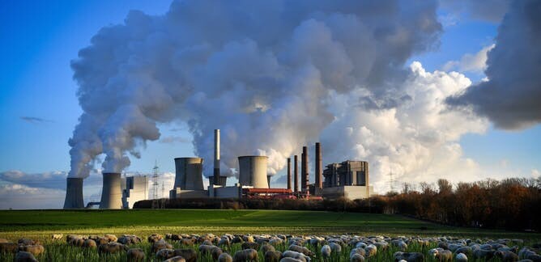
PRESENTATION
emission (n)
/ɪˈmɪʃn/
the act of sending out of light, heat, gas, etc.

Slide 6
PRESENTATION
New words | Pronunciation | Meaning
recycle
illegal
emission

Slide 7
PRESENTATION
New words | Pronunciation | Meaning
recycle | /ˌriːˈsaɪkl/ | to treat things that have already been used so that they can be used again
illegal | /ɪˈliːɡl/ | not allowed by the law
emission | /ɪˈmɪʃn/ | the act of sending out of light, heat, gas, etc.

Slide 8
PRACTICE
1
Work in pairs. Match the environmental problems to the suggested solutions
Solutions to environmental problems
1. DISAPPEARANCE OF ENDANGERED ANIMALS
a. Recycle paper, plastics and wood products
b. Use electric vehicles or public transport, and plant more trees
2. DEFORESTATION
c. Stop illegal hunting and fishing
d. Stop burning leaves, rubbish and other materials
e. Avoid products that are made from animal parts
3. AIR POLLUTION
f. Introduce strict laws to prevent the cutting of natural forests

Slide 9
PRACTICE
2
Work in pairs. Complete the presentation outline below with the information in the box.
SOLUTIONS TO AIR POLLUTION Presentation Outline Welcoming the audience and introducing the topic _____________________________________________ 2. The first solution ___________________________________________ 3. The second solution ___________________________________________ 4. Finishing the presentation and thanking the audience ____________________________________________ | The first solution is to stop burning leaves, rubbish and other materials. This will reduce the smoke produced in the air. That conclude our presentation today. Thank you for listening. Another solution is to use electric vehicles or public transport. This will reduce the gas emissions from private vehicles and will make the air cleaner. Hi everyone. I’m here today to talk to you about the solutions to one of the most serious problems in our city – air pollution.
D
A_
C_
B

Slide 10
PRACTICE
PRACTICE
3
Work in groups. Each group:
Choose an environmental problem in 1.
Design a creative mind map / diagram on your environmental problem.
Prepare a 3-5 minute presentation on the solutions to it. Use the suggested organization and expressions to help you.

Slide 11
PRACTICE
PRACTICE
3
Groupwork: Prepare a presentation
Suggested organization and expressions
I. INTRODUCTION: Welcoming the audience and introducing the topic Hi everyone. Good morning/ afternoon. I’m here today to talk to you about/ discuss … I’d like to talk about ... Today, I’d like to share with you ....
II.1 BODY – MAIN PART 1: Introduce the first point / idea Firstly, the problem can be solved by … The first solution is to ...
II.2. BODY – MAIN PART 2: Introduce the second point / idea My next point is … Another solution is to …
III. CONCLUSION: Finishing the presentation and thanking the audience That concludes our presentation. That’s the end of our presentation today. Thank you for listening. Thank you for your attention.

Slide 12
Fill in the blank
_____________ leads to health problems such as the increase of heart rate and hearing damage
A. Water pollution
B. Noise pollution
C. Soil pollution
D. Air pollution
HOME

Slide 13
Fill in the blank
_____________ leads to health problems such as the increase of heart rate and hearing damage
A. Water pollution
B. Noise pollution
C. Soil pollution
D. Air pollution
HOME

Slide 14
Fill in the blank
Loud sounds from motor vehicles and musical instruments results in ______________
A. Water pollution
B. Noise pollution
C. Air pollution
D. Soil pollution
HOME

Slide 15
Fill in the blank
Fossil fuel burning by motor vehicles and factories results in ______________
A. Water pollution
B. Noise pollution
C. Air pollution
D. Soil pollution
HOME

Slide 16
Fill in the blank
_____________ leads to contaminated vegetation and the decrease of soil fertility
A. Water pollution
B. Noise pollution
C. Land pollution
D. Air pollution
HOME

Slide 17
Fill in the blank
_____________ leads to lots of environmental problems such as greenhouse effect and global warming
A. Water pollution
B. Noise pollution
C. Soil pollution
D. Air pollution
HOME

Slide 18
Fill in the blank
Dumping plastic and waste in the ground results in ______________
A. Water pollution
B. Noise pollution
C. Air pollution
D. Soil pollution
HOME

Slide 19
Fill in the blank
Harmful rubbish and chemicals thrown in the rivers results in ______________
A. Water pollution
B. Noise pollution
C. Soil pollution
D. Air pollution
HOME

Slide 20
Which is the greenest form of transportation?
Car
Bicycle
Bus
Train
BACK

Slide 21
When is World Environment Day celebrated?
5 February
5 August
5 June
5 May
BACK

Slide 22
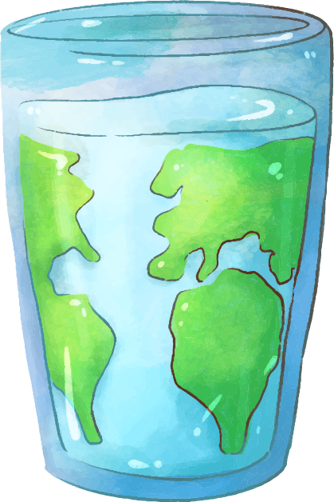
What should we do to protect environment
?
Notes:
Now, after we learnt human activities and consequences, we will discuss some solutions to reduce our negative impacts on the environment. I want you to think about this question. You have 2 min to list some practical ways and then I will call someone share your ideas in front of class.

Slide 23
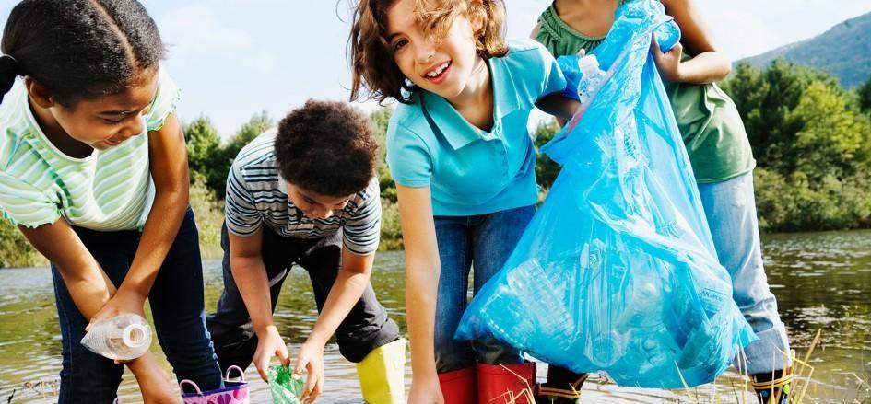
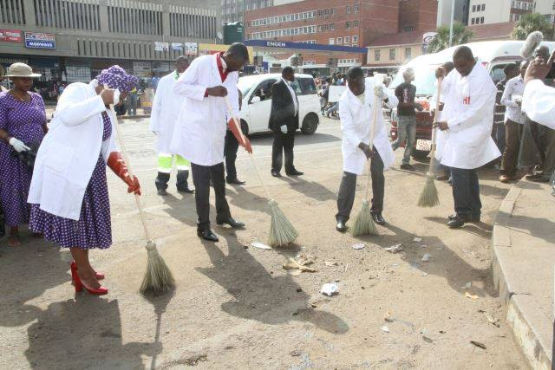
Protect environment
We should:....

Slide 24
Recycle the waste paper, glass, plastic…
Plant trees
Protect environment
Sweep the street
collect garbage
We should:....

Slide 25
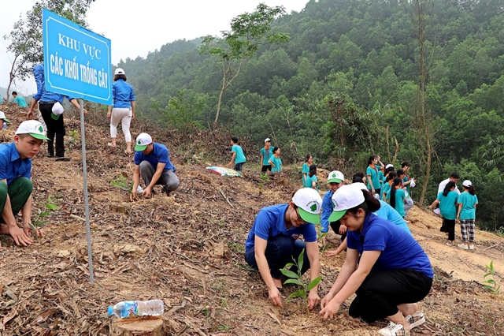
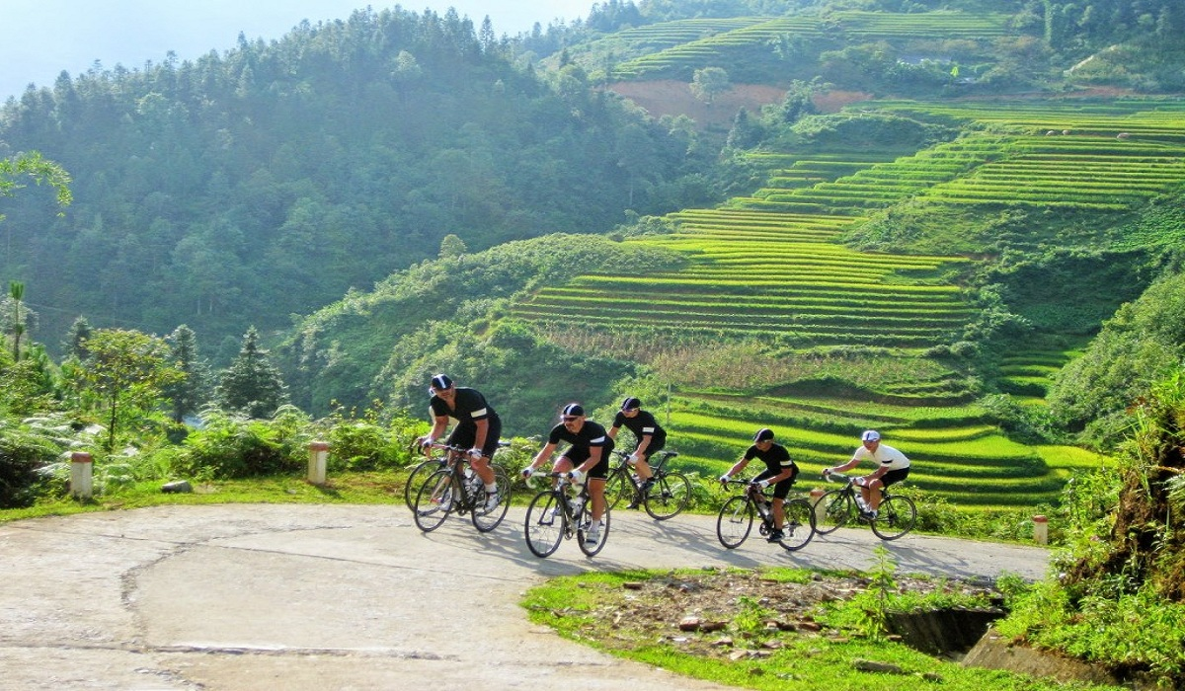
Some ways to reduce our negative impacts
Plant trees
Go biking

Slide 26
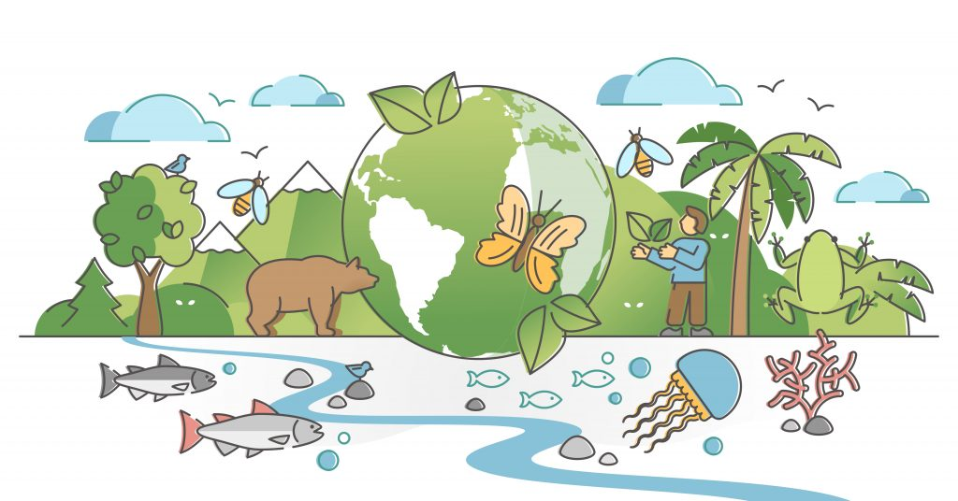
Some ways to reduce our negative impacts
Protect biodiversity

Slide 27
Some ways to reduce our negative impacts
Save water

