Slide 1
WARM-UP: GUESSING GAME
Game rules
☞ 3 sets of pictures (3 pictures/set)
☞ If you:
+ gets the correct answer after the 1st picture ➔ 3 candies
+ gets the correct answer after the 2nd picture ➔ 2 candies
+ gets the correct answer after the 3rd picture ➔ 1 candy

Slide 2
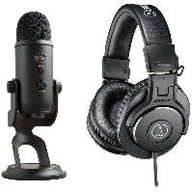
WARM-UP
Set 1
online learning
Notes:
(Ghi điểm đội)

Slide 3
WARM-UP
Set 2
self-study
Notes:
(Ghi điểm đội)

Slide 4
WARM-UP
Set 3
face-to-face learning
Notes:
(Tổng kết điểm đội)

Slide 5
Warm-up
Different ways to learn
online learning
self-study
face-to-face learning
Notes:
Asks Ss to make a sentence with the words and phrases

Slide 6
Lead-in
We should combine different learning ways which are self-study, face-to-face and online learning.
(v)
(adj)
(v)
(n)
(n)
which
(adj)
(n)
(n)
Content words
Notes:
Pronunciation: Sentence stress, Vocabulary: Different ways of learning, Grammaf: Relative Clauses -> Ghi bảng: Unit 8. New ways to learn – Lesson 2: Language- I. Pronunciation

Slide 7
English 10 Global Success
UNIT 8:
NEW WAYS TO LEARN
Lesson 2: LANGUAGE
Nguyen Du High School

Slide 8
UNIT 8: NEW WAYS TO LEARN – Lesson 2: Language
Vocabulary
Pronunciation
Warm-up/
Lead-in
Grammar
Production
Presentation
Practice

Slide 9
UNIT 8: NEW WAYS TO LEARN – Lesson 2: Language
I. Pronunciation
Sentence stress
Notes:
Ghi đề lên bảng: Unit 8……

Slide 10
I. PRONUNCIATION
Content words
Nouns
Verbs
Adjectives
Structure words
Determiners
Articles
Prepositions
Adverbs
Pronouns
Auxiliary verbs
Conjunctions
stressed
unstressed
Notes:
Ghi bài lên bảng: Stressed content word: chĩa ra N, V, Adj, Adv

Slide 11
I. PRONUNCIATION
2
Read and underline the stressed words in the sentences.
Our teacher often gives us videos to watch at home.
2. They should make an outline for their presentation.
3. Blended learning is a new way of learning and students really like it.
Notes:
Từ câu 3: Hỏi Blended learning là gì? -> Blended learning is one of different ways of learning. Let’s move to Part2: Vocabulary (Different ways of learning)

Slide 12
UNIT 8: NEW WAYS TO LEARN – Lesson 2: Language
II. Vocabulary
Different ways of learning
Notes:
Ghi đề lên bảng II. Vocabulary

Slide 13
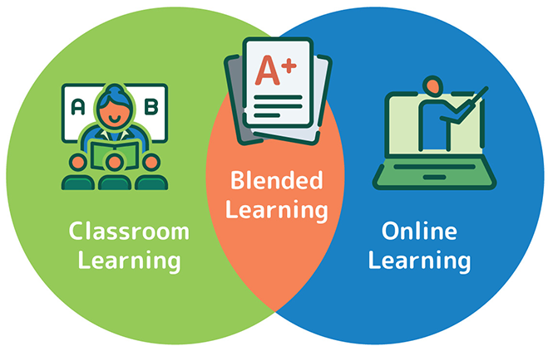
II. VOCABULARY
1
Match the words and phrases with their meanings.
1. face-to-face (adj)
a. an intended plan to achieve a specific purpose
2. prepare (for) (v)
b. a way of learning that combines online materials with traditional classroom methods
3. strategy (n)
c. close together and facing each other
4. online learning (n)
d. make things ready to be used
5. blended learning (n)
e. a way of learning that happens on the Internet
Notes:
vẽ hình Trái tim/ Cam lên bảng -> 2 đội ghi đáp án trên hình (Tổng kết điểm HĐ) (Mỗi đáp án đúng được 10 điểm)

Slide 14
II. VOCABULARY
2
Complete the sentences with the words and phrases in Task 1.
Face-to-face
1. ___________________ learning allows us to communicate with teachers immediately and directly.
2. You need a specific ____________ to improve your English speaking skills.
strategy
prepare for
3. Our teachers always encourage us to ___________ lessons before class.
4. ___________________ is a way of leaning that provides a combined interactivity for both learners and teachers.
Blended learning
that
Notes:
Chuyền banh/ slide bốc tên ngẫu nhiên- theo danh sách lớp

Slide 15
UNIT 8: NEW WAYS TO LEARN – Lesson 2: Language
III. Grammar
Relative clauses
Notes:
Ghi đề lên bảng

Slide 16
III. GRAMMAR
1. Relative clauses
A relative clause gives more information about
a person or thing by defining the noun before it.
- We should combine different learning ways which are self-study, face-to-face and online learning.
- Blended learning is a way of learning that provides a combined interactivity for both learners and teachers.

Slide 17
III. GRAMMAR
2. Relative pronouns
Relative pronouns
Usage
Examples
who
people
Mrs. Green, who taught me English, has just got married.
which
things and animals
Do you see the cat which is lying on the roof?
whose
possessions
Do you know the boy whose mother is a nurse?
that
people and things in defining relative clauses
We don’t know the person that donated the money.

Slide 18
III. GRAMMAR
3. Types of relative clauses
Defining relative clauses | Non-defining relative clauses
Gives essential information | Gives extra information
Without comma | With comma(s)
 | Proper nouns (Peter, Quy Nhon…) My/ your/ his/… + N This/ that/ these/ those + N
THAT | No THAT
Eg: The teacher who taught me English has just got married. | Eg: Mrs. Green, who taught me English, has just got married.
1. The teacher who taught me English has just got married.
2. Mrs. Green, who taught me English, has just got married.

Slide 19
III. GRAMMAR
Defining or non-defining relative clause?
My brother, who is good at computers, teaches me how to use a laptop.
non-defining
Peter, whose sister is taking an online maths course, is a friend of mine.
non-defining
Lan has read the book which/that I lent her.
defining
The boy who had designed this invention is only 10 years old.
defining
That app, which can help improve your pronunciation, is easy to use.
non-defining
Notes:
Cho cả lớp trả lời nhanh đồng thanh. We all look at again the Signals of Non-defining relative clauses so that it help you to do the following exercises

Slide 20
III. GRAMMAR
Join the following sentences. Use who, that, which or whose. Add commas where necessary.
1. My brother teaches me how to use a laptop. He is good at computers.
My brother _____________________________________________
2. Peter is a friend of mine. His sister is taking an online maths course.
Peter __________________________________________________
3. Lan has read the book. I lent her the book.
Lan ___________________________________________________
, who is good at computers, teaches me how to use a laptop.
, whose sister is taking an online maths course, is a friend of mine.
has read the book which/that I lent her.

Slide 21
III. GRAMMAR
2
Join the following sentences. Use who, that, which or whose. Add commas where necessary.
4. The boy has designed this invention. He is only 10 years old.
The boy ________________________________________________
5. That app is easy to use. It can help improve your English pronunciation.
That app _______________________________________________
__________________________
who has designed this invention is only 10 years old.
, which can help improve your English pronunciation,
is easy to use.
Notes:
Ghi giấy rooki dán bảng/ dùng máy chiếu vật thể

Slide 22
Production: Game
Notes:
Cho HS ghi ra giấy rôki, chạy lên dán bảng

Slide 23
HOMEWORK
Revise what you have learnt
Do exercises in the workbook (page 57-60)
Prepare for the next lesson: Reading
(New words and tasks)

Slide 24
Thank you !

