Slide 1
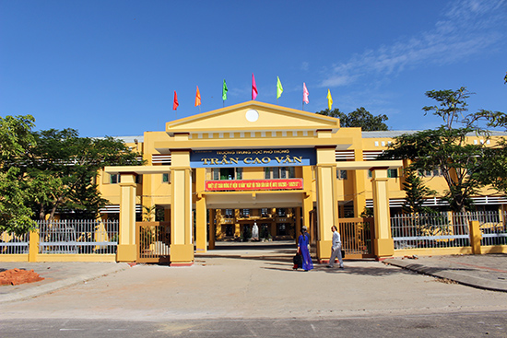
Monday, February 19th, 2024
WELCOME TO OUR CLASS!

Slide 2

I. WARM-UP:
LET’S PLAY THE GAME: THREE-CUE QUESTION
WHICH INTERNATIONAL ORGANISATION IS IT?
1. Its head office is in New York.
2. It was formed on December 11th 1946.
3. Its aim is to advocate for the protection of children’s rights, to help meet their basic needs and help them reach their full potential.
→ UNICEF (The United Nations Children’s Fund)
QUĨ NHI ĐỒNG LIÊN HIỆP QUỐC

Slide 3
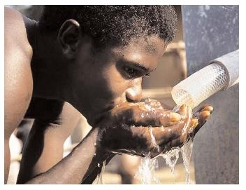


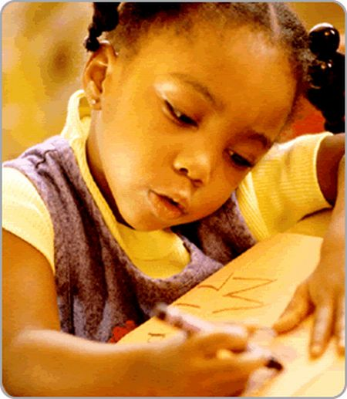


Slide 4



UNIT 7: VIET NAM AND INTERNATIONAL ORGANIZATIONS
LESSON3: READING

Slide 5
II. PRE-READING
1
Work in pairs. Which of the following do you think UNICEF does to support Viet Nam’s education? (on page 79)
1
Providing opportunities for all children to attend school and learn
Finding jobs for out-of-school children
Giving disadvantaged teenagers a chance to continue their education
Helping teenagers learn necessary skills for the job market

Slide 6
* VOCABULARY
1. job market /ʤɒb ˈmɑːkit/ (n.p):
thị trường việc làm
2. disability/ˌdɪsəˈbɪləti/ (n):
sự tàn tật, sự khuyết tật
→ children with disabilities (n.p):
trẻ em khuyết tật
3. particularly /pəˈtikjʊləli/(adv):
một cách đặc biệt
4. fast-changing/fɑːst-ˈʧeɪnʤɪŋ/(a):
thay đổi nhanh chóng

Slide 7
III. WHILE-READING
2
Work in pairs. Read the text and circle the correct meanings of the highlighted words (on page 79).
1
Since UNICEF set up an office in 1975 in Viet Nam, it has run projects in various fields to provide the highest possible support for children in our country. The organisation particularly aims to create opportunities for all children in Viet Nam to attend school, learn and succeed. The following programmes help achieve the UNICEF’s education aims for Viet Nam.
Education for Disadvantaged Young People
UNICEF helps disadvantaged teenagers continue their education by offering them job training and career advice. They are also taught essential skills for the job market.
Providing Education Opportunities for Children with Disabilities
This programme gives children with disabilities a chance to get access to and benefit from a quality education. It also helps promote equal participation in society and a culture in which people respect each other.
Improving Learning Achievements
This is another practical programme supported by UNICEF. The aim is to better prepare children for the challenges in the future. UNICEF helps Viet Nam in joining regional educational programmes to improve children’s learning achievements. When they leave school, they should have the necessary skills and knowledge to work in a fast-changing world.

Slide 8
III. WHILE-READING
Work in pairs. Read the text and circle the correct meanings of the highlighted words.
2
1
  create
  a. make something happen b. increase something c. refuse something
  (v): sáng tạo, tạo ra
2. essential
a. usual b. necessary c. successful
  (a): cần thiết
  (v): tôn trọng, kính trọng
3. respect
a. have a good opinion of somebody b. look down on somebody
c. get on well with somebody
4. practical
a. connected with organisations b. connected with ideas
c. connected with real situations
  (a): thực tế, thiết thực

Slide 9
III. WHILE-READING
3
Work in groups. Read the text again and choose the best answers
Since UNICEF set up an office in 1975 in Viet Nam, it has run projects in various fields to provide the highest possible support for children in our country. The organisation particularly aims to create opportunities for all children in Viet Nam to attend school, learn and succeed. The following programmes help achieve the UNICEF’s education aims for Viet Nam.
Education for Disadvantaged Young People
UNICEF helps disadvantaged teenagers continue their education by offering them job training and career advice. They are also taught essential skills for the job market.
Providing Education Opportunities for Children with Disabilities
This programme gives children with disabilities a chance to get access to and benefit from a quality education. It also helps promote equal participation in society and a culture in which people respect each other.
Improving Learning Achievements
This is another practical programme supported by UNICEF. The aim is to better prepare children for the challenges in the future. UNICEF helps Viet Nam in joining regional educational programmes to improve children’s learning achievements. When they leave school, they should have the necessary skills and knowledge to work in a fast-changing world.

Slide 10
3. Read the text again and choose the best answers.
1. The text is mainly about _________.
A. UNICEF’s programmes in Viet Nam B. UNICEF’s achievements in Viet Nam
C. UNICEF’s participation in Viet Nam D. UNICEF’s support for Viet Nam’s education
2. The word “opportunities" in paragraph 1 is closest in meaning to _____.
chances B. cases C. positions D. careers
3. The word “They” in paragraph 2 refers to ______.
A. essential skills B. young people
C. disadvantaged teenagers D. education opportunities
4. UNICEF carries out _______ programmes to help Viet Nam achieve the education aims.
A. 2 B. 3 C. 4 D. 5
5. According to the text, which of the followings is NOT TRUE?
A. Children with disabilities are given a chance to get access to and benefit from a quality education.
B. Viet Nam is helped in joining regional educational programmes to improve children’s learning achievements.
C. UNICEF provides educational programmes for disadvantaged young people.
D. UNICEF’s aim is to create opportunities for disabled children in Viet Nam to attend school, learn and succeed.

Slide 11
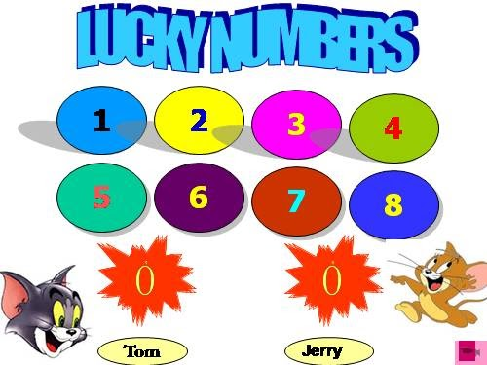
Unit
Lucky numbers
Work in 2 teams.
Choose a number.
Answer the question in each number and get 1 point with the correct answer.
With LUCKY NUMBER, you get 2 points without answering the question.

Slide 12
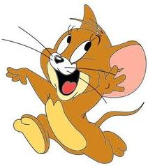

LUCKY NUMBERS
1
2
3
4
5
6
7
8
4
3
2
1
6
5
4
3
2
1
0
6
7
0
7
5
Tom
Jerry

Slide 13


lucky number

Slide 14

3.The word “They” in paragraph 1 refers to ______.
essential skills
B. young people
C. disadvantaged teenagers
D. education opportunities

Slide 15
4. UNICEF carries out _______ programmes to help Viet Nam achieve the education aims.
2
3
4
5

Slide 16
1. The text is mainly about _________.
UNICEF’s programmes in Viet Nam
UNICEF’s achievements in Viet Nam
UNICEF’s participation in Viet Nam
UNICEF’s support for Viet Nam’s education

Slide 17
2. The word “opportunities" in paragraph 1 is closest in meaning to _____.
chances
cases
C. positions
D. careers

Slide 18
5. According to the text, which of the followings is NOT TRUE?
Children with disabilities are given a chance to get access to and benefit from a quality education.
B. Viet Nam is helped in joining regional educational programmes to improve children’s learning achievements.
C. UNICEF provides educational programmes for disadvantaged young people.
D. UNICEF’s aim is to create opportunities for disabled children in Viet Nam to attend school, learn and succeed.

Slide 19
IV. POST-READING
4
Work in groups. Discuss the following questions.
1
Which of the UNICEF’s education programmes mentioned in the text do you think can be the most useful for your local community? Why?
1. Education for Disadvantaged Young People
2. Providing Education Opportunities for Children with Disabilities
3. Improving Learning Achievements

Slide 20
V. CONSOLIDATION
1.
Wrap-up
1
- Read for specific information about UNICEF’s support for Viet Nam’s education
- Guess the meanings of words from context

Slide 21
V. CONSOLIDATION
2
Homework
Prepare for the next lesson: Unit 7: Speaking
2. Do exercises in the workbook
3. Prepare project (page 85)

Slide 22



Thanks for your attention!

Slide 23

Goodbye!

