Slide 1
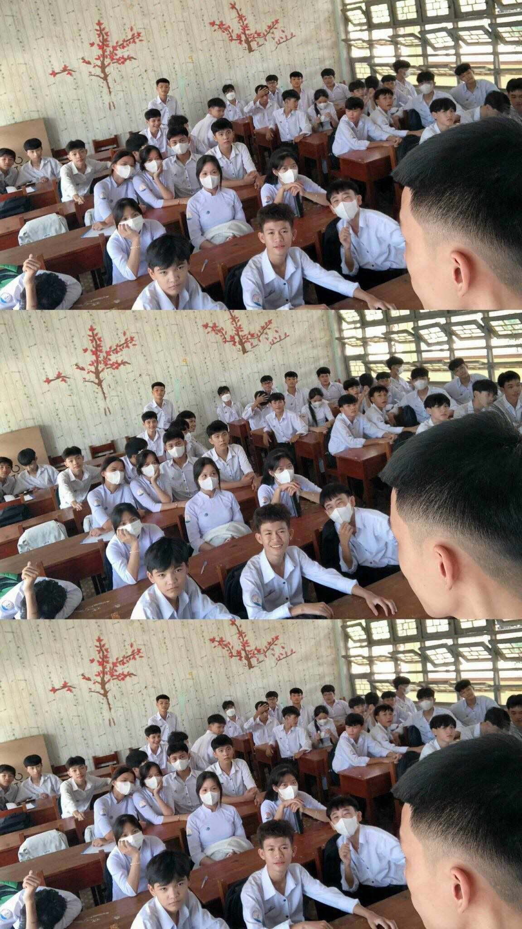
10A9

Slide 2
Period 17
Unit 2. Humans and
the environment
Looking back and project

Slide 3
I. Looking back
Pronunciation, Vocabulary and Grammar in Unit 2
Our class are going to present
the plan for a Go Green Weekend
event which was assigned
by four groups.

Slide 4
/kl/, /pl/, /gr/, /pr/
Pronunciation
Our class are going to present
the plan for a Go Green Weekend
event which was assigned
by four groups.

Slide 5
Topic: Humans and the environment
Vocabulary
Our class are going to present
the plan for a Go Green Weekend
event which was assigned
by four groups.
Our class are going to present
the plan for a Go Green Weekend
event which was assigned
by four groups.

Slide 6
Will vs Be going to
Passive voice
Grammar
Our class are going to present
the plan for a Go Green Weekend
event which was assigned
by four groups.

Slide 7
Choose the correct answer:
1. What is the consonant blend in the sentence The professor is proud of the results of our project?
A. /pr/ B. /kl/ C. /pl/ D. /gr/
2. What is the consonant blend in the sentence Grass is growing on the ground?
A. /pr/ B. /kl/ C. /pl/ D. /gr/
3. More people adopt a ______________ lifestyle.
A. green B. organic C. sustainable D. refillable
4. You should cut down on electricity usage to reduce your ___________. A. eco-friendly B. carbon footprint C. awareness D. resource
5. Modern household ___________ make housework much easier.
A. appliances B. chemicals C. materials D. products
6. I’m sure you ___________ your driving test. Don’t worry. A. is going to pass B. are going to pass C. will pass D. will be passed
7. Do you hear the thunder? It ___________ heavily. A. is going to rain B. are going to rain C. will rain D. will be rained
8. More trees ___________ around the school. A. is planted B. planted C. are planted D. plant
9. Wind energy ___________ to produce electricity.
A. is used B. are used C. use D. is using
10. Important environmental issues __________ at the meeting.
A. discussed B. will discuss C. were discussed D. was discussed

Slide 8
II. Project
Our class are going to present
the plan for a Go Green Weekend
event which was assigned
by four groups.
Our class are going to present
the plan for a Go Green Weekend
event which was assigned
by four groups.

Slide 9
Assessment
 | Group 1 | Group 2 | Group 3 | Group 4
DELIVERY
Greeted the audience.
Spoke clearly and naturally.
Cooperated when delivering their talk.
Interacted with the audience.
Used graphs / charts to illustrate their findings.
Concluded their talk appropriately.
CONTENT: The presentation includes the plan for a Go Weekend event
the suitability of the activities for the event
the number of the activities
the possibility of the activities
the purposes for giving the activities for the event

Slide 10
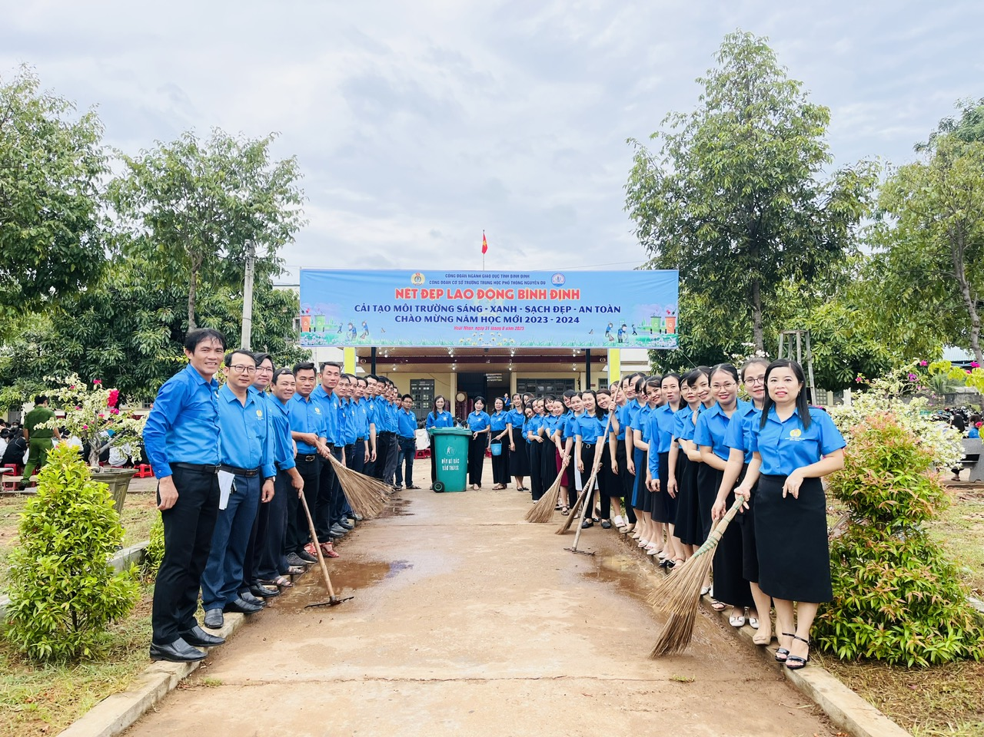
Activities at Nguyen Du High School

Slide 11
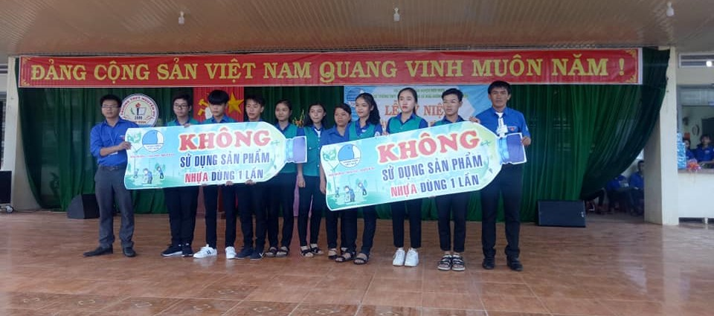
Activities at Nguyen Du High School

Slide 12
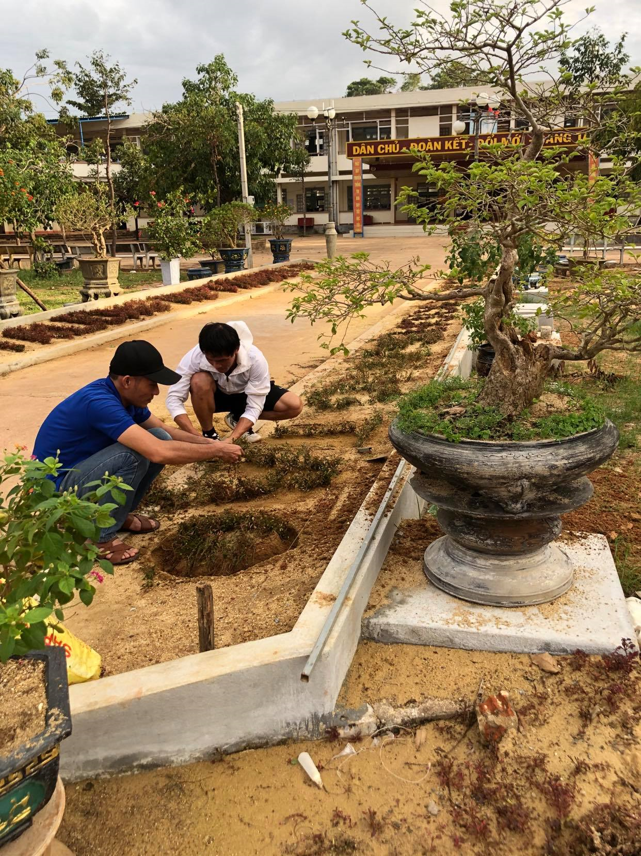
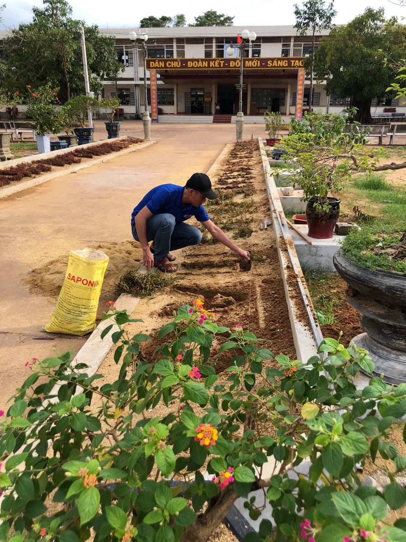
Activities at Nguyen Du High School

Slide 13
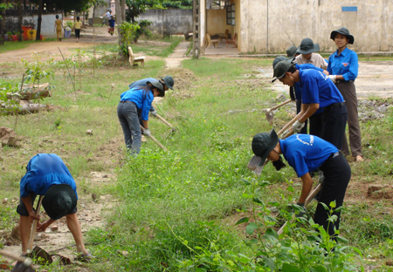
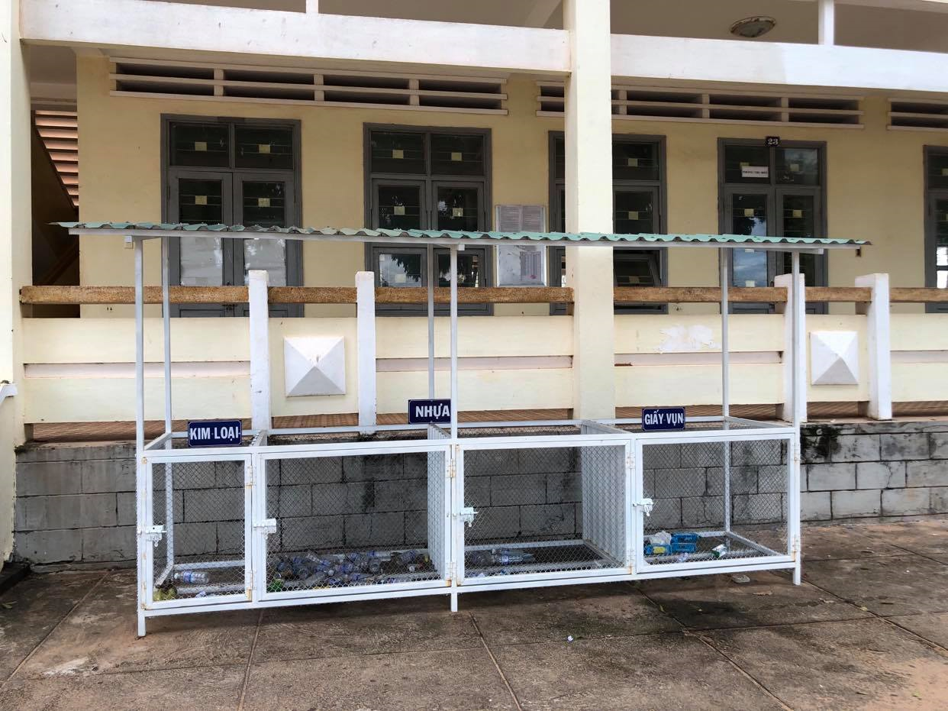
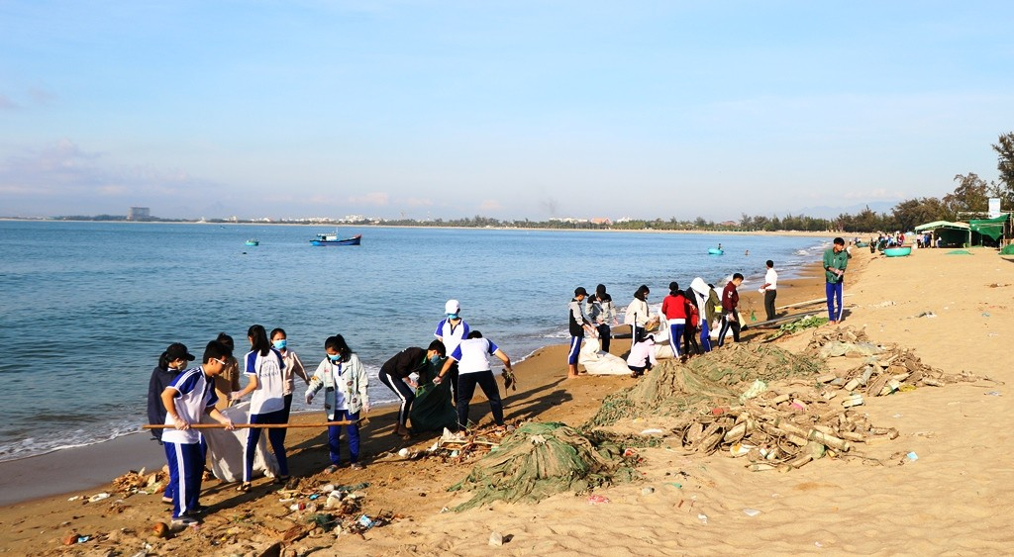
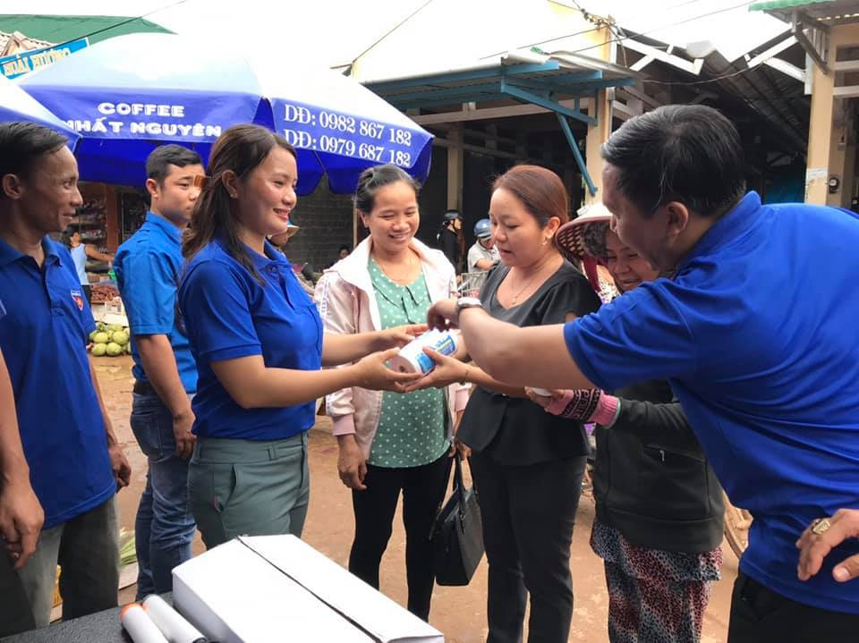
Humans and the environment

Slide 14
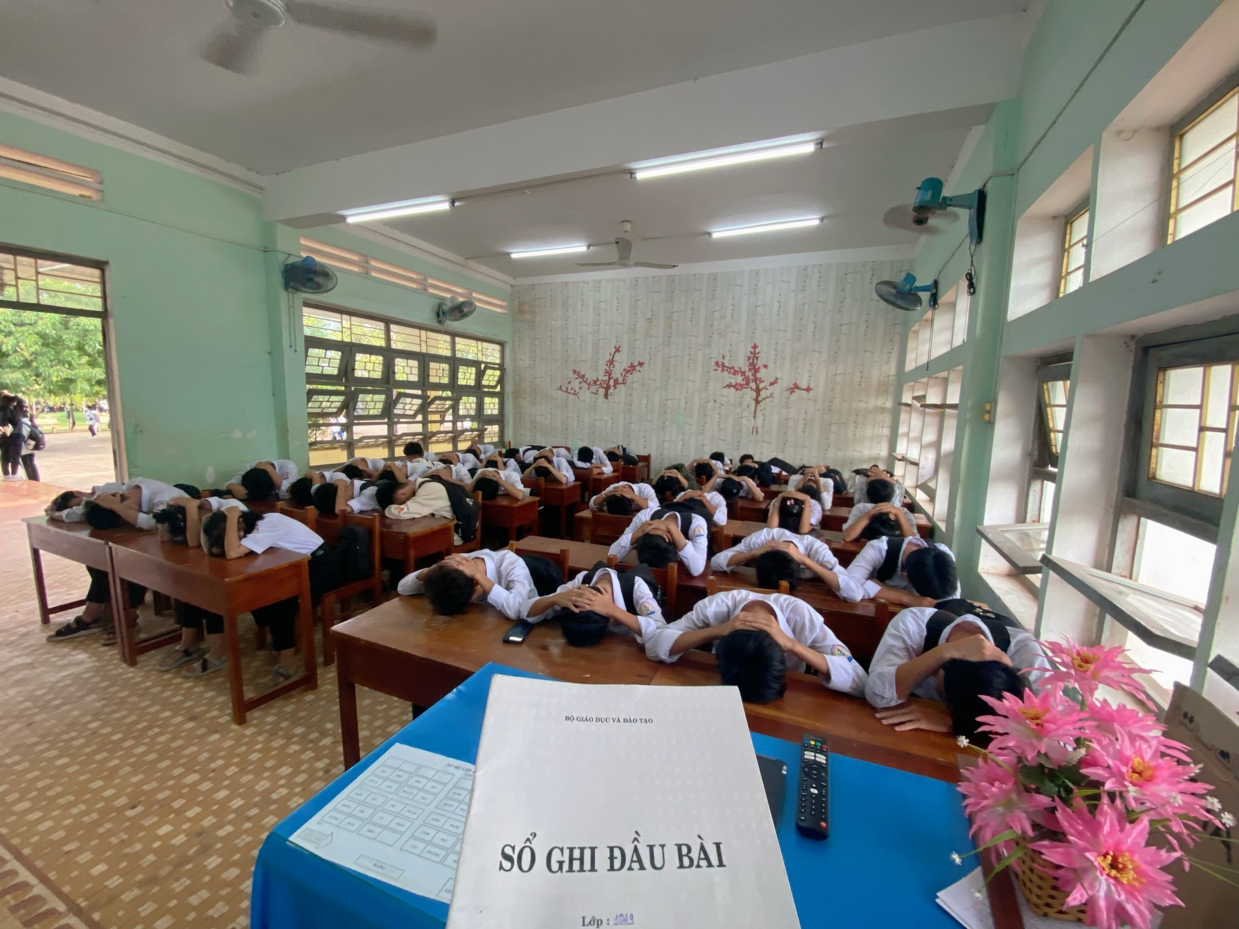
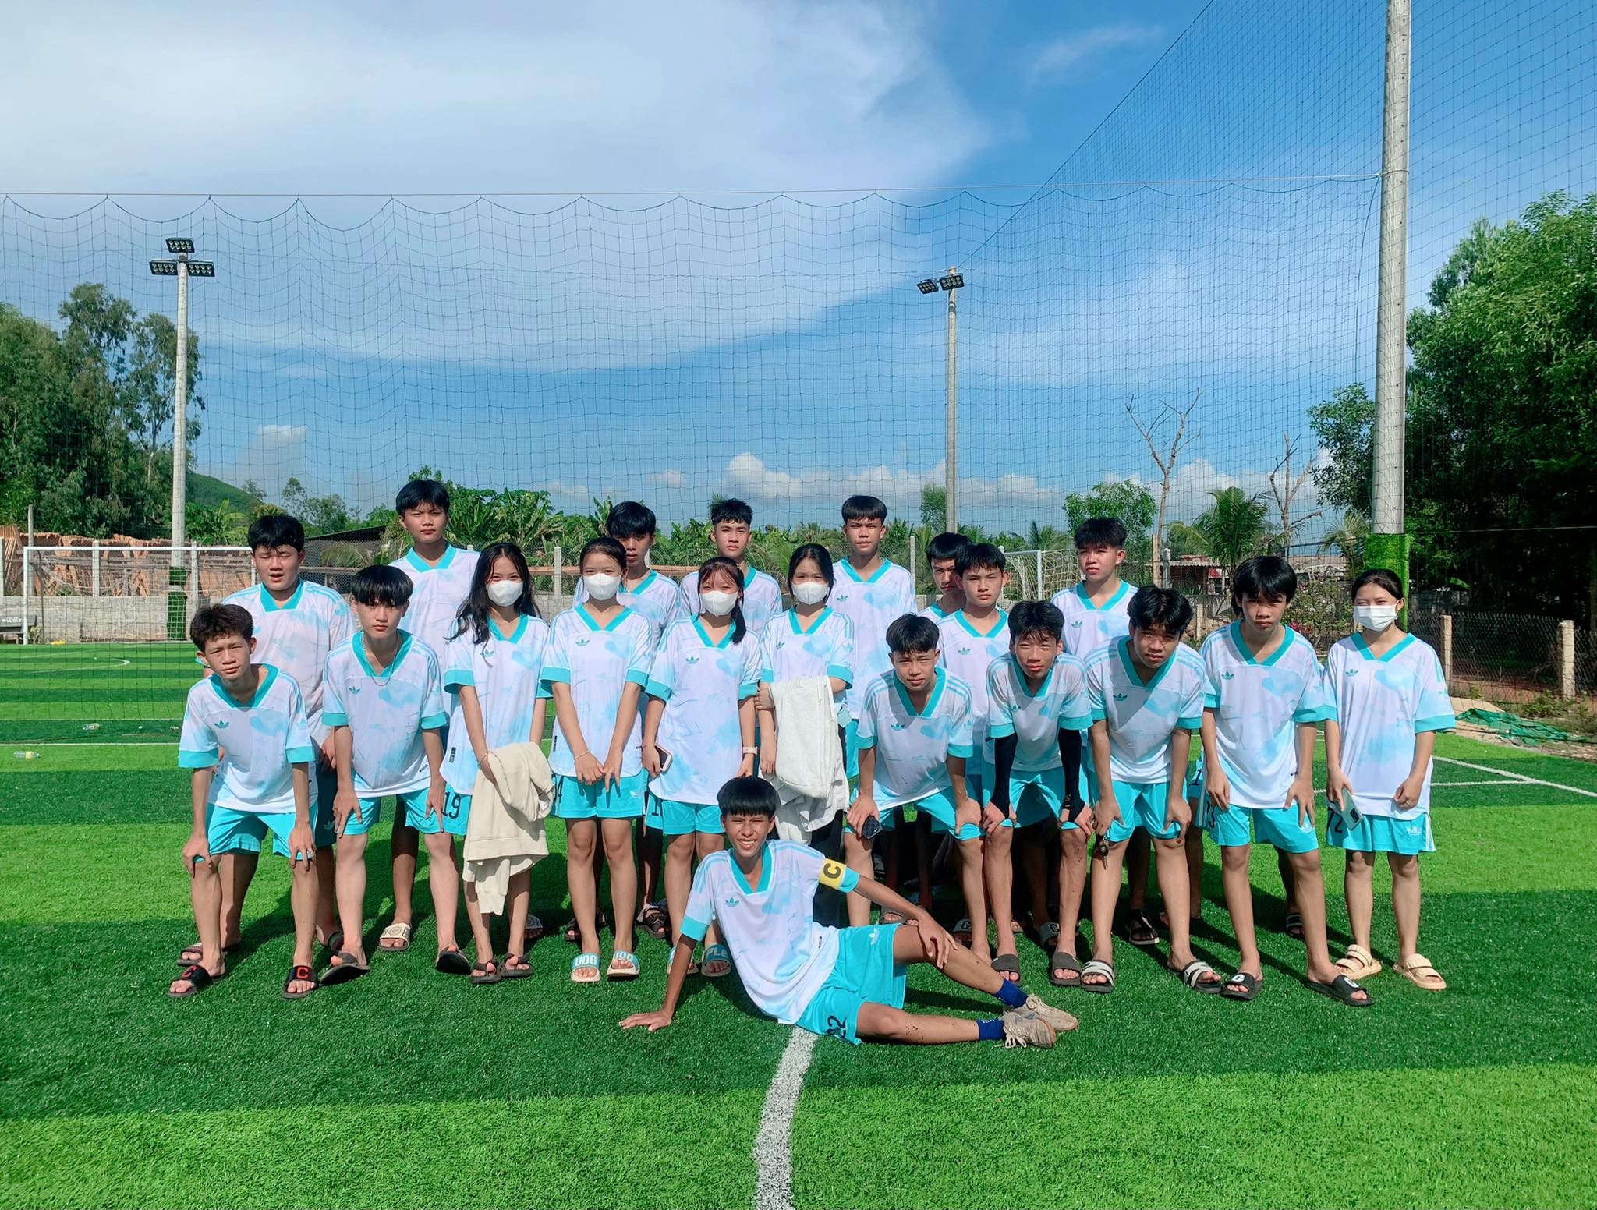
Class 10A9
Goodbye

