Slide 1


Welcome to class 12A4

Slide 2

Wednesday, March 8th, 2017
UNIT 8:
THE WORLD OF WORK
WARM-UP

Slide 3
UNIT 8: LISTENING Wednesday, March 8th, 2017
Look at the following key words and guess what the jobs are:
1
Patients, clinics, prescription, medicine
2
Design, bridges, construction, technique
A doctor
An engineer
3
Novels, imaginary characters, stories, literature
4
Control flights, aircrew, air, navigation
A writer
A pilot

Slide 4

Wednesday, March 8th, 2017
UNIT 8: Period 77: LISTENING
WHAT MAKES A GOOD CV?

Slide 5
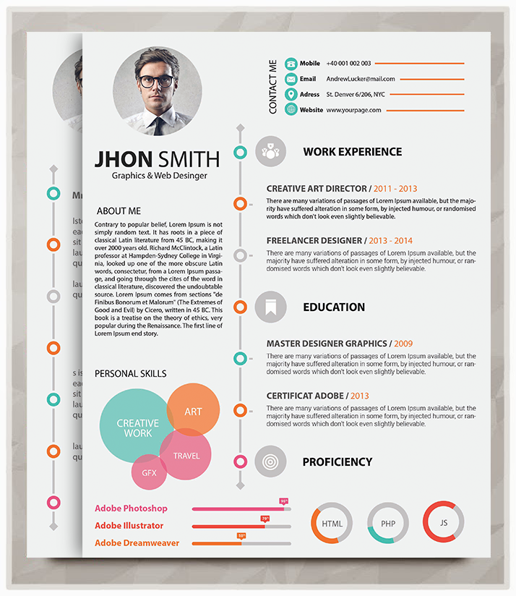
UNIT 8(P.77): LISTENING
Wednesday, March 8th, 2017
BEFORE LISTENING:
Task 1: Work in pairs: Ask and answer the following questions:
1- What is a CV?
2- How important is your CV in
applying for a job?
3- What makes a successful CV?

Slide 6



UNIT 8(P.77): LISTENING
Wednesday, March 8th, 2017
BEFORE LISTENING:
Match the words with their meanings:
TASK 2:
A | B
1. unique (adj) 2. tip (n) 3. cluttered (adj) 4. tailor (..to..) (v) 5. personnel (n) | Full of details in an untidy way. Very special The department in a company that deals with employing and training people. A useful piece of advice about something practical. Adapt something for a particular purpose.

Slide 7


UNIT 8(P.77): LISTENING
Monday, March 6th, 2017
Wednesday, March 8th, 2017
WHILE LISTENING:
TASK 3
Mr Le, an invited speaker, is talking to grade 12 students about how to write a good CV. Listen to his talk and choose the best answer(s), then check your answers to the questions in 1:

Slide 8
UNIT 8(P.77): LISTENING
Monday, March 6th, 2017
Wednesday, March 8th, 2017
1. What is a CV?
A
A-It is a written record of your education.
B-It is a letter of personal information
C-It includes your work experience .
C
2. How important is your CV in applying for a job?.
A
A-It creates the first impression on your employer
B-It can be the deciding factor in whether or not you can get an interview.
B
C-It plays an important role in getting a job.
3. What makes a successful CV?
A-It is clear and full of information.
B-It is simple in design, includes key words from the job description.
B
C-It is tailored to the job you are applying for.
C

Slide 9
UNIT 8(P.77): LISTENING
Wednesday, March 8th, 2017
WHILE LISTENING:
TASK 4
Listen again and complete each of the sentences with no more than three words.
1-Your CV is one of the most important requirements for getting...........
2-If your CV looks.................. and confusing, the personnel manager is going to think that you will be a cluttered and confused employee.
3-Many companies nowadays use..........................to scan CVs for important key words.
4-Every job you apply for is going to have a unique .................................
5-You should have a different and unique CV for .................. you apply for.
a job
cluttered
digital software
set of requirements
every job

Slide 10
UNIT 8(P.77): LISTENING
Wednesday, March 8th, 2017
AFTER LISTENING:
TASK 5
Work in groups of 8, summarizing three tips from Mr Le’s talk of how to make a good CV .
Your talk should have the following points:
1-Opening:
-Greeting:
-Introducing: On behalf of my group, I will present three useful tips to make a good CV.
2-Body:
-The role of a CV in applying for a job
-To make a good CV, first of all, ..........
Secondly,...............
Last but not least,................
3-Closing:
-That’s all about my talk. Thanks for your listening.

Slide 11


UNIT 8(P.77): LISTENING
Wednesday, March 8th, 2017
Homework
1. Practice again your talk about the useful tips to make a good CV.
2. Prepare for the next part: UNIT 8 WRITING

Slide 12
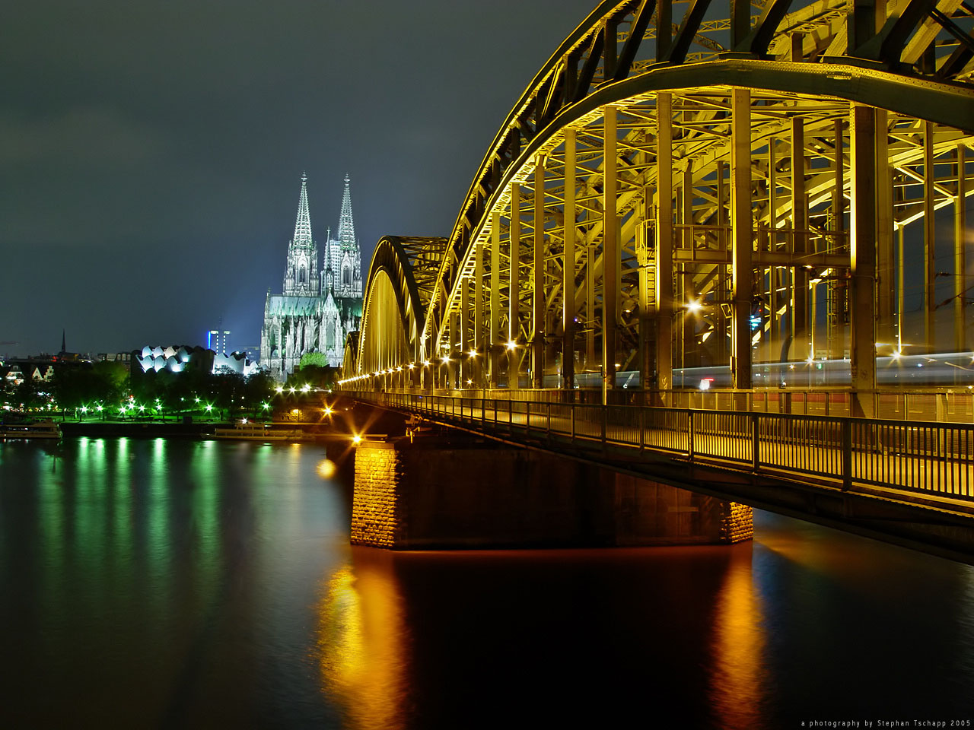
THANK
YOU
FOR
YOUR
ATTENTION

Slide 13
UNIT 3: LISTENING Monday, October 19th, 2015
Based on the following key words and guess what the jobs are:
1
His job is to take care of people’s health and help save people’s lives
2
His job is to apply new farming techniques and raise animals, plants...
A doctor
A farmer
3
His job is to create imaginary characters and events. He can also tell stories through pictures
4
His job is to find good and safe hotels for customers and taking them
to places of interest
A writer
A tour guide

Slide 14
UNIT 3: LISTENING Monday, October 19th, 2015
Based on the following key words and guess what the jobs are:
1
His job is to take care of people’s health and help save people’s lives
2
His job is to apply new farming techniques and raise animals, plants...
A doctor
A farmer
3
His job is to create imaginary characters and events. He can also tell stories through pictures
4
His job is to find good and safe hotels for customers and taking them
to places of interest
A writer
A tour guide

