Slide 1

ENGLISH 12
GOOD MORNING!

Slide 2


Unit 5:
CULTURAL IDENTITY
SPEAKING
Maintaining cultural identity

Slide 3
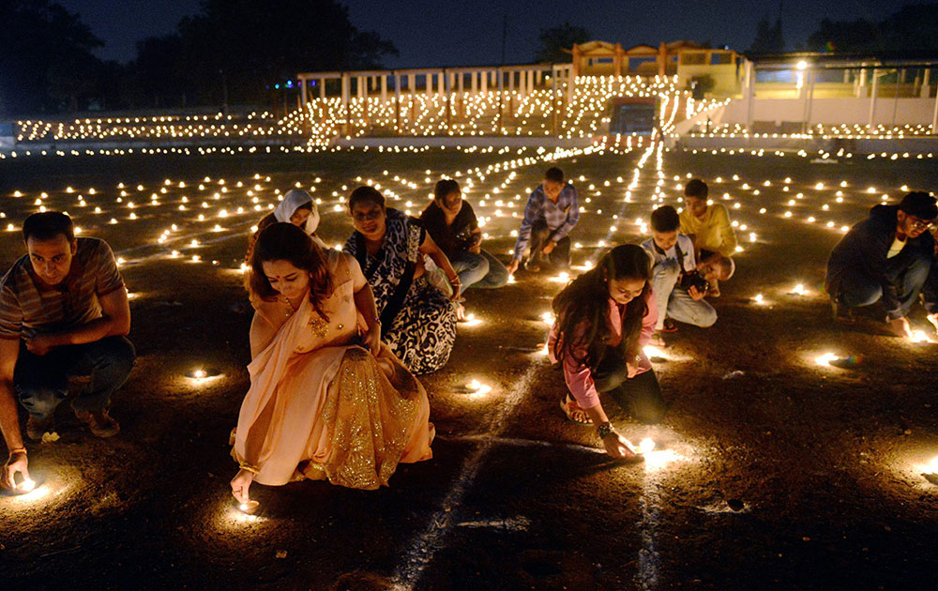
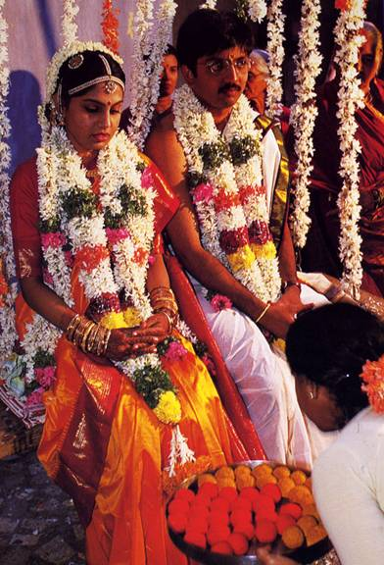
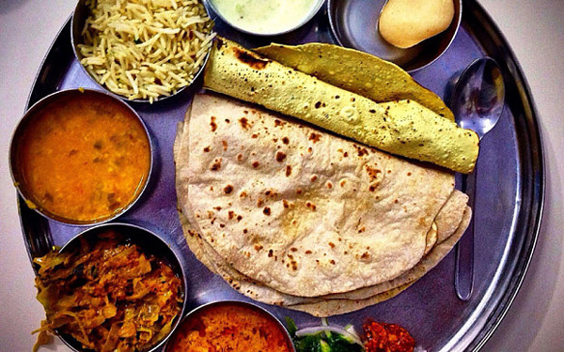
Which country is it?
INDIA
मैं तुम्हें प्यार करता हूँ

Slide 4
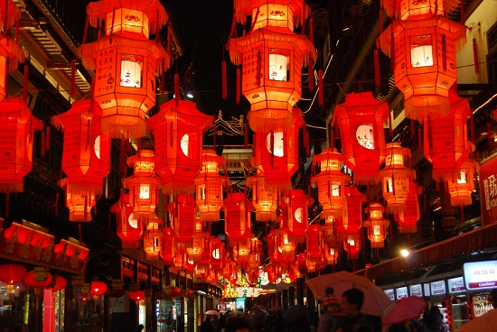
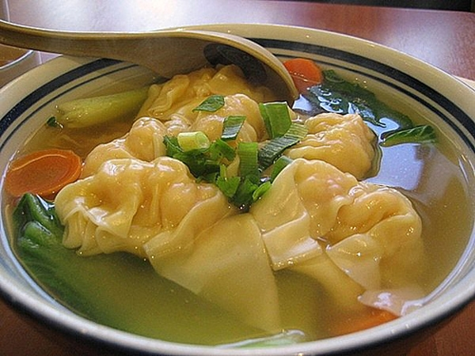
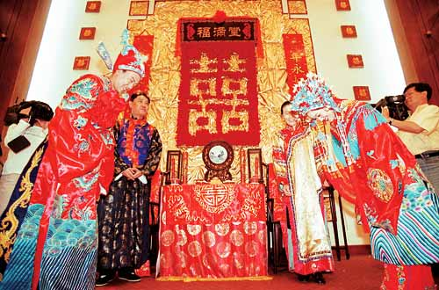
Which country is it?
CHINA
我爱你

Slide 5
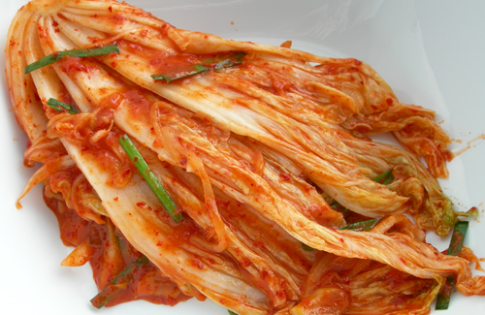
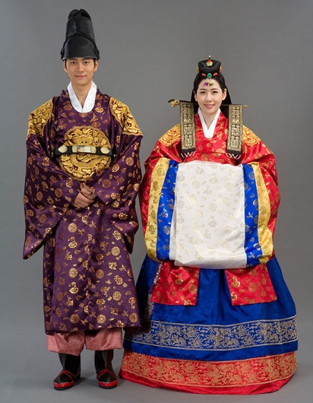
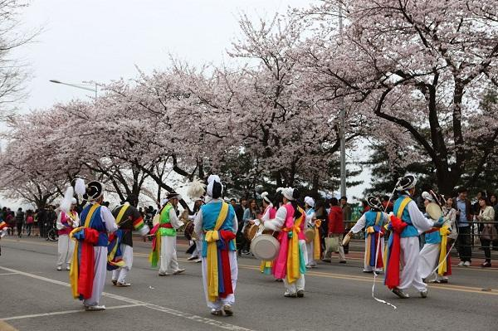
Which country is it?
KOREA
나는 너를 사랑해

Slide 6
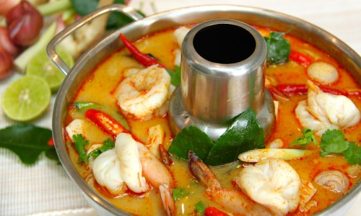
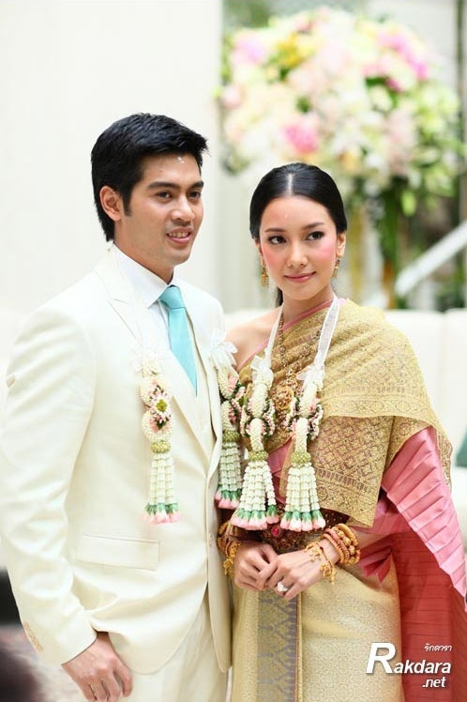
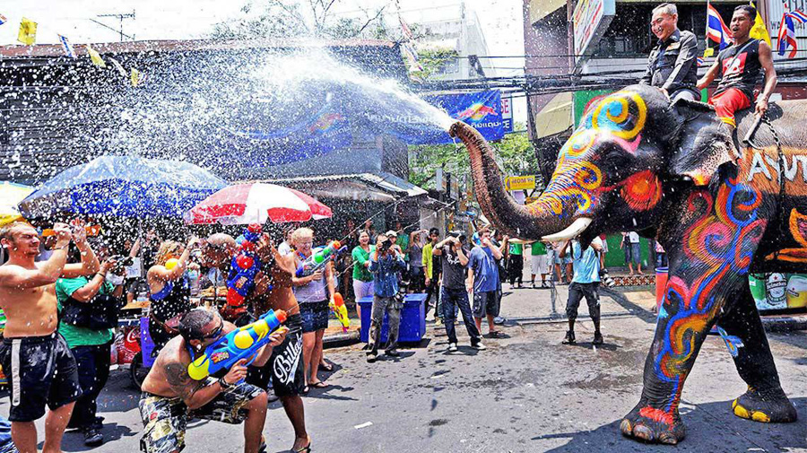
Unit 5: CULTURAL IDENTITY
SPEAKING
THAILAND
ฉันรักคุณ

Slide 7
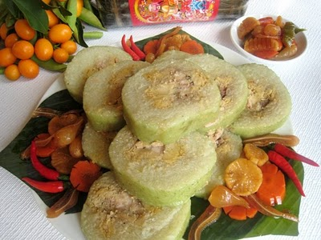
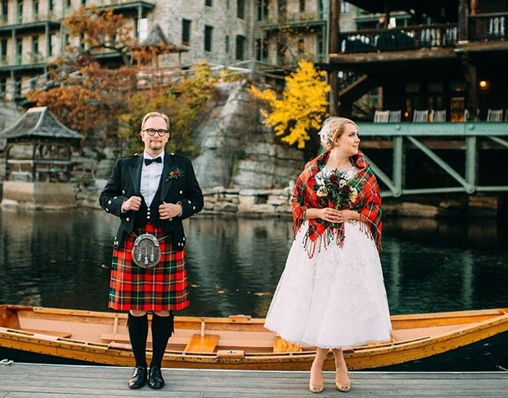
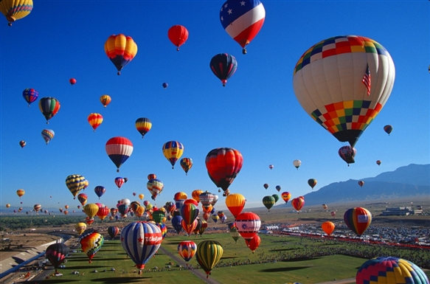
Which country is it?
Russia
Я ЛЮБЛЮ ТЕБЯ

Slide 8
Unit 5: CULTURAL IDENTITY
SPEAKING: Maintaining cultural identity
Activity 1: Work with a partner. Match each of the activities with its reason
Activities | Reasons
1. Preserving native language | a. Represents national identities; reflects climatic conditions
2. Wearing traditional clothing | b. Gives big appetites and adequate nutrition; strengthens cultural ties
3. Celebrating traditional holidays | c. Develops intellectual abilities; shapes cultural identity
4. Eating traditional food | d. Offers a sense of being rooted in native culture; brings people together
1c – 2a – 3d – 4b

Slide 9

Unit 5: CULTURAL IDENTITY
SPEAKING: Maintaining cultural identity
Activity 2: Use the given phrases to complete the conversation
shape their cultural identity
Preserve their native language
cultural identity
develop their intellectual abilities
A: What do you think people should do to maintain cultural identity in the age of globalization?
B: I believe they should (1) _______________________.
C: That’s true. Language is a vital part of culture and critical to a person’s (2) _______________________.
A: Yes. It enables people to communicate, establish links with family and community members, and acquire and value their native culture.
B: I can’t agree with you more. It is said that people’s first language helps (3) _____________________________ and
(4) _______________________.
C: That’s absolutely correct. Do you have anything else to add?
Preserve their native language
cultural identity
develop their intellectual abilities
shape their cultural identity

Slide 10

Unit 5: CULTURAL IDENTITY
SPEAKING: Maintaining cultural identity
Activity 3: Work in pairs. Have a similar conversation discussing what you should do to maintain cultural identity in the age of globalization. Use may use the ideas in Activity 1 and some expressions below.
Some useful expressions
+ To give one’s opinion
I believe/ I think (that) …./In my opinion, …./From my point of view, …./As I see it, ...
S should/ had better V
V-ing … is important
+ To express an agreement
I quite agree/ I agree with you (completely)/ You are right/ That’s true/ That’s absolutely correct/ Absolutely!

Slide 11


Unit 5: CULTURAL IDENTITY
SPEAKING: Maintaining cultural identity
Activity 4: Work in groups. Make a speech on what people should do to maintain cultural identity in the age of globalization. Remember to offer reasons, explanations or examples to make your speech more interesting and persuasive.

Slide 12

HOMEWORK
Learn by heart new words.
Write a paragraph (100-150 words) about how people maintain their cultural identity in modern society.
Prepare listening lesson

Slide 13
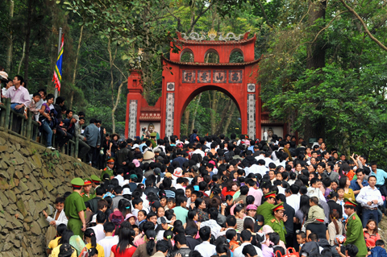
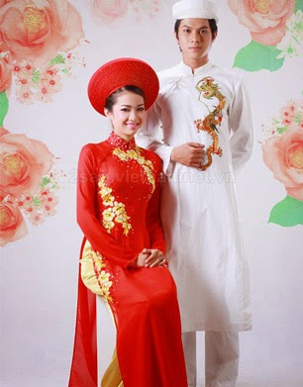
Unit 5: CULTURAL IDENTITY
SPEAKING
VIETNAM
A E

