Slide 1


Slide 2

What countries do you think of when you see the following pictures or videos?

Slide 3


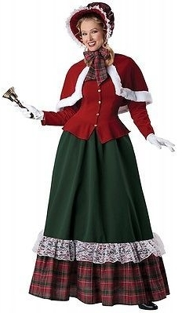
England

Slide 4
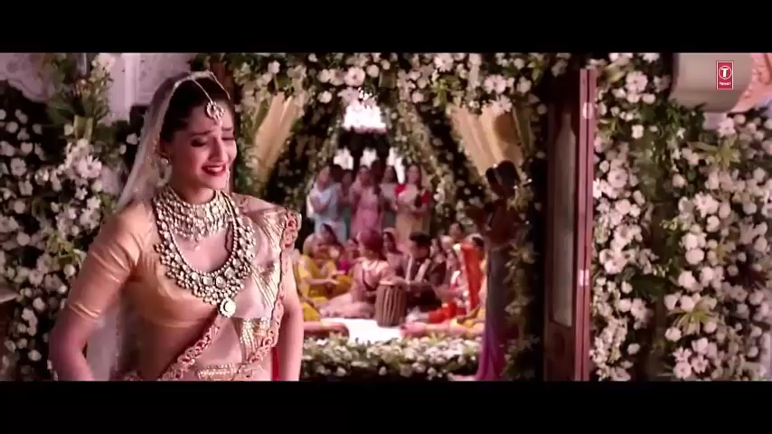
India

Slide 5

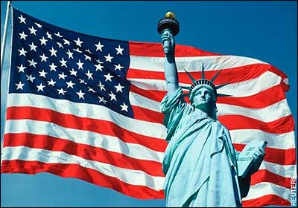
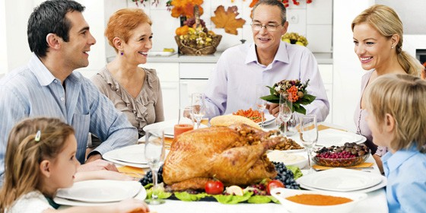
America

Slide 6
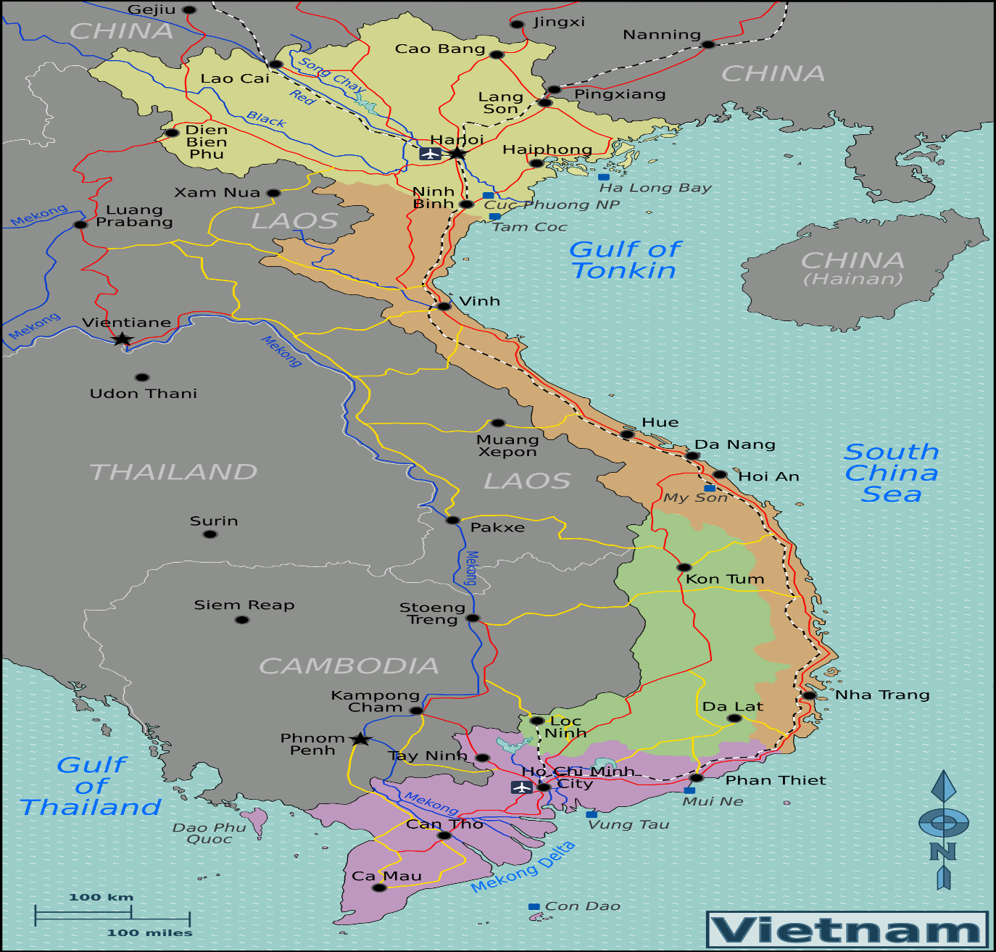
Vietnam

Slide 7
Unit 5: CULTURAL IDENTITY
Period 40: Reading
CULTURAL IDENTITY IN MODERN SOCIETY

Slide 8


Slide 9
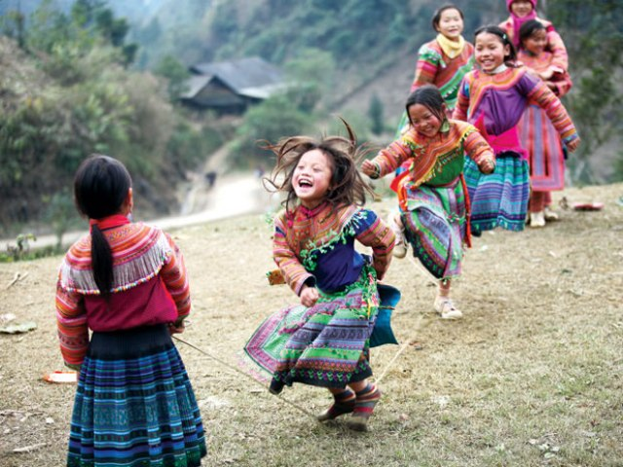
Take sb / st for granted
Coi ai / thứ gì là điều hiển nhiên
Example:
Children take playing for granted.
Trẻ em coi vui chơi là hiển nhiên.

Slide 10

Take it for granted that ...
Cứ nghĩ là ...
Example:
She took it for granted that I would go with her.
Cô ấy cứ nghĩ là tôi sẽ đi cùng với cô ấy.

Slide 11

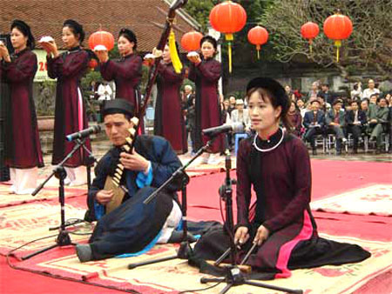
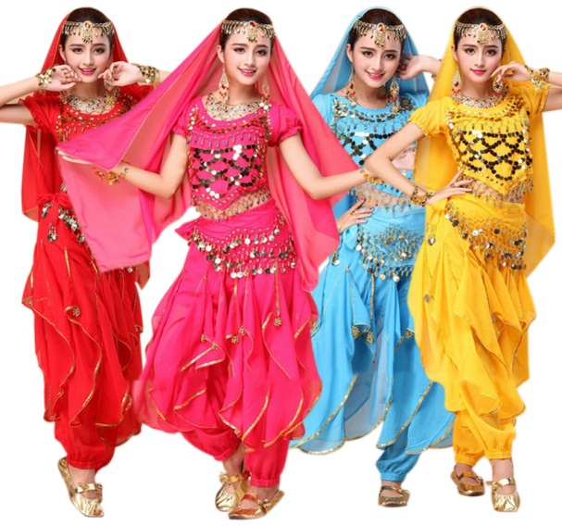
Cultural identifier /′kʌltʃərəl aɪ′dentɪfaɪə(r)/ (np)
bản sắc văn hóa

Slide 12
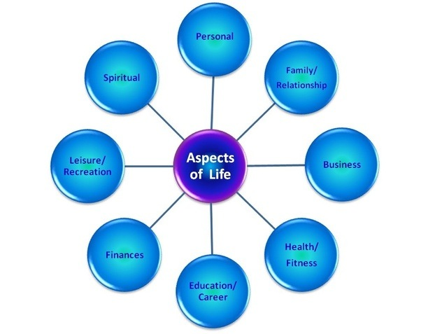

Aspect /′æspekt/ (n)
Mặt, khía cạnh

Slide 13

Abandon /ə′bændən/ (v)
= Give up
Từ bỏ

Slide 14



Integrate /′ɪntɪɡreɪt/ (v)
Hòa nhập
integrate into / with something

Slide 15

Vocabulary
- Abandon /ə′bændən/ (v)
Từ bỏ
- Integrate /′ɪntɪɡreɪt/ (v)
hòa nhập
integrate into / with something
-Take it for granted that ...
cứ nghĩ là ...
- Take sb / st for granted
coi ai / thứ gì là điều đương nhiên
- Aspect /′æspekt/ (n)
mặt, khía cạnh
- Cultural identifier /′kʌltʃərəl aɪ′dentɪfaɪə(r)/ (np)
bản sắc văn hóa

Slide 16






Task 1. Use the words or phrases in the box to complete the sentences with their correct form.
(n)
(n)
integrate
aspect
for granted
(phr)
cultural identifier
(np)
for granted
1. He had taken it _________________ that his friend would tell the truth.
2. ____________________ are characteristics shared by individuals belonging to the same group or community.
3. When he studied abroad, he successfully _________________ into the local culture.
4. His book covers all _________________ of a migrant’s life.
Cultural identifiers
integrated
aspects

Slide 17
Task 2. Read the passage about cultural identity. Four sentences have been removed from the passage. Choose a sentence (a-d) to complete each gap (1-4).
a. On the other hand, there are people who choose to abandon their heritage culture and assimilate into the new culture of the majority.
b. Cultural identity is usually understood as the identity or feeling of belonging to a group that has its own culture.
c. However, people often do not confine themselves to one culture.
d. The first stage, known as unexamined cultural identity, occurs during childhood, when culture is taken for granted.
________________
_______
________
_________
_______________
_______
______________________
_________
______________

Slide 18
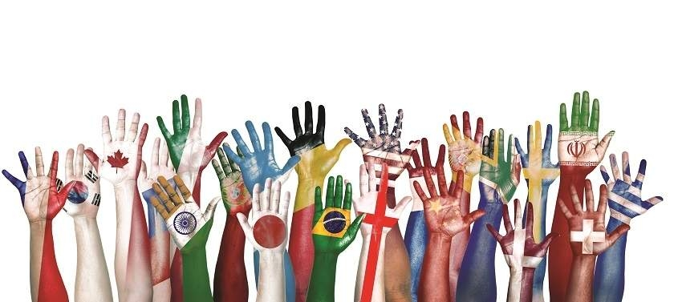
Task 2. Read the passage about cultural identity. Four sentences have been removed from the passage. Choose a sentence (a-d) to complete each gap (1-4).
(1) ________________
(2) ________________
(3) ________________
(4) ________________
b
d
c
a

Slide 19
Task 3. Read the passage again and answer the questions.
How do individuals define themselves?
What happens in the first and the second stages of the formation of cultural identity?
When do people reach the final stage?
Why can people’s cultural identity be affected by other cultures even if they live in their native country?
What are the three ways people react when they move to a new culture?
____
_________________
_______________
____
_______
______
______
______
__________
____
______________
________
_____________
_________
__________
_____

Slide 20


GAME
2
3
1
4
LUCKY
NUMBERS
7
5
6

Slide 21
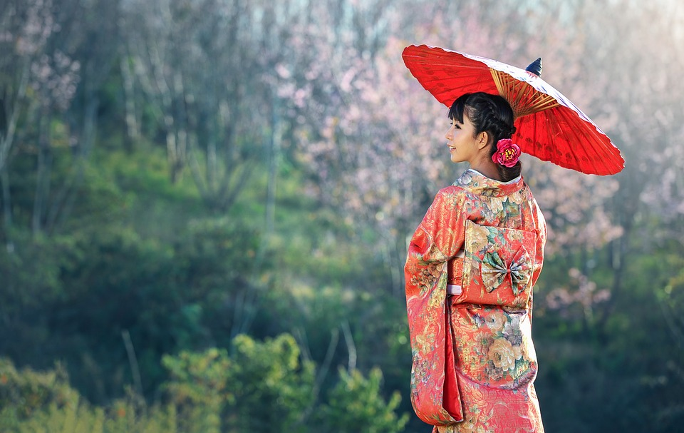
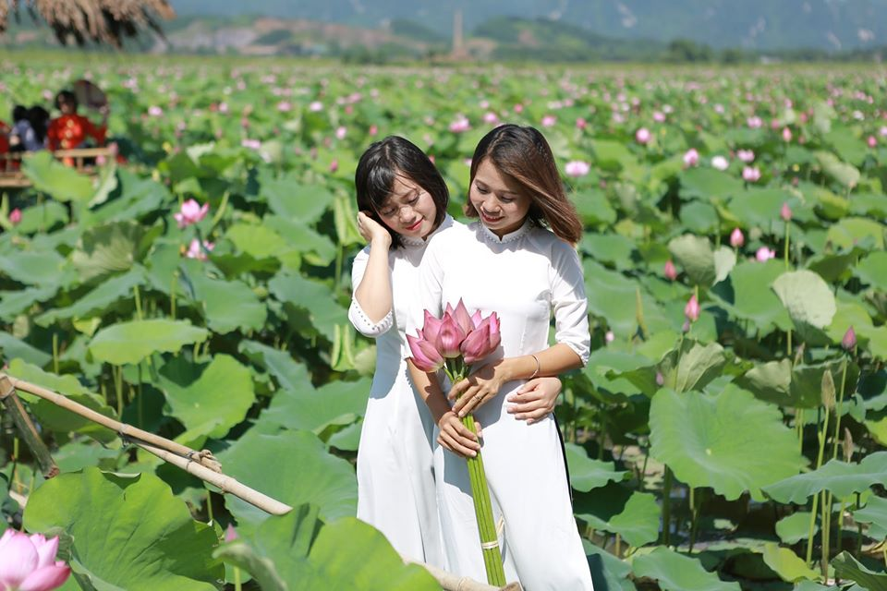
Task 4. Work in pairs to dicuss this question:
What should you do to develop your cultural identity in today’s modern society?

Slide 22

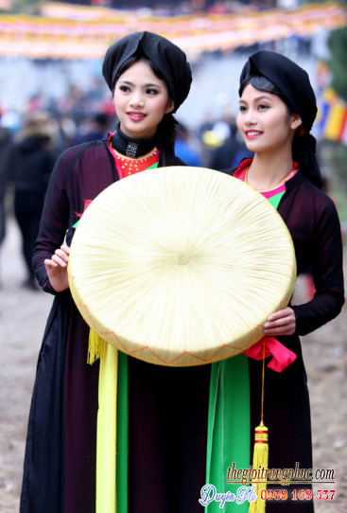
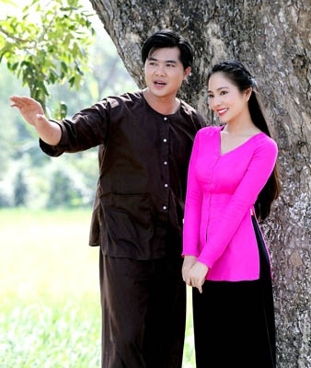
Wear our traditional costumes

Slide 23
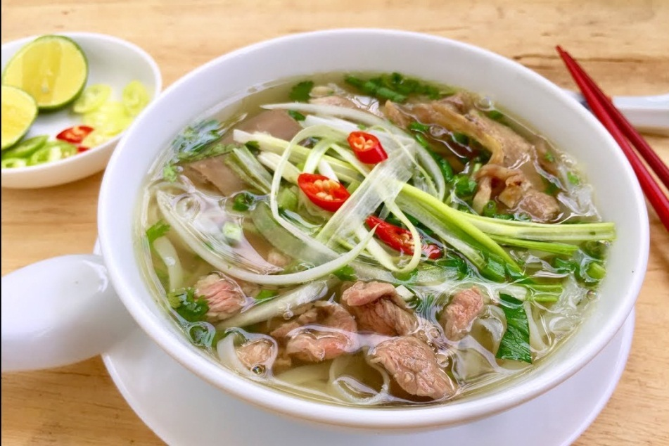


Cook and eat our traditional foods

Slide 24
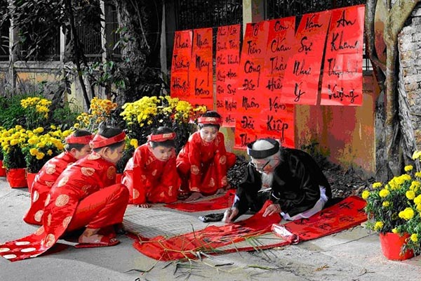
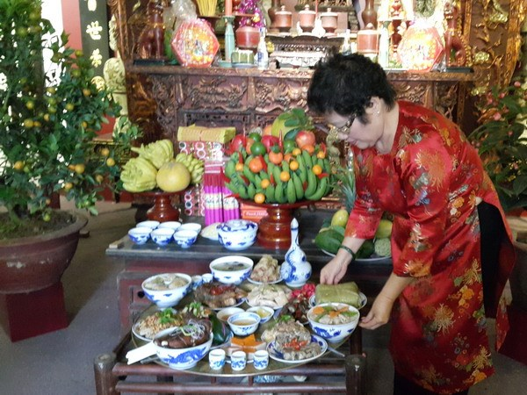
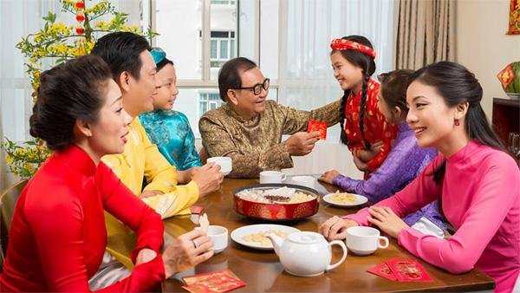
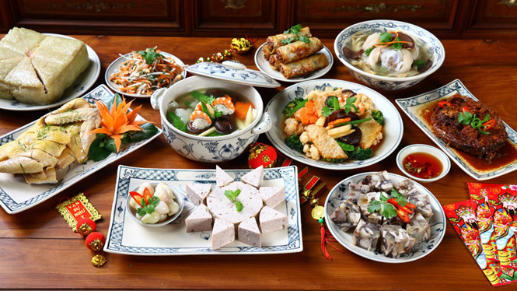
Celebrate traditional holidays and festivals

Slide 25
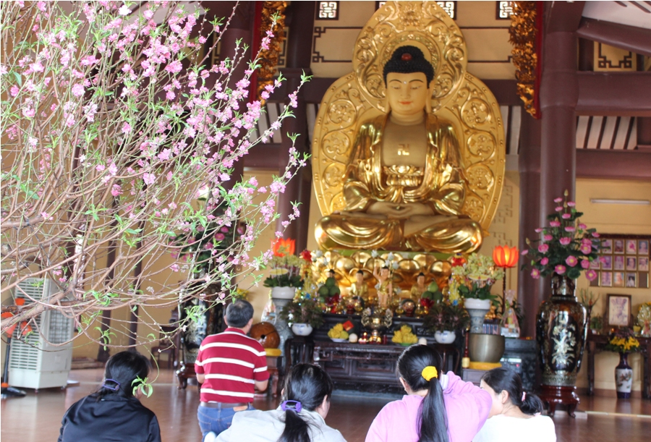
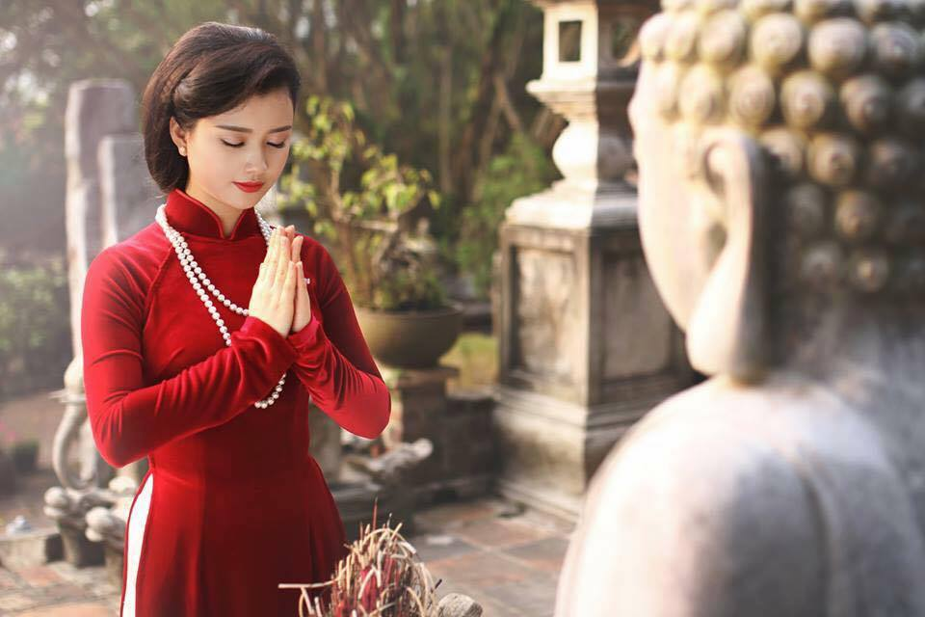
Preserve our religious beliefs and practices

Slide 26
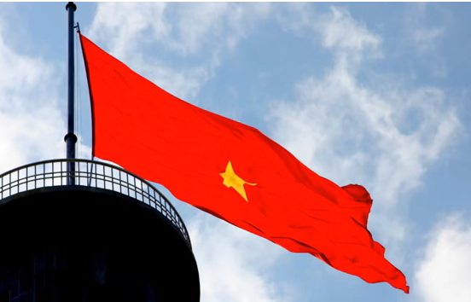
Speak our native language

Slide 27


Homework
Summarize the reading passage in your own words.

Slide 28
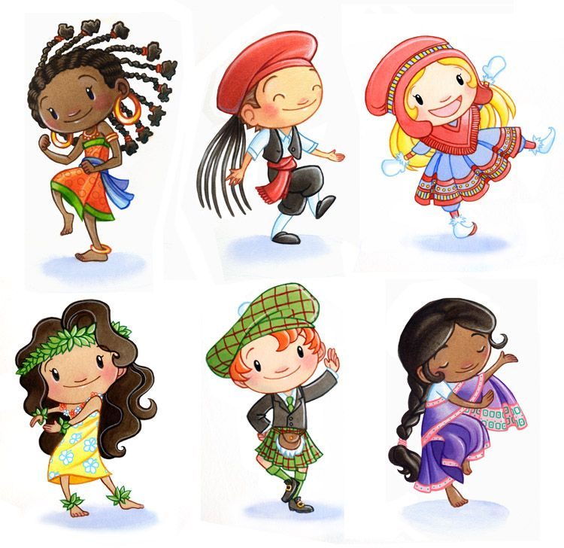
Thank you

Slide 29

Unit 5: Cultural Identity
Activity 3 (page 63)
Question 1:
How do individuals define themselves?
Suggested answer:
They define themselves by cultural identifiers such as nationality, ethnicity, location, history, language, gender, belief, customs, clothing and food.

Slide 30
Unit 5: Cultural Identity
Activity 3 (page 63)
Question 2:
What happens in the first and the second stages of the formation of cultural identity?
Suggested answer:
In the first stage, children take culture for granted, and easily accept cultural ideas and values without much critical thinking.
In the second stage, teenagers may become more curious, and willing to explore, analyse, and compare their beliefs with other cultures.

Slide 31
Unit 5: Cultural Identity
Activity 3 (page 63)
Question 3:
When do people reach the final stage?
Suggested answer:
People reach the final stage when they develop a clear sense of cultural identity, know which special group they belong to and feel satisfied with their cultural identity.

Slide 32
Unit 5: Cultural Identity
Activity 3 (page 63)
Question 4:
Why can people’s cultural identity be affected by other cultures even if they live in their native country?
Suggested answer:
Because access to the Internet and the media provides instant contact with many cultures.

Slide 33
Unit 5: Cultural Identity
Activity 3 (page 63)
Question 5:
What are the three ways people react when they move to a new culture?
Suggested answer:
First, they keep their cultural identity. Second, they assimilate into the new culture of the majority. Third, they integrate into the new cultural environment while keeping their own cultural identity and flexibly adjusting to the different aspects of the new culture.

Slide 34



Congratulations!
9 points for you !

