Slide 1
Game: Hidden picture

Slide 2
Game rules
Three groups competes with one another.
6 pieces cover the completes picture.
A correct answer helps you to uncover one part of completed picture.
Answer within 10 secs, other groups grab your chance to answer if you exceed time limit.
Vietnamese correct name: 1 point, English correct name: 2 points, the completed picture: 20 points
Say “BINGO” anytime if you have an answer for the key picture
-

Slide 3
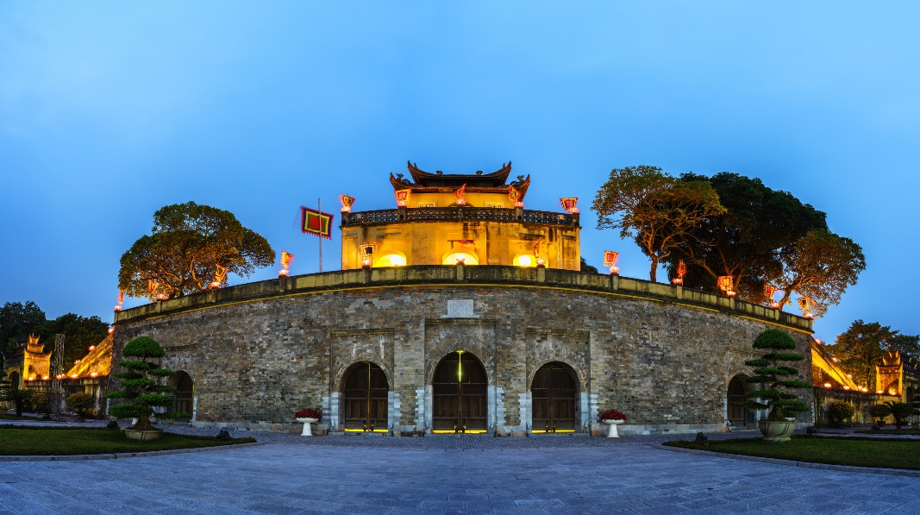
Key
1
2
3
4
5
6

Slide 4
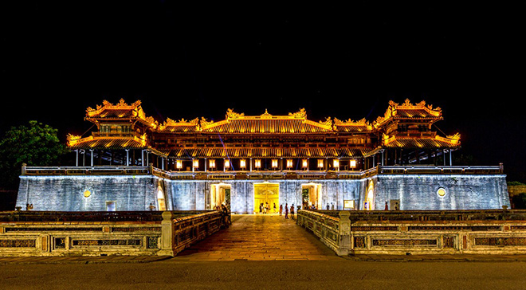
Hue Imperial citadel complex

Slide 5
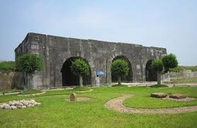
Citadel of Ho Dynasty

Slide 6
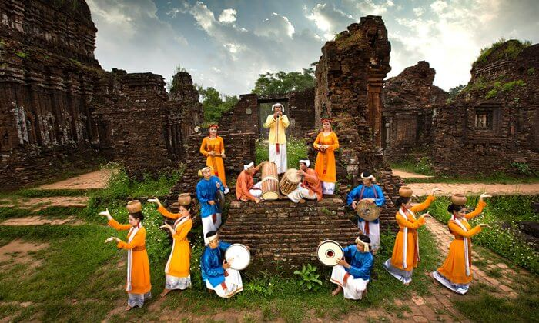
My Son sanctuary

Slide 7
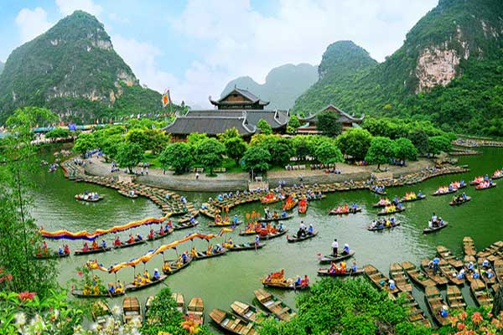
Trang An landscape complex

Slide 8
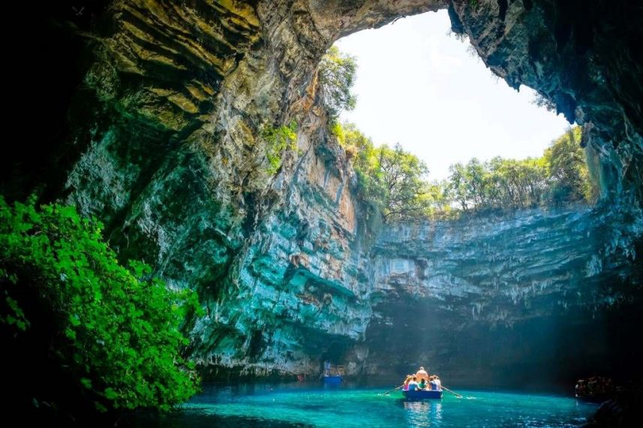
Phong Nha-Ke Bang National Park

Slide 9
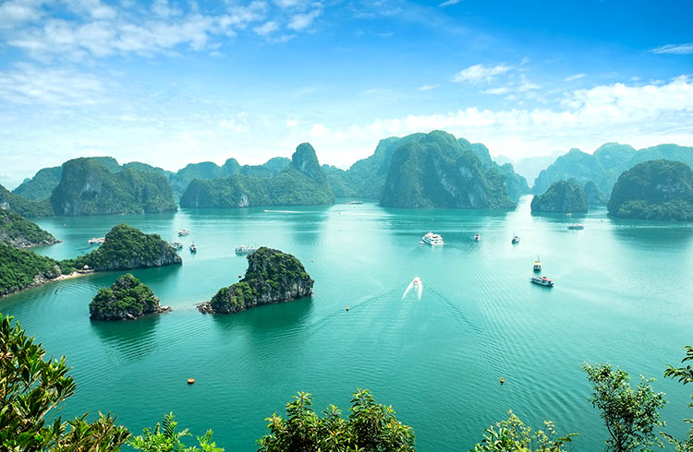
Ha Long Bay

Slide 10
The Imperial Citadel of Thang Long

Slide 11
UNIT 8:
OUR WORLD HERITAGES
Lesson: Getting started/ p.

Slide 12
Objectives
By the end of the lesson, you will be able to:
Familiarise yourself with the new topic
Get to know some words related to the topic,
pronunciation and grammatical feature

Slide 13
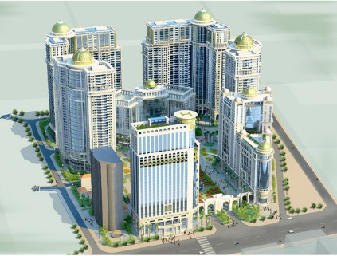
Vocabulary
a large building with various
connected rooms or a group of
buildings

Slide 14
Vocabulary
Complex (n): tổ hợp
phức hợp
/ˈkɒm.pleks/
E.g. They plan to build an apartment complex, scheduled to take 5 months

Slide 15
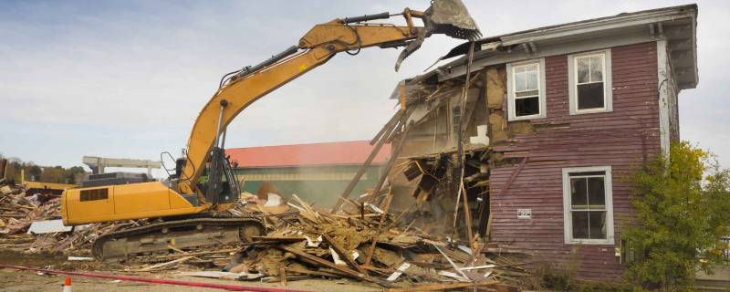
Vocabulary
To pull down, destroy completely,
esp. the building

Slide 16
Vocabulary
To demolish (v): phá dỡ
/dɪˈmɒl.ɪʃ/
E.g. They are going to demolish the
old building soon

Slide 17
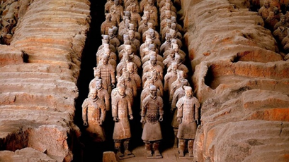
Vocabulary
Related to the studies of things/
people in the past in order to learn about their culture and society
...... +discovery, + ...... site, + .....value

Slide 18
Vocabulary
Archaeological (a):
thuộc về khảo cổ học
/ˌɑː.kiˈɒl.ə.dʒi/
E.g. One of the most spectacular
archaeological discoveries of the 20th
century is terra cotta statues in Qin
Shi Huang Emperor burial complex.
Archaeology (n)
Archaeologist (n)

Slide 19
Vocabulary
an object, tradition, or system
from the past that continues to exist
Relic (n):
/ˈrel.ɪk/
tàn tích

Slide 20
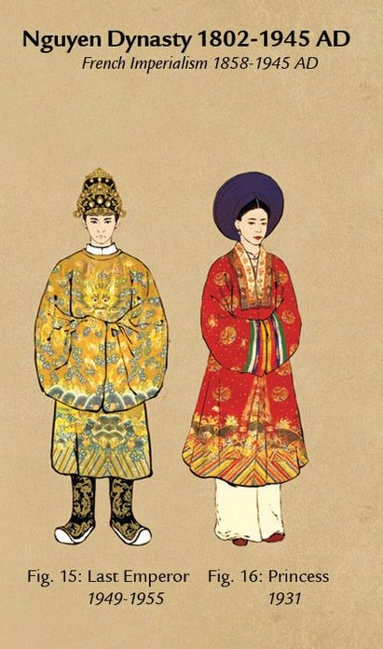
Vocabulary
a series of rulers or leaders who are all from the same family,
Prosperous+ ......, feudal + ......

Slide 21
Vocabulary
triều đại
Dynasty (n):
/ˈdaɪ.nə.sti/
E.g. The Nguyễn dynasty was the last Vietnamese dynasty

Slide 22
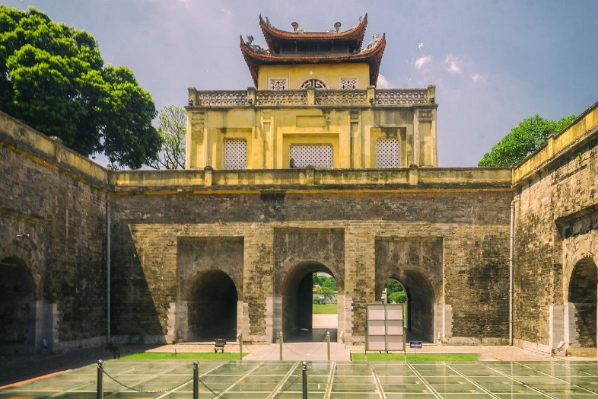
Vocabulary

Slide 23
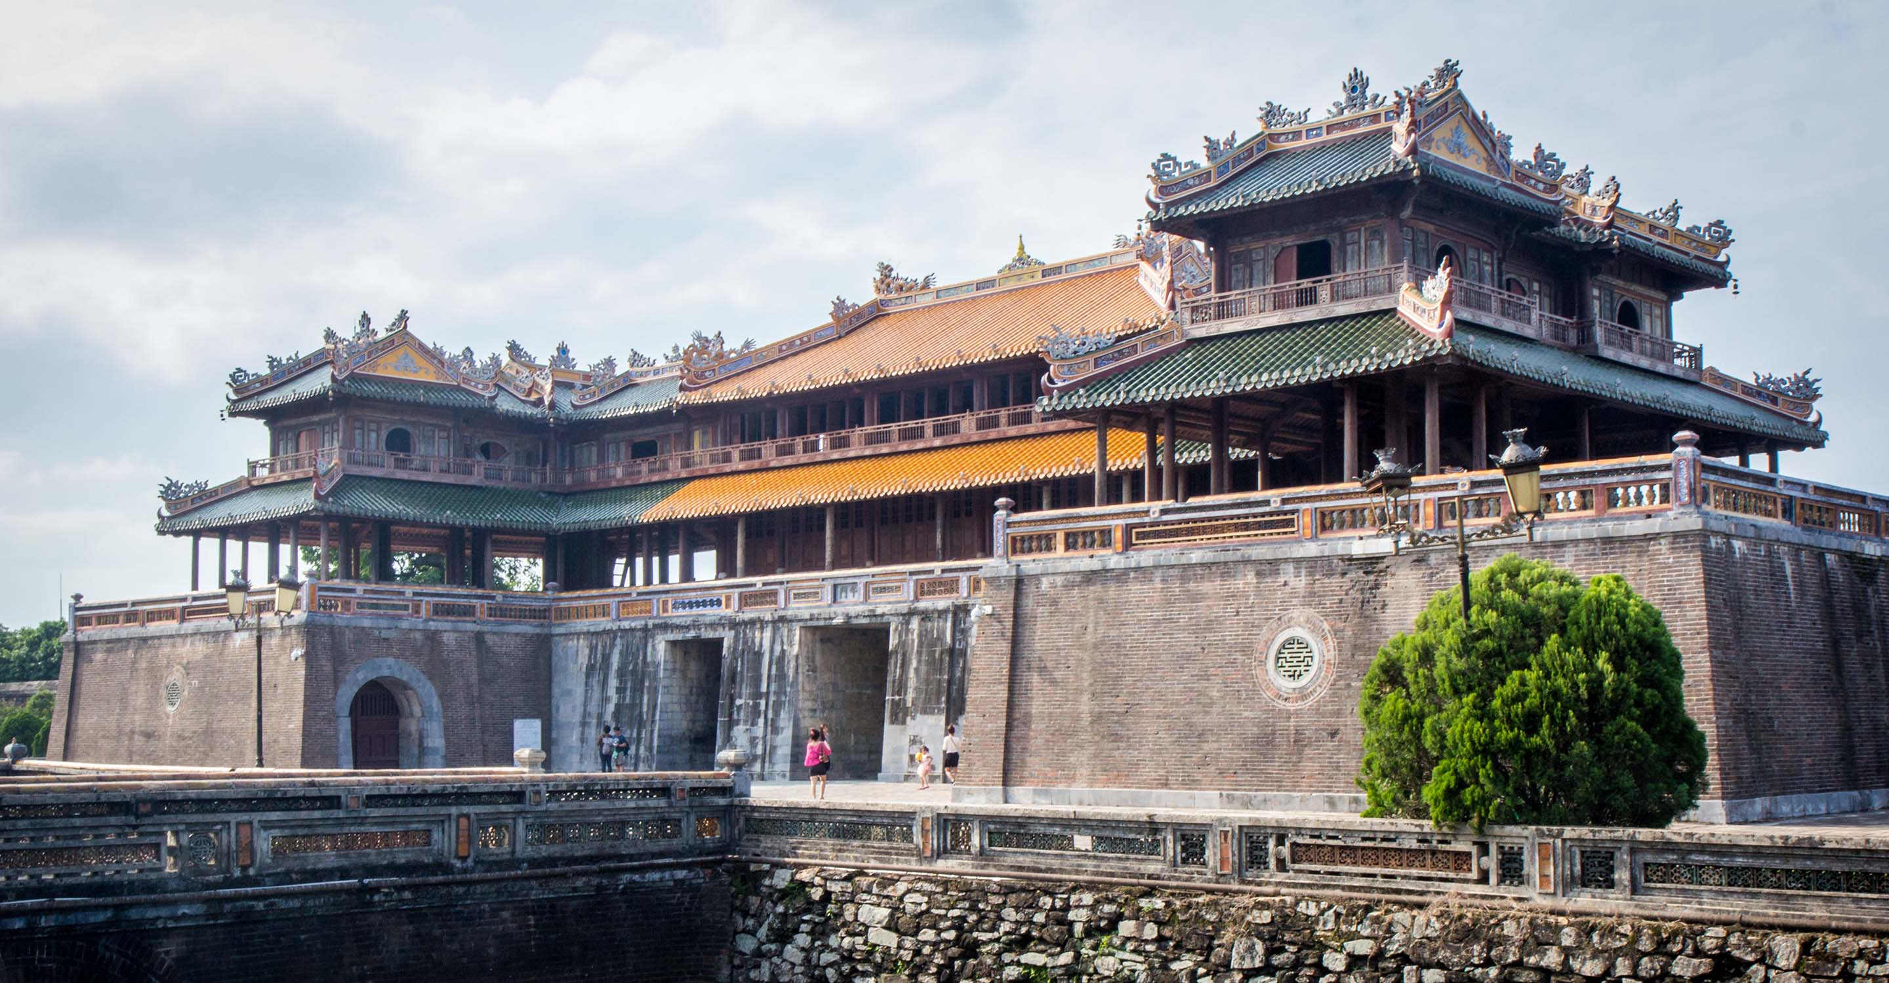
Vocabulary
cố đô
Citadel (n):
/ˈsɪt.ə.del/
E.g. Hue Imperial Citadel stands firm
in the center of the city, alongside
the Perfume River.

Slide 24
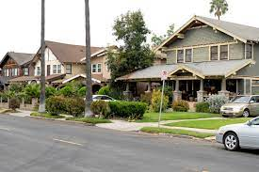
Vocabulary
complete and in the original state
remain+ ......., keep + ....., preserve + .....
Before After

Slide 25
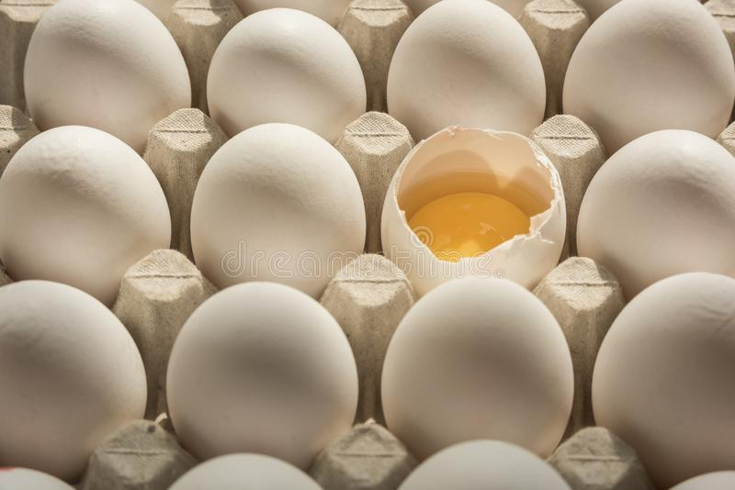
Vocabulary
Nguyên vẹn
Intact
Intact (a):
/ɪnˈtækt/
In ruin
E.g. Most of the unearth relics remain intact.
Đổ nát
In ruin :

Slide 26
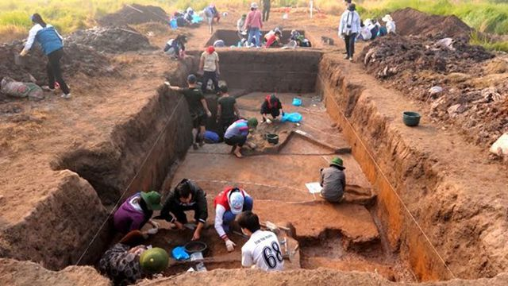
Vocabulary
The act of unearthing to discover
old objects
Archaeological + ......, artifacts + .....

Slide 27
Vocabulary
Sự khai quật
Excavation (n):
/ˌeks.kəˈveɪ.ʃən/
E.g. A large-scale excavation was
conducted to study features and
artifacts
Khai quật
Excavate (v):

Slide 28
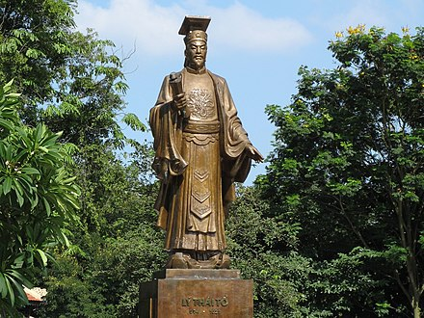
Vocabulary
a structure or building that is built
to honour a special person or event:
Ly Thai To .......

Slide 29
Vocabulary
đài tưởng
niệm
Monument (n):
/ˈmɒn.jə.mənt/
E.g. King Ly Thai To Monument is located in Ly Thai To Garden, Dinh Tien Hoang Street.

Slide 30
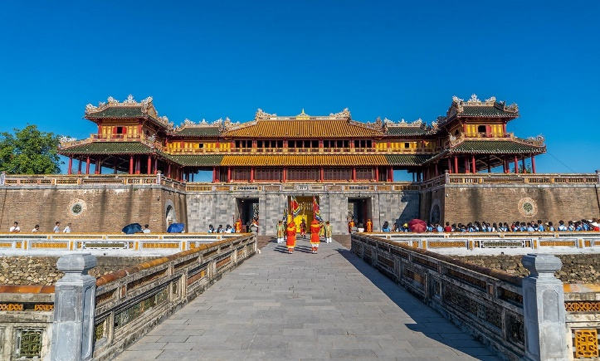
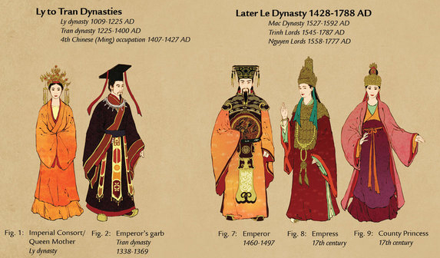
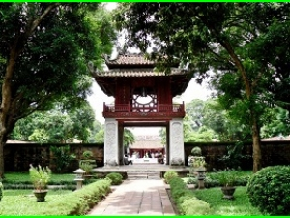
Vocabulary
....... palace
....... robes
....... academy

Slide 31
Vocabulary
Thuộc về
hoàng gia
Imperial (a):
/ɪmˈpɪə.ri.əl/
E.g. Imperial robes of Emperor are normally embroided with gold dragon pattern.

Slide 32
1. complex | (n) | Tổ hợp, phức hợp
2. demolish | (v) | Phá dỡ
3. archaelogical - archaelogy - archaelogist | (adj) (n) (n) | Thuộc về khảo cổ học Khảo cổ học Nhà khảo cổ học
4. relic | (n) | Tàn tích
5. dynasty | (n) | Triều đại
6. citadel | (n) | Cố đô
7. intact >< in ruins | (a) | Vẹn nguyên >< đổ nát
8. excavation - excavate | (n) (v) | Việc khai quật Khai quật
9. monument | (n) | Đài tưởng niệm
10. imperial | (a) | Thuộc về hoàng gia
Vocabulary

Slide 33
Predictions
Which of the following do you predict the content mentions?
- Time of construction
- What people can see there
- Time when it is official recognized as World Heritage Sites
- Other 8 UNESCO World Heritage Sites in Vietnam
- What people should carry along when going there
- Names of excavated relics
- Time they will visit the citadel

Slide 34
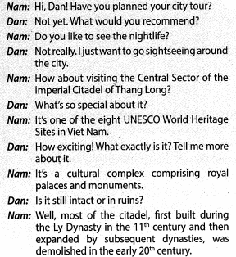
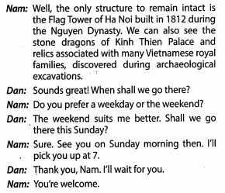
Listen and check

Slide 35
Predictions
Which of the following do you predict the content mentions?
- Time of construction
- What people can see there
- Time when it is official recognized as World Heritage Sites
- Other 8 UNESCO World Heritage Sites in Vietnam
- What people should carry along when going there
- Names of excavated relics
- Time they will visit the citadel
✓
✓
✓
✓

Slide 36
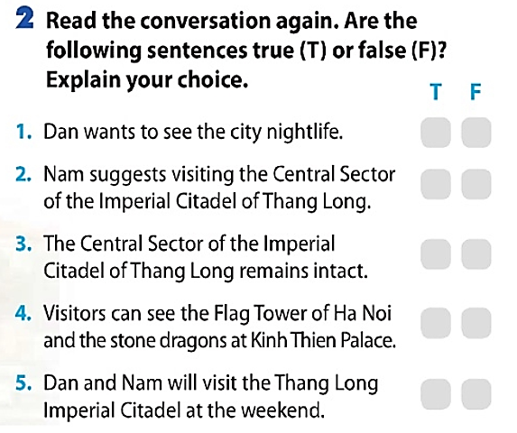
Task 2:

Slide 37
Task 2:
T F
1. Dan wants to see the city nightlife
✓
Correction: He wants to go sightseeing
2. Nam suggests visiting the Central Sector of the Imperial Citadel of Thang Long
✓
Nam: How about visiting the Central Sector of the Imperial Citadel of Thang Long

Slide 38
Task 2:
T F
3. The Central Sector of the Imperial
Citadel of Thang Long remains intact.
✓
Correction: Most of the citadel was demolished in the early 20th century
4. Visitors can see the Flag Tower of Hanoi and the stone dragons at Kinh Thien Palace.
✓
Nam: The only structure to remain intact is the Flag Tower ....
We can also see the stone dragons of Kinh Thien Palace and relics...

Slide 39
Task 2:
T F
5. Dan and Nam will visit the Thang Long Imperial Citadel at the weekend.
✓
Nam: Do you prefer weekday or the weekend?
Dan: The weekend suits me better. Shall we go
there this Sunday?
Nam: Sure, See you on Sunday morning then

Slide 40
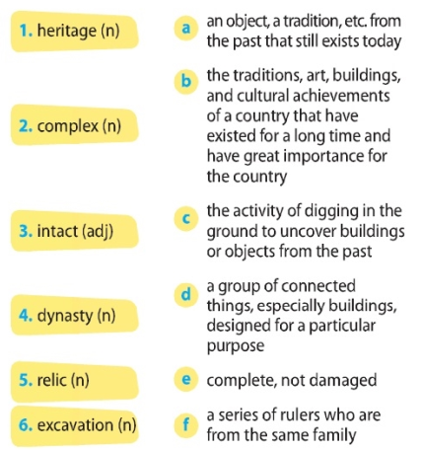
Task 3:
1. b
2. d
3. e
4. f
5. a
6. c

Slide 41
Task 4:
Work and discuss with your partner
Find the sentences in the conversation which have the same meaning as the following sentences.
1. It is a cultural complex that comprises royal palaces and monument.
2. Most of the citadel which was built during the Ly dynasty in the 11th century and then expanded by the subsequent dynasties, was
demolished in the early 20th century.
3. The only structure that is still intact is the Flag Tower of Hanoi.

Slide 42
Task 4:
It is a cultural complex that comprises royal palaces and
monument.
It is a cultural complex comprising royal palaces and monument.

Slide 43
Task 4:
2. Most of the citadel which was built during the Ly dynasty in the 11th century and then expanded by the subsequent
dynasties, was demolished in the early 20th century.
Most of the citadel first built during the Ly dynasty in the 11th century and.... was demolished in the early 20th century.

Slide 44
Task 4:
3. The only structure that is still intact is the Flag Tower of
Hanoi.
The only structure to remain intact is the Flag Tower of Hanoi.

Slide 45
Task 4:
1. It is a cultural complex that comprises royal palaces and monument.
It is a cultural complex comprising royal palaces and monument.
2. Most of the citadel which was built during the Ly dynasty in the 11th century and then expanded by the subsequent dynasties, was demolished in the early 20th century.
Most of the citadel first built during...., was demolished in the ....
3. The only structure that is still intact is the Flag Tower of Hanoi.
The only structure to remain intact is the Flag Tower of Hanoi.

Slide 46
Task 4:
1. It is a cultural complex that comprises royal palaces and monument.
It is a cultural complex comprising royal palaces and monument.
2. Most of the citadel which was built during the Ly dynasty in the 11th century and then expanded by the subsequent dynasties, was demolished in the early 20th century.
Most of the citadel first built during...., was demolished in the ....
3. The only structure that is still intact is the Flag Tower of Hanoi.
The only structure to remain intact is the Flag Tower of Hanoi.

Slide 47
Grammatical feature:
Reduction of relative clause with participial phrases
(past participle, present participle) and to-infinitive

Slide 48
Task 5:
Find questions with the form A OR B?
with your partner
Discuss its name
Alternative/choice question

Slide 49
Pronunciation feature
Intonation of alternative/choice questions

Slide 50
In pair, ask and answer
Have you ever visited the Central Sector of the Imperial
Citadel of Thang Long?
+ If yes, tell your partner about your visit. If no, would you like to visit? Why?

Slide 51
Self-assessement
By the end of the lesson, you will be able to:
Familiarise yourself with the new topic.
Get to know some words related to the topic,
pronunciation and grammatical feature.

Slide 52
Summary
Complex
imperial
Excavate & excavation
Intact
in ruins
Monument
citadel
To demolish
relics
dynasty
archaeological

Slide 53
Summary
Vocabulary
Lexical items of the topic “Our World Heritage Sites”
Pronunciation
Intonation of alternative question
Grammar
Reduction of relative clauses with participial phrases, to -infinitive

Slide 54
Revise today’s new words & Record yourself
Prepare for the next lesson

