Slide 1


Slide 2
LOOKING BACK and PROJECT
Unit
5
GLOBAL WARMING
Unit
FAMILY LIFE
LESSON 8
Student Book – page 60 + 61

Slide 3
LESSON 8
LOOKING BACK AND PROJECT
WARM-UP
Quiz
Pronunciation: Underline the stressed words.
Vocabulary: Choose the correct word or phrase
Grammar: Rewrite the sentences.
LOOKING BACK
PROJECT
What we can do every day to help limit global warming.
CONSOLIDATION
Wrap up
Homework

Slide 4
HOW MUCH DO YOU REMEMBER THE OLD LESSON?
Unit
FAMILY LIFE
Work in 2 groups
Take turn to answers the questions by CHOOSING TRUE (T)OR FALSE (F), OR FILLING THE BLANKS
After each right answer, the group will receive THE MARKS OR THE GIFT
In the end, which group has more marks will be THE WINNER

Slide 5


1. Burnt for energy, fossil fuels release large amounts of carbon dioxide into the atmosphere.
20 marks
True
False

Slide 6
2. Global warming is NOT also linked to rising sea levels.
15 marks
True
False

Slide 7
3. Trapping too much of the sun’s heat, greenhouse gases stop it from escaping back into space.
A BIG CLAP
True
False

Slide 8
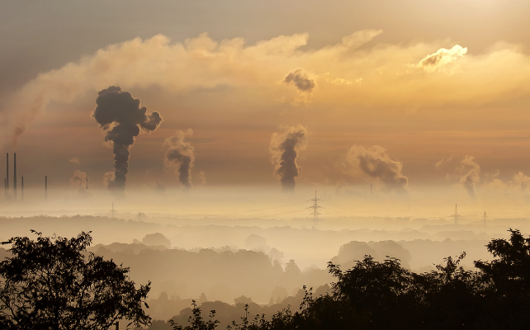
4.Wind and sunlight are examples of ………..sources of energy .
nonrenewable
YOU ARE EXCELLENT !
renewable

Slide 9
5.Deforestation is an effective solution to climate change.
30 MARKS
True
False

Slide 10
6. Methane is a greenhouse gas that is less powerful than CO2, at warming the earth.
15 MARKS
True
False

Slide 11
7. The world biggest source of soot is burning crop………...
waste
30 MARKS
plants

Slide 12
8. Renewable energy will never…………because it come from natural sources.
run on
2 PENS
run out

Slide 13
Renewable energy will never run out because it come from natural sources.

Slide 14


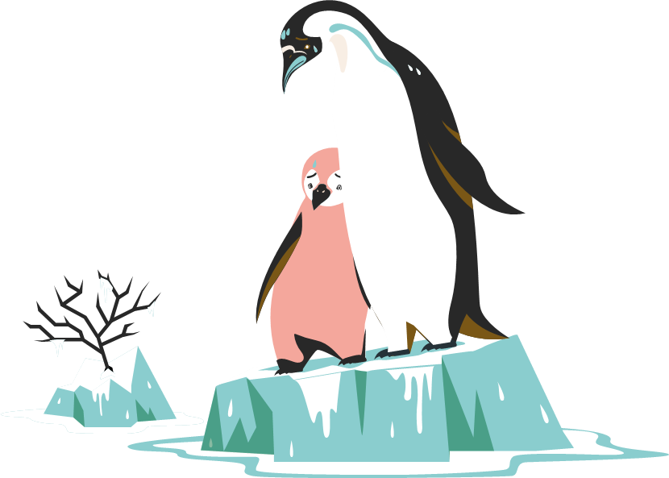
PRONUNCIATION
Listen and underline the stressed words. Then practise saying the sentences with a natural rhythm.
1. Forests are helpful in cooling down our planet.
2. Plants can store a lot of carbon in their roots, branches, and leaves.
3. Oceans can also remove carbon from the atmosphere and store it.
4. Oceans may start releasing the carbon they store as global temperatures rise.

Slide 15
VOCABULARY
Choose the correct word or phrase to complete the diagram.
- Human activities : -raising cows
- burning of ……1…….(oil, ….2...….and gas) and crop ……3……..……...
……5…….…………………dioxide
and ……6…………………….…( CH 4)
- People should find ……7………………..……sources of energy such as wind, waves and sunlight .
…..4…

Slide 16
VOCABULARY
Choose the correct word or phrase to complete the diagram.
- Human activities : -raising cows
- burning of …………………………(oil, …....and gas) and crop .. ……..……...
………….….dioxide
………………………...…( CH 4)
- People should find …………..……sources of energy such as wind, waves and sunlight .
fossil fuels
coal
waste
release
carbon
methane
renewable

Slide 17
GRAMMAR
1. Because renewable energy comes from natural sources,
it is very clean and unlimited.
=> Coming from natural sources, renewable energy
is very clean and unlimited.
2. If fossil fuels are burned, they release a lot of carbon dioxide.
=> Burned, fossil fuels release a lot of carbon dioxide.

Slide 18
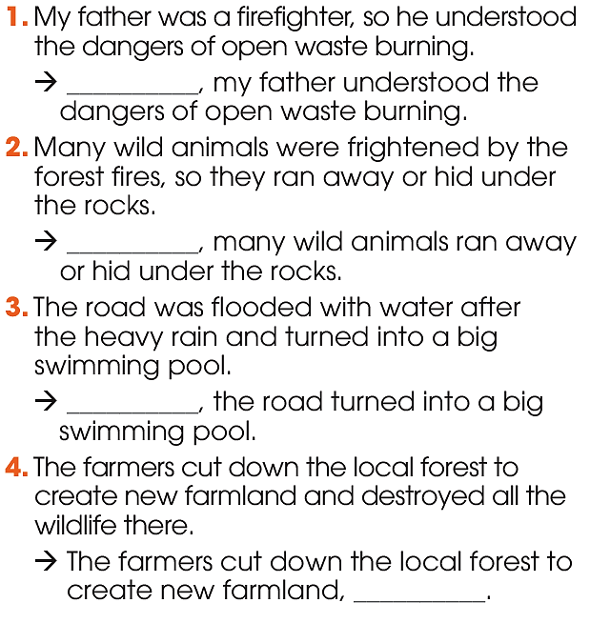
GRAMMAR
Rewrite the sentences using present or past participle clauses.

Slide 19
GRAMMAR
1.My father was a firefighter, so he understood the dangers of open waste burning.
=> Being a firefighter, my father understood the dangers of open waste burning.
2. Many wild animals were frightened by the forest fires, so they ran away or hid under the rocks.
=> Frightened by the forest fires, many wild animals ran away or hid under the rocks.
3. The road was flooded with water after the heavy rain and turned into a big swimming pool.
Flooded with water after the heavy rain, the road turned into a big swimming pool.
4. The farmers cut down the local forest to create new farmland and destroyed all the wildlife there.
The farmers cut down the local forest to create new farmland, destroying all the wildlife there.

Slide 20
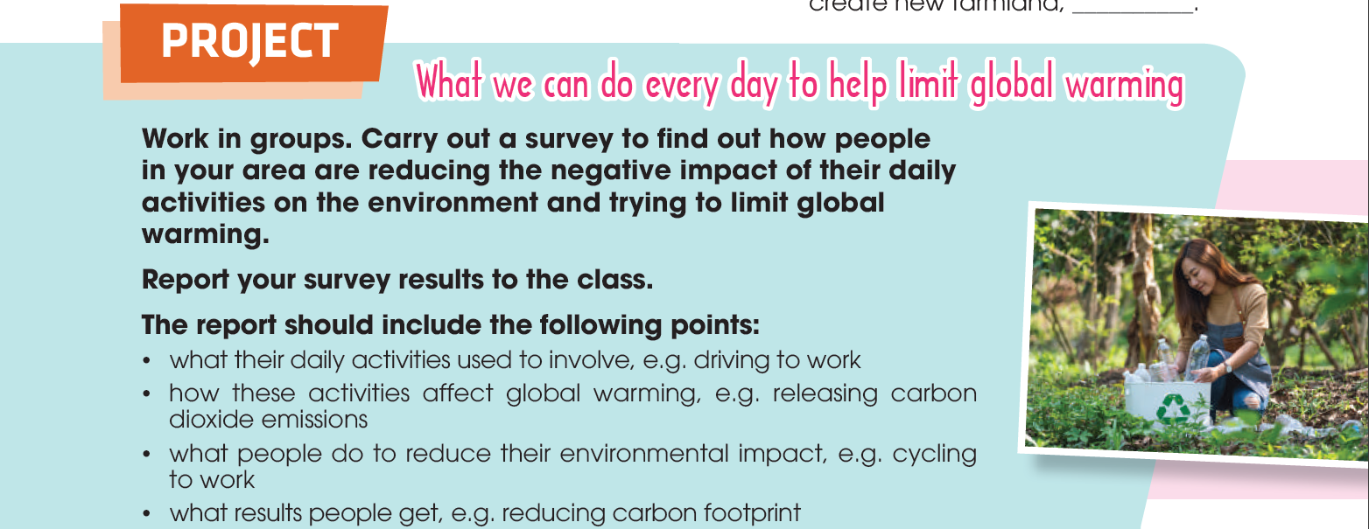
PROJECT

Slide 21

What have you learnt today?
CONSOLIDATION
Wrap-up
1
Review the vocabulary and grammar of Unit 5.
Apply what you have learnt (vocabulary and grammar) into practice through a project.
Carry out a survey to find out how local people reduce their environmental impact and present the survey results to the class.

