Slide 2
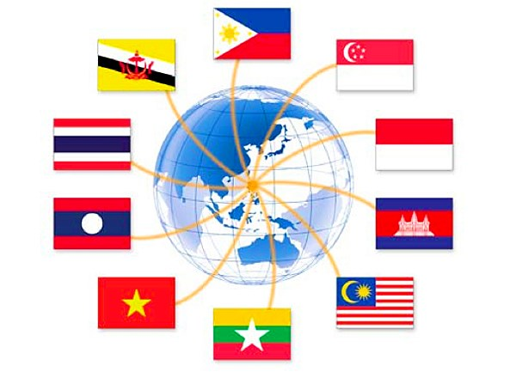
GAME
Stick the national flags of 10 ASEAN membership states beside the right names of those countries

Slide 3
GAME: Matching
a.
1. Brunei Darussalam
2. Cambodia
3. Indonesia
4. Laos
5. Malaysia
6. Myanmar
7. The Philippines
8. Singapore
9. Thailand
10. Vietnam
f.
b.
g.
c.
h.
d.
i.
e.
j.

Slide 4
GAME: Matching
a.
1. Brunei Darussalam
f.
2. Cambodia
3. Indonesia
4. Laos
b.
g.
5. Malaysia
6. Myanmar
7. The Philippines
c.
8. Singapore
h.
9. Thailand
10. Vietnam
d.
i.
e.
j.

Slide 5
Period 40:
Unit 5:
BEING PART OF ASEAN
Part 3: Reading
The Association of Southeast Asian Nations

Slide 6
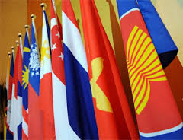
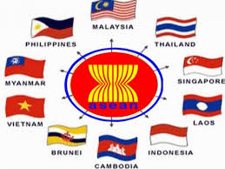

Slide 7
Vocabulary
1. identity /aɪˈden.tə.ti/ (n) :
danh tính/ bản sắc

Slide 8
Vocabulary
2. motto /ˈmɒt.əʊ/ (n) :
phương châm

Slide 9
Vocabulary
3. come into force (ph.v)
có hiệu lực

Slide 10
Vocabulary
4. in accordance with (ph.v) :
theo như/phù hợp với
-> 5. legal /ˈliː.ɡ^{ə}l/ (adj) : be in accordance with the law
(hợp pháp)

Slide 11
Vocabulary
6. dispute /dɪˈspjuːt/ (n) = argument/ disagreement
(tranh chấp/tranh luận)

Slide 12
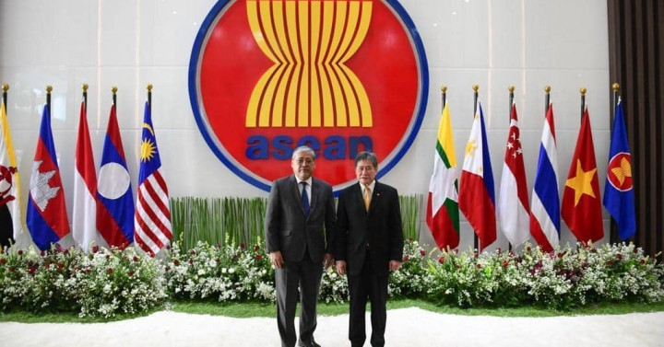
Vocabulary
7. affair /əˈfeə^{r}/ (n) = political events and activities

Slide 13
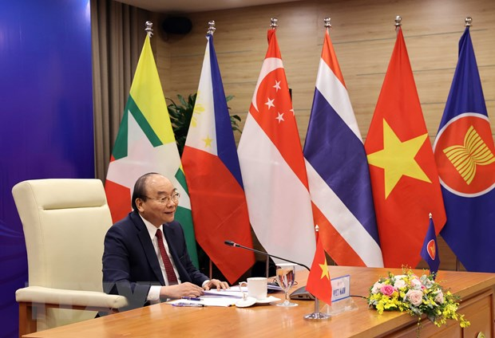
Vocabulary
8. internal /ɪnˈtɜː.n^{ə}l/ (adj) = domestic
(trong nước)

Slide 14
Vocabulary
1. identity /aɪˈden.tə.ti/ (n) : danh tính/ bản sắc
2. motto /ˈmɒt.əʊ/ (n) : phương châm
3. come into force : có hiệu lực
4. in accordance with : theo như/phù hợp với
5. legal /ˈliː.ɡ^{ə}l/ (adj) : be in accordance with the law (hợp pháp)
6. dispute /dɪˈspjuːt/ (n) = argument/ disagreement (tranh chấp/tranh luận)
7. affair /əˈfeə^{r}/ (n) = political events and activities (vụ việc)
8. internal /ɪnˈtɜː.n^{ə}l/ (adj) = domestic (trong nước)

Slide 15
Activity 1: Match the headings (1-5) with the paragraphs (A-E)
5
1. Cultural and sports activities | Paragraph A ----------
2. Aims and motto | Paragraph B ----------
3. Charter | Paragraph C ----------
4. Area, population and economies | Paragraph D ----------
5. History and membership | Paragraph E ----------
4
2
3
1

Slide 16
Activity 2
Find the words or expressions in the text that have the following meanings
1. The Constitution of ASEAN | Charter ( paragraph D)
2. a policy of not getting involved in other countries’ disputes | non- interference ( paragraph D)
3. a short sentence or phrase used to express a principle, goal, or ideal of a person or an organisation | motto (paragraph C)
4. an act of showing proper acceptance, consideration or appreciation | respect ( paragraph D)

Slide 17
Activity 3: Read the text and answer the questions
1. Which were the first five members of ASEAN?
2. When did the other states join the bloc?
3. How big is ASEAN?
4. What are the six majors?
5. What is ASEAN‘s motto?
6. What are the main principles of the ASEAN charter?
7. How does the bloc integrate its state member?

Slide 18
Lucky flags

Slide 19
How big is ASEAN?
It has a land area of 4,46 million km2 and a population of 600 million people. ASEAN would rank as the eight largest economy in the world if it were a single country.
(Paragraph B)

Slide 21
Which were the first five members of ASEAN?
Indonesia, Malaysia, the Philippines, Singapore and Thailand were the first five members of ASEAN.
(paragraph A)

Slide 22
When did other states join the bloc?
Brunei became the sixth member in 1984. In 1995, Vietnam became the seventh member. Laos and Myanmar joined the bloc in 1997, and Cambodia joined two years later. (paragraph A)

Slide 24
What are the main principles of the ASEAN Charter?
Its main principles include respect for the member states independence and non-interference in their internal affairs.
(paragraph D)

Slide 25
How does the bloc integrate its member states?
ASEAN organizes projects and activities which include educational awards, and various cultural and sports activities. (paragraph E)

Slide 27
What are the six majors?
Indonesia, Thailand, Malaysia, Singapore, the Philippines and Vietnam are the six majors.
(Paragraph B)

Slide 28
What is ASEAN’s motto?
“One Vision, One Identity, One Community”
(Paragraph C)

Slide 29
KEY
They were Indonesia, Malaysia, the Philippines, Singapore and Thailand.
Brunei became the sixth member in 1984 and Viet Nam became the seventh member in 1995. Laos and Myanmar joined the bloc in 1997 and Cambodia joined two years later.
It has a land area of 4.46 million km2 and a population of about 600 million people. (ASEAN would rank as the eighth largest economy in the world if it were a single country.)
They are Indonesia, Thailand, Malaysia, Singapore, the Philippines, and Viet Nam.
It is 'One Vision, One Identity, One Community'.
They are to respect for the member states' independence and non-interference in their internal affairs.
It organises different projects and activities, including educational awards, and various cultural and sports activities.

Slide 30
Activity 4: Complete the sentences using the words in the box.
principles | Malaysia | motto | 4.46 million | August 8th 1967 | Cambodia
1984 | 15 December 2008 | stands for | 600 million | Viet Nam | Laos and Myanmar
1. ASEAN (1)………………………… the Association of Southeast Asian Nations, which was formed on (2)…………………………………., in Bangkok, Thailand.
2. The first five members of ASEAN were Indonesia, (3) …………………………., the Philippines, Singapore and Thailand.
3. Brunei Darussalam became the sixth member in (4)………………………..
4. In 1995, (5)………………………… became the seventh member.
5. (6) ……………………………………….. joined the bloc in 1997.

Slide 31
Activity 4: Complete the sentences using the words in the box.
principles | Malaysia | motto | 4.46 million | August 8th 1967 | Cambodia
1984 | 15 December 2008 | stands for | 600 million | Viet Nam | Laos and Myanmar
6. (7) ……………………………….. became the tenth member in 1999.
7. The bloc has a land area of (8)………………..km2 and a population of about (9)…………………… people.
8. The bloc’s (10) ……………….. is: ‘One Vision, One Identity, One Community’.
9. The ASEAN Charter came into force on (11) ……………………………………..
10. The main (12)……………………………… include respect for the member states’ independence and non-interference in their internal affairs.

Slide 32
Activity 4: Complete the sentences using the words in the box.
stands for
1. ASEAN (1)………………………… the Association of Southeast Asian Nations, which was formed on (2)…………………………………., in Bangkok, Thailand.
2. The first five members of ASEAN were Indonesia, (3) …………………………., the Philippines, Singapore and Thailand.
3. Brunei Darussalam became the sixth member in (4)………………………..
4. In 1995, (5)………………………… became the seventh member.
5. (6) ……………………………………….. joined the bloc in 1997.
August 8th 1967
Malaysia
1984
Viet Nam
Laos and Myanmar

Slide 33
Activity 4: Complete the sentences using the words in the box.
6. (7) ……………………………….. became the tenth member in 1999.
7. The bloc has a land area of (8)………………..km2 and a population of about (9)…………………… people.
8. The bloc’s (10) ……………….. is: ‘One Vision, One Identity, One Community’.
9. The ASEAN Charter came into force on (11) ……………………………………..
10. The main (12)……………………………… include respect for the member states’ independence and non-interference in their internal affairs.
Cambodia
4.46 million
600 million
motto
15 December 2008
principles

Slide 34
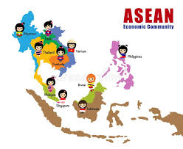
Thank you for your attention

Slide 35
A. ASEAN stands for the Association of Southeast Asian Nations, which was formed on August 8th 1967, in Bangkok, Thailand by Indonesia, Malaysia, the Philippines, Singapore and Thailand. Brunei Darussalam became the sixth member in 1984, right after its independence. In 1995, Viet Nam became the seventh member. Laos and Myanmar joined the bloc in 1997, and Cambodia joined two years later.

Slide 36
B. The bloc has a land area of 4.46 million km² and a population of about 600 million people. Its sea area is about three times larger than its land area. ASEAN would rank as the eighth largest economy in the world if it were a single country. Indonesia, Thailand, Malaysia, Singapore, the Philippines and Viet Nam are called the six majors. These countries are the six largest economies in the region.

Slide 37
C. ASEAN aims at promoting economic growth, social progress and cultural development. At the same time, it focuses on protecting regional peace and stability, and providing opportunities for its member states to discuss diﬀerences peacefully. The bloc’s motto is: 'One Vision, One Identity, One Community'.

Slide 38
D. The ASEAN Charter came into force on 15 December 2008. It is the Constitution of ASEAN and the ten member states must act in accordance with it. After entering into force on December 15th 2008, the Charter has become a legal agreement among the ten ASEAN member states. Its main principles include respect for the member states’ independence and non-interference in their internal aﬀairs.

Slide 39
E. ASEAN organises different projects and activities to integrate its members. These include educational awards, and various cultural and sports activities. Examples of these are the Singapore-sponsored ASEAN Scholarships, the Southeast Asian Games, the ASEAN Para Games, the ASEAN Schools Games and the ASEAN Football Championship.

