Slide 1



Welcome everyone to our class

Slide 2

Watch the video

Slide 3


Slide 4

UNIT 4: CARING FOR THOSE IN NEED
PERIOD 36: COMMUNICATION AND CULTURE
COMMUNICATION
East Meets West

Slide 5
UNIT 4: CARING FOR THOSE IN NEED
PERIOD 36: COMMUNICATION AND CULTURE
Communication
East Meets West

Slide 6

COMMUNICATION

Slide 7
COMMUNICATION
*Vocabulary:
hygiene /ˈhaɪdʒiːn/ (n) = cleanliness
vệ sinh

Slide 8

Humanitarian /hjuːˌmænɪˈteəriən/ (n)/ (adj)
( người theo chủ nghĩa) nhân đạo

Slide 9

non- governmental / ˌnɑːn ˌɡʌvərnˈmentl/ (adj)
phi chính phủ

Slide 10

Cooperation /kəʊˌɒpəˈreɪʃn/(n)
sự hợp tác

Slide 11
Vocabulary
hygiene /ˈhaɪdʒiːn/ (n):
vệ sinh
humanitarian /hjuːˌmænɪˈteəriən/ (n)/(adj):
nhân đạo
non- governmental / ˌnɑːn ˌɡʌvərnˈmentl/ (adj):
phi chính phủ
Cooperation /kəʊˌɒpəˈreɪʃn/ (n):
sự hợp tác

Slide 12

COMMUNICATION
1. Listen to an introduction to a charitable organisation. Complete the table.

Slide 13

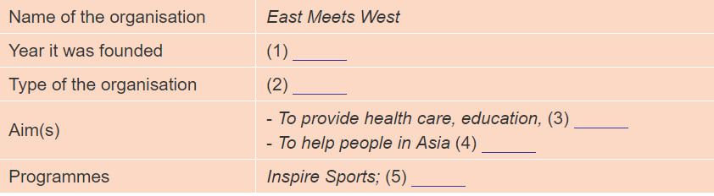
1. Listen to an introduction to a charitable organisation. Complete the table.

Slide 14
1. Year it was founded
East Meets West was started by humanitarian Le Ly Ilayslip in 1988
2. Type of the organisation
East Meets West has become a non-governmental organisation with large- scale projects in Southeast Asia and South Asia.

Slide 15
3. Its programmes are mainly in the fields of healthcare, education, clean water and good hygiene
Aims
4. and aim at helping people in Asia have better lives.

Slide 16
programmes
In Viet Nam, East Meets West has launched the "Inspire Sports" programme in Quang Tri Province to provide disabled people with opportunities to take part in sports with professional coaches and healthcare workers.
5. East Meets West is also working with Viet Nam Television on an international campaign called "Life is Beautiful" to raise awareness about the issues that disabled people are facing in the country

Slide 17
Task 1. Listen to an introduction to a charitable organization . Complete the table.
Name of the organization | East Meets West
Year it was founded | (1)
Type of the organization | (2)
Aim(s) | - To provide health care, education, (3) - To help people in Asia (4)
Programmes | Inspire Sports; (5)
1988
non- governmental
clean water and good hygiene
have better lives
Life is Beautiful

Slide 18
Task 2.Work in 4 groups. Your class want to get involved in East Meets West’s work. Prepare a campaign to support it.
Discuss and write down your campaign’s.Give your results.
(volunteer work)
Events
Aims:
( to help disadvantaged children)
Campaign
Message
Funding:
( fund-raising performances)
(Happiness rises double; Sadness divides half)
Coorperation with other organisations
Volunteers:
( Students from grade 10 and 11)
(With Student's Parents Society )

Slide 19

Look at the picture.
What is it about?

Slide 20

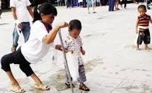
Culture
International Day of Persons with disabilities.

Slide 21
Vocabulary:
Issue /ˈɪʃuː/ (n) :
= problem
vấn đề
citizen /ˈsɪtɪzn/ (n) :
people living together in a country
công dân

Slide 22

integration /ˌɪntɪˈɡreɪʃn/ (n)
sự hòa nhập
integrate /ˈɪntɪɡreɪt/ (v)

Slide 23
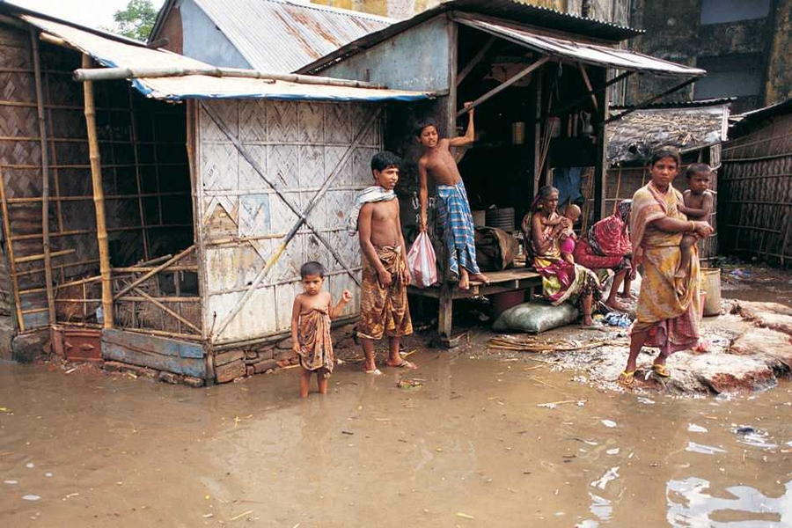
poverty /ˈpɑːvərti/ (n) :
sự nghèo nàn
poor /pʊə(r)/ (adj)

Slide 24

sự phân biệt
discrimination /dɪˌskrɪmɪˈneɪʃn/ (n) :

Slide 25
Vocabulary:
Issue /ˈɪʃuː/ (n) :
vấn đề
Integration /ˌɪntɪˈɡreɪʃn/ (n) :
sự hòa nhập
integrate /ˈɪntɪɡreɪt/ (v)
hòa nhập
poverty /ˈpɑːvərti/ (n) :
sự nghèo nàn
poor /pʊə(r)/ (adj):
nghèo
citizen /ˈsɪtɪzn/ (n) :
công dân
discrimination dɪˌskrɪmɪˈneɪʃn/ (n) :
sự phân biệt

Slide 26
Vocabulary check
Work in pair in 1 minute
Match A (words) with B (meanings)
A | B
1. issue | a. sự nghèo nàn
2. integration | b. công dân
3. poverty | c. sự phân biệt
4. citizen | d. vấn đề
5. discrimination | e. sự hòa nhập

Slide 27

GAME
Who's a millionaire ?

Slide 28


RULES
RULES
Work in 4 groups.
Give your answer after 10 seconds (by using small board)
10 points for each correct answer.
WINNER will receive a PRESENT
Work in four groups in 2 minutes
Take turn to read aloud the following sentences
Find out who is best at reading
The best will have a present
01
00
59
58
57
56
55
54
53
52
51
50
49
48
47
46
45
44
43
42
41
40
39
38
37
36
35
34
33
32
31
30
29
28
27
26
25
24
23
22
21
20
19
18
17
16
15
14
13
12
11
10
09
08
07
06
05
04
03
02
01
00

Slide 29





Who's a millionaire?
50:50
Question 1: Who promoted the International Day of
Persons with Disabilities ?
A. The World Trade Organization
B. The World Health Organization
C. The United Nations
C. The United Nations
D. The Asian
Time for sending SMS
1
2
3
4
5

Slide 30
Who's a millionaire?
50:50
Question 2: What is the aim of this special day?
A. teaching the disable to read and write
B raising awareness of disability issues and calls for support for the rights and well – being of disabled people
B. raising awareness of disability issues and calls for
support for the rights and well – being of disabled people
C. raising money to prepare gifts for the disabled
D. providing healthcare and education
Time for sending SMS
1
2
3
4
5

Slide 31
Who's a millionaire?
50:50
Question 3: What are the problems that many
disabled people are still facing?
A. They are facing unemployment, health and discrimination
B. They are facing poverty, uneducated and healthcare
C. They are facing challenges and healthcare
D. They are facing challenges, discrimination, poverty, limited access to education, employment and heath care
D. They are facing challenges, discrimination, poverty,
limited access to education, employment and heath care.
Time for sending SMS
1
2
3
4
5

Slide 32
Who's a millionaire?
50:50
Question 4: “they” in the last sentence in paragraph 2
refer to_______
A. disabled children
B. schools
C. people with disabilities
C. people with disabilities
D. citizens
Time for sending SMS
1
2
3
4
5

Slide 33

Disabled people are citizens like everyone else and have the same rights !

Slide 34

homework
- Write the lesson in the notebook.
- Prepare the new lesson.

