Slide 1




Slide 2
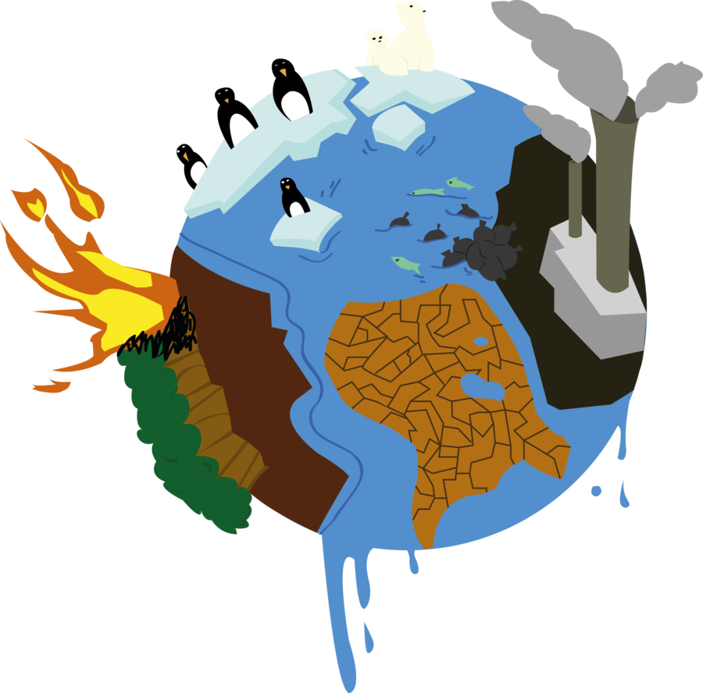
WARM-UP
Global Warming Quiz

Slide 3
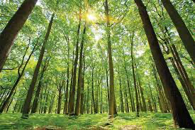

1/ True or False: Forests remove CO2 from the atmosphere and slow global warming.
True
False

Slide 4
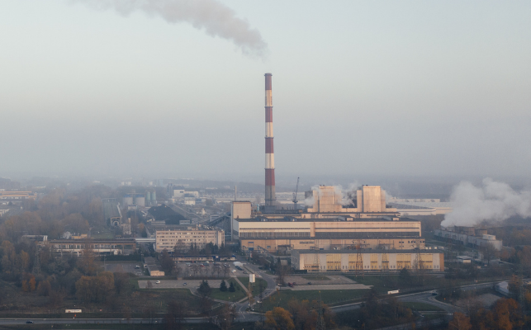
2/ Which of the following is a greenhouse gas?
CO2
CH4
Water Vapour
All of the above

Slide 5
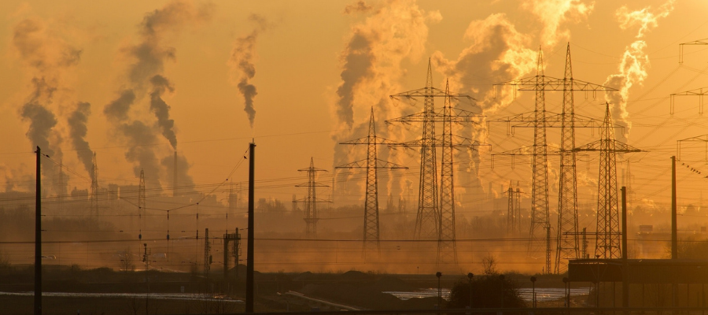
3/ Carbon dioxide is produced when _______ are burnt?
greenhouse gas
fossil fuels
deforestation
power plant

Slide 6
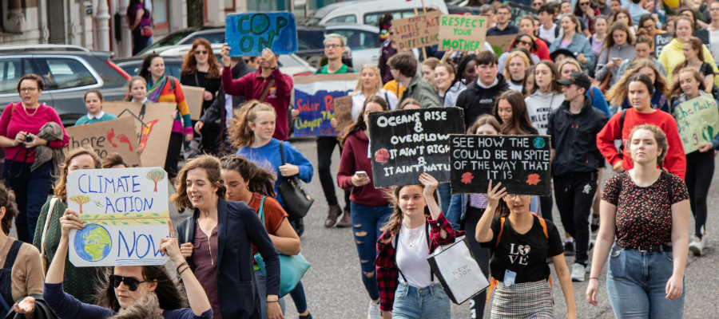
4/ What can we do to help reduce global warming?
Reduce the use of fossil fuels
End deforestation
Reduce methane emissions
All of the above

Slide 7
BLACK CARBON AND GLOBAL
TEMPERATURE
Unit
5
GLOBAL WARMING
Unit
FAMILY LIFE
LESSON 5
LISTENING
Student Book – page 57

Slide 8
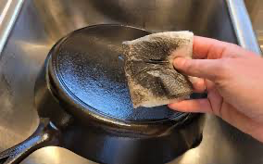

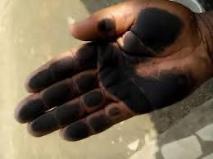
PRE-LISTENING
soot (n)
/sʊt/
a black powder, produced when coal, wood, etc. is burned

Slide 9

PRE-LISTENING
soil (n)
/sɔɪl/
the material on the surface of the ground in which plants grow; earth

Slide 10
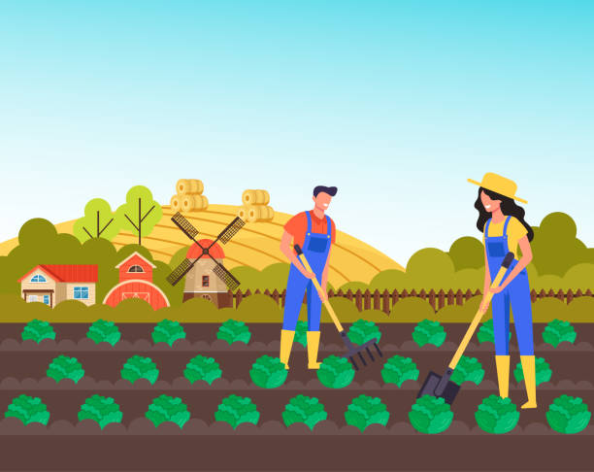
PRE-LISTENING
crop (n)
/krɒp/
a plant such as a grain, vegetable, or fruit grown in large amounts on a farm

Slide 11

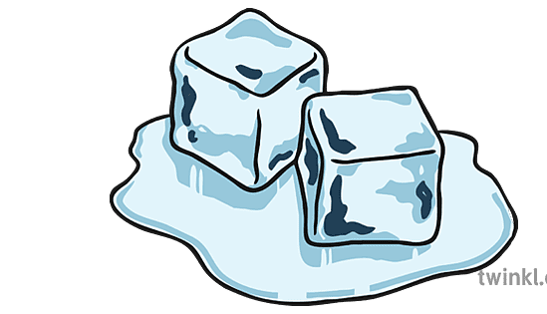
PRE-LISTENING
melt (v)
/melt/
to turn from something solid into something soft or liquid

Slide 12
PRE-LISTENING
Form | Pronunciation | Meaning
1. soot (n) | /sʊt/ | a black powder composed mainly of carbon, produced when coal, wood, etc. is burned
2. soil (n) | /sɔɪl/ | the material on the surface of the ground in which plants grow; earth
3. crop (n) | /krɒp/ | a plant such as a grain, vegetable, or fruit grown in large amounts on a farm, or the total amount gathered of such a plant
4. melt (v) | /melt/ | to turn from something solid into something soft or liquid

Slide 13
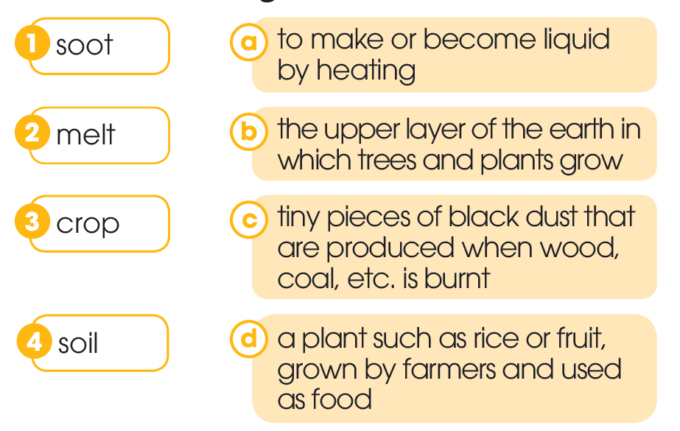
PRE-LISTENING
1
Work in pairs. Match the words with their meanings.

Slide 14
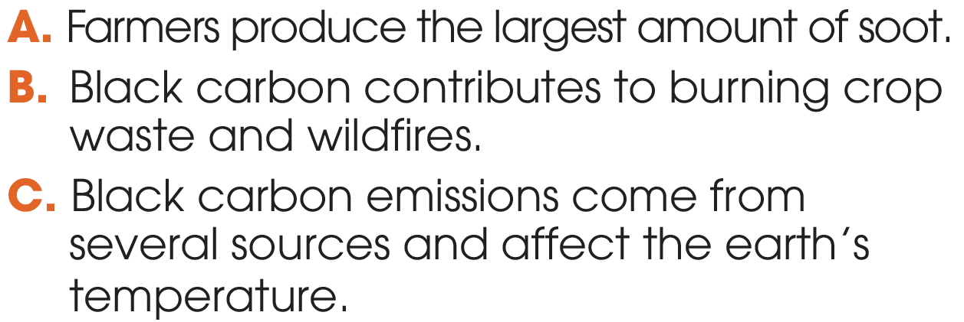
WHILE-LISTENING
2
Listen to a talk and choose the main idea.

Slide 15
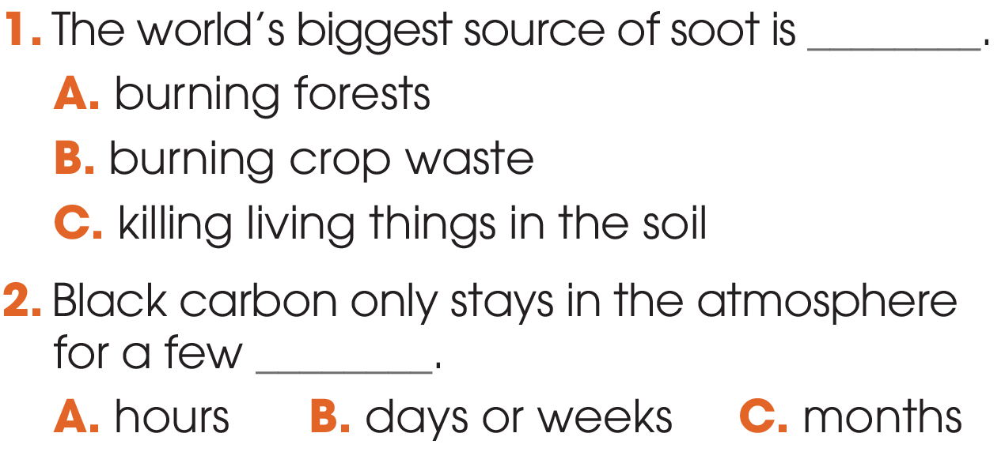
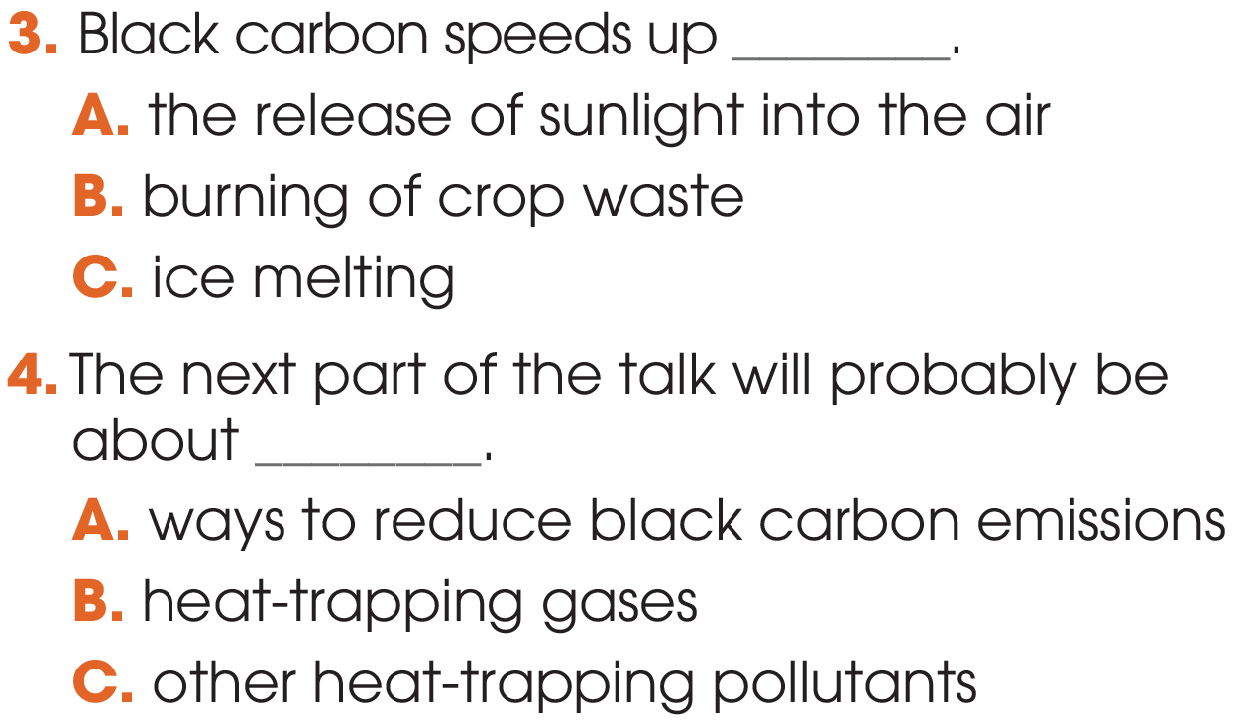
WHILE-LISTENING
3
Listen to the talk again. Choose the correct answers A, B, or C.

Slide 16
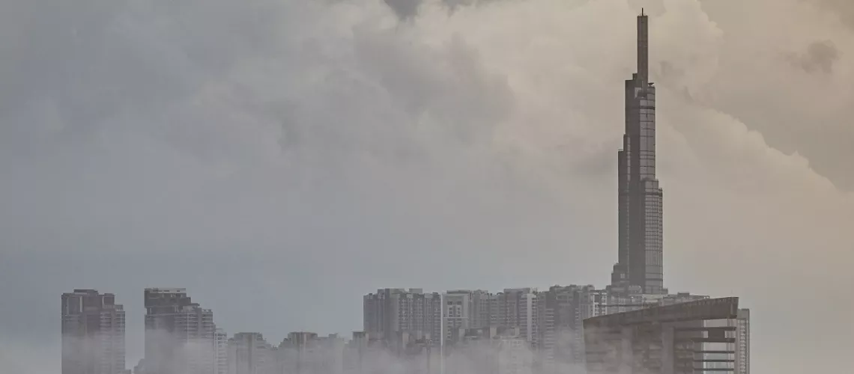
POST-LISTENING
4
Work in groups and answer the questions.
- Is black carbon found in your city or neighbourhood?
- If so, where does it come from?
- What should we do to reduce black carbon emissions in your neighbourhood ?

Slide 17
CONSOLIDATION
1
Wrap-up
What have you learnt today?
New vocabulary
Listen for main ideas and specific information in a talk about black carbon and global temperature

Slide 18
CONSOLIDATION
2
Homework
Do exercises in the workbook.
Prepare for Lesson 6 - Unit 5.

