Slide 1




Slide 2
KIM’S GAME
Ss work in two teams. Try to remember the things on screen without writing.
After that, Ss have 20 seconds to go to the board and write all the words (name of the things).
The team with more correct words is the winner.

Slide 3
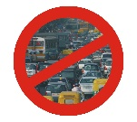


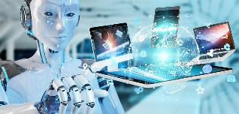
No traffic jam/
congestion
tall buildings
No pollution
robots/computers

Slide 4
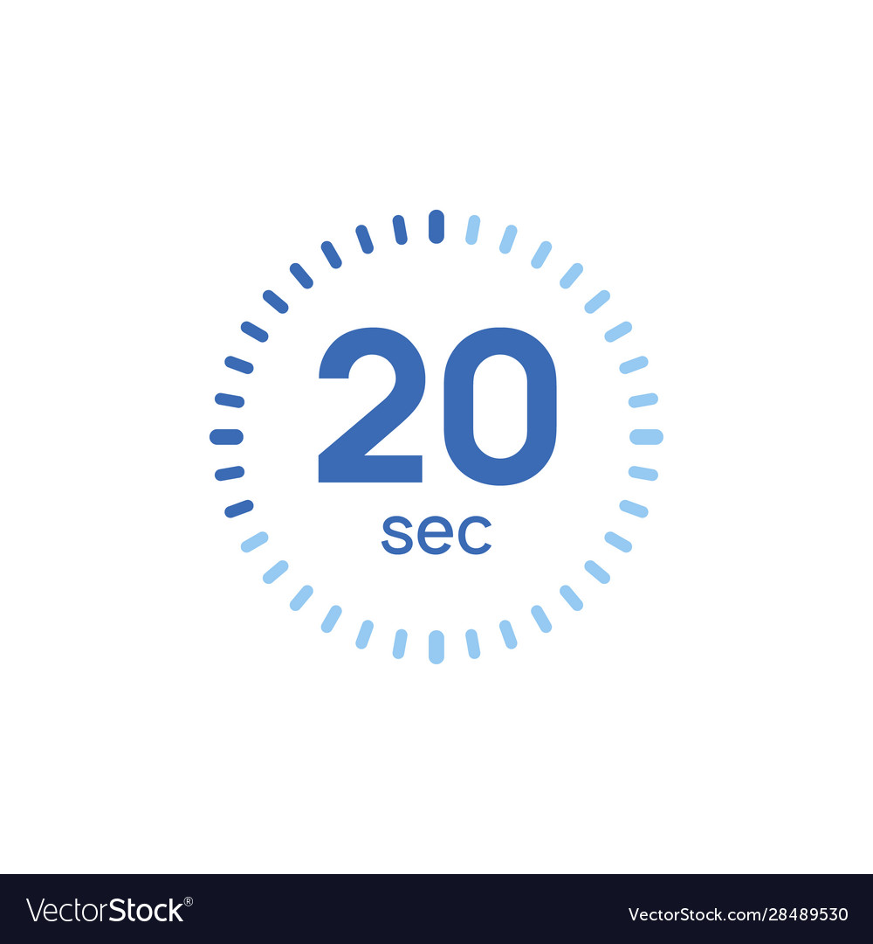

Slide 5
No traffic jam/
congestion
tall buildings
No pollution
robots/computers

Slide 6
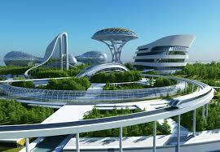
PRE-READING
1
Answer the questions:
What will future cities look like?

Slide 7
Unit
3
Cities of the future
Unit
FAMILY LIFE
LESSON 3
READING
Characteristics of future cities

Slide 8


PRE-READING
* VOCABULARY
sustainable (adj)
/səˈsteɪ.nə.bļ/
involving the use of natural products and energy in a way that does not harm the environment

Slide 9

PRE-READING
operate (v)
/ˈɒp.ər.eɪt/
to work in a particular way

Slide 10

PRE-READING
efficient (adj)
/ɪˈfɪʃənt/
working well without wasting time, money, or energy

Slide 11
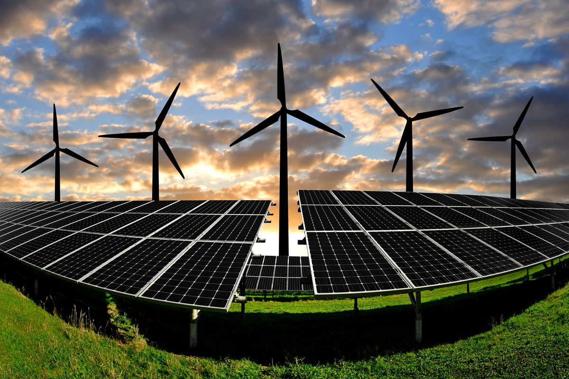
PRE-READING
renewable (adj)
/rɪˈnjuːəbəl/
(of energy and natural RESOURCES) that is replaced naturally or controlled carefully and can therefore be used without the risk of finishing it all

Slide 12
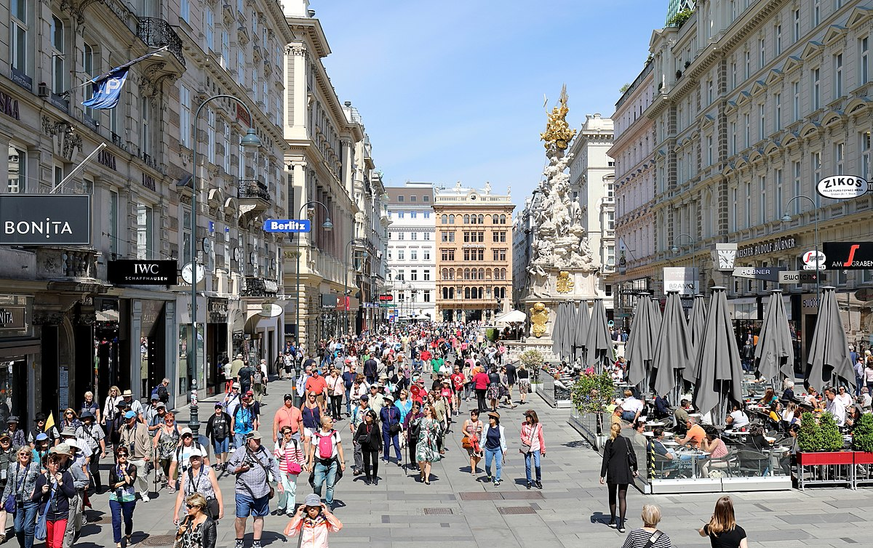

PRE-READING
pedestrian zone (n)
/pəˈdɛstrɪən zəʊn/
an area that has been concerted for the use of pedestrians only, by excluding all motor

Slide 13
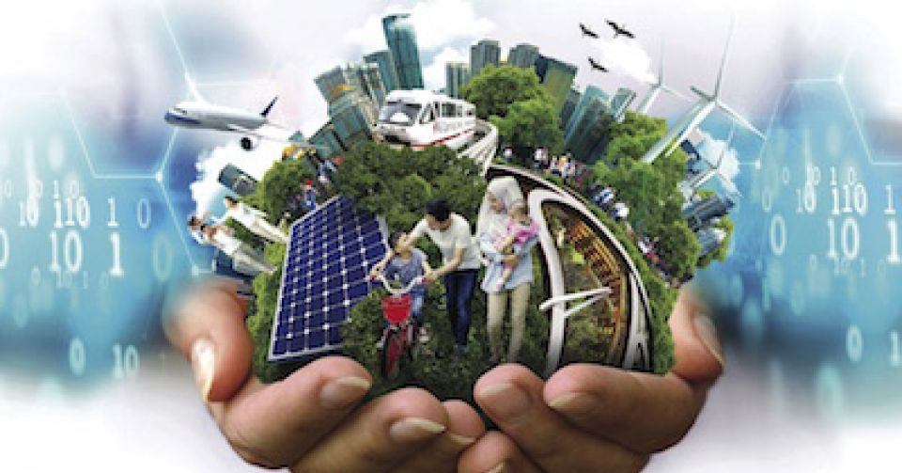
PRE-READING
liveable (adj)
/ˈlɪv.ə.bļ/
fit to live in

Slide 14
Form | Pronunciation | Meaning | Vietnamese equivalent
1. sustainable (adj) | /səˈsteɪ.nə.bļ/ | involving the use of natural products and energy in a way that does not harm the environment | bền vững
2. operate (v) | /ˈɒp.ər.eɪt/ | to work in a particular way | hoạt động
3. efficient (adj) | /ɪˈfɪʃənt/ | working well without wasting time, money, or energy | có hiệu quả
4. renewable (adj) | /rɪˈnjuːəbəl/ | replaced naturally or controlled carefully and can therefore be used without the risk of finishing it all | có thể hồi phục
5. pedestrian zone (n) | /pəˈdɛstrɪən zəʊn/ | an area that has been concerted for the use of pedestrians only, by excluding all motor. | khu dành cho người đi bộ
6. livable/liveable (adj) | /ˈlɪv.ə.bļ/ | fit to live in | đáng sống

Slide 15
2
Circle the correct meanings of the highlighted words and phrases.
1. operate more efficiently
A. to work better without wasting time, money, or energy
B. to control a machine without wasting resources
C. to cut a body open for medical reasons in a more careful way
2. sensors
A. devices that can react to light, heat, or pressure
B. instruments that can be played by people
C. devices for discovering rubbish
3. pedestrian zones
A. areas for cars only B. areas for electric buses C. areas for walking only
4. liveable
A. suitable for farming B. nice to live in C. good for the environment

Slide 16
WHILE-READING
2
Circle the correct meanings of the highlighted words and phrases.
1. operate more efficiently
A. to work better without wasting time, money, or energy
B. to control a machine without wasting resources
C. to cut a body open for medical reasons in a more careful way
2. sensors
A. devices that can react to light, heat, or pressure
B. instruments that can be played by people
C. devices for discovering rubbish

Slide 17
WHILE-READING
2
Circle the correct meanings of the highlighted words and phrases.
3. pedestrian zones
A. areas for cars only
B. areas for electric buses
C. areas for walking only
4. liveable
A. suitable for farming
B. nice to live in
C. good for the environment

Slide 18
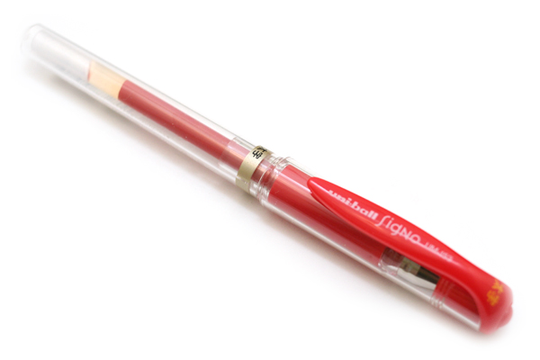
A RED PEN FOR YOU

Slide 19
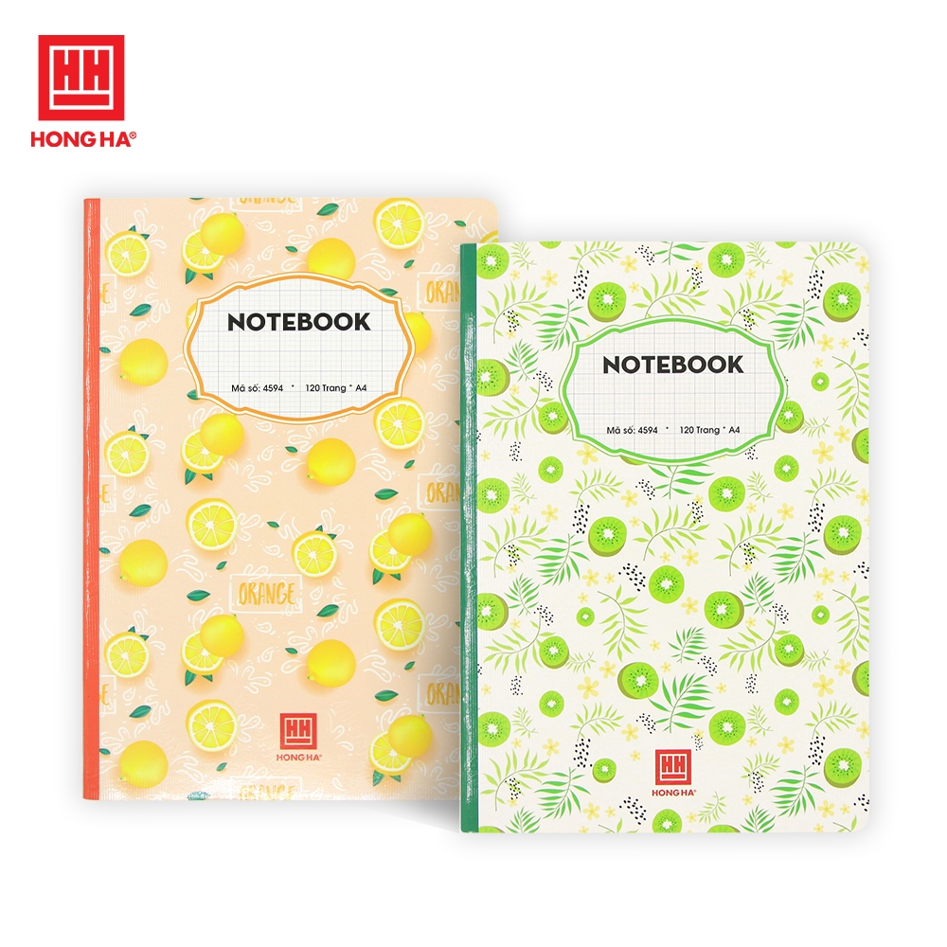
YOUR GIFT IS A NOTEBOOK

Slide 20

A BIG APPLAUSE FOR YOU

Slide 21

YOU WILL BE ADDED 1 POINT IN YOUR 15 MINUTE TEST

Slide 22
WHILE-READING
3
Read the article again and decide whether the statements are true (T) of false (F).
1. About 70 million people will live in cities by 2050.
2. Smart cities use modern technologies to save time and provide better services.
3. City dwellers will be able to grow vegetables underground or in roof gardens.
4. Space for walking and cycling will be replaced with computer-controlled transport systems.

Slide 23




LUCKY NUMBER:20Ps
Game:

Slide 24

2. Smart cities use modern technologies to save time and provide better services.
T
Paragraph 2, lines 1, 2, 3
A smart city is a modern urban area that uses a range technologies to provide services, solve problems, and support people better. The new technologies can help save time by predicting changes in the traffic and warning people of possible traffic jams.

Slide 25
1. About 70 million people will live in cities by 2050.
10 billion
F
Paragraph 1, lines 1, 2
By 2050 the world’s population is expected to reach 10 billion, and nearly 70 per cent of these people will live in cities.

Slide 26
3. City dwellers will be able to grow vegetables underground or in roof gardens.
T
Paragraph 3, lines 2, 3
Making room for biodiversity and nature can be done in various ways including underground and rooftop farming, green roofs, and roof gardens.

Slide 27
4. Space for walking and cycling will be replaced with computer-controlled transport systems.
F
Paragraph 2, lines 6, 7.
In addition, more pedestrian zones for walking and cycle paths will be made available for people in all neighbourhoods.

Slide 28


Slide 29

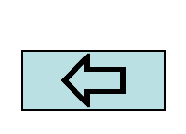
Lucky Number

Slide 30
WHILE-READING
3
Read the article again and decide whether the statements are true (T) of false (F).
1. About 70 million people will live in cities by 2050.
2. Smart cities use modern technologies to save time and provide better services.
3. City dwellers will be able to grow vegetables underground or in roof gardens.
4. Space for walking and cycling will be replaced with computer-controlled transport systems.
F
T
T
F

Slide 31
WHILE-READING
4
Read the article again and complete the diagram.
Smart
Modern technologies are used to (1) __________ people better.
Smart devices help cities (2) __________ more efficiently.
support
operate
Cities of the future
Sustainable
Cities will include a lot of (3) ___________ and become home to more plants and animals.
Eco-friendly (4) ______________ will reduce greenhouse gas emissions.
green space
infrastructure

Slide 32
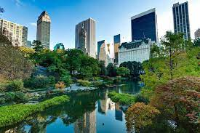
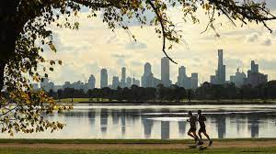
POST-READING
5
Discussion
Would you like to live in a smart and sustainable city?
Why/Why not?

Slide 33
CONSOLIDATION
1
Wrap-up
What have you learnt today?
Some lexical items about characteristics of future cities
Reading for main ideas and specific information about future cities

Slide 34
CONSOLIDATION
2
Homework
Do exercises in the workbook.
Prepare for Lesson 4 - Unit 3.

Slide 35
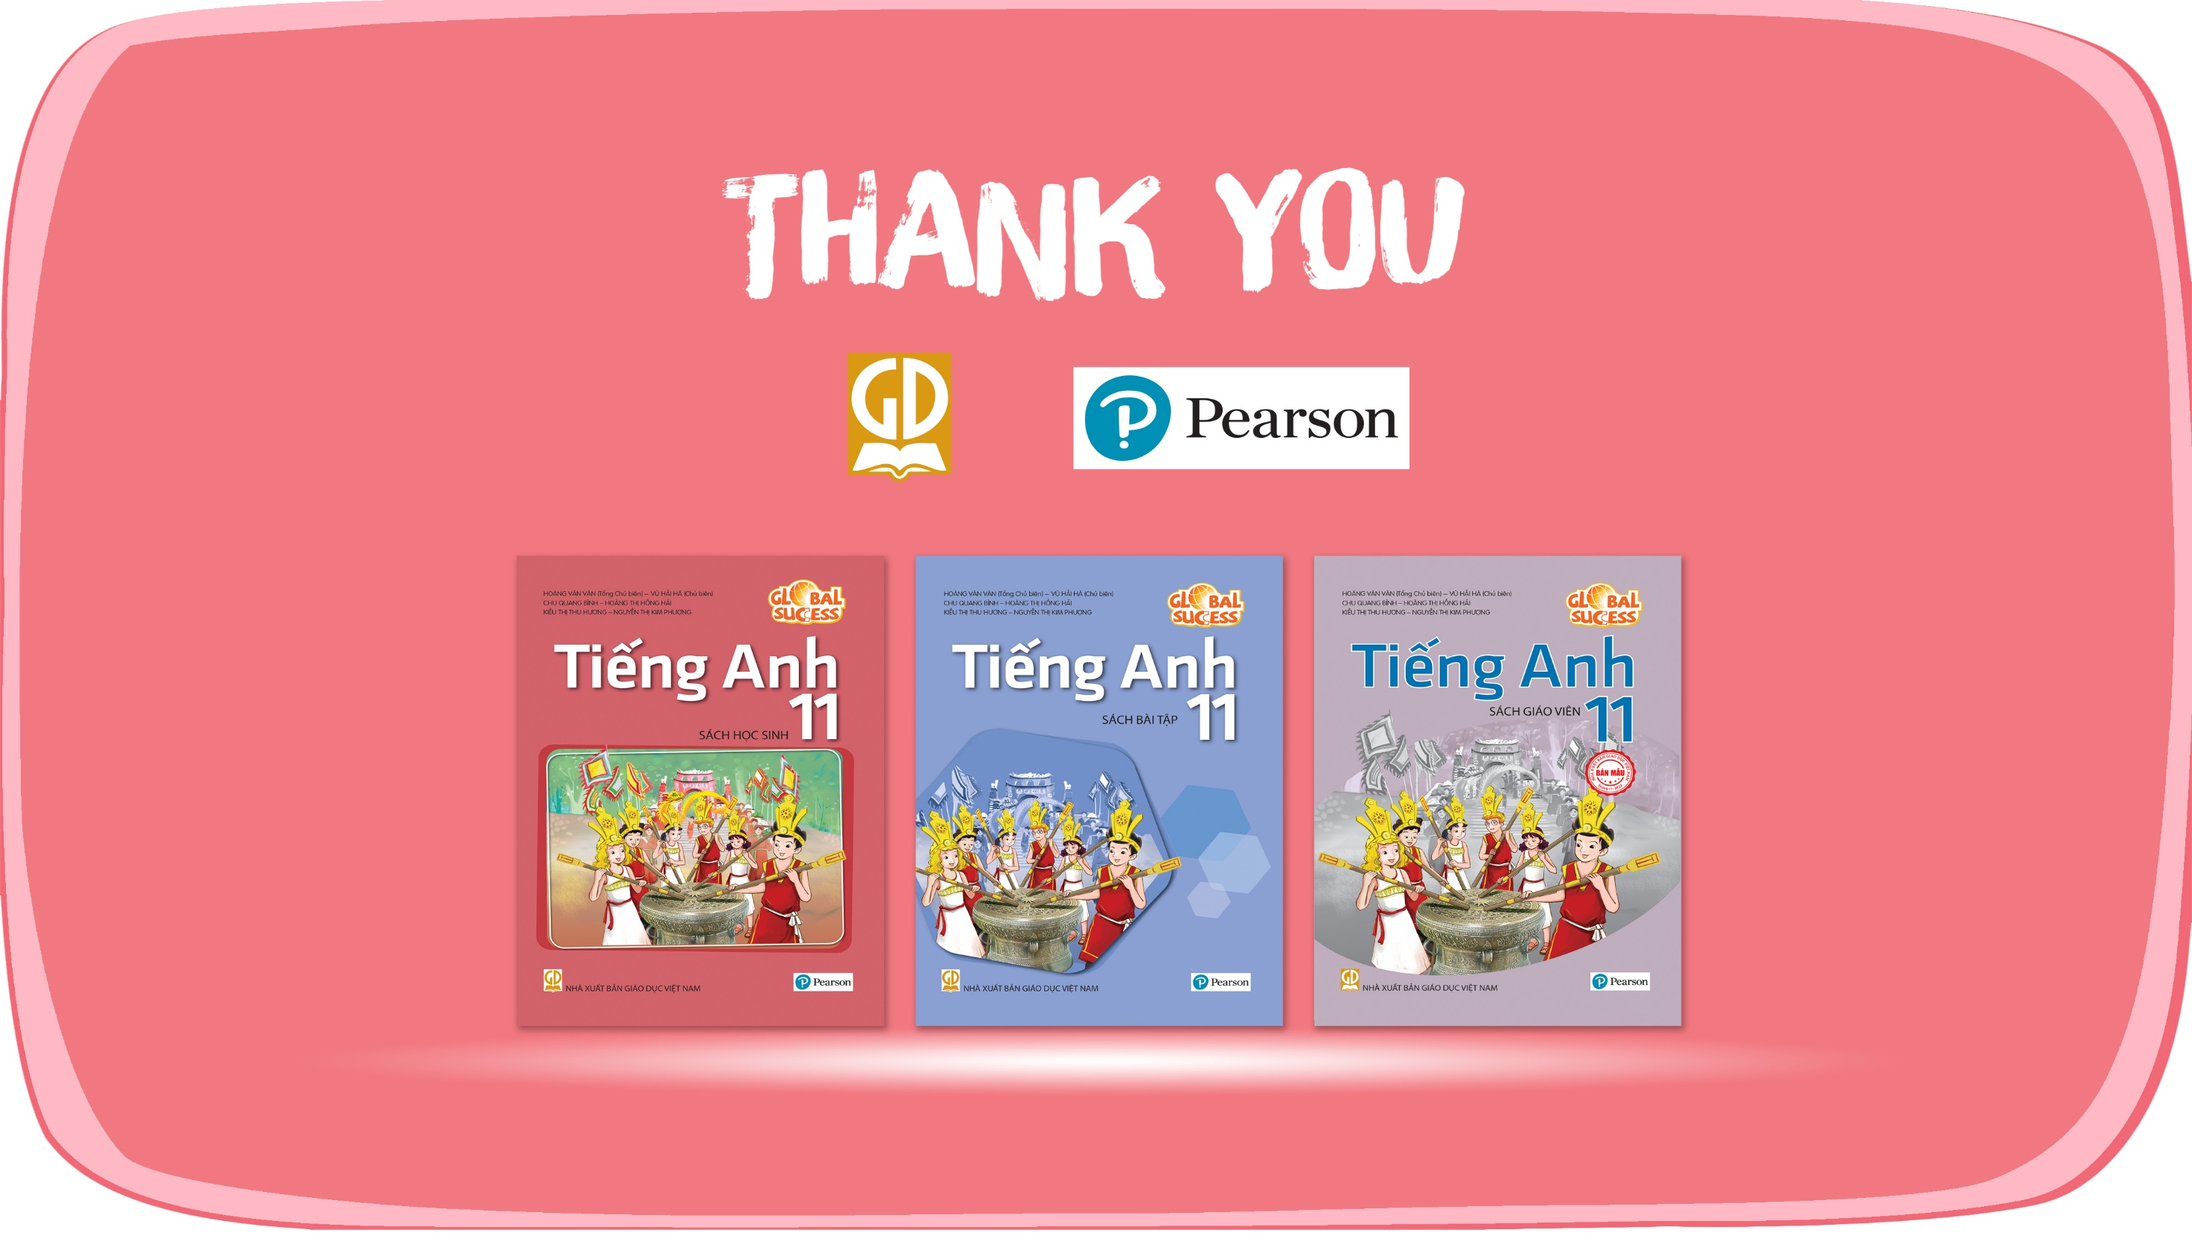
Website: hoclieu.vn
Fanpage: facebook.com/www.tienganhglobalsuccess.vn

