Slide 1

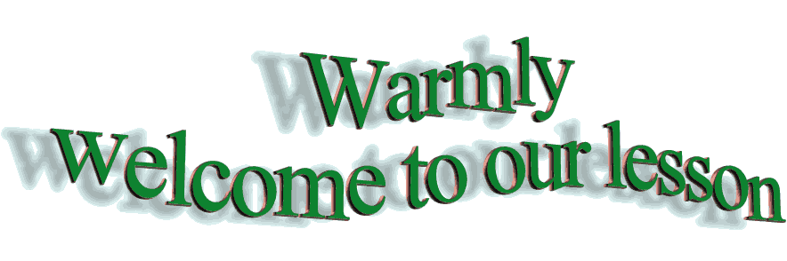


Slide 2
Unit
3
CITIES OF THE FUTURE
Unit
FAMILY LIFE
LESSON 2
LANGUAGE

Slide 3

PRONUNCIATION: Linking final consonants to initial vowels
1
Listen and repeat. Pay attention to the linking between the words in the sentences.
1. He lives in the city centre.
2. Cities of the future will be more exciting.
3. The new high-rise building is in the west of the city.
4. A lot of people come to the city to walk across the famous bridge.

Slide 4
PRONUNCIATION: Linking final consonants to initial vowels
2
Listen and mark the consonant and vowel sounds that are linked. Then practise saying the sentences.
1. Traffic jams are the city's biggest problem, especially during rush hour.
2. This is the most beautiful city I’ve ever visited.

Slide 5
VOCABULARY
Match the words and phrases with their meanings.
1
city dweller (np) | 1 - | a garden built on the top of a building
2. traffic jam (n) | 2 - | b. a very tall, modern building, usually in a city
3. urban centre (np) | 3 - | c. a person who lives in the city
4. roof garden (n) | 4 - | d. a situation of too many vehicles on a road so that they can move only very slowly or are stopped completely
5. skyscraper (n) | 5 - | e. an area in a city where a large number of people live
c
d
e
a
b

Slide 6
VOCABULARY
2
Complete the sentences using the correct forms of the words and phrases in Task 1.
1. ____________is a serious problem in many big cities around the world. 2. The new underground has allowed ________ to get around more easily. 3. With the help of technology, people can now grow vegetables in the ___________ of high-rise buildings. 4. The _________ attracts people’s attention because of its unusual architecture. 5. More people are moving away from the __________ of large cities to the suburbs.

Slide 7




LUCKY NUMBER:20Ps
Game:

Slide 8

1. ____________is a serious problem in many big cities around the world.
Traffic jam
30 POINTS

Slide 9
2. The new underground has allowed ________ to get around more easily.
city dwellers
35 POINTS

Slide 10
5. More people are moving away from the __________ of large cities to the suburbs.
urban centres
40 points

Slide 11
4. With the help of technology, people can now grow vegetables in the ___________ of high-rise buildings.
roof gardens
20 points

Slide 12
4. The _________ attracts people’s attention because of its unusual architecture.
skyscraper
50 points

Slide 13

Lucky Number 30 points

Slide 14
VOCABULARY
2
Complete the sentences using the correct forms of the words and phrases in Task 1.
Traffic jam
1. ________ is a serious problem in many big cities around the world.
2. The new underground has allowed ____________ to get around more easily.
3. With the help of technology, people can now grow vegetables in the ___________ of high-rise buildings.
4. The _________ attracts people’s attention because of its unusual architecture.
5. More people are moving away from the ____________ of large cities to the suburbs.
city dwellers
roof gardens
skyscraper
urban centres

Slide 15
GRAMMAR
STATIVE VERBS IN THE CONTINUOUS FORM
1. Describe a state rather than an action.
- Thoughts and opinions (agree, believe, remember, think, understand)
- Feelings and emotions (hate, love, prefer)
- Senses (appear, feel, hear, look, see, seem, smell, taste)
- Possession (belong, have, own)
2. Stative verbs are not normally used in the continuous form. However, some stative verbs can be used in the continuous form to describe actions, depending on the context.
Eg: My dad has a new car.
He is having a good time.

Slide 16
GRAMMAR
1
Choose the correct forms of the verbs to complete the following sentences.
1. I think / am thinking that living in the city is good for young people.
2. We are thinking / think of moving out of the city.
3. I don’t see / am not seeing the building. It’s too far away.

Slide 17
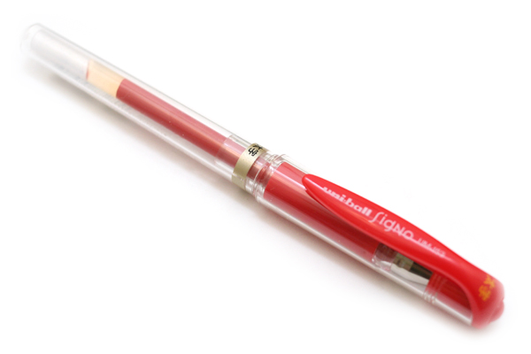
A RED PEN FOR YOU

Slide 18

A BIG APPLAUSE FOR YOU

Slide 19

YOU WILL BE ADDED 1 POINT IN YOUR 15 MINUTE TEST

Slide 20
GRAMMAR
LINKING VERBS
1. Linking verbs is used to link the subject with an adjective or a noun that describes or identifies the subject. --> Noun or adjective goes after a linking verb.
2. Some common linking verbs: be, seem, look, become, appear, sound, taste and smell.
Ex:
1. The soup tasted good.
2. Using public transport seems a good way to reduce the carbon footprint.

Slide 21
GRAMMAR
2
Find and correct the mistakes in the following sentences.
1. The urban lifestyle seems more excitingly to young people.
2. The museum looks beauty from a distance.
3. Widening the road sounds a good solve to traffic problems in the area.
=> exciting
=> beautiful
=> solution

Slide 22
GRAMMAR
3
Work in pairs. Talk about future developments in your neighbourhood. Use stative verbs in continuous form and linking verbs.
Example:
A: The government is thinking of building a new skyscraper here.
B: Fantastic! Our city will look more morden.

Slide 23
CONSOLIDATION
1
Wrap-up
What have you learnt today?
Some lexical items about cities and smart living
Linking final consonants to initial vowels
Stative verbs in the continuous form and Linking verbs

Slide 24
CONSOLIDATION
2
Homework
Do exercises in the workbook.
Prepare for Lesson 3 - Unit 3.

