Slide 3
Unit
4
1
Unit
FAMILY LIFE
FOR A BETTER COMMUNITY
LESSON 1
GETTING STARTED
Volunteering in the community

Slide 4
PRESENTATION
volunteer (n)
/ˌvɒlənˈtɪə(r)/
a person who does a job without being paid for it
Tình nguyện viên

Slide 5
PRESENTATION
advertisement (n)
/ədˈvɜːtɪsmənt/
a notice, picture or film telling people about a product, job or service
Tờ quảng cáo

Slide 6
PRESENTATION
community (n)
/kəˈmjuːnəti/
all the people who live in a particular area, country, etc. when talked about as a group
Cộng đồng

Slide 7
PRESENTATION
Community service (n)
/kəˌmjuːnəti ˈsɜːvɪs/
Work done without payment to
help other people.
Dịch vụ cộng đồng

Slide 8
PRESENTATION
boost (v)
/buːst/
to make something increase, or become better or more successful
Thúc đẩy

Slide 9
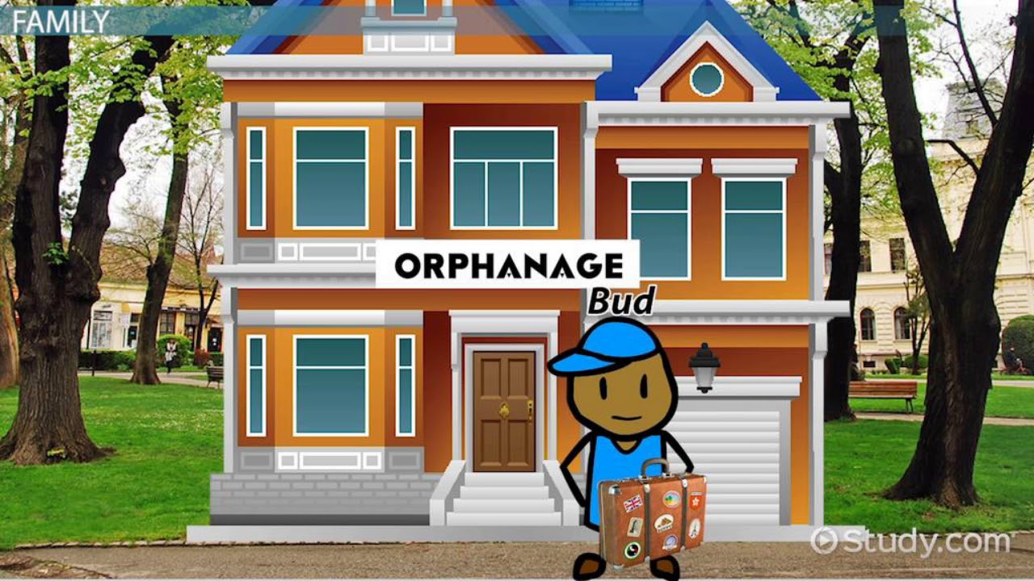
PRESENTATION
orphanage (n)
/ˈɔːfənɪdʒ/
a home for children whose parents are dead
Trại trẻ mồ côi

Slide 10
PRESENTATION
apply (v)
/əˈplaɪ/
to make a formal request, usually in writing, for something such as a job, a loan, permission for something, a place at a university, etc.
Nộp đơn

Slide 11
PRESENTATION
confidence (n)
/ˈkɑːnfɪdəns/
the quality of being certain of your abilities or of having trust in people, plans, or the future.
Sự tự tin

Slide 12
PRESENTATION
Get involved (v.p)
/ɡet ɪnˈvɒlvd/
= join, take part in
Tham gia

Slide 13
PRESENTATION
endless (adj)
/ˈendləs/
never finishing, or seem never to finish
Vô tận

Slide 14
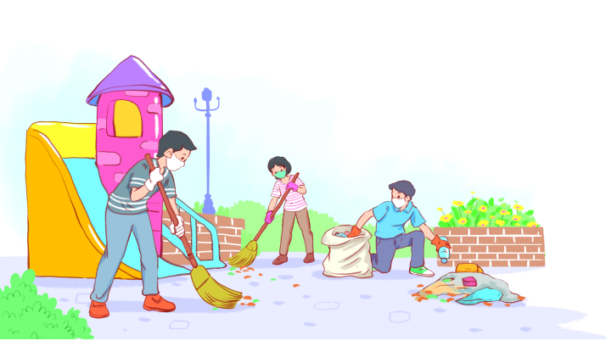
PRACTICE
1
Listen and read.
Volunteering in the community

Slide 15
PRACTICE
1
Listen and read.
Volunteering in the community
Kim: Hi, Tam. I went to your house at 9 a.m., but you weren’t there.
Tam: Oh, when you came, I was working as a volunteer at our local centre for community development.
Kim: Ah, I see. How did you become a volunteer there?
Tam: Just by chance. Last summer, while I was visiting the centre, I saw an advertisement for volunteers. I applied and my application was successful.
Kim: I also want to be a volunteer. I find community work very interesting.
Tam: I agree. Community service not only benefits the local area, but can also boost our confidence and help us learn many useful skills.

Slide 16
PRACTICE
PRACTICE
1
Listen and read.
Volunteering in the community
Kim: What are the regular activities organised by the centre?
Tam: Oh, there are endless opportunities for getting involved. For example, you can join a local environmental group to clean up the park once a week or volunteer at an orphanage.
Kim: Sounds good. How can I apply?
Tam: I’ll email you the form. You just fill it in and send it in.
Kim: Thanks so much. I’m so excited about volunteering at the centre.
Tam: No problem. Good luck. Hope your application is successful and you enjoy the work.

Slide 17
PRACTICE
PRACTICE
2
Read the conversation again and answer the questions.
1. What was Tam doing when Kim went to her house?
She was working as a volunteer at the local centre for community development.
2. What are some regular activities at the centre for community development?
Cleaning up the park or volunteering at the orphanage.
3. How can Kim apply for volunteer work at the centre?
She needs to fill in the form, then send it in.

Slide 18
PRACTICE
3
Find the adjectives with the following suffixes in the conversation and write them below.
suffixes | adjectives
-ed
-ing
-ful
-less
excited
interesting
useful, successful
endless

Slide 19
PRACTICE
4
Find a verb phrase in the conversation to complete each sentence.
1. Oh, when you came, I____________ as a volunteer at our local centre for community development.
2. Last summer, while I was visiting the centre, I_____ an advertisement for volunteers.
was working
saw

Slide 20
LESSON 1
GETTING STARTED
Unit
GETTING STARTED
WARM-UP
Clip watching
PRESENTATION
Vocabulary
Task 1: Listen and read.
Task 2: Read the conversation and answer the questions.
Task 3: Find the adjectives.
Task 4: Complete the sentences.
PRACTICE
PRODUCTION
Self-reflection

Slide 21
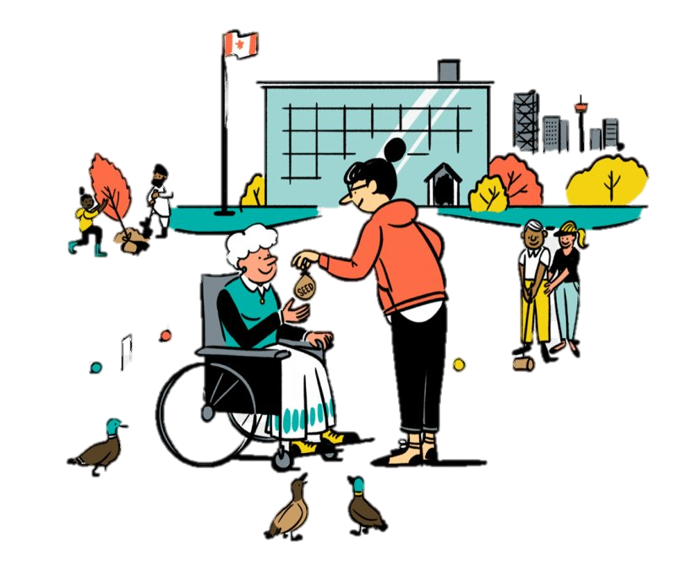
PRODUCTION
SELF-REFLECTION
- Talk about activities you are going to do to make your community a better one for a minute
- Your talk should include:
+ How many activities are you going to talk about?
+ Where do you do those activities?
+ Who do you do with?
+ How often do you do those activities?

Slide 22
CONSOLIDATION
1
Wrap-up
Gain an overview about the topic For a better community
Gain vocabulary to talk about voluntary work

Slide 23
CONSOLIDATION
2
Homework
1. Do exercises in the workbook
2. Prepare for the next lesson
3. Prepare for the Project

