Slide 1
Good afternoon!
Welcome to
our class!

Slide 2
MUSIC SHOW

Slide 3
Rules
+ Watch a clip containing 6 music shows
+ Take note the names of music shows
+ Write the answer on the paper
+ With a correct answer, get 10 points

Slide 5
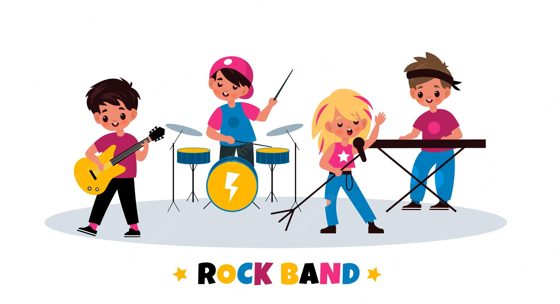
START TIMER
TIME LIMIT:
30 seconds
TIME’S UP!
30
25
5
20
10
15

Slide 6
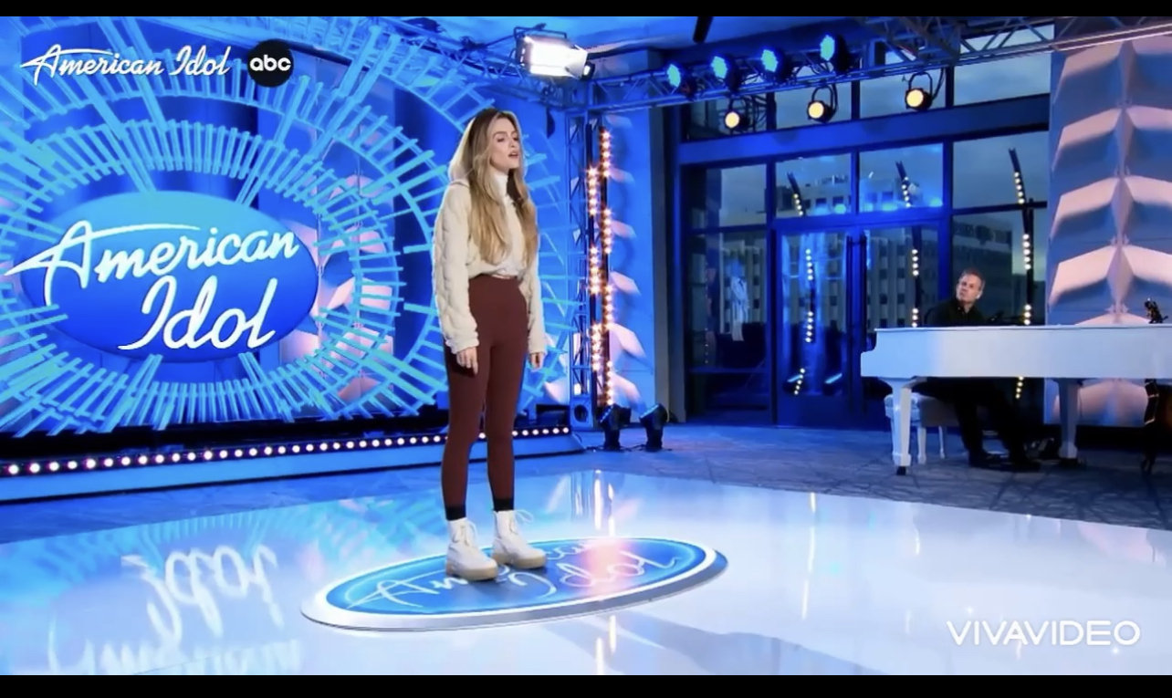
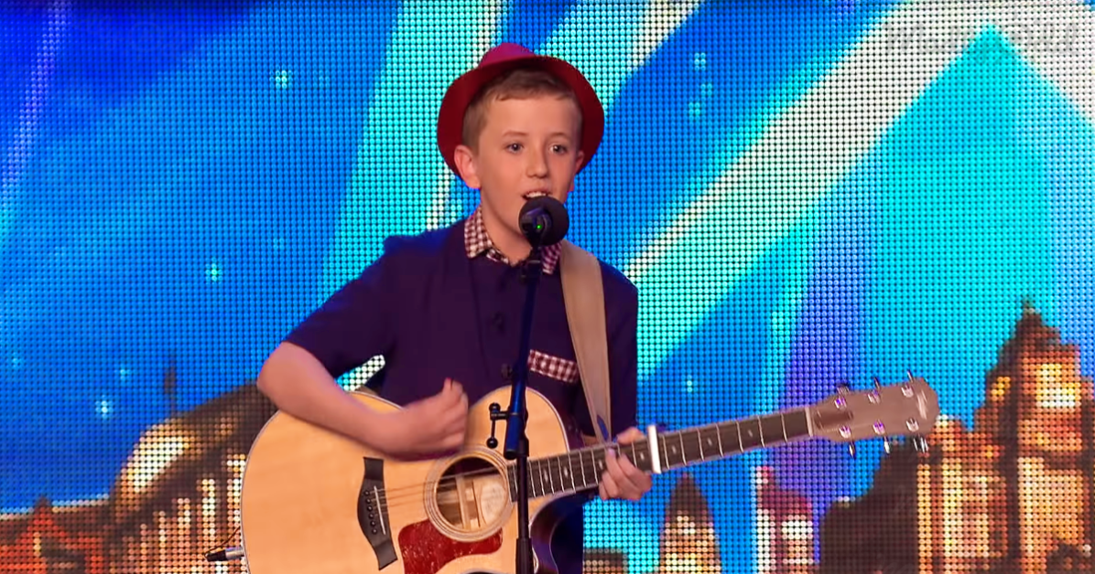
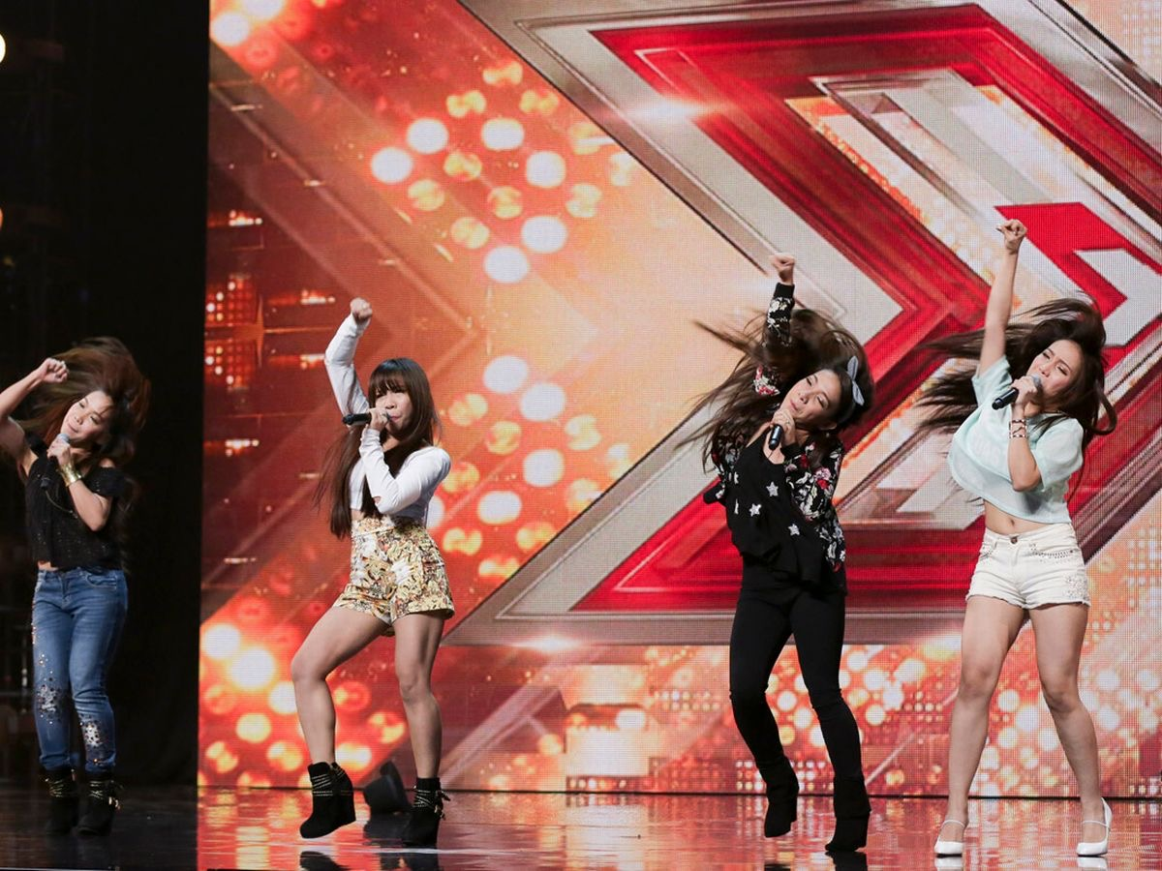
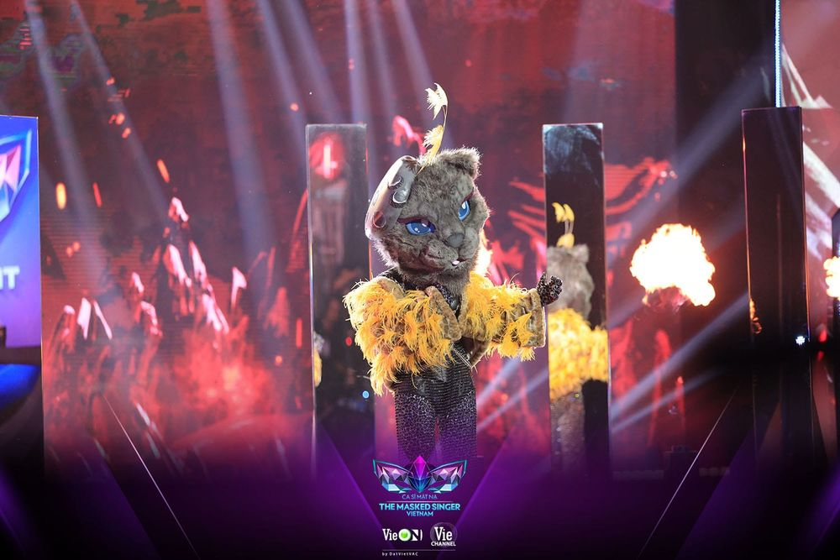
AMERICAN IDOL
BRITAIN’S GOT TALENT
THE X FACTOR
KING OF RAP
THE MASKED SINGER VIET NAM
THE VOICE

Slide 7
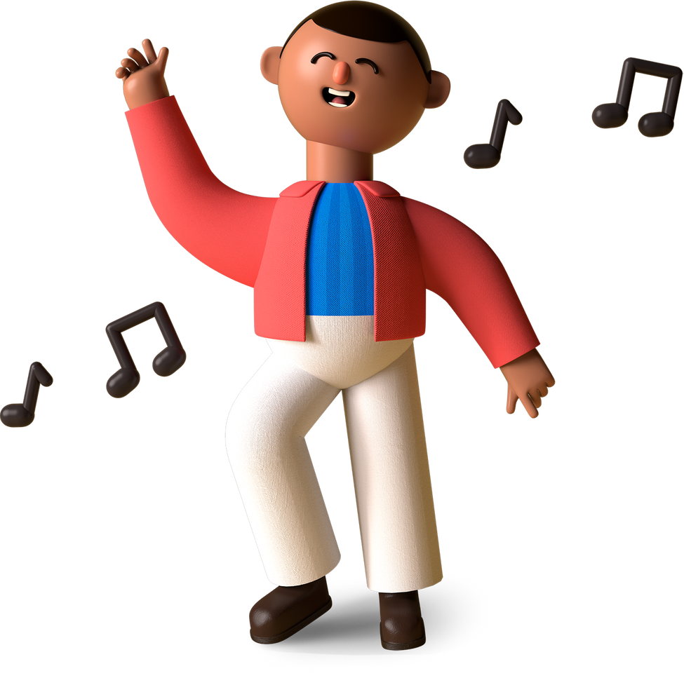
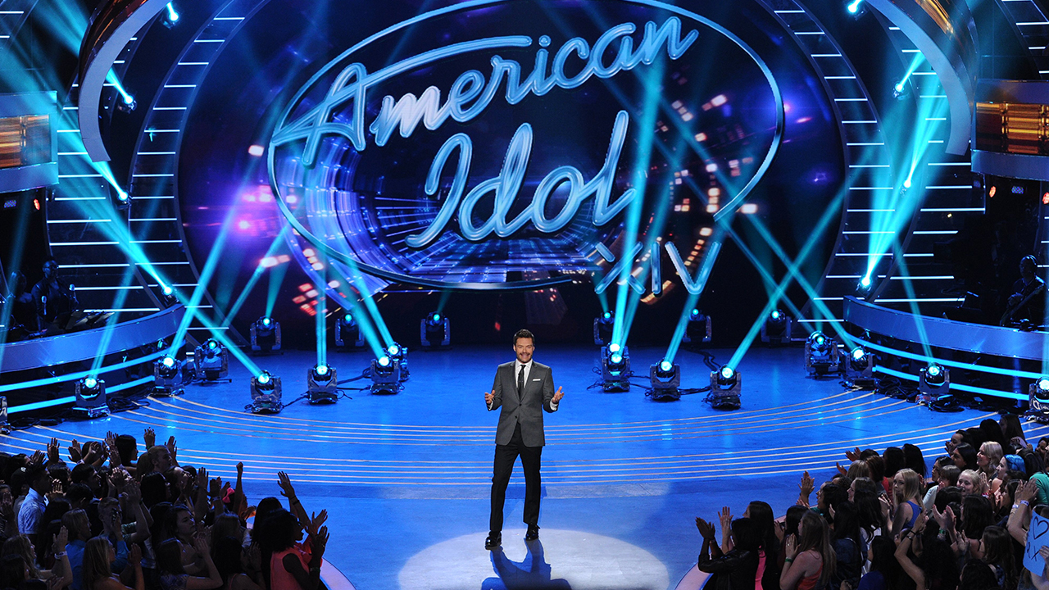

Slide 8
UNIT 3
Music
Reading

Slide 9
Part 1
Part 3
MATCH THE HIGHLIGHTED WORD OR PHRASES
DISCUSS IN PAIR
Part 2
CHOOSE THE BEST ANSWER

Slide 10
VOCABULARY
reality /riˈæləti/ (noun)
using real people
(not actors) in real situations, presented as entertainment
Thực tế
Page 2
Reality competitions

Slide 11
VOCABULARY
semi-final /ˌsemi ˈfaɪnl/ (noun)
Parts of a competition that are held to decide who will compete
in the last part
Bán kết
Page 2

Slide 12
VOCABULARY
ordinary /ˈɔːdnri/ (adj)
Ex: Readers said they wanted more stories about
ordinary people and fewer stories about famous people.
not unusual
or different
in any way
Bình thường
Page 2

Slide 13
VOCABULARY
Participant /pɑːˈtɪsɪpənt/(noun)
a person who is taking part in an activity or event
Người tham gia
Page 2

Slide 14
VOCABULARY
New words | Pronunciation | Meaning
reality (n) | /riˈæləti/
semi-final (n) | /ˌsemi ˈfaɪnl/
Participant (n) | /pɑːˈtɪsɪpənt/
ordinary (adj) | /ˈɔːdnri/
Thực tế
Bán kết
Người tham gia
Bình thường
Page 2

Slide 15
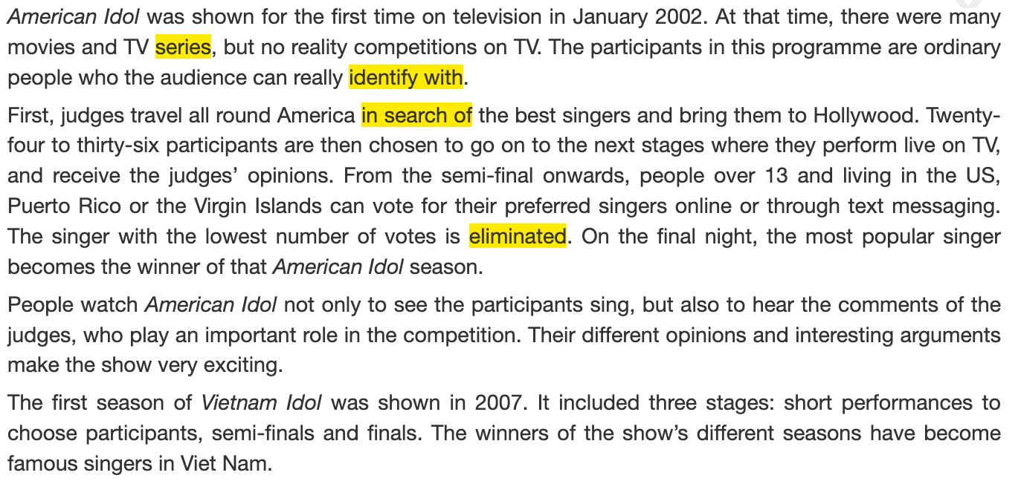
Task 1: Read a text about a famous music show.
Match the highlighted words and phrases in the text to the meanings below.
Page 5

Slide 16
HELPFUL TIPS
Read through the text to get an overall idea.
Start with words you already know.
Use the context (the sentence it is in and other words around it) to find the meaning of the other words.

Slide 17
Task 1: Read a text about a famous music show.
Match the highlighted words and phrases in the text to the meanings below.
Page 5

Slide 18
Read a text about a famous music show. Match the highlighted words and phrases in the text to the meanings.
1. series
a. feel that they are similar to and can understand them
b. a set of TV or radio programmes on the same subject
2. identify with
3. in search of
c. removed from the competition
4. eliminated
d. Looking for

Slide 19
Task 2: Read the text again and choose the best answers.
1. What is American Idol?
A game show on TV
A TV singing contest
A live dancing competition
2. Which if the following statements is correct?
A. From the semi-final, singers who can go to the next stage are decided by the audience vote.
B. The judges choose as many singers as they can.
C. People around the world can vote for the songs they like.
3. Who wins American Idol?
A. The singer with the highest number of the votes on the final night.
B. The singer with the highest number of votes and highest scores from the judges.
C. The singer with the highest scores from the judges.
4. Which of the following statements about the judges is NOT mentioned?
A. They give comments after each live performance.
B. They have different views about the singers’ performances.
C. They are not in favour of choosing ordinary people.
5. What can be inferred about the competition in Viet Nam?
A. The audience decides who makes it to the final stage.
B. All the singers will be famous.
C. It can help develop participants’ singing careers.

Slide 20
HELPFUL TIPS
First, read the questions, underline the key words

Slide 21
1. What is American Idol?
A game show on TV
A TV singing contest
A live dancing competition
4. Which of the following statements about the judges is NOT mentioned?
A. They give comments after each live performance.
B. They have different views about the singers’ performances.
C. They are not in favour of choosing ordinary people.
2. Which if the following statements is correct?
A. From the semi-final, singers who can go to the next stage are decided by the audience vote.
B. The judges choose as many singers as they can.
C. People around the world can vote for the songs they like.
5. What can be inferred about the competition in Viet Nam?
A. The audience decides who makes it to the final stage.
B. All the singers will be famous.
C. It can help develop participants’ singing careers.
3. Who wins American Idol?
A. The singer with the highest number of the votes on the final night.
B. The singer with the highest number of votes and highest scores from the judges.
C. The singer with the highest scores from the judges.

Slide 22
HELPFUL TIPS
Re-read the questions, try to predict the answer
Read the answer options, eliminate the ones that are absolutely wrong.
Search the text to find evidence.

Slide 23
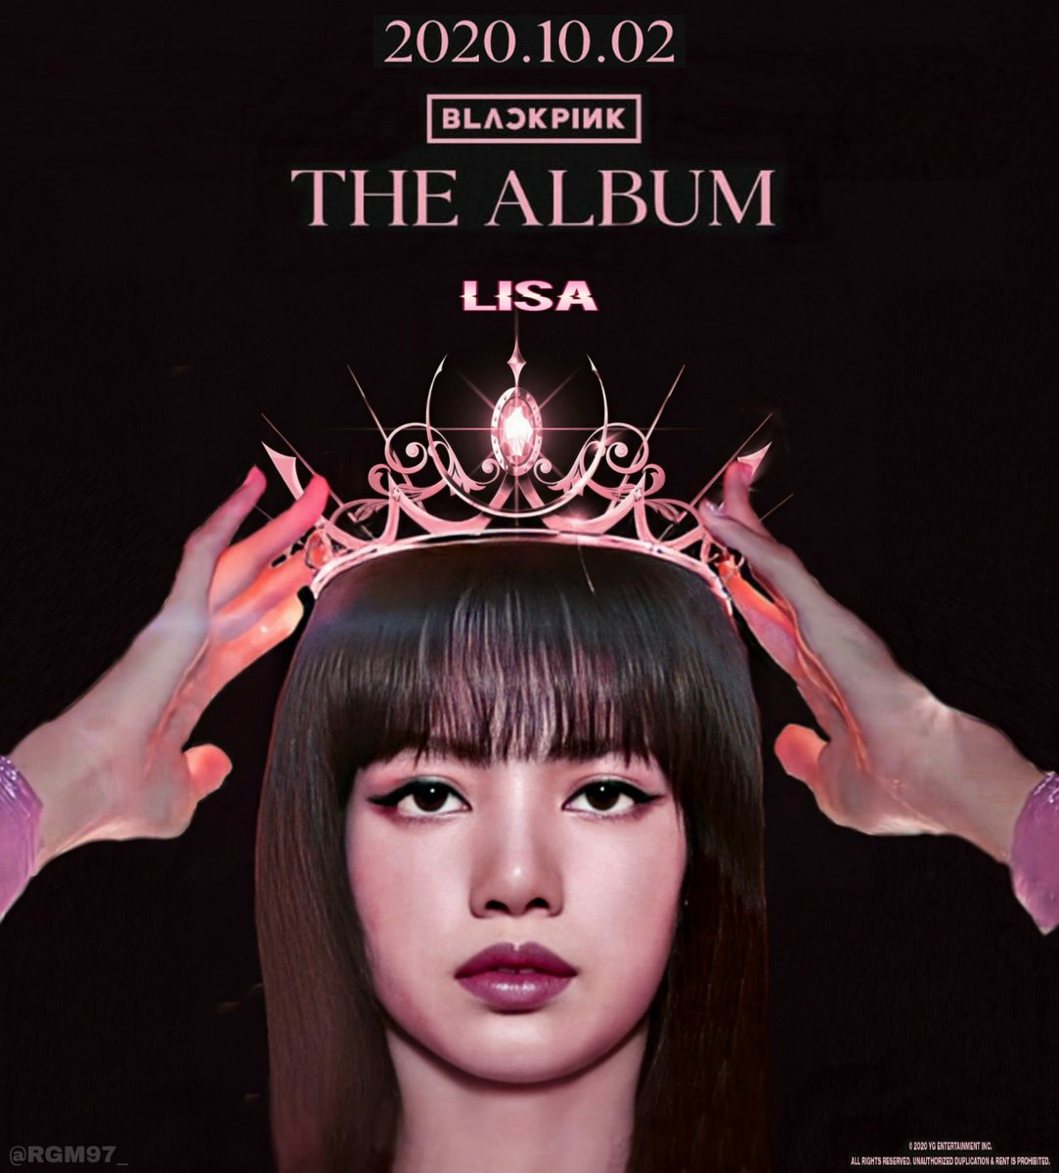
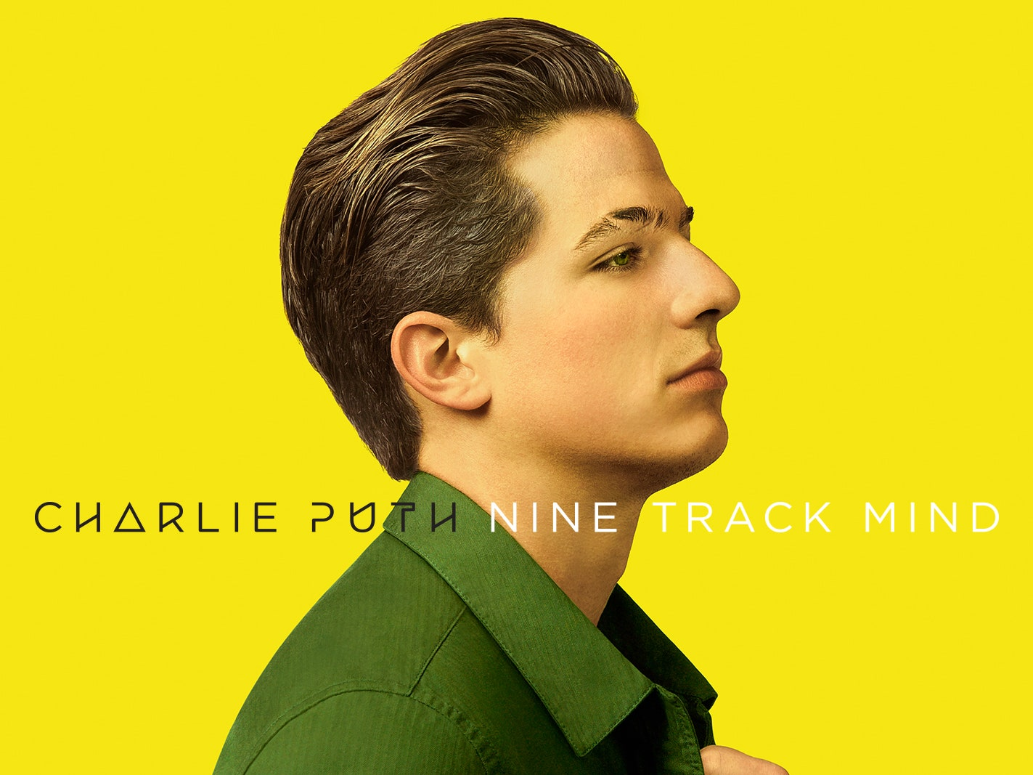

Slide 24
Task 2: Read the text again and choose the best answers.
1. What is American Idol?
A game show on TV
A TV singing competition
A live dancing competition

Slide 25
Task 2: Read the text again and choose the best answers.
2. Which of the following statements is correct?
A. From the semi-final, singers who can go to the next stage are decided by the audience vote.
B. The judges choose as many singers as they can.
C. People around the world can vote for the songs they like.

Slide 26
Task 2: Read the text again and choose the best answers.
3. Who wins American Idol?
A. The singer with the highest number of the votes on the final night.
B. The singer with the highest number of votes and highest scores from the judges.
C. The singer with the highest scores from the judges.

Slide 27
Task 2: Read the text again and choose the best answers.
4. Which of the following statements about the judges is NOT mentioned?
A. They give comments after each live performance.
B. They have different views about the singers’ performances.
C. They are not in favour of choosing ordinary people.

Slide 28
Task 2: Read the text again and choose the best answers.
5. What can be inferred about the competition in Viet Nam?
A. The audience decides who makes it to the final stage.
B. All the singers will be famous.
C. It can help develop participants’ singing careers.

Slide 29
DISCUSSION
Discuss whether you want to participate in Vietnam Idol.
Give your reasons.

Slide 30
Question: Do you want to participate in Vietnam Idol ?
Answer:
YES
NO
- love singing
- don't have a beautiful voice
- have chance to become famous and earn lots of money.
- don't want to be watched by many people.
- have a fear of crowds

Slide 31
HOMEWORK
Search for more music shows on the Internet, take note the regulations and the prizes.
Prepare for the Speaking lesson.

