Slide 1






Welcome to our class
THPT Nguyễn Du – Bình Định

Slide 2


Slide 3

Warm-up

Slide 4
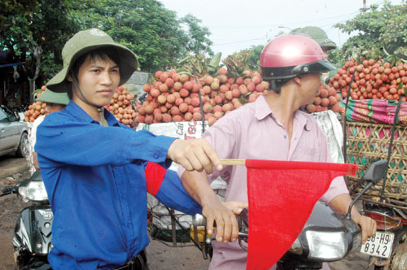
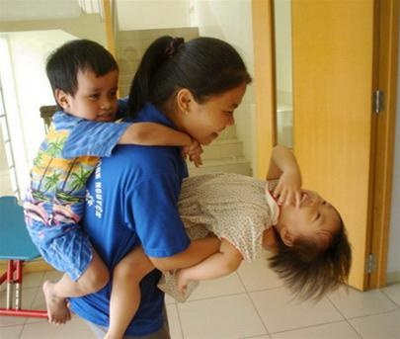
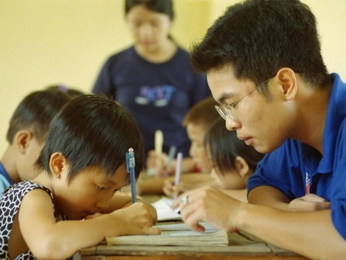
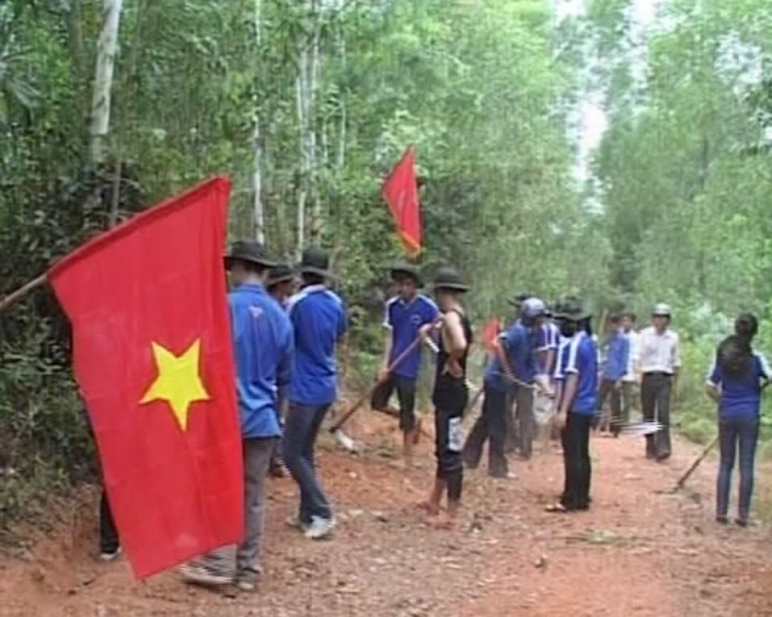
Match the phrases with the pictures:
1
VOLUNTEER WORK IN COMMUNITY
2
3
4
A. directing the traffic
B. Teaching the poor children
What do you call those kinds of work?
C. repairing the country road.
D. playing with the children.

Slide 5


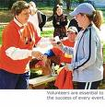
Unit
4
1
Unit
FAMILY LIFE
FOR A BETTER COMMUNITY
LESSON 1
GETTING STARTED
Volunteering in the community

Slide 6
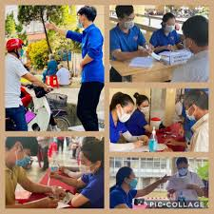


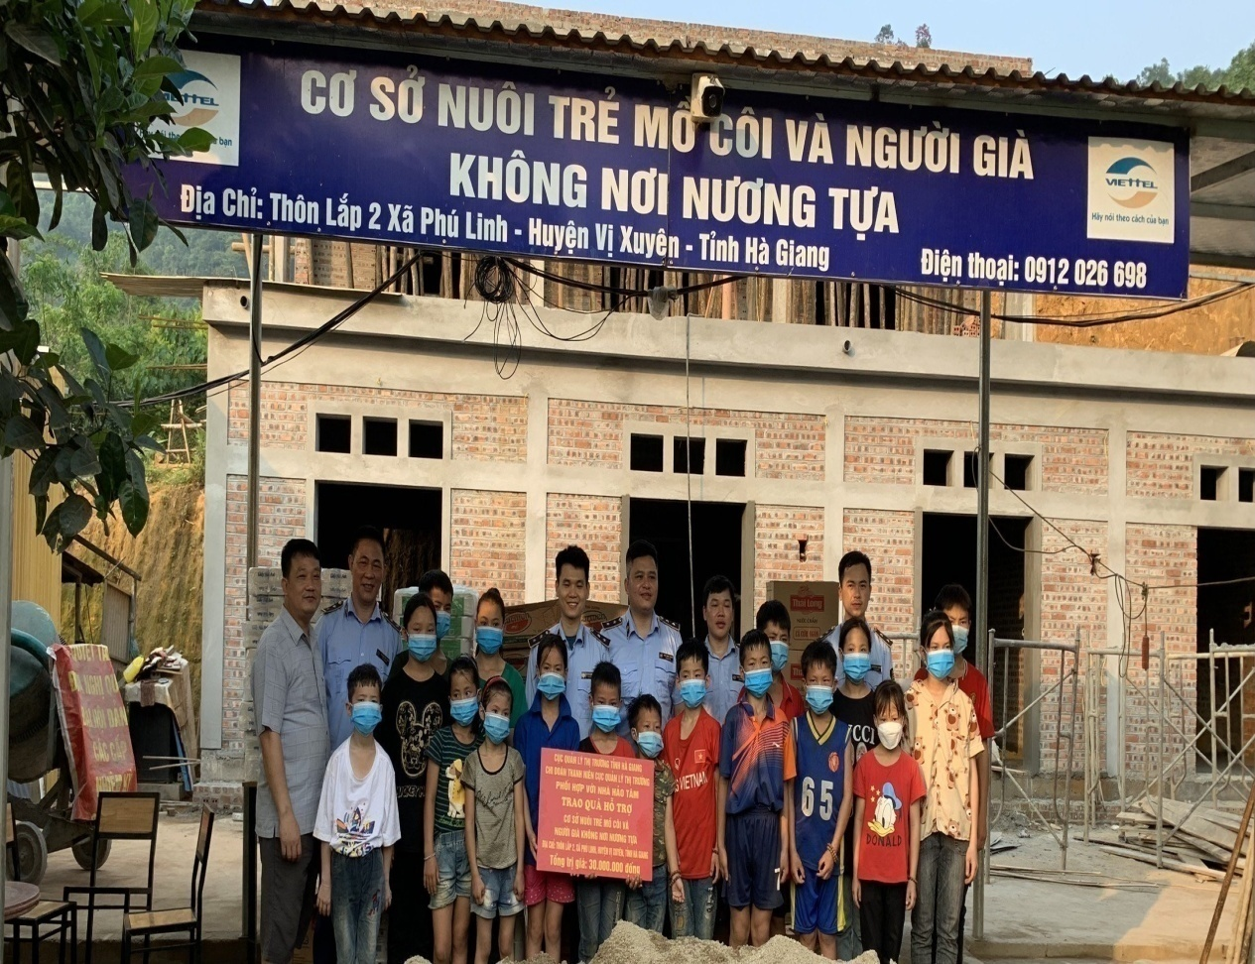

I. VOCABULARY
1. Volunteer (n, v) /ˌvɒlənˈtɪə(r)/
Tình nguyện viên (n), Tình nguyện(v)
2. advertisement (n) /ædˈvəːtaɪzmənt/
Quảng cáo
3. Community (n) /kəˈmjuːnəti/
Cộng đồng
4. Boost (v) /buːst/
Thúc đẩy, làm tăng thêm
5. Orphanage (n) /ˈɔːfənɪdʒ/
Trại trẻ mồ côi

Slide 7
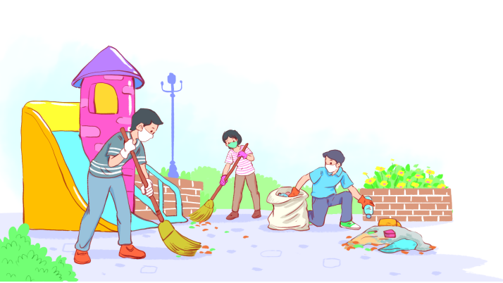
II. PRACTICE
Volunteering in the community
Act 1
Listen and read.
Kim: Hi, Tam. I went to your house at 9 am, but you weren't there.
Tam: Oh, when you came, I was working as a volunteer at our local centre for community development.
Kim: Ah, I see. How did you become a volunteer there?
Tam: Just by chance. Last summer, while I was visiting the centre, I saw an advertisement for volunteers. I applied and my application was successful.
Kim: I also want to be a volunteer. I find community work very interesting.
Tam: I agree. Community service not only benefits the local area, but can also boost our confidence and help us learn many useful skills.
Kim: What are the regular activities organised by the centre?
Tam: Oh, there are endless opportunities for getting involved. For example, you can join a local environmental group to clean up the park once a week or volunteer at an orphanage.
Kim: Sounds good. How can I apply?
Tam: I'll email you the form. You just fill it in and send it in.
Kim: Thanks so much. I'm so excited about volunteering at the centre.
Tam: No problem. Good luck. Hope your application is successful and you enjoy the work.

Slide 8
II. PRACTICE
PRACTICE
Act 2
Read the conversation again and answer the questions.
1. What was Tam doing when Kim went to her house?
She was working as a volunteer at the local centre for community development.
2. What are some regular activities at the centre for community development?
Cleaning up the park or volunteering at the orphanage.
3. How can Kim apply for volunteer work at the centre?
She needs to fill in the form, then send it in.
L2,3
L13 ->18
L5 from the bottom

Slide 9
II. PRACTICE
Act 3
Find the adjectives with the following suffixes in the conversation and write them below.
suffixes | adjectives
-ed
-ing
-ful
-less
excited
interesting
useful, successful
endless

Slide 10
II. PRACTICE
Act 4
Find a verb phrase in the conversation to complete each sentence.
1. Oh, when you came, I____________ as a volunteer at our local centre for community development.
2. Last summer, while I was visiting the centre, I_____ an advertisement for volunteers.
was working
saw

Slide 11
III. CONSOLIDATION
Choose A, B, C or D to Complete the sentences
1. Your music is very ____. Can't you just stop it?
A. annoyed B. interesting C. annoying D. bored
2. Some of the students were ____ at English, so volunteer teachers had to try very hard.
A. hopeless B. hopeful C. endless D. excited
3. you can join a local environmental group to _________the park once a week or volunteer at an orphanage
A. cleaning up B. clean up C. cleaned up D. cleans up
4. while I was visiting the centre, I ____ an advertisement for volunteers
A. see B. seeing C. saw D. was seeing

Slide 12


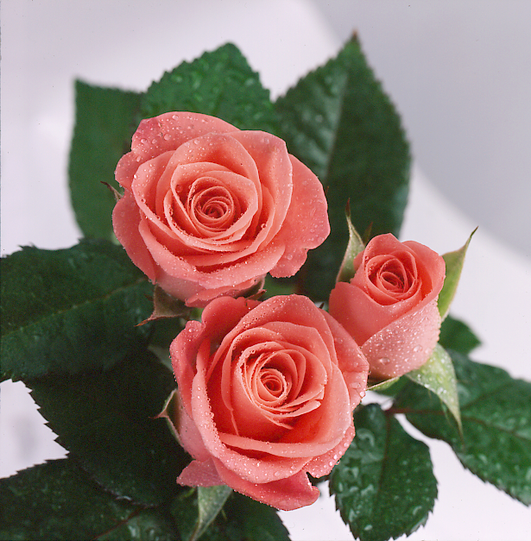
Thank you for your attendance

