Slide 1






Welcome to our class
Trường THPT Nguyễn Du – Bình Định

Slide 2


Slide 3

Warm-up

Slide 4
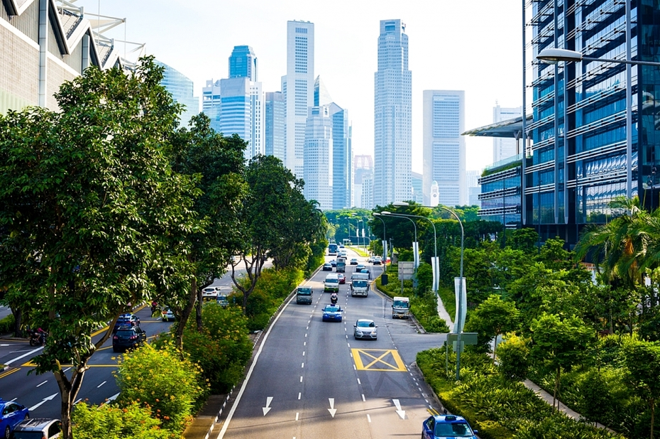
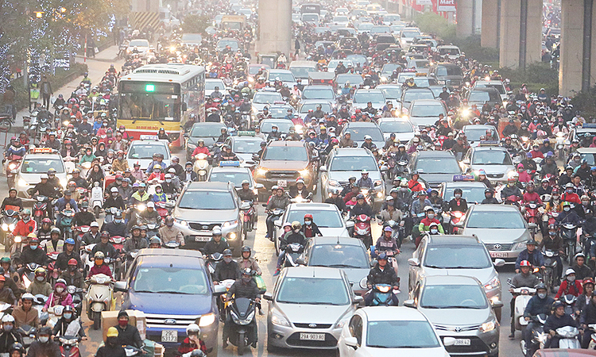
WARM-UP
Which of two cities below would you like to live in?
Why?
1
2
If given a choice, what lifestyle would you choose?
Green lifestyle
I’ d like to live in the first city
because it’s clean, with lots of trees and fresh air, living there people will be healthier
The second city has a lot of traffic, so it has noise pollution, air pollution, it affects human health

Slide 5

Unit
2
1
Unit
FAMILY LIFE
HUMANS AND THE ENVIRONMENT
LESSON 3
READING

Slide 6
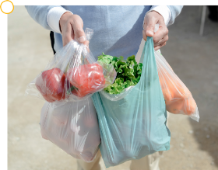
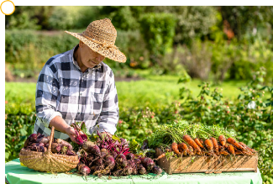
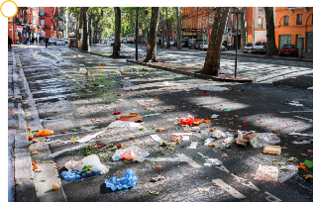
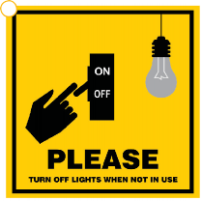
PRE-READING
1
Work in groups. Look at the pictures and answer the questions.
Which pictures show a green lifestyle? Why?
a
b
c
d
a. Plastic bags pollute the environment. It doesn’t show a green lifestyle
b. fresh food is better for our health. It shows a green lifestyle
c. the streets very dirty and pollutes the air and water. It doesn’t show a green lifestyle.
d. This can save electricity and shows a green lifestyle.

Slide 7
2. Read the following text and choose the best title for it.
A. Green living (Sống xanh)
B. Green issues (Các vấn đề xanh)
C. Green products (Các sản phẩm xanh)
More and more people adopt a green lifestyle. It is a choice we make to change to a greener and more sustainable lifestyle. There are many things you can do to become an eco-friendly person. Here are some of them.
Turning off your appliances when they are not in use
This is one of the easiest ways to save energy and reduce your carbon footprint. It also helps reduce energy bills and prevent any dangerous situations such as a fire or an explosion.
Buying products that are grown using more natural organic methods
This helps reduce the use of harmful chemicals in food. Organic food is better for us because it is safer and healthier. It also tastes better.
Cutting down on plastic use
This really helps the environment because it takes many years for plastic waste to break down into small pieces. Bring a reusable bag when you go shopping, and your own refillable bottle instead of buying bottled water.
Recycling as much as possible
This prevents pollution because it reduces the need to collect new raw materials and protects natural resources such as water and trees. So don't throw away your used household items, but sort and recycle them.

Slide 8
VOCABULARY
1. explosion (n) /ɪkˈspləʊʒn/: vụ nổ
2. Sustainable (adj) / səs’teinəbl/: bền vững
3. method (n) /ˈmeθəd/: phương pháp
4. Reusable (adj) /ri:’ju:zəbl/ : có thể dùng lại được
5. refillable (adj) /ˌriːˈfɪləbl/: có thể làm đầy lại
6. raw material (np)/ˌrɑː məˈtɪəriəl/: nguyên liệu thô
7. sort (v) /sɔːt/: phân loại
8. Natural resource (np): nguồn tài nguyên thiên nhiên

Slide 9
2. Read the following text and choose the best title for it.
A. Green living (Sống xanh)
B. Green issues (Các vấn đề xanh)
C. Green products (Các sản phẩm xanh)
More and more people adopt a green lifestyle. It is a choice we make to change to a greener and more sustainable lifestyle. There are many things you can do to become an eco-friendly person. Here are some of them.
Turning off your appliances when they are not in use
This is one of the easiest ways to save energy and reduce your carbon footprint. It also helps reduce energy bills and prevent any dangerous situations such as a fire or an explosion.
Buying products that are grown using more natural organic methods
This helps reduce the use of harmful chemicals in food. Organic food is better for us because it is safer and healthier. It also tastes better.
Cutting down on plastic use
This really helps the environment because it takes many years for plastic waste to break down into small pieces. Bring a reusable bag when you go shopping, and your own refillable bottle instead of buying bottled water.
Recycling as much as possible
This prevents pollution because it reduces the need to collect new raw materials and protects natural resources such as water and trees. So don't throw away your used household items, but sort and recycle them.

Slide 10
WHILE-READING
3
Circle the correct meanings of the highlighted words and phrases in the text.
1. sustainable
a. causing little or no damage to the environment
b. bringing no benefits to the environment
2. organic
a. without the use of animal organs
b. without the use of chemicals
3. cutting down on
a. reducing
b. reusing
4. natural resources
a. materials supporting life
b. materials harmful to life

Slide 11
WHILE-READING
4
Read the text again and decide whether the following statements are true (T) or false (F).
T
F
1. Green living is now compulsory for many people.
2. Turning off electrical appliances is an easy way to save energy.
3. It takes a long time for plastic waste to break down.
4. The use of refillable water bottle is not encouraged.
P1
More and more people adopt a green lifestyle. It is a choice we make …
P2
This is one of the easiest way to save energy ….
P4
because it takes many years for plastic waste to break down
P4
Bring a reusable bag when you go shopping, and your own refillable bottle instead of buying bottled water

Slide 12
POST-READING
PRACTICE
5
Work in pairs. Discuss the following question.
In your opinion, which of the suggestions in the text is the easiest way to live green?
In my opinion, turning off household appliances when they are not in use is the easiest way to live green because we can do this thing at home. We don’t need any training for this.

Slide 13
Homework
- Search for more ways to live green on the Internet, take note some and post them on the Facebook/Zalo of your class.
- Prepare for Speaking lesson.

Slide 14


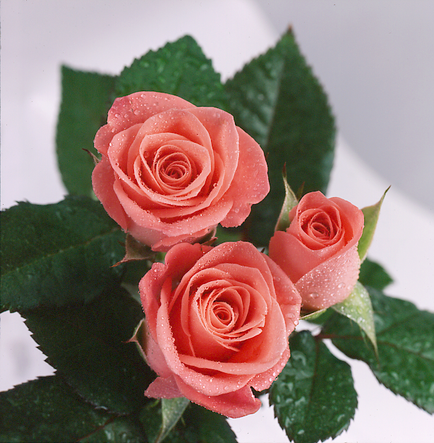
Thank you for your attendance

