Slide 1
WELCOME TO CLASS 12
Presented by
Le Thi Thu Thuy
https://www.facebook.com/thuy.lethithu.75/posts/3472989429434644

Slide 2
Unit 5:
CULTURAL IDENTITY
Vocabulary: related to cultural identity
Pronunciation: Assimilation
Grammar:
- The present perfect vs. the present perfect continuous
- Repeated comparatives
Skills:
- Reading: Cultural identity in today’s modern society
- Speaking: The ways to maintain cultural identity
- Listening: Cultural diversity in an Asian country
- Writing: The most important feature that defines someone’s cultural identity
Communication and Culture:
- Migration and cultural identity
- Festivals of ethnic groups in Viet Nam

Slide 3
Unit 5:
CULTURAL IDENTITY
Lesson: GETTING STARTED
Preserving cultural identity

Slide 4
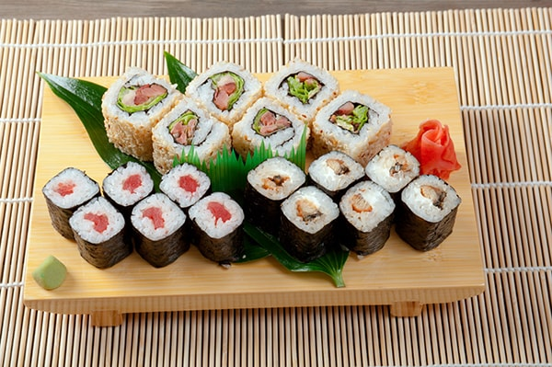
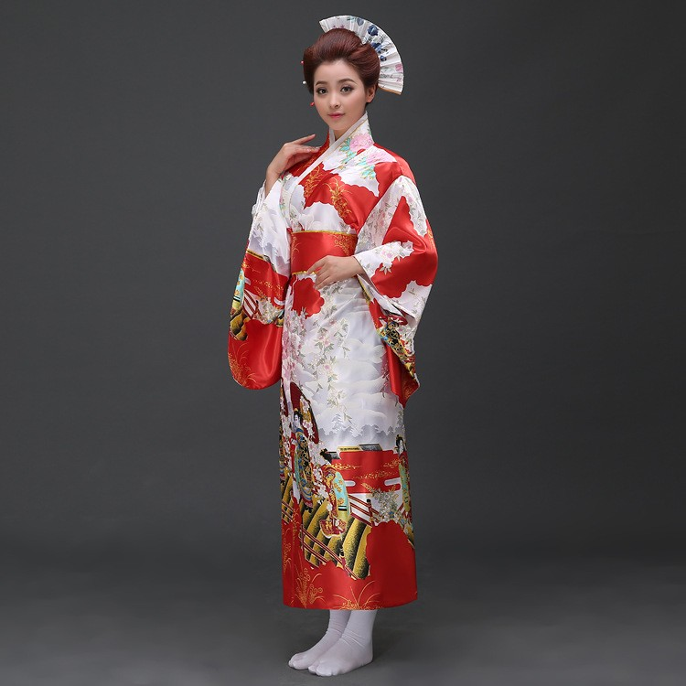
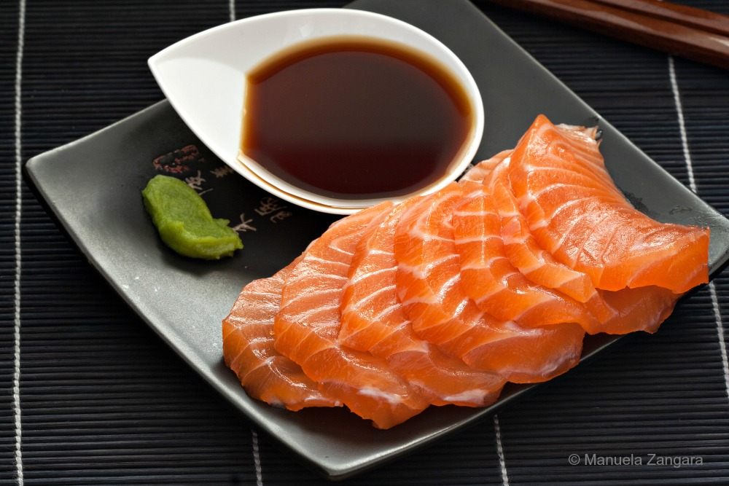
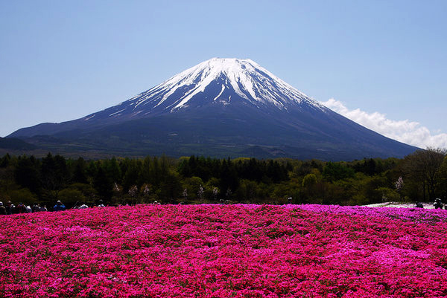
Which country is it?
JAPAN
Cherry blossom
Sushi
Kimono
Sashimi
Mount Fuji

Slide 5
Vocabulary - Collocation
cultural identity (np)
/ˈkʌltʃərəl aɪˈdentəti/
bản sắc văn hóa
-> express/ protect/ preserve their cultural identity
traditional costumes (np)
/trəˈdɪʃənl ˈkɒstjuːmz/

Slide 6
Vocabulary - Collocation
cultural identity (np)
/ˈkʌltʃərəl aɪˈdentəti/
bản sắc văn hóa
-> express/ protect/ preserve their cultural identity
traditional costumes (np)
/trəˈdɪʃənl ˈkɒstjuːmz/
trang phục truyền thống
Objects, events, activities, social groupings and language that participants use, produce and reproduce in the context of making meaning in everyday life
cultural practices (np)
/ˈkʌltʃərəl ˈpræktɪsɪs/
tập quán văn hóa
religious belief (np)
/rɪˈlɪdʒəs bɪˈliːfs/

Slide 7
Vocabulary - Collocation
cultural identity (np)
/ˈkʌltʃərəl aɪˈdentəti/
bản sắc văn hóa
-> express/ protect/ preserve their cultural identity
traditional costumes (np)
/trəˈdɪʃənl ˈkɒstjuːmz/
trang phục truyền thống
cultural practices (np)
/ˈkʌltʃərəl ˈpræktɪsɪs/
tập quán văn hóa
religious belief (np)
/rɪˈlɪdʒəs bɪˈliːfs/
tín ngưỡng tôn giáo

Slide 8
- Listen to the conversation between Mr. Brown, Van, Lam and Yumi;
ACTIVITY 1
- Pay attention to the difficult words (pronunciation) and the intonation;
- Answer the question: What are they talking about?
Notes:
How many new words have been mentions? What are they? Can you repeat?

Slide 9
Mr Brown: Hello everybody. Hope you're all working on your essay on cultural identity. Do you have any questions?
Van: Yes. I'm not quite sure about how people express their cultural identity.
Mr Brown: That's an interesting question. Can anyone give some examples?
Lam: I think people can do that through the language they speak, the food they eat and ... certain styles of clothing. For example, some people still wear their traditional costumes so they can preserve their national identity.
Mr Brown: That's right. It can also be expressed by beliefs and cultural practices.
Yumi: Do you mean people's religious beliefs, music activities and festivals?
Mr Brown: Correct. Any other questions?
Lam: I wonder... why people need to protect their cultural identity.
Yumi: You live here, in your motherland, so you can't see why this is important. But for me, a Japanese living in Viet Nam, it's essential to understand my family history and traditions.
Van: Interesting. Are your parents both Japanese, Yumi?
Yumi: Yes, but they've been living here for twenty years, and they're afraid that my sister and I are becoming less and less familiar with our traditions.
Lam: So how do you maintain your culture?
Yumi: Well, we wear kimonos on special occasions and celebrate Japanese festivals such as the cherry blossom festival. We also eat sushi, sashimi and udon noodles. At home we speak Japanese only.
Van: Do you often go back home?
Yumi: I've been to Kyoto four or five times to visit my grandparents. But to tell you the truth, I don't know whether Viet Nam or Japan is really my home. My parents are from Japan, but I was born and grew up here.
Mr Brown: I'd be interested to read about your experiences in Viet Nam in your essay, Yumi. OK, just to remind you that the essays are due next Wednesday and late submissions won't be accepted.
They are talking/ discussing about the essay on cultural identity.
Notes:
Who is Mr. Brown? And who are Lam, Nam and Jumi? What are they talking about?

Slide 10
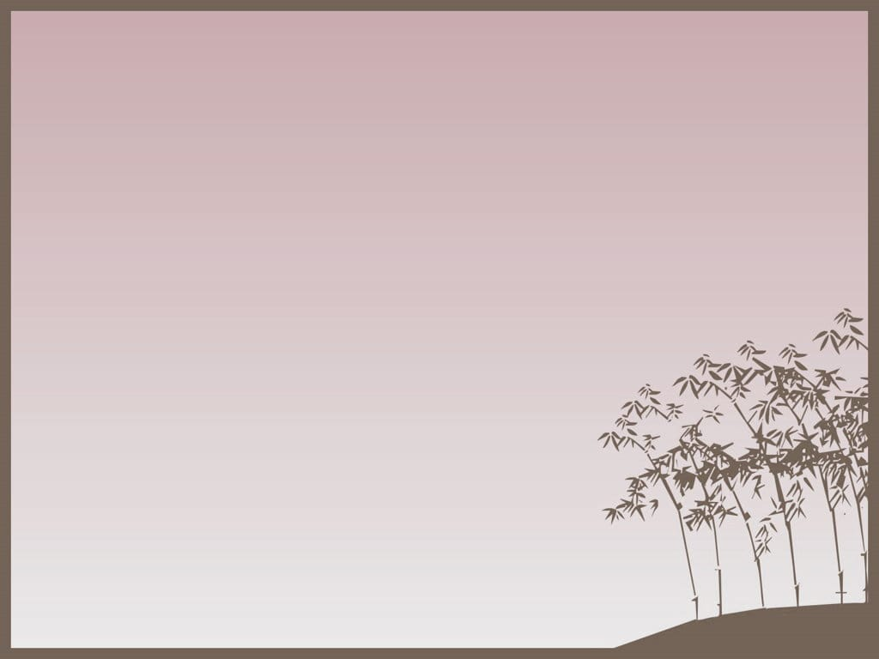
Note
The present perfect and the present perfect continuous
've been
I've been to Kyoto four or five times to visit my grandparents
have/ has + Vpp
they've been living here for twenty years
've been living
have/ has + been + V-ing
Notes:
From the sentences, would you recall the structure of the present perfect?

Slide 11
ACTIVITY 2
Answer the questions
1. According to Yumi, why do people need to protect their cultural identity?
2. How do Yumi's family maintain their culture?
3. Where is home for Yumi?
Because it’s essential to understand
their family history and traditions.
They wear kimonos on special occasions;
They celebrate Japanese festivals;
They eat sushi, sashimi and udon noodles;
They speak Japanese at home.
She doesn’t know whether Viet Nam, where she was born,
or Japan, where her parents com from, is really her home.

Slide 12
ACTIVITY 3
Complete the diagram
1.
Language
2.
3.
Food
Clothing
EXPRESSIONS OF
CULTURAL IDENTITY
Religious
beliefs
Cultural
practices
4.
5.

Slide 13
ACTIVITY 3
Japan
1.
Language:
Japanese
Food: sushi, sashimi, udon noodles…
2.
Clothing: Kimonos
3.
EXPRESSIONS OF
CULTURAL IDENTITY
Religious
beliefs: Shinto, Buddhism…
Cultural practices: cherry blossom festival, Awa Odori dance festival…
4.
5.
Notes:
Viet Nam: 1. Language: Vietnamese; 2. Food: Phở, Bún chả, Gỏi cuốn, Bánh xèo, Xôi, Bánh canh, Bánh mì, Chả giò, Chè…; 3. Clothing: Áo dài, 4. Religious belief: Buddhism,, Catholicism, ancestor-worship; 5. Cultural Practices: Hung Kings Commemoration Day - 10th day of Third Lunar month, Bai Dinh Pagoda Festival, Huong Pagoda Festival, Co Loa Citadel Festival, Lim Festival, Death Anniversary of the Hung Kings, Cyclo, Non la, Lotus, …

Slide 14
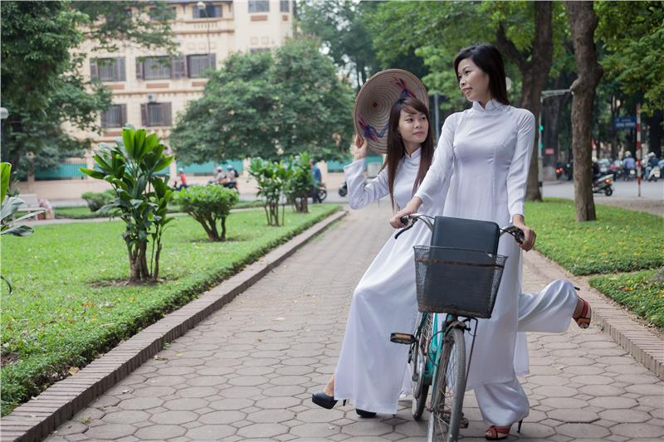
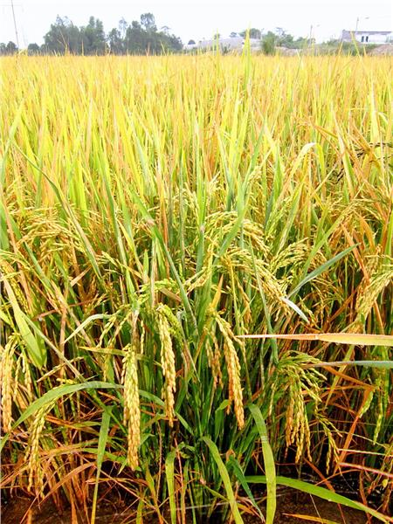
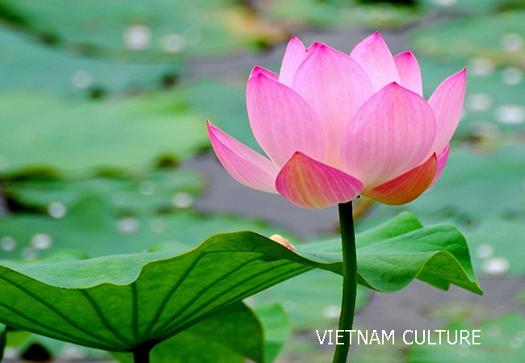
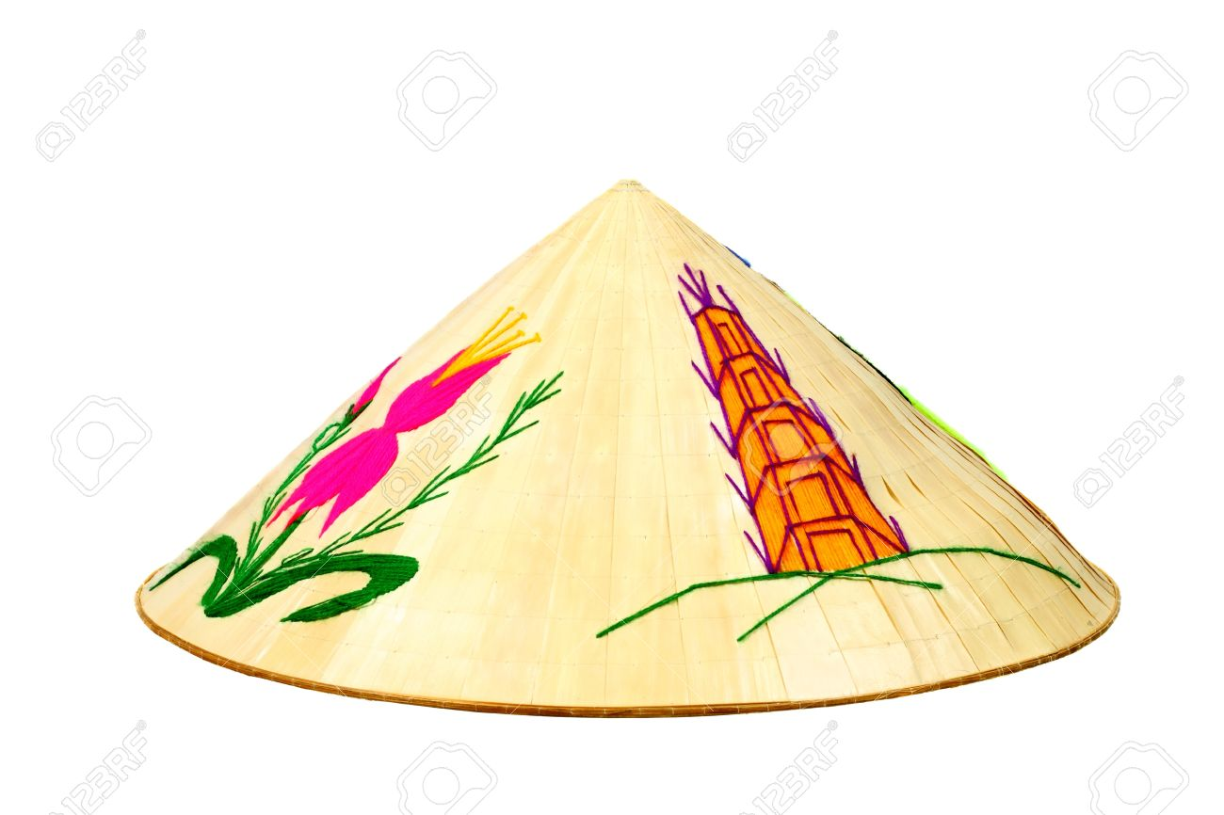
Cultural Symbols of Viet Nam
“Ao dai” – Vietnamese
traditional long dress
Vietnam National Emblem
Vietnam National Flag
Rice
Lotus - symbol flower of Vietnam
Non La – Vietnamese conical leaf hat

Slide 15
The teacher, Mr. Brown and three students, Van, Lam and Jumi, discuss about the essay on cultural identity.
What have you learnt?
Vocabulary: related to cultural identity;
Structure: The present perfect and the present perfect continuous.
Consolidation
Expressions of cultural diversity, especially in Japan and in Viet Nam

Slide 16
HOMEWORK
Review Unit 3,4 to prepare for the 45 minute test
Vocabulary related to
+ The Green Movement
+ The Mass Media
- Grammatical points:
+ Simple, compound, and complex sentences
+ Relative clauses with WHICH referring to the whole clause
+ Prepositions after certain verbs
+ The past perfect vs. the simple past
Reading, Listening: related to the two topics
Writing: An essay about the advantages and disadvantages of using a form of social networking media.

Slide 18
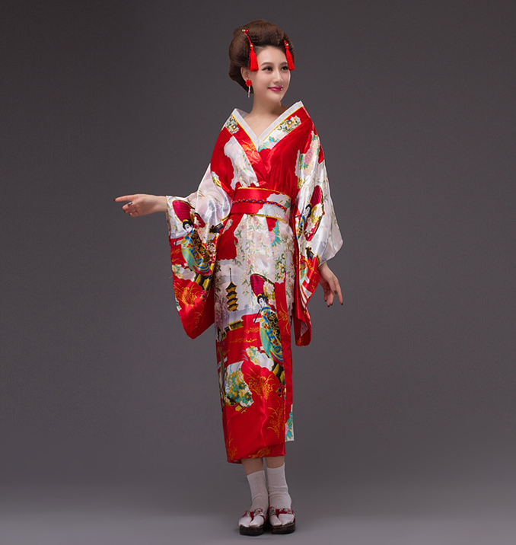
Which country does this traditional costume
belong to?
Kimono
JAPAN
Notes:
Japan

Slide 19
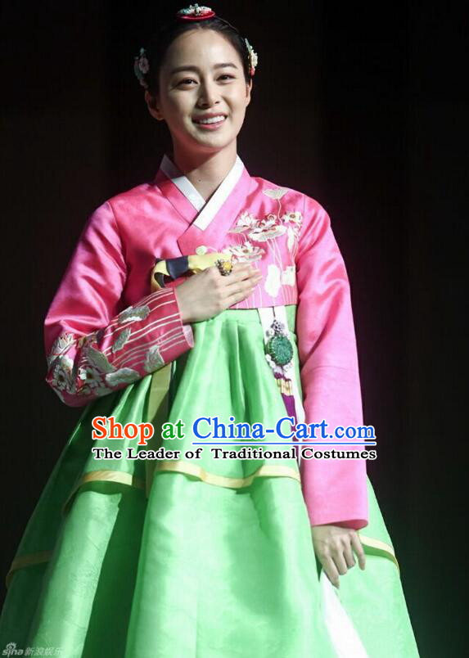
Which country does this
traditional costume
belong to?
Hanbok
KOREA

Slide 20
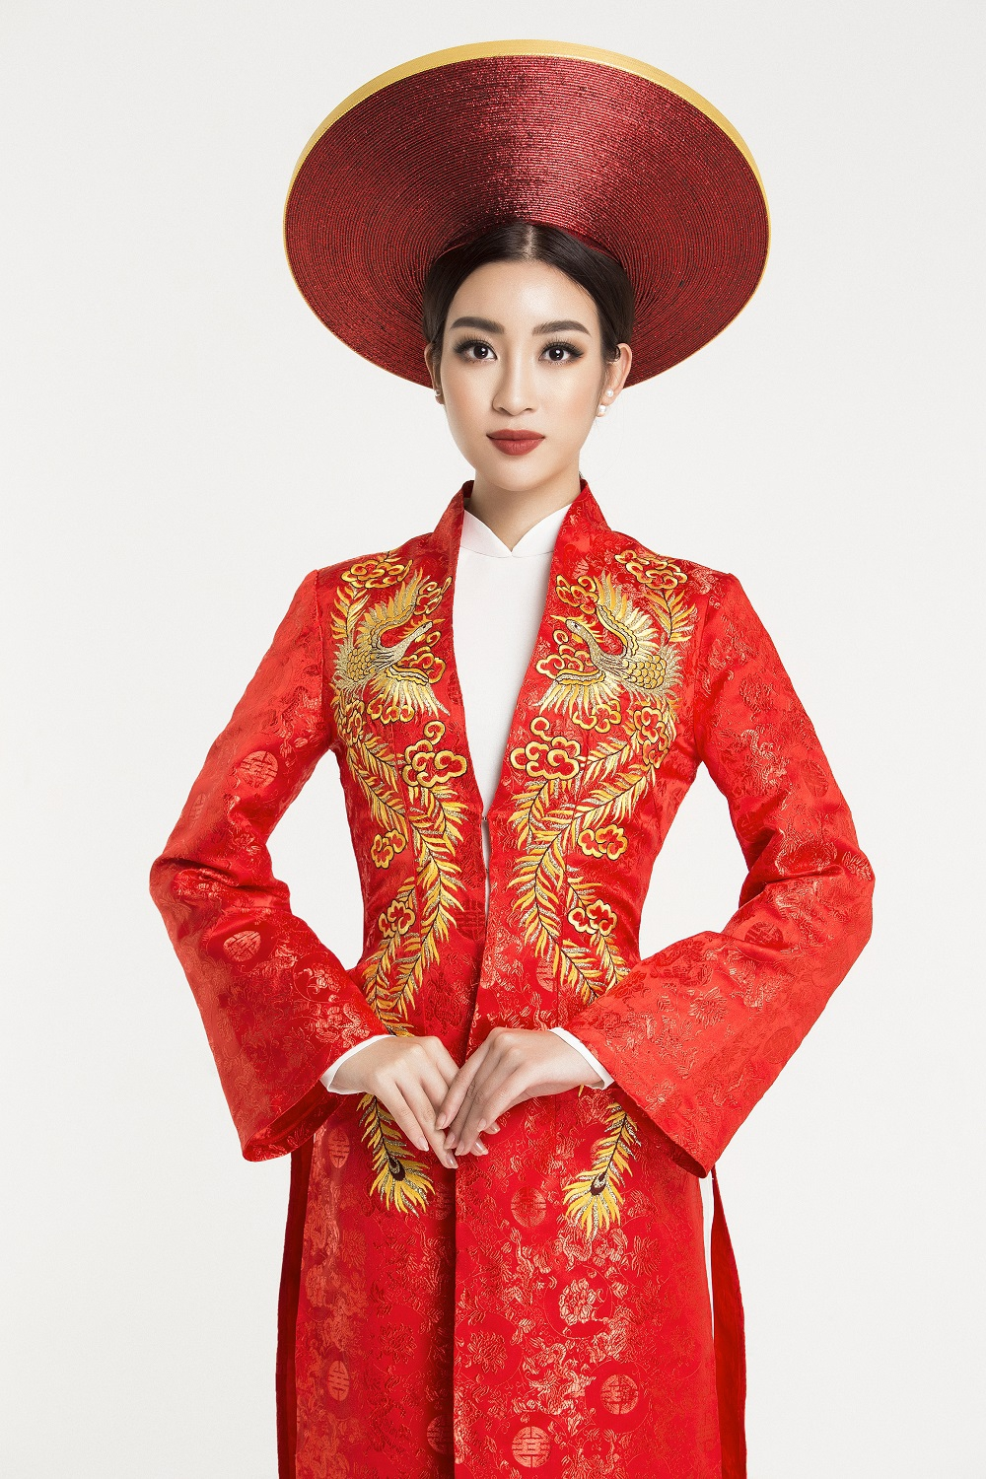
Which country does this traditional costume
belong to?
Ao dai
VIET NAM
6
Notes:
Đỗ Mỹ Linh – đang tham gia cuộc thi Miss World, xuất sắc vươn lên đứng vị trí đầu bảng xếp hạng bình chọn thí sinh được yêu thích nhất, ghi tên trong top 20 phần thi Beauty With a Purpose – Sắc đẹp vì mục đích cao cả (hay còn gọi là Người đẹp nhân ái).
Đêm chung kết cuộc thi Miss World 2017 sẽ được diễn ra vào ngày 18/11 tại Sanya City Arena (Trung Quốc).

Slide 21
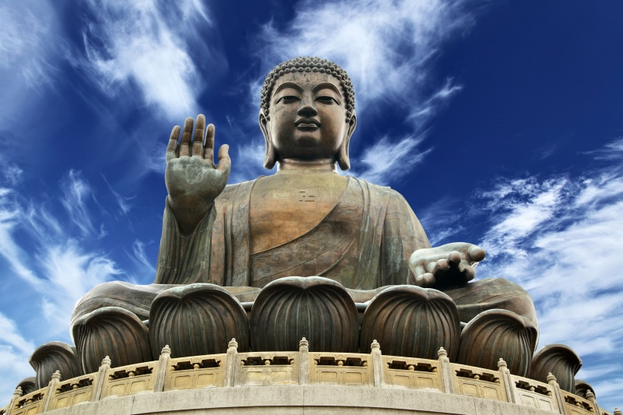
The predominant religious belief in Vietnam is Buddhism.
7

Slide 22
Mr Brown: Hello everybody. Hope you're all working on your essay on cultural identity. Do you have any questions?
Van: Yes. I'm not quite sure about how people express their cultural identity.
Mr Brown: That's an interesting question. Can anyone give some examples?
Lam: I think people can do that through the language they speak, the food they eat and ... certain styles of clothing. For example, some people still wear their traditional costumes so they can preserve their national identity.
Mr Brown: That's right. It can also be expressed by beliefs and cultural practices.
Yumi: Do you mean people's religious beliefs, music activities and festivals?
Mr Brown: Correct. Any other questions?
Lam: I wonder... why people need to protect their cultural identity.
Yumi: You live here, in your motherland, so you can't see why this is important. But for me, a Japanese living in Viet Nam, it's essential to understand my family history and traditions.
Van: Interesting. Are your parents both Japanese, Yumi?
Yumi: Yes, but they've been living here for twenty years, and they're afraid that my sister and I are becoming less and less familiar with our traditions.
Lam: So how do you maintain your culture?
Yumi: Well, we wear kimonos on special occasions and celebrate Japanese festivals such as the cherry blossom festival. We also eat sushi, sashimi and udon noodles. At home we speak Japanese only.
Van: Do you often go back home?
Yumi: I've been to Kyoto four or five times to visit my grandparents. But to tell you the truth, I don't know whether Viet Nam or Japan is really my home. My parents are from Japan, but I was born and grew up here.
Mr Brown: I'd be interested to read about your experiences in Viet Nam in your essay, Yumi. OK, just to remind you that the essays are due next Wednesday and late submissions won't be accepted.
Notes:
Can you recall the vocabulary you have learnt? What does it mean?

Slide 23
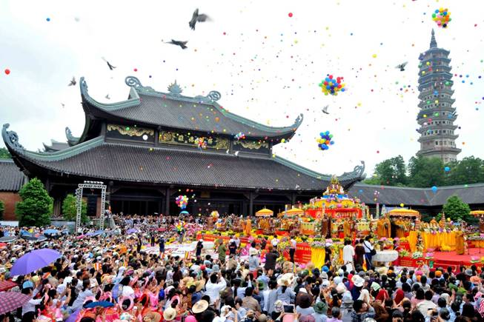
TRADITIONAL FESTIVALS IN VIETNAM
Bai Dinh Pagoda Festival

Slide 24
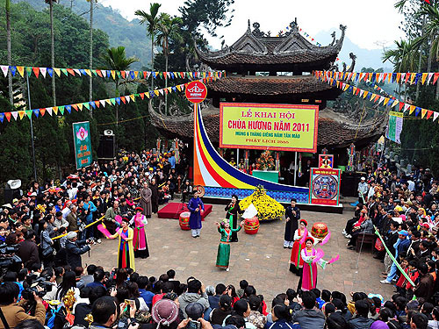
TRADITIONAL FESTIVALS IN VIETNAM
2. Huong Pagoda Festival

Slide 25
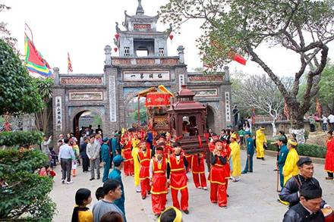
TRADITIONAL FESTIVALS IN VIETNAM
3. Co Loa Citadel Festival

Slide 26
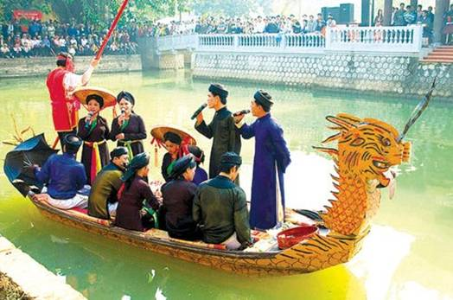
TRADITIONAL FESTIVALS IN VIETNAM
4. Lim Festival
5. Death Anniversary of the Hung Kings

Slide 27
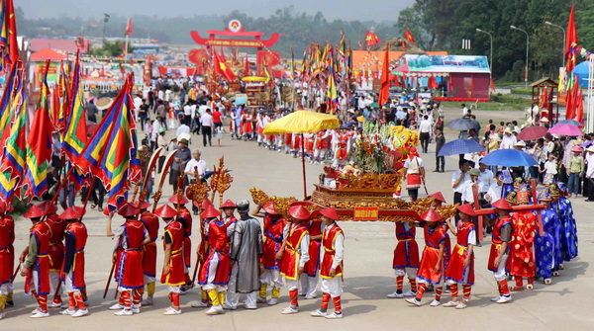
TRADITIONAL FESTIVALS IN VIETNAM
5. Death Anniversary of the Hung Kings

Slide 28
Mr Brown: Hello everybody. Hope you're all working on your essay on cultural identity. Do you have any questions?
Van: Yes. I'm not quite sure about how people express their cultural identity.
Mr Brown: That's an interesting question. Can anyone give some examples?
Lam: I think people can do that through the language they speak, the food they eat and ... certain styles of clothing. For example, some people still wear their traditional costumes so they can preserve their national identity.
Mr Brown: That's right. It can also be expressed by beliefs and cultural practices.
Yumi: Do you mean people's religious beliefs, music activities and festivals?
Mr Brown: Correct. Any other questions?
Lam: I wonder... why people need to protect their cultural identity.
Yumi: You live here, in your motherland, so you can't see why this is important. But for me, a Japanese living in Viet Nam, it's essential to understand my family history and traditions.
Van: Interesting. Are your parents both Japanese, Yumi?
Yumi: Yes, but they've been living here for twenty years, and they're afraid that my sister and I are becoming less and less familiar with our traditions.
Lam: So how do you maintain your culture?
Yumi: Well, we wear kimonos on special occasions and celebrate Japanese festivals such as the cherry blossom festival. We also eat sushi, sashimi and udon noodles. At home we speak Japanese only.
Van: Do you often go back home?
Yumi: I've been to Kyoto four or five times to visit my grandparents. But to tell you the truth, I don't know whether Viet Nam or Japan is really my home. My parents are from Japan, but I was born and grew up here.
Mr Brown: I'd be interested to read about your experiences in Viet Nam in your essay, Yumi. OK, just to remind you that the essays are due next Wednesday and late submissions won't be accepted.

Slide 29
Mr Brown: Hello everybody. Hope you're all working on your essay on cultural identity. Do you have any questions?
Van: Yes. I'm not quite sure about how people express their cultural identity.
Mr Brown: That's an interesting question. Can anyone give some examples?
Lam: I think people can do that through the language they speak, the food they eat and ... certain styles of clothing. For example, some people still wear their traditional costumes so they can preserve their national identity.
Mr Brown: That's right. It can also be expressed by beliefs and cultural practices.
Yumi: Do you mean people's religious beliefs, music activities and festivals?
Mr Brown: Correct. Any other questions?
Lam: I wonder... why people need to protect their cultural identity.
Yumi: You live here, in your motherland, so you can't see why this is important. But for me, a Japanese living in Viet Nam, it's essential to understand my family history and traditions.
Van: Interesting. Are your parents both Japanese, Yumi?
Yumi: Yes, but they've been living here for twenty years, and they're afraid that my sister and I are becoming less and less familiar with our traditions.
Lam: So how do you maintain your culture?
Yumi: Well, we wear kimonos on special occasions and celebrate Japanese festivals such as the cherry blossom festival. We also eat sushi, sashimi and udon noodles. At home we speak Japanese only.
Van: Do you often go back home?
Yumi: I've been to Kyoto four or five times to visit my grandparents. But to tell you the truth, I don't know whether Viet Nam or Japan is really my home. My parents are from Japan, but I was born and grew up here.
Mr Brown: I'd be interested to read about your experiences in Viet Nam in your essay, Yumi. OK, just to remind you that the essays are due next Wednesday and late submissions won't be accepted.

Slide 30
Mr Brown: Hello everybody. Hope you're all working on your essay on cultural identity. Do you have any questions?
Van: Yes. I'm not quite sure about how people express their cultural identity.
Mr Brown: That's an interesting question. Can anyone give some examples?
Lam: I think people can do that through the language they speak, the food they eat and ... certain styles of clothing. For example, some people still wear their traditional costumes so they can preserve their national identity.
Mr Brown: That's right. It can also be expressed by beliefs and cultural practices.
Yumi: Do you mean people's religious beliefs, music activities and festivals?
Mr Brown: Correct. Any other questions?
Lam: I wonder... why people need to protect their cultural identity.
Yumi: You live here, in your motherland, so you can't see why this is important. But for me, a Japanese living in Viet Nam, it's essential to understand my family history and traditions.
Van: Interesting. Are your parents both Japanese, Yumi?
Yumi: Yes, but they've been living here for twenty years, and they're afraid that my sister and I are becoming less and less familiar with our traditions.
Lam: So how do you maintain your culture?
Yumi: Well, we wear kimonos on special occasions and celebrate Japanese festivals such as the cherry blossom festival. We also eat sushi, sashimi and udon noodles. At home we speak Japanese only.
Van: Do you often go back home?
Yumi: I've been to Kyoto four or five times to visit my grandparents. But to tell you the truth, I don't know whether Viet Nam or Japan is really my home. My parents are from Japan, but I was born and grew up here.
Mr Brown: I'd be interested to read about your experiences in Viet Nam in your essay, Yumi. OK, just to remind you that the essays are due next Wednesday and late submissions won't be accepted.

Slide 31
Mr Brown: Hello everybody. Hope you're all working on your essay on cultural identity. Do you have any questions?
Van: Yes. I'm not quite sure about how people express their cultural identity.
Mr Brown: That's an interesting question. Can anyone give some examples?
Lam: I think people can do that through the language they speak, the food they eat and ... certain styles of clothing. For example, some people still wear their traditional costumes so they can preserve their national identity.
Mr Brown: That's right. It can also be expressed by beliefs and cultural practices.
Yumi: Do you mean people's religious beliefs, music activities and festivals?
Mr Brown: Correct. Any other questions?
Lam: I wonder... why people need to protect their cultural identity.
Yumi: You live here, in your motherland, so you can't see why this is important. But for me, a Japanese living in Viet Nam, it's essential to understand my family history and traditions.

Slide 32
Van: Interesting. Are your parents both Japanese, Yumi?
Yumi: Yes, but they've been living here for twenty years, and they're afraid that my sister and I are becoming less and less familiar with our traditions.
Lam: So how do you maintain your culture?
Yumi: Well, we wear kimonos on special occasions and celebrate Japanese festivals such as the cherry blossom festival. We also eat sushi, sashimi and udon noodles. At home we speak Japanese only.
Van: Do you often go back home?
Yumi: I've been to Kyoto four or five times to visit my grandparents. But to tell you the truth, I don't know whether Viet Nam or Japan is really my home. My parents are from Japan, but I was born and grew up here.
Mr Brown: I'd be interested to read about your experiences in Viet Nam in your essay, Yumi. OK, just to remind you that the essays are due next Wednesday and late submissions won't be accepted.

