Slide 1

ENGLISH 12
WELCOME!
Teacher: Le Thi Thu Thuy

Slide 2
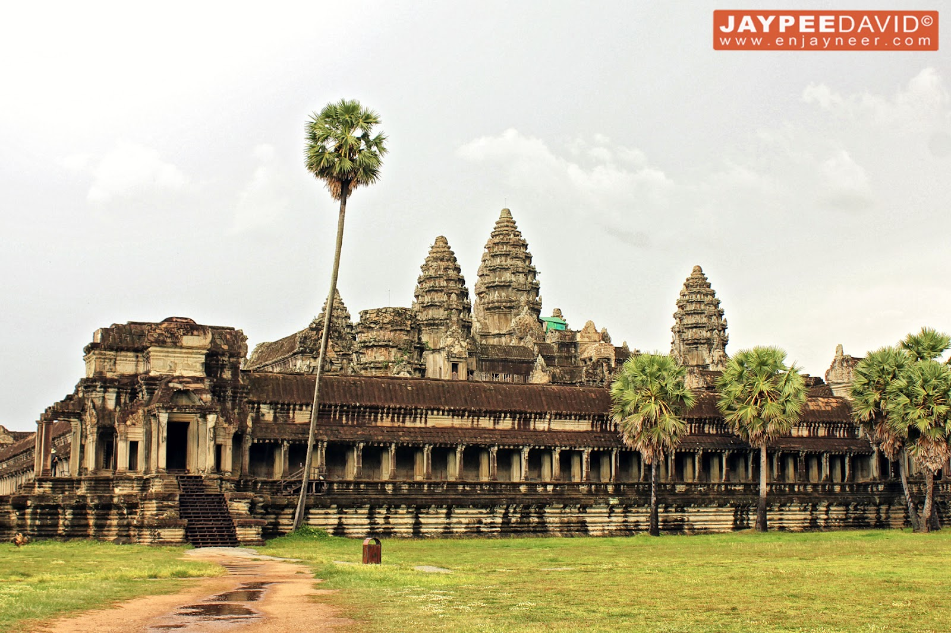
Which countries do these cultural values belong to?

Slide 3
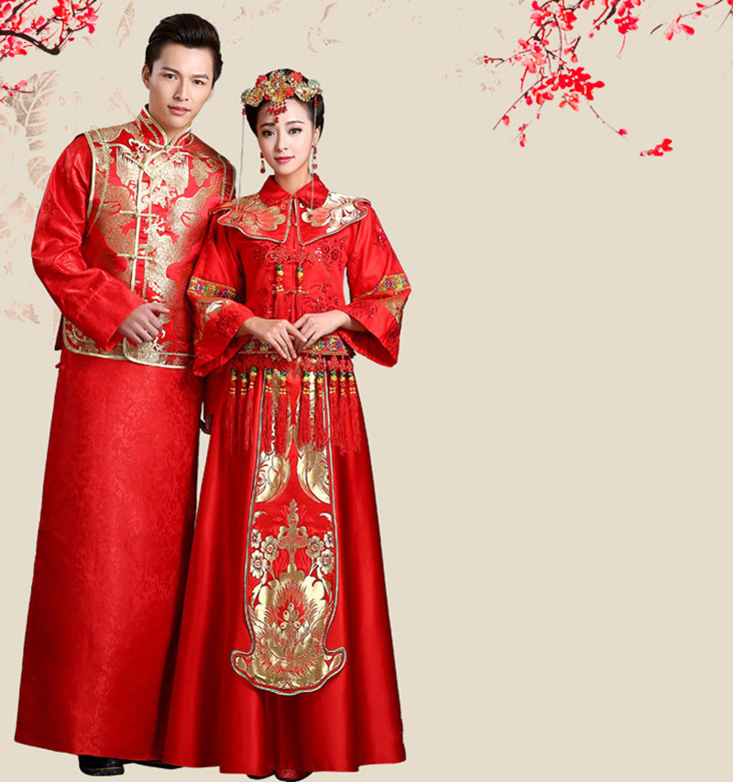
Which countries do these cultural values belong to?

Slide 4
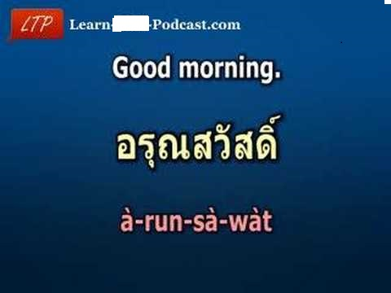
Which countries do these cultural values belong to?

Slide 5
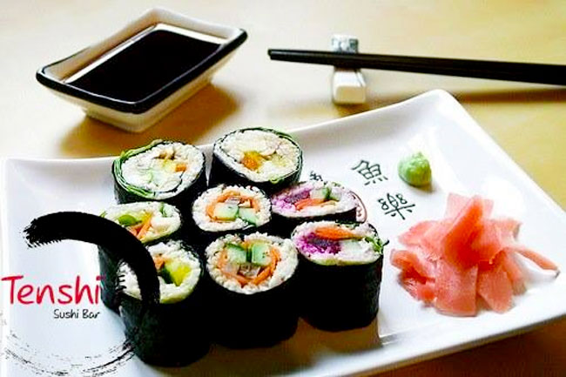
Which countries do these cultural values belong to?

Slide 6
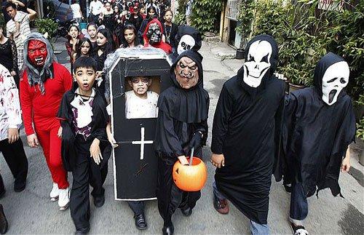
Which countries do these cultural values belong to?

Slide 7


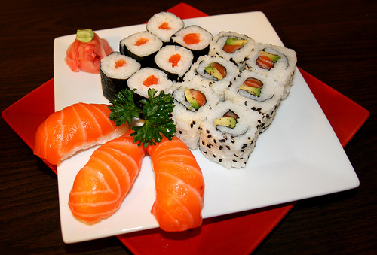
Angkor Wat - Cambodia
Wedding costume- China
Thai - Thailand
Cultural
identity
Sushi - Japan
Halloween- The USA

Slide 8
Lesson 3: Reading
Cultural identity in modern society
UNIT 5: CULTURAL IDENTITY

Slide 9
Vocabulary
1.cultural identifier (n) :
a series of characters used to refer to a culture
2. integrate /ˈɪntɪɡreɪt/ (v):
hội nhập, hòa nhập
E.g. He finds it difficult to integrate into a new school.
3. to take for granted (idiom)
Cho là tất nhiên, cho là hiển nhiên
E.g. We tend to take such things as air, water, fortunes or people who love us for granted. Only when they are gone will we start realizing how important they really are.
4. aspect /ˈæspekt/ (n)
khía cạnh
5. urge /ɜːdʒ/ (n) (v) :
a strong desire to do something
6.to inherit /ɪnˈherɪt/(v):
→ inherit sth. From sb.
to have qualities, physical features, etc. that are similar to those of your parents, grandparents, etc.
7. adjust to /əˈdʒʌst/ (v)
≈ adapt
8. flexibly /ˈfleksəbli/ (adv.)
in a way that changes to suit new conditions
9. confine oneself to sth.:
tự giới hạn trong phạm vi nào đó
E.g. People often do not confine themselves to one culture.

Slide 10
Activity 1: Complete the sentences with the correct forms of the words or phrases
1. He had taken it ________ that his friend would tell the true.
2. ______are characteristics shared by individuals belongings to the same group or community.
3. When he studied abroad, he successfully ______into the local culture.
4. His book covers all _______ of a migrant’s life.
Keys:
for granted
cultural identifiers
integrated
aspects

Slide 11
Activity 2: Read the newspaper column about cultural identity. Choose a sentence (a-d to complete each gap (1-4))
a. On the other hand, there are people who choose to abandon their heritage culture and assimilate into the new culture of the majority.
b. Cultural identity is usually understood as the identity of feeling of belonging to a group that has its own culture.
c. However, people often do not confine themselves to one culture.
d. The first stage, known as unexamined cultural identity, occurs during childhood, when culture is taken for granted.

Slide 12
Activity 2: Read the newspaper column about cultural identity. Choose a sentence (a-d to complete each gap (1-4)
a. On the other hand, there are people who choose to abandon their heritage culture and assimilate into the new culture of the majority.
b. Cultural identity is usually understood as the identity of feeling of belonging to a group that has its own culture.
c. However, people often do not confine themselves to one culture.
d. The first stage, known as unexamined cultural identity, occurs during childhood, when culture is taken for granted.

Slide 13
Activity 3: Read the newspaper column again and answer the questions
1. How do individuals define themselves?
2. What happens in the first stage of formation of cultural identity?
3. When do people reach the final stage?
4. Why can people’s cultural identity be affected by other cultures even if they live in their native country?
5. What are three ways people react when they move to a new culture?

Slide 14
Activity 3: Read the newspaper column again and answer the questions
1. They define themselves by (cultural identifiers such as ) nationality, ethnicity, location, history, language, gender, beliefs, customs, clothing and food.
2. In the first stage, culture is taken for granted. Cultural ideas and values provided by families, communities or the media are easily accepted without much critical thinking.
3. When they develop a clear sense of cultural identity, know which social group they belong to, and feel satisfied with their cultural identity.
4. Because access to the Internet and the media provides instant contact with many cultures.
5. First, they keep their cultural identity. Second, they assimilate into the new culture of the majority. Third, they integrate into the new cultural environment (keeping their cultural identity and flexibly adjusting to the different aspects of the new culture)

Slide 15
Activity 4: Review what people in the passage do to develop their cultural identity in modern society.
Speaking their language
Cooking their food
Wearing their traditional clothing
Celebrating their festival

Slide 16
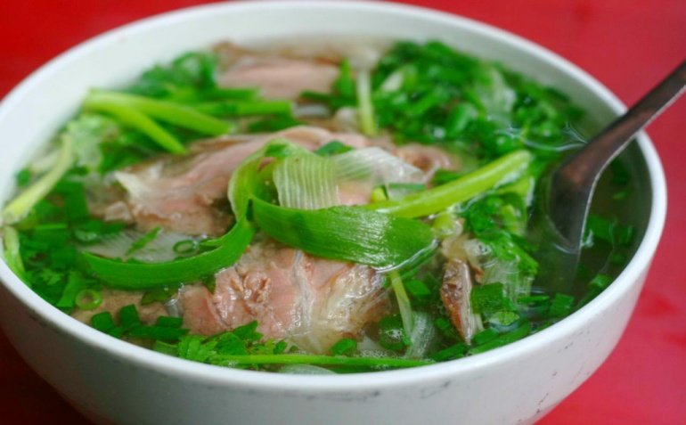
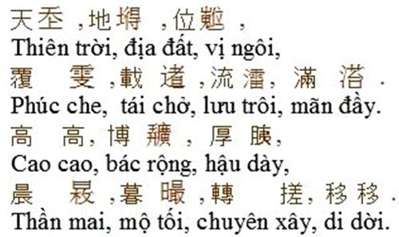
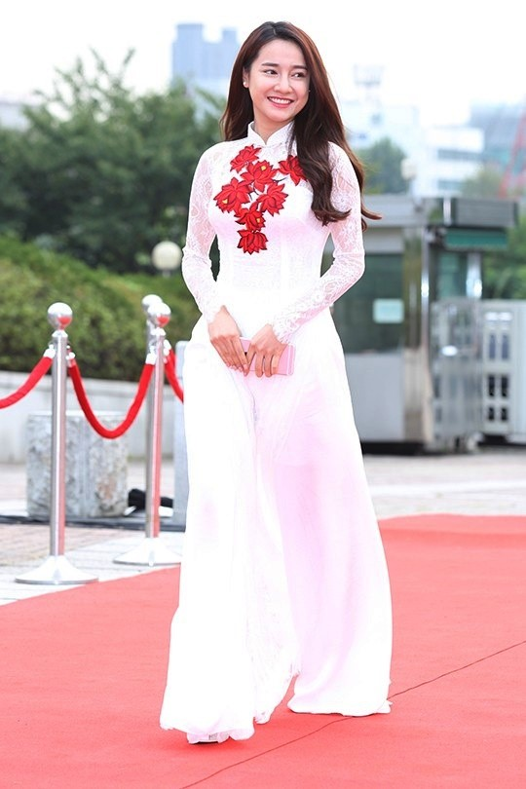
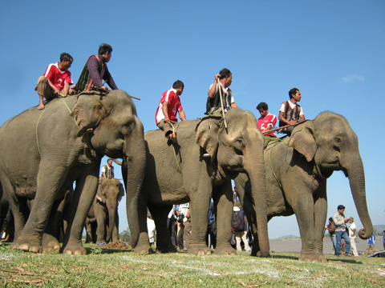
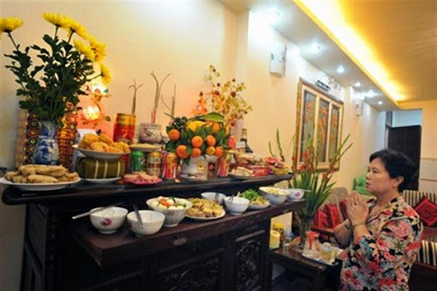
Name some Vietnamese cultural identifiers

Slide 17
Group discussion:
Being Vietnamese, what should you do to develop your cultural identity in today’s modern society?

Slide 18

HOMEWORK
Learn by heart new words.
Write a paragraph (80 words) about how people maintain their cultural identity in modern society.
Prepare speaking lesson

