Slide 1
SỞ GIÁO DỤC VÀ ĐÀO TẠO BÌNH ĐỊNH
TRƯỜNG THPT LÝ TỰ TRỌNG
MÔN TIẾNG ANH LỚP 10
Năm học 2024 - 2025
Gv thực hiện: Hồ Thị Thu Trang

Slide 2


UNIT 6
GENDER EQUALITY
Content by: Quang Mỹ
Powerpoint by: Đăng Nguyên

Slide 3


UNIT 6
GENDER EQUALITY

Slide 4
WARM-UP
What do you know about the other gender

Slide 5






GIRL
WOMEN ARE BETTER AT DISTINGGUISHING THAN MEN
WOMEN LIVE LONGER THAN MEN
WOMEN ARE BETTER AT RECOGNIZING COLORS THAN MEN
WARM-UP
What do you know about the other gender

Slide 6





BOY
MEN LOVE COMPLIMENTS FROM OTHER MEN
IN MAN’S LIFE, THE TIME HE LOOKS AT WOMAN IS EQUAL TO A YEAR
MEN LIE TWICE AS MUCH AS WOMEN

Slide 7

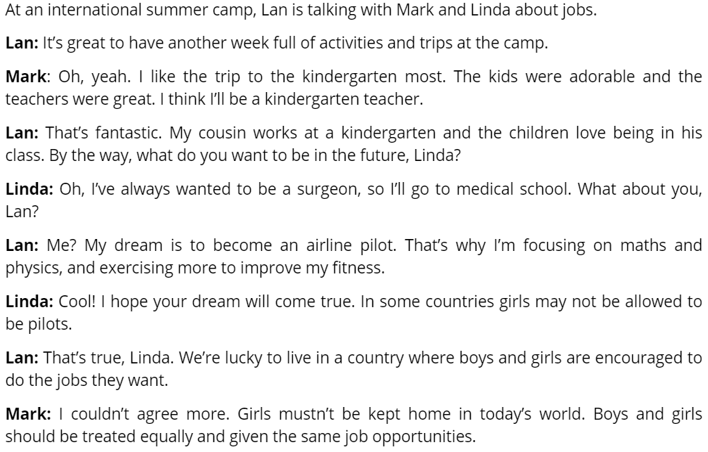

LISTEN AND READ

Slide 8

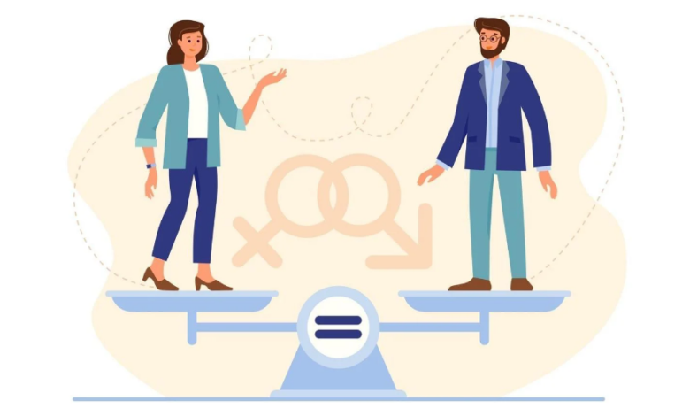
VOCABULARY
gender equality /ˈʤɛndər i(ː)ˈkwɒlɪti/
(n/p): bình đẳng giới

Slide 9

VOCABULARY
career choices /kəˈrɪə ˈʧɔɪsɪz/
(n/p): lựa chọn nghề nghiệp

Slide 10
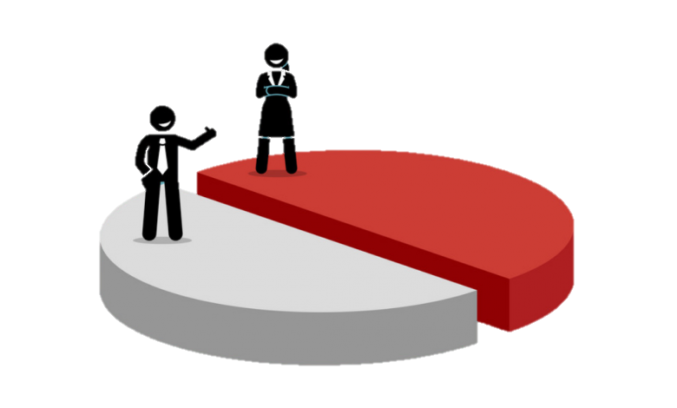
VOCABULARY
equal opportunity /ˈiːkwəl ˌɒpəˈtjuːnɪti/
(n/p): cơ hội bình đẳng

Slide 11

VOCABULARY
(An adj) _______: used to describe someone or something that makes you love or like them, usually because they are attractive and often small.
adorable /əˈdɔːrəbl/ (adj): đáng yêu

Slide 12

VOCABULARY
surgeon
/ˈsɜːdʒən/
(n): bác sĩ phẫu thuật

Slide 13
VOCABULARY
If you keep working hard, your goals will_________.
A. come true
B. come on
C. come back

Slide 14
VOCABULARY
1.gender equality: (n) bình đẳng giới
2. career choices: (n) lựa chọn nghề nghiệp
3. equal opportunity: (n) cơ hội bình đẳng
4. adorable: (adj) đáng yêu
5. surgeon: (n) bác sĩ phẩu thuật
6. come true: hiện thực

Slide 15
TRUE - FALSE
1. Linda would like to be a kindergarten teacher.
Key: F - Linda: Oh, I’ve always wanted to be a surgeon, so I’ll go to medical school.
2. Lan wants to be a teacher of maths and physics in the future
Key: F - Lan: Me? My dream is to become an airline pilot
3. Mark says that girls mustn’t be kept home in today’s world.
Key: T - Mark: I couldn’t agree more. Girls mustn’t be kept home in today’s world. Boys and girls should be treated equally and given the same job opportunities.

Slide 16

MATCH THE WORD
TREATED
SCHOOL
MEDICAL
OPPORTUNITIES
JOB
EQUALLY

Slide 17


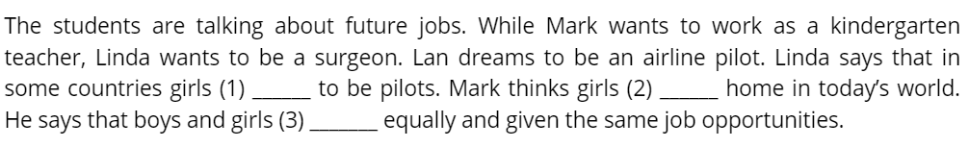


COMPLETE THE SUMMARY
1/ May not be allow
2/ Mustn’t be kept
3/ Should be treated

Slide 18



QUIZ GAME

Slide 19
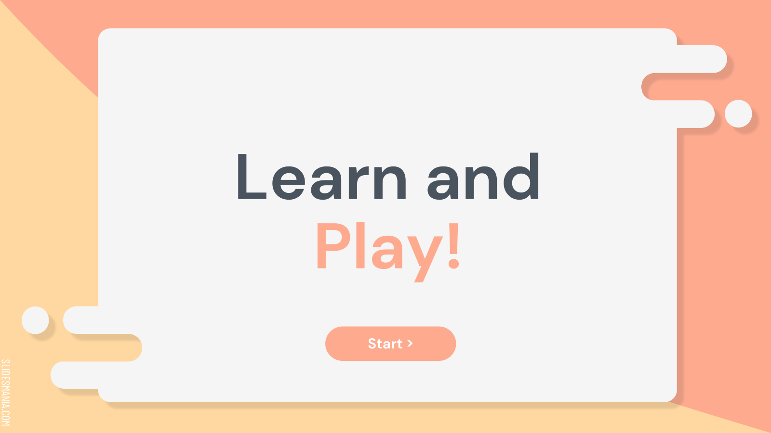
Start >

Slide 20
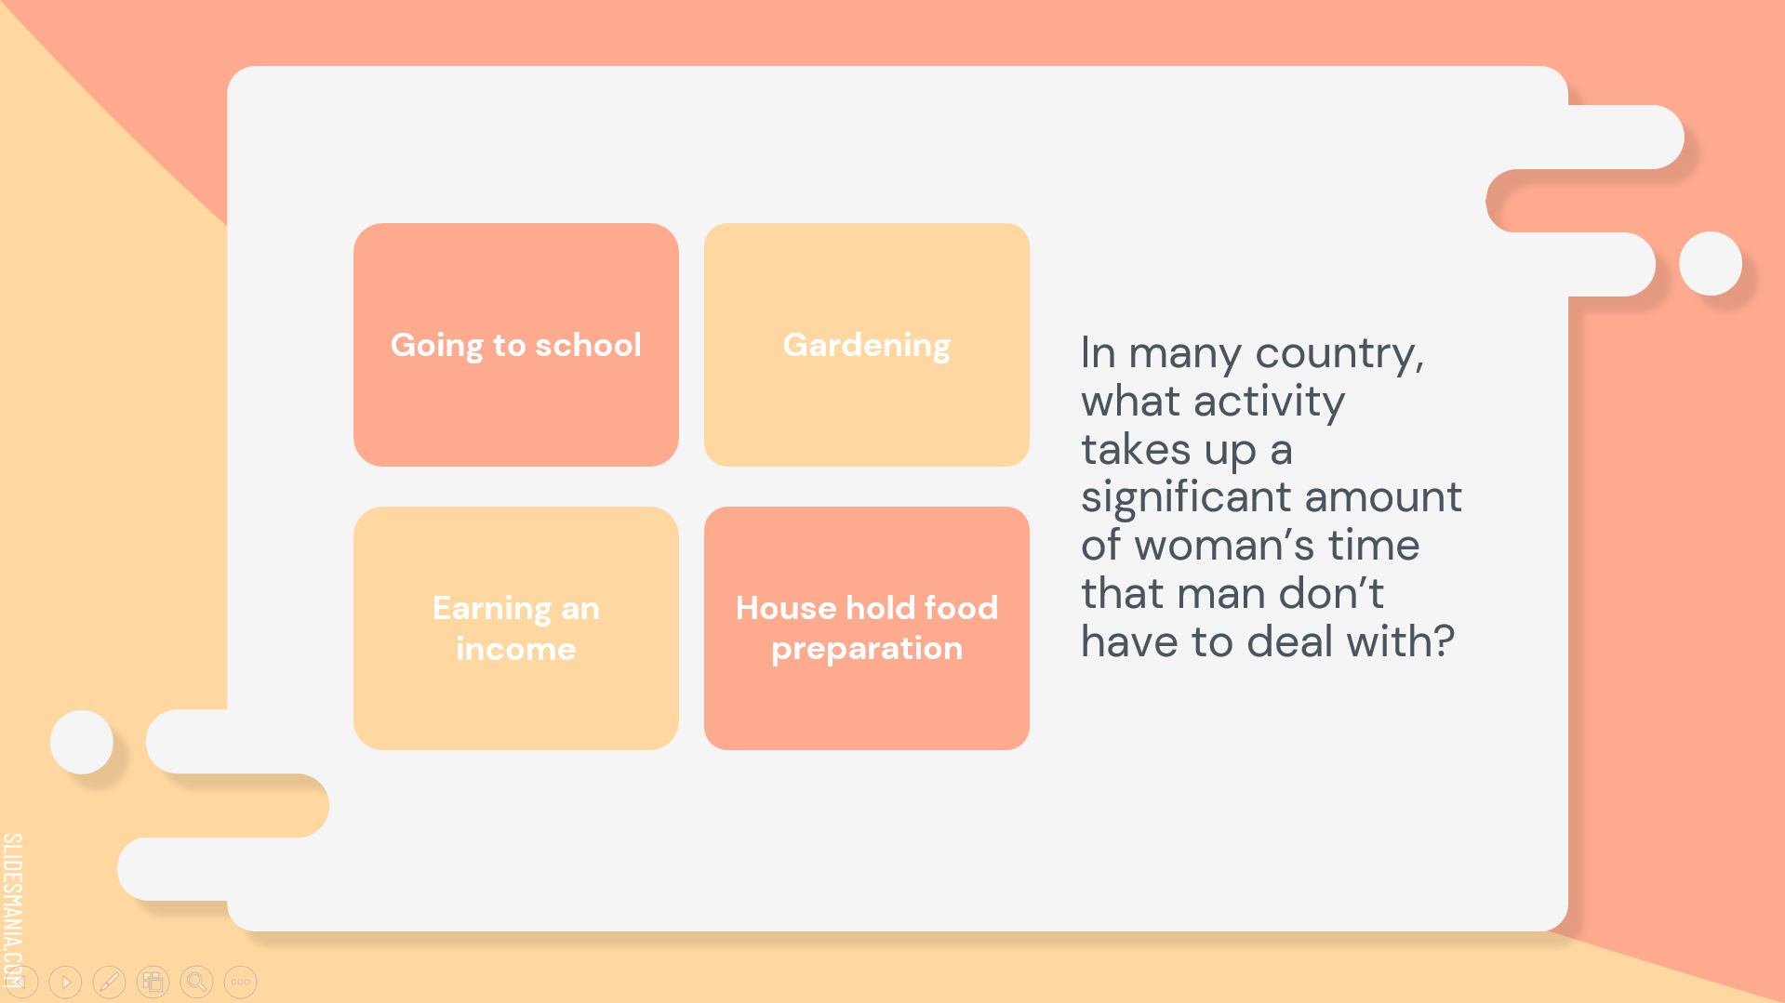
Notes:
Answer 4 is set to correct here. To edit it, please watch the “how to set it up” video.

Slide 21


Next >

Slide 22
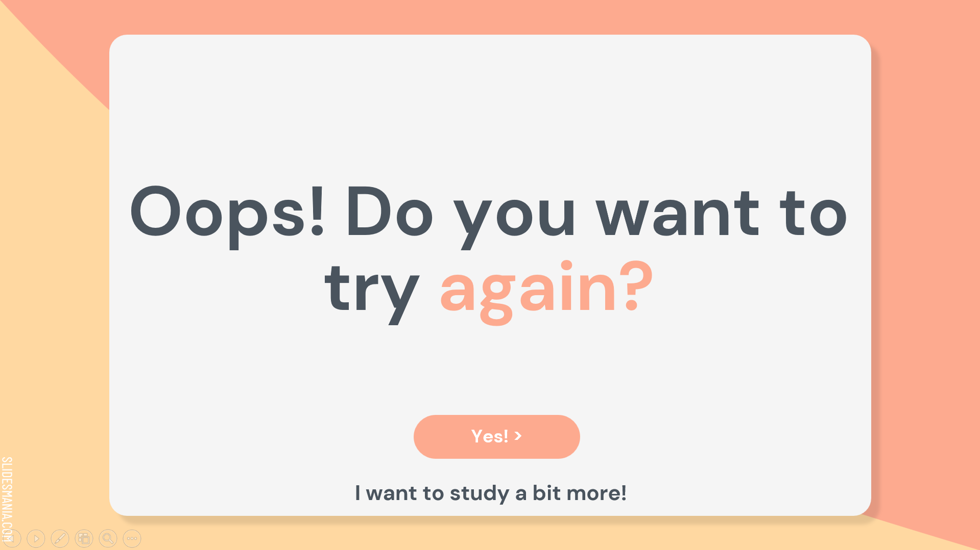
Yes! >
I want to study a bit more!

Slide 23
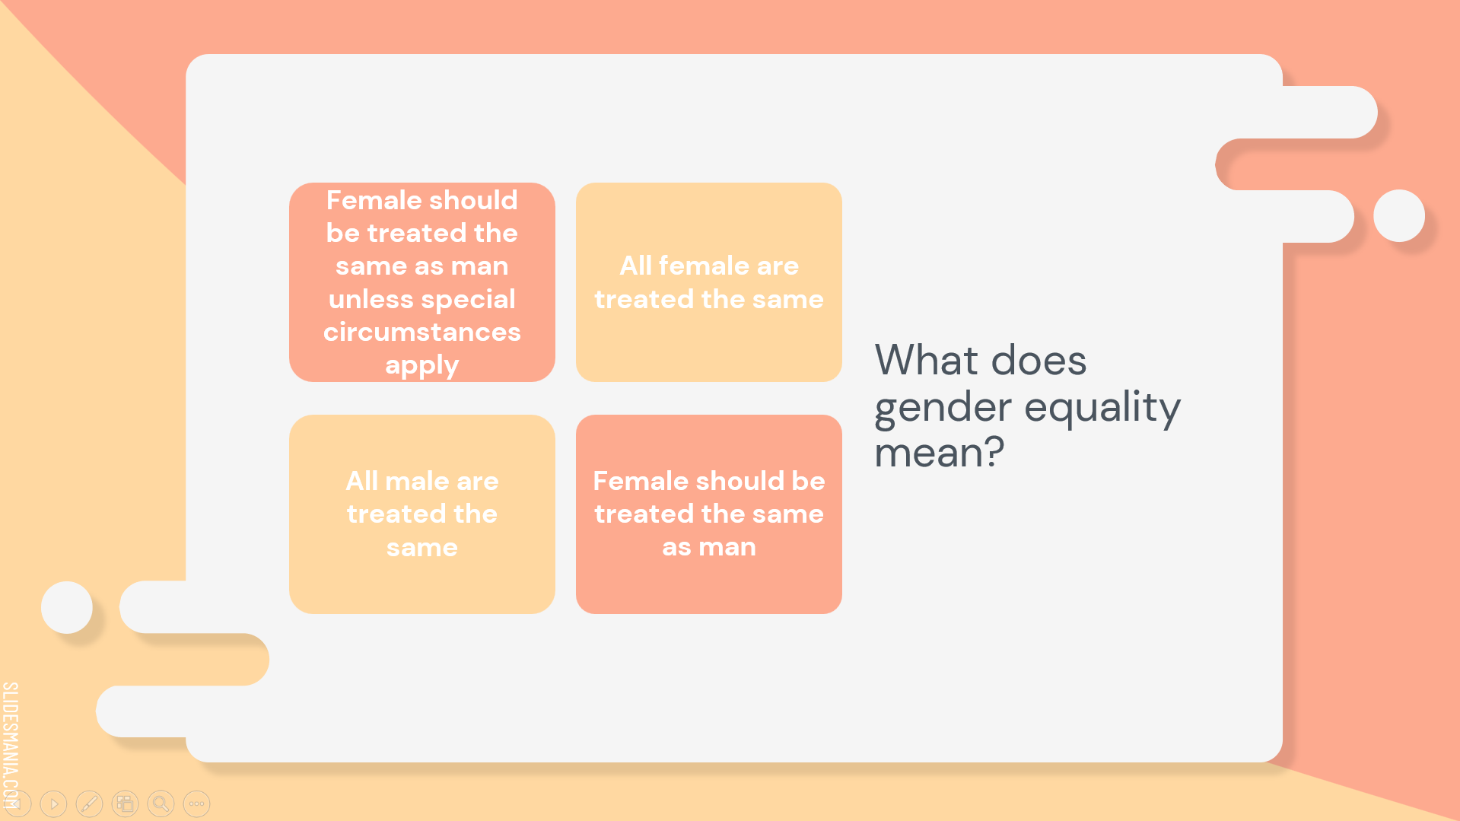
Notes:
Answer 1 is set to correct here. To edit it, please watch the “how to set it up” video.

Slide 24
Next >

Slide 25
Yes! >
I want to study a bit more!

Slide 26
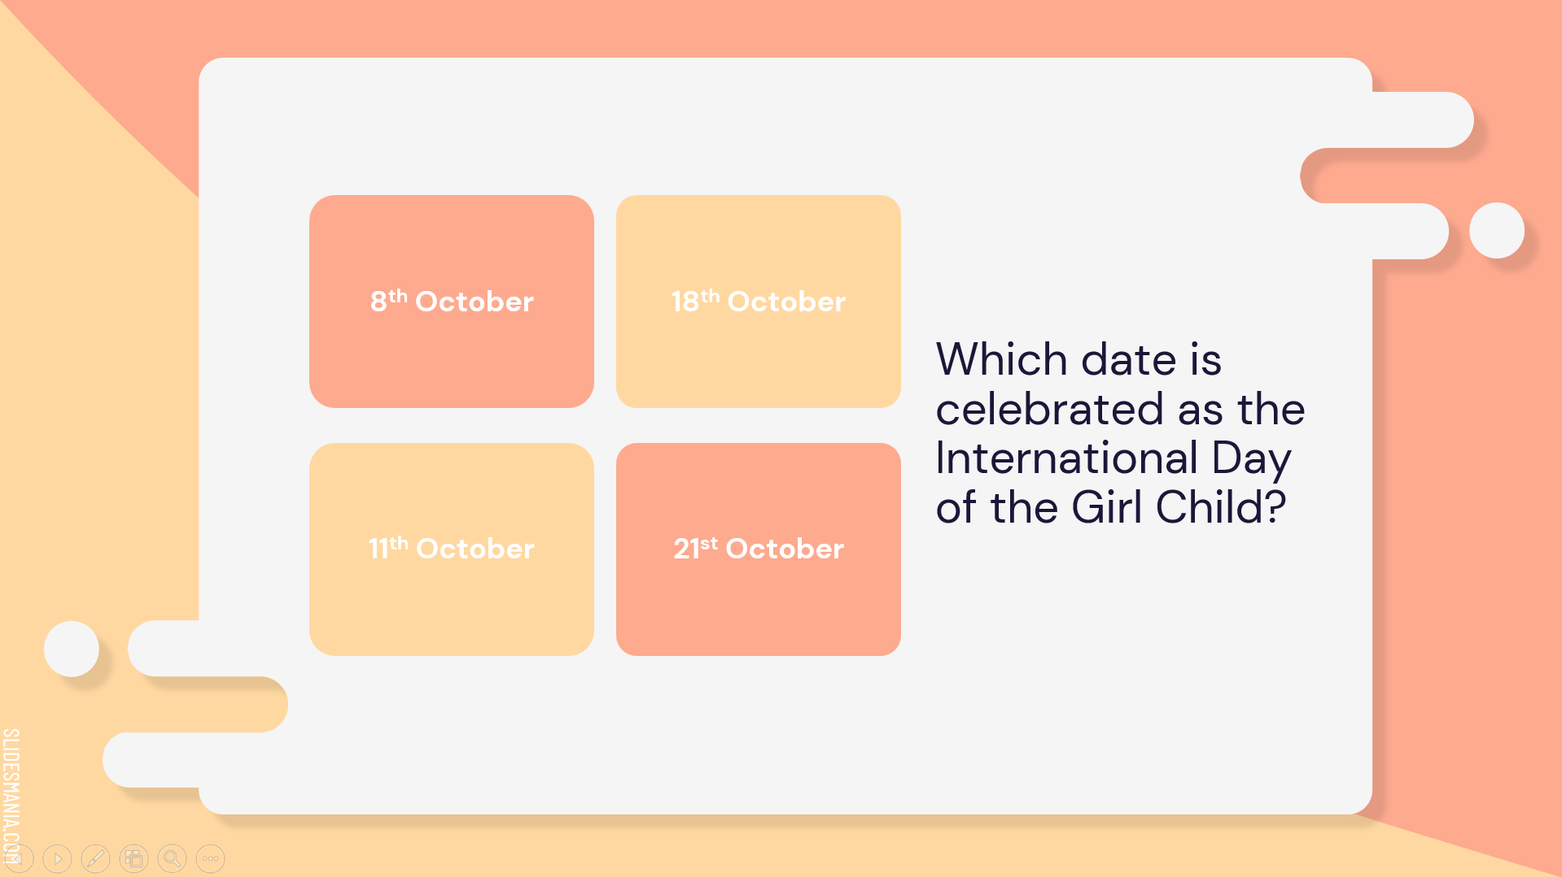
Notes:
Answer 3 is set to correct here. To edit it, please watch the “how to set it up” video.

Slide 27
Next >

Slide 28
Yes! >
I want to study a bit more!

Slide 29
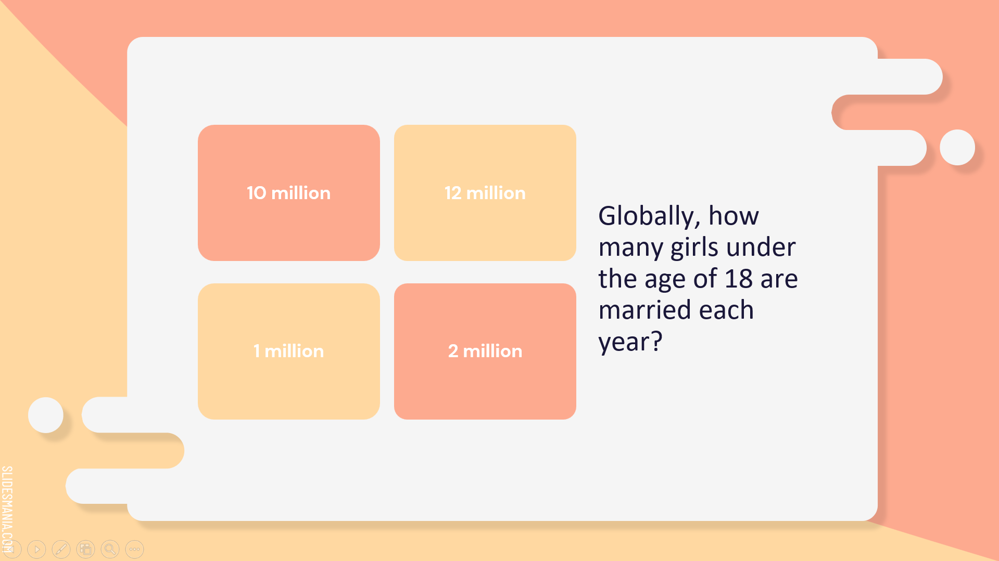
Notes:
Answer 2 is set to correct here. To edit it, please watch the “how to set it up” video.

Slide 30
Next >

Slide 31
Yes! >
I want to study a bit more!

Slide 32
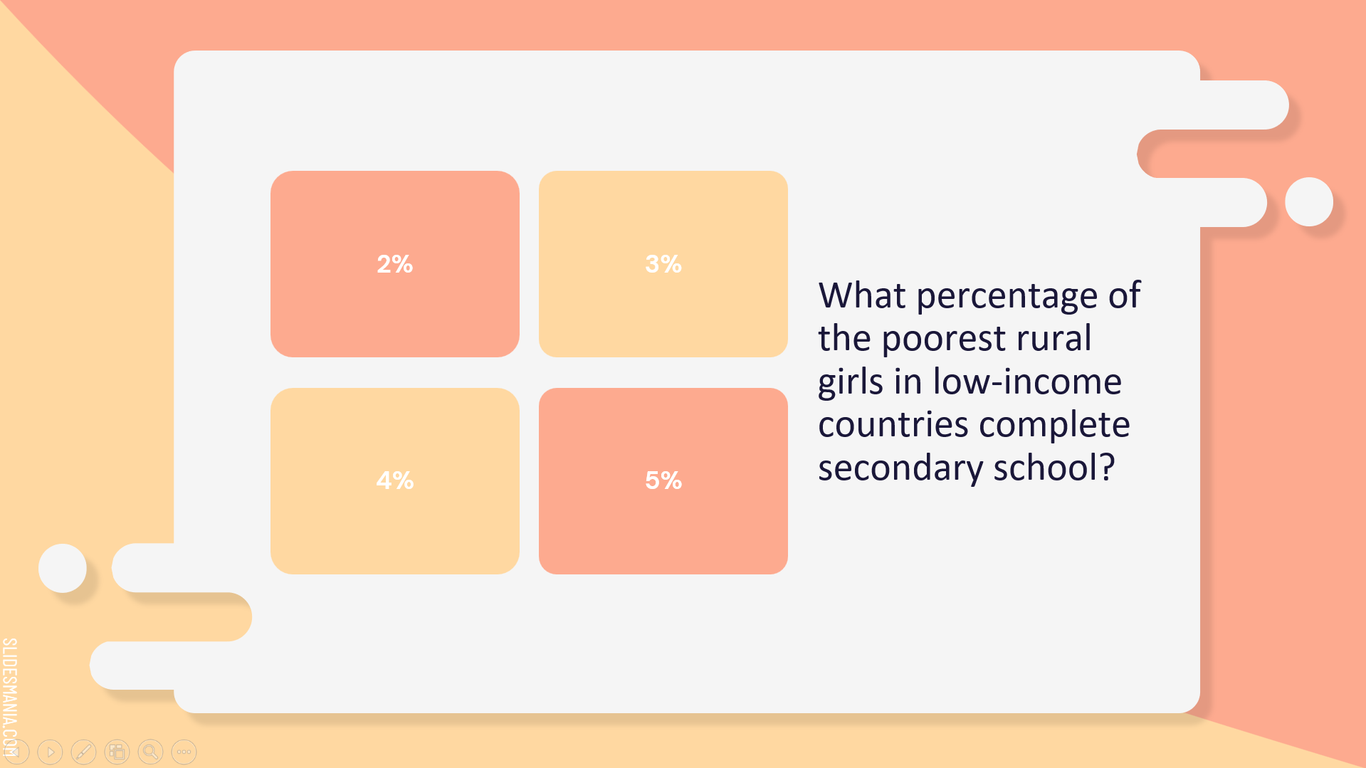
Notes:
Answer 1 is set to correct here. To edit it, please watch the “how to set it up” video.

Slide 33
Next >

Slide 34
Yes! >
I want to study a bit more!

Slide 35
THANK FOR

