Slide 1

GIÁO VIÊN : TRẦN THỊ THU HOÀI
English 10 _ Unit 9 Protecting The Environment
Period 86 _ Section IV. SPEAKING
LỚP: 10A2
NĂM HỌC: 2024 – 2025

Slide 2
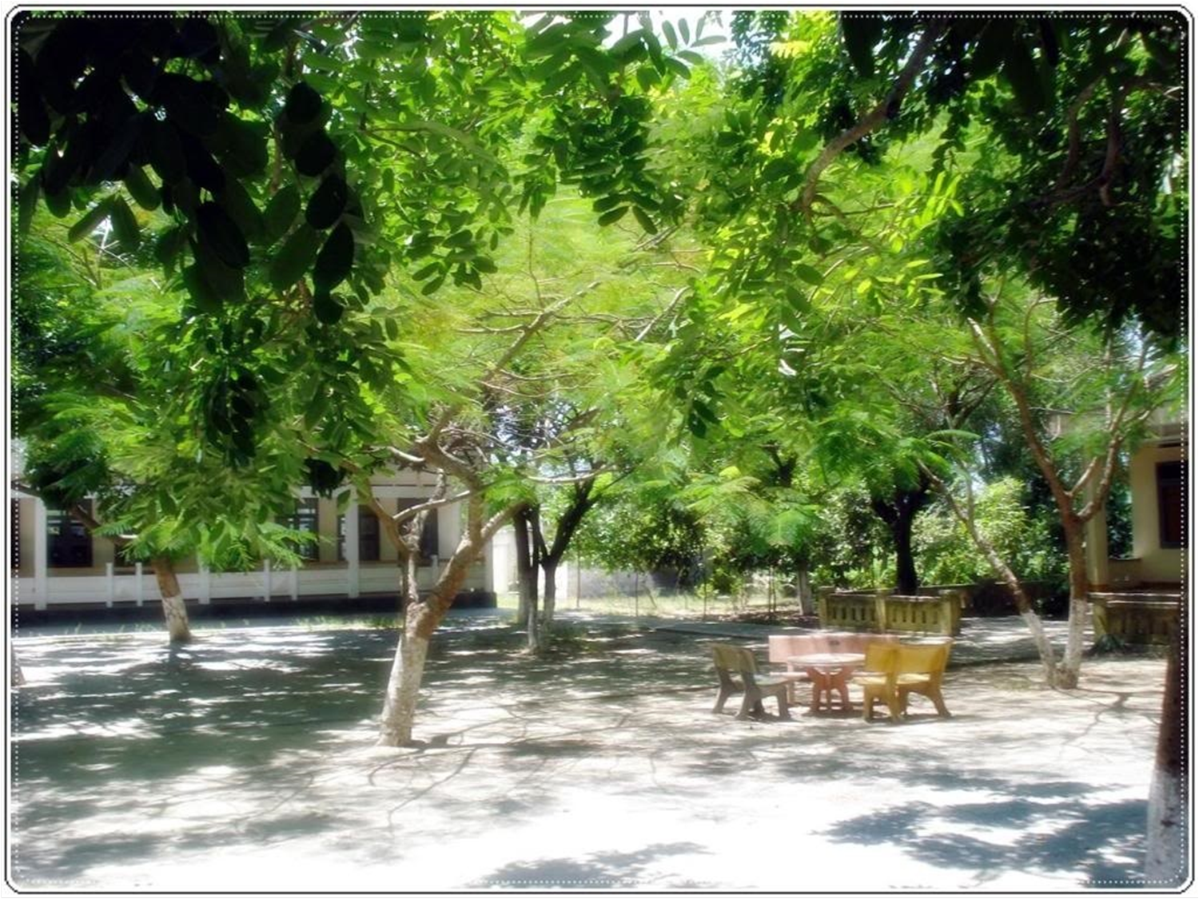
Welcome to class 10A2_
LyTuTrong High School
THURSDAY, MARCH 27, 2025
Have a nice day!
Teacher in charge: Ms Thu Hoai

Slide 3


Unit
9
1
Unit
FAMILY LIFE
Protecting the environment
LESSON 4
SPEAKING
Solutions to environmental problems

Slide 4

Unit
1
1
FAMILY LIFE
Family Life
Unit
OBJECTIVES
Identify environmental problems and relevant solutions.
Gain an overview about the outline and useful expressions for making oral presentations on solutions to an environmental problem.

Slide 5
LESSON 4
SPEAKING
WARM-UP
Lucky wheel
CONTROLLED PRACTICE
Task 1: Match the environmental problems to the suggested solutions.
Task 2: Complete the presentation outline.
LESS CONTROLLED PRACTICE
Task 3: Presentation
CONSOLIDATION
Wrap-up
Home work

Slide 6
LESSON 4
SPEAKING
WARM-UP
Lucky wheel

Slide 7






Play again
CANDY
1
2
3
BOOK
DRINK
4
5
6
SNACK
CLAP
BISCUIT
MONEY
7
8
9
SPIN

Slide 8


Which of these items can be composted, or turned into natural fertilizer, for your garden?
Golf balls
Aluminum foil
Egg shells
All of the above
BACK

Slide 9
What uses the most energy in U.S. homes each year?
Lighting
Heating and air-conditioning
Refrigeration
Heating water
BACK

Slide 10
Which of these species are threatened by global warming?
Koala
Clownfish
Arctic fox
All of the above
BACK

Slide 11
How many degrees has the Earth warmed up in the past 100 years?
1⁰F
2⁰F
3⁰F
4⁰F
BACK
Notes:
german

Slide 12
What is most frequently found in beach clean-ups?
Glass
Shoes
Pieces of plastic
Jewelry
BACK

Slide 13
Paper can be made from which of these materials?
Panda excrement
Hemp
Wood
All of the above
BACK

Slide 14
Which is the greenest form of transportation?
Car
Bicycle
Bus
Train
BACK

Slide 15
Which of the following gases protects us from harmful sun rays?
Nitrogen
Ozone
Carbon dioxide
Carbon monoxide
BACK
Notes:
What is the date of this anniversary

Slide 16
When is World Environment Day celebrated?
5 February
5 August
5 June
5 May
BACK

Slide 17

WARM-UP
Ảnh minh họa

Slide 18
LESSON 4
SPEAKING
WARM-UP
Lucky wheel
CONTROLLED PRACTICE
Task 1: Match the environmental problems to the suggested solutions.
Task 2: Complete the presentation outline.

Slide 19
CONTROLLED PRACTICE
1
Work in pairs. Match the environmental problems to the suggested solutions.
1. DISAPPEARANCE OF ENDANGERED ANIMALS
a. Recycle paper, plastics and wood products
b. Use electric vehicles or public transport, and plant more trees
2. DEFORESTATION
c. Stop illegal hunting and fishing
d. Stop burning leaves, rubbish and other materials
e. Avoid products that are made from animal parts
3. AIR POLLUTION
f. Introduce strict laws to prevent the cutting of natural forests

Slide 20
CONTROLLED PRACTICE
2
Work in pairs. Complete the presentation outline below with the information in the box.
SOLUTIONS TO AIR POLLUTION Presentation Outline 1. Welcoming the audience and introducing the topic _____________________________________________ 2. The first solution ___________________________________________ 3. The second solution ___________________________________________ 4. Finishing the presentation and thanking the audience ____________________________________________ | The first solution is to stop burning leaves, rubbish and other materials. This will reduce the smoke produced in the air. That conclude our presentation today. Thank you for listening. Another solution is to use electric vehicles or public transport. This will reduce the gas emissions from private vehicles and will make the air cleaner. Hi everyone. I’m here today to talk to you about the solutions to one of the most serious problems in our city – air pollution.
D
A
C
B

Slide 21
LESSON 4
SPEAKING
WARM-UP
Lucky wheel
CONTROLLED PRACTICE
Task 1: Match the environmental problems to the suggested solutions.
Task 2: Complete the presentation outline.
LESS CONTROLLED PRACTICE
Task 3: Presentation

Slide 22
LESS CONTROLLED PRACTICE
PRACTICE
3
Presentation
Work in groups.
Choose an environmental problem in Task 1.
Make a presentation on the solutions to it. Use the suggested organisation and expressions to help you.
Join the contest: WHO’S THE BEST PRESENTER?

Slide 23
Contest: WHO’S THE BEST PRESENTER?
MARKING SHEET
Presenter’s Name: ..................................................... Group: ....................
Content (4 pts) | Presentation skills (3 pts) |  |  |  | Language skills (3 pts)
 | Organisation & Linking (1 pt) | Body language (0.5 pt) | Visual aid (1 pt) | Communication with audience (0.5 pt)
Examiner’s name and signature
…...............................................
Total mark: …...../10

Slide 25




★ Net Zero – Mục tiêu đạt mức phát thải ròng bằng 0.
Use alternative energy
Reduce Carbon dioxide emission
PRACTISE 3R : REDUCE, REUSE & RECYCLE
,and others.

Slide 26


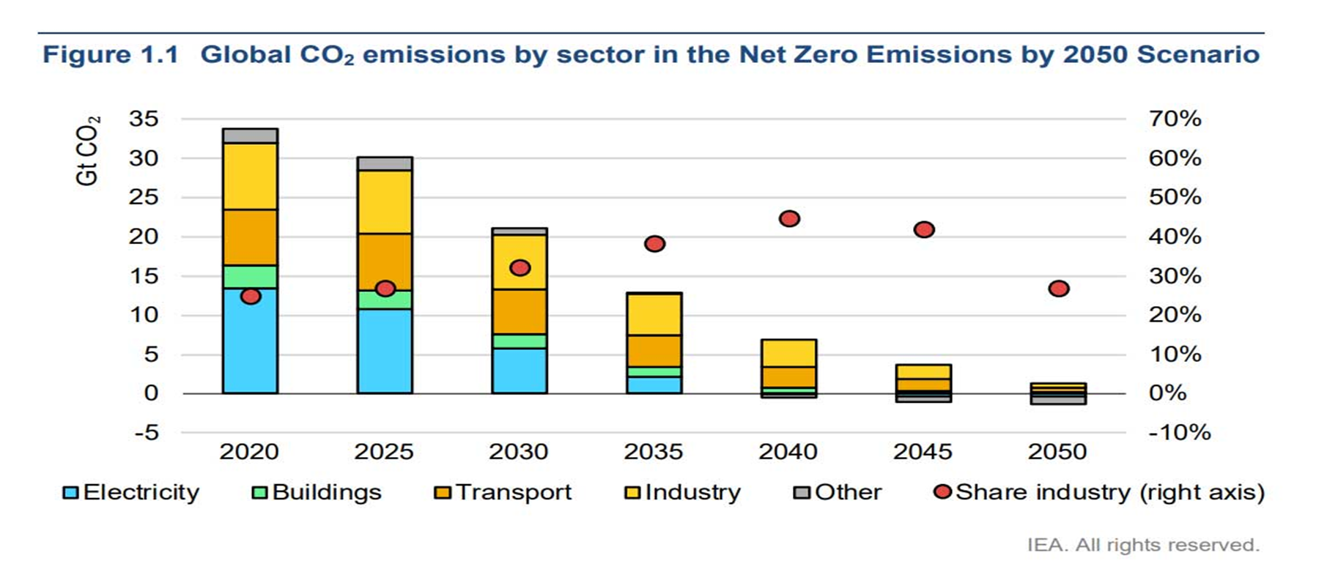

Slide 27

Contest: WHO’S THE BEST PRESENTER?

Slide 28

THE BEST PRESENTER

Slide 29
LESSON 4
SPEAKING
Unit
GETTING STARTED
WARM-UP
Lucky wheel
PRESENTATION
Vocabulary
Task 1: Match the environmental problems to the suggested solutions.
Task 2: Complete the presentation outline.
Task 3: Prepare a presentation.
Task 4: Join “Who’s the best presenter?” contest.
PRACTICE
CONSOLIDATION
Wrap-up
Home work

Slide 30
CONSOLIDATION
1
Wrap-up
Identify environmental problems and relevant solutions.
Gain an overview about the outline and useful expressions for making oral presentations on solutions to an environmental problem.

Slide 31
CONSOLIDATION
2
Homework
Do exercises in the Workbook

Slide 32

Website: hoclieu.vn
Fanpage: facebook.com/tienganhglobalsuccess.vn/

