Slide 1
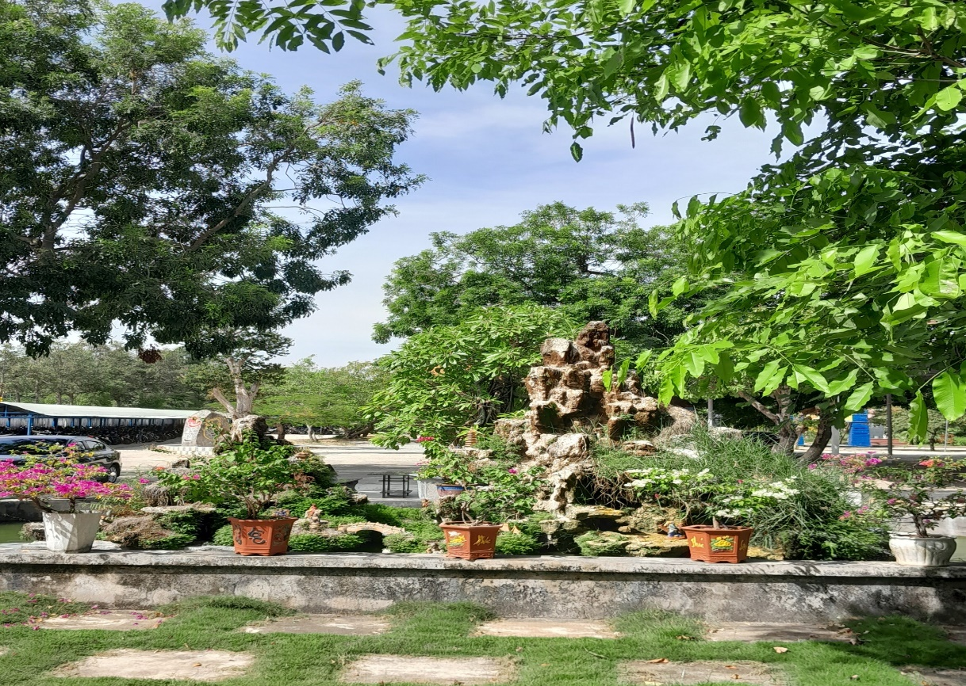
SỞ GIÁO DỤC VÀ ĐÀO TẠO BÌNH ĐỊNH
TRƯỜNG THPT LÝ TỰ TRỌNG
MÔN TIẾNG ANH 10 (GLOBAL SUCCESS)
NĂM HỌC 2024-2025
GV THỰC HIỆN: NGUYỄN HỮU PHƯỜNG
Lớp : 10A1

Slide 2

Unit
10
1
Unit
FAMILY LIFE
ECOTOURISM
LESSON 3
READING
Ecotour brochures

Slide 3

Unit
1
1
FAMILY LIFE
Family Life
Unit
OBJECTIVES
Develop reading skills for specific information in a brochure about ecotours.

Slide 4
LESSON 3
READING
WARM-UP
Name the tours
PRE-READING
Task 1: Answer these questions.
Task 2: Solve the crossword.
Task 3: Which tour does each statement below talk about?
WHILE-READING
POST-READING
Task 4: Think of new ideas for making one of the tours better for the environment.
CONSOLIDATION
Wrap-up
Homework

Slide 5
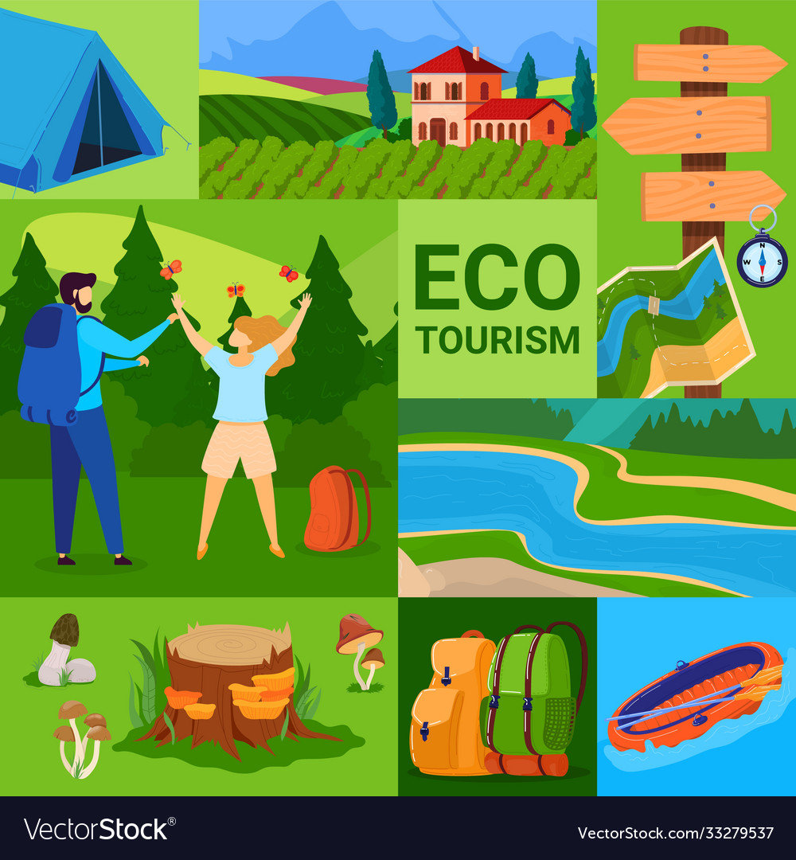
NAME THE TOURS

Slide 6
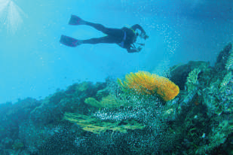
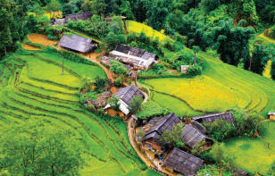
WARM-UP
Reef Tour
Trekking Tour

Slide 7
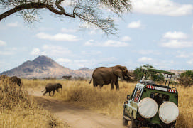
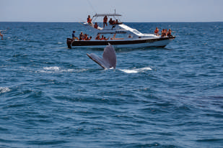
WARM-UP
National Park Tour
Whale-watching Tour

Slide 8
LESSON 3
READING
WARM-UP
Name the tours
PRE-READING
Task 1: Answer these questions.

Slide 9
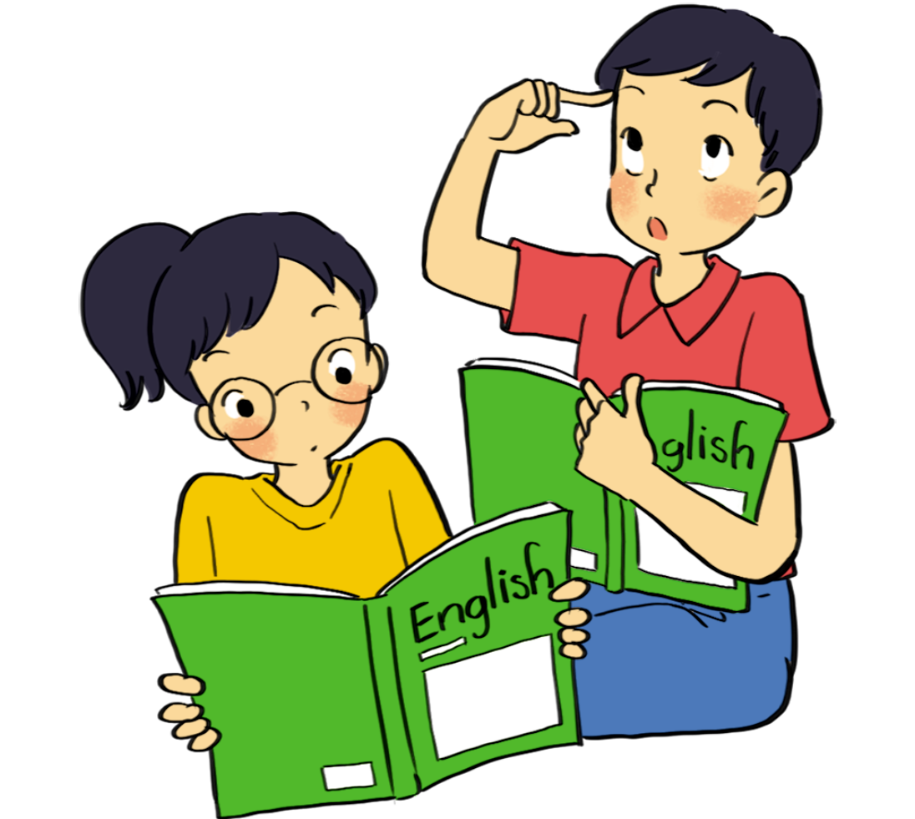
PRE-READING
1
Work in pairs. Answer these questions.
1. Have you ever been on an ecotour?
2. Look at the photos in task 2. What do you think tourists do on these tours?

Slide 10
LESSON 3
READING
WARM-UP
Name the tours
PRE-READING
Task 1: Answer these questions.
Task 2: Solve the crossword.
Task 3: Which tour does each statement below talk about?
WHILE-READING

Slide 11
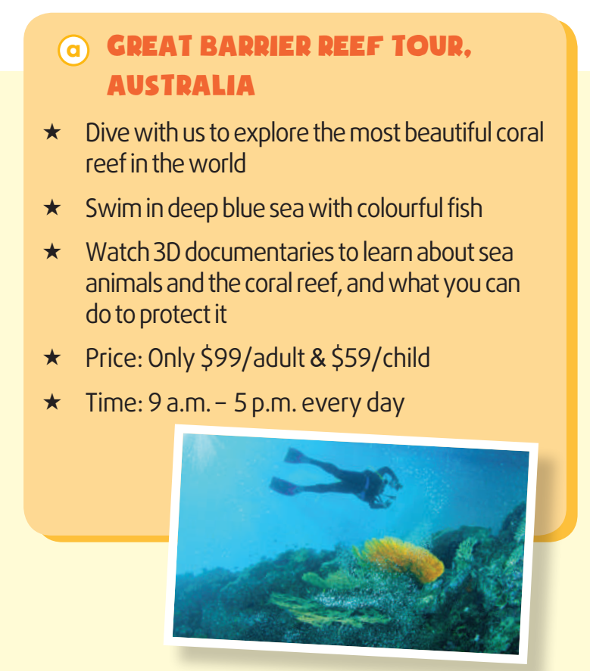
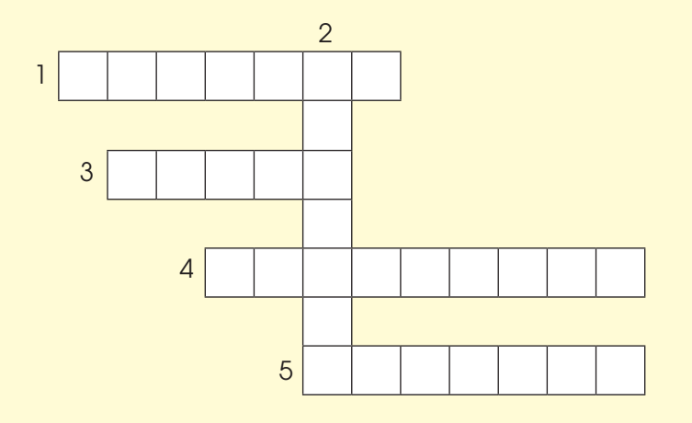

WHILE-READING
2
Read the brochures below. Then work in pairs to solve the crossword using words from the brochures.
ACROSS
1. (v) to keep something safe from damage or harm

Slide 12
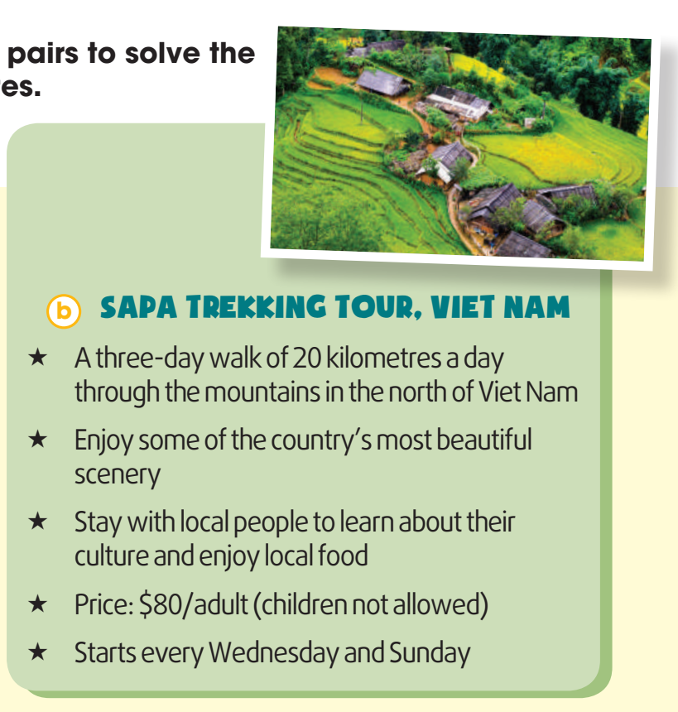

WHILE-READING
2
Read the brochures below. Then work in pairs to solve the crossword using words from the brochures.
DOWN
2. (n) the way of life of a group of people or countries

Slide 13

WHILE-READING
2
Read the brochures below. Then work in pairs to solve the crossword using words from the brochures.
ACROSS
3. (adj) connected with the place you are living

Slide 14
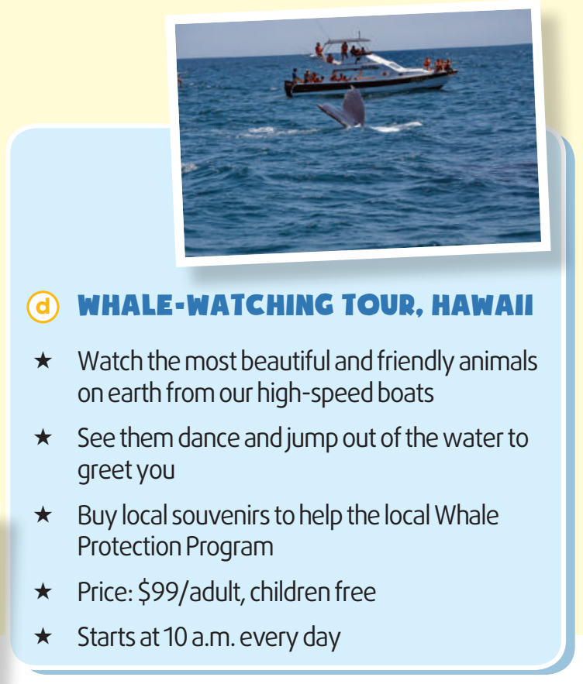

WHILE-READING
2
Read the brochures below. Then work in pairs to solve the crossword using words from the brochures.
ACROSS
4. (n) things you buy or keep to remind yourself of a place or holiday

Slide 15
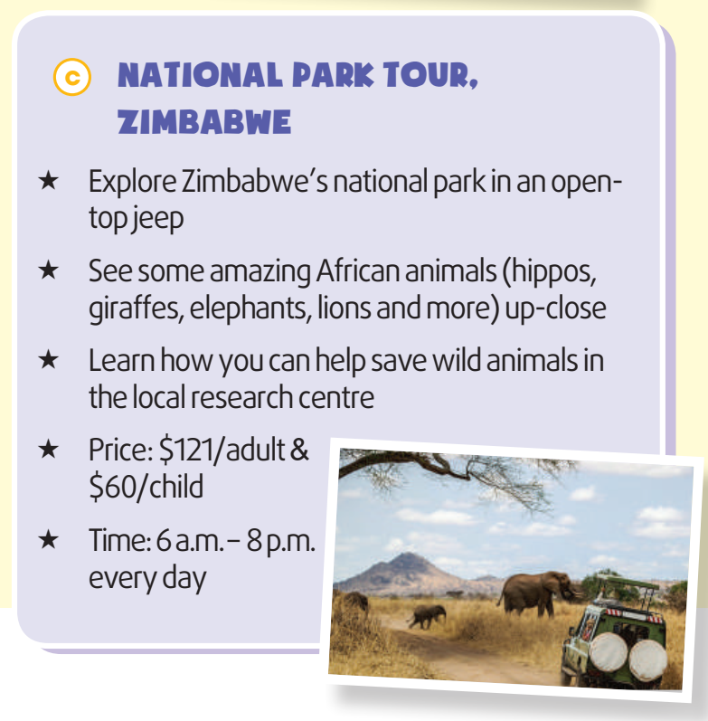

WHILE-READING
2
Read the brochures below. Then work in pairs to solve the crossword using words from the brochures.
ACROSS
5. (v) to find more about a place (Brochures a and c)

Slide 16
WHILE-READING
3
Which tour does each statement below talk about? Write a, b, c or d.
1. You can buy arts and crafts to help protect the environment. _________
2. You can learn how to help protect wildlife. _________
3. This tour is not suitable for families with children. _________
4. This tour offers educational videos about the environment. _________
d
c
b
a

Slide 17
WHILE-READING
3
In which tour can you ……..?
- watch the most beautiful and friendly animals on earth.
Whale watching tour in Hawaii
- dive to explore the most beautiful coral reef.
Reef tour in Australia
- not allow to take along children.
Sapa trekking tour
- learn how to save wild animals
Park tour in Zambabwe
- get close to some animals.
Park tour in Zambabwe
- stay with local people and enjoy local food
Sa pa Trekking tour
- Swim in deep blue sea with colourful fish.
Reef tour in Australia

Slide 18
LESSON 3
READING
WARM-UP
Name the tours
PRE-READING
Task 1: Answer these questions.
WHILE-READING
Task 2: Solve the crossword.
Task 3: Which tour does each statement below talk about?
POST-READING
Task 4: Think of new ideas for making one of the tours better for the environment.

Slide 19

POST-READING
4
Work in groups. Think of new ideas for making one of the tours better for the environment.

Slide 20

POST-READING
4
Work in groups. Think of new ideas for making one of the tours better for the environment.
Suggested answer:
A. If they ban swimming with fish, the Great Barrier Reef will be better protected. Tourists should not be allowed to dive very close to the coral reefs.

Slide 21
POST-READING
4
Work in groups. Think of new ideas for making one of the tours better for the environment.
Suggested answer:
B. Tourists should always follow the walking paths and trails on the Sa Pa Trekking Tour. The local people with whom the tourists stay should only use local ingredients. If they only use local ingredients, their carbon footprint will be lower.

Slide 22
POST-READING
4
Work in groups. Think of new ideas for making one of the tours better for the environment.
Suggested answer:
C. When visiting the National Park in Zambabwe, we should not litter because it will damage the environment. Besides, we should not tease animals, they may become scared or more dangerous.

Slide 23
POST-READING
4
Work in groups. Think of new ideas for making one of the tours better for the environment.
Suggested answer:
D. The boats on the Whale-watching Tour should not get too close to the whales or make too much noise. If the boats are environmentally friendly, they will not harm the whales or their habitats. This is because environmentally-friendly boats use less fuel and oil, make small waves and are quiet.

Slide 24
LESSON 3
READING
WARM-UP
Name the tours
PRE-READING
Task 1: Answer these questions.
Task 2: Solve the crossword.
Task 3: Which tour does each statement below talk about?
WHILE-READING
POST-READING
Task 4: Think of new ideas for making one of the tours better for the environment.
CONSOLIDATION
Wrap-up
Homework

Slide 25
CONSOLIDATION
1
Wrap-up
Develop reading skills for specific information in a brochure about ecotours.

Slide 26
CONSOLIDATION
2
Homework
Prepare for the next lesson: Unit 10 – Speaking
2.Do exercises in the workbook
3. Create 2 more brochures about the tourist attractions in you community.

Slide 27



THANK YOU FOR YOUR ATTENDANCE and COOPERATION.
THE END

