Slide 1
Trường THPT Lý Tự Trọng
Họ và tên: Cao Văn Hương
Tiết học thư viện
Unit 7: Viet Nam and International Organizations (Global Success)
Lớp 10A5
Năm học 2024-2025.

Slide 2
Warm up

Slide 3








WATCH AND REMEMBER

Slide 4
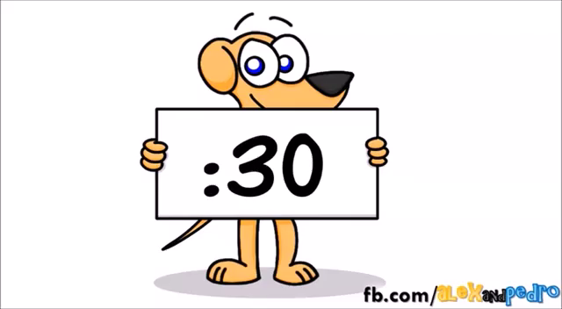

Slide 5
GUESS THE LOGO!
United Nations (UN)
United Nations
Children’s Fund (UNICEF)
World Trade Organization (WTO)
United Nations Development Programme (UNDP)
World Wide Fund
for Nature (WWF)
The Food and Agriculture Organisation of the United Nations (FAO)
Association of Southeast Asian Nations (ASEAN)

Slide 6

Unit
7
1
FAMILY LIFE
Unit
VIET NAM AND INTERNATIONAL ORGANISATIONS
P54-LESSON 1
GETTING STARTED
Viet Nam and international organisations

Slide 7
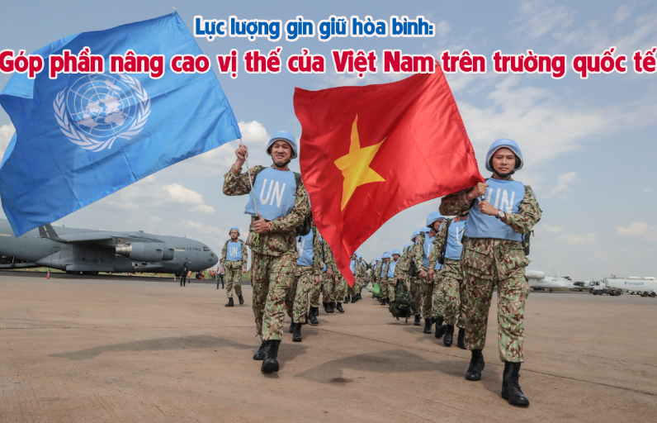

I. VOCABULARY
peacekeeping (adj)
/ˈpiːskiːpɪŋ/
intended to help stop people fighting and prevent war or violence in a place where this is likely

Slide 8
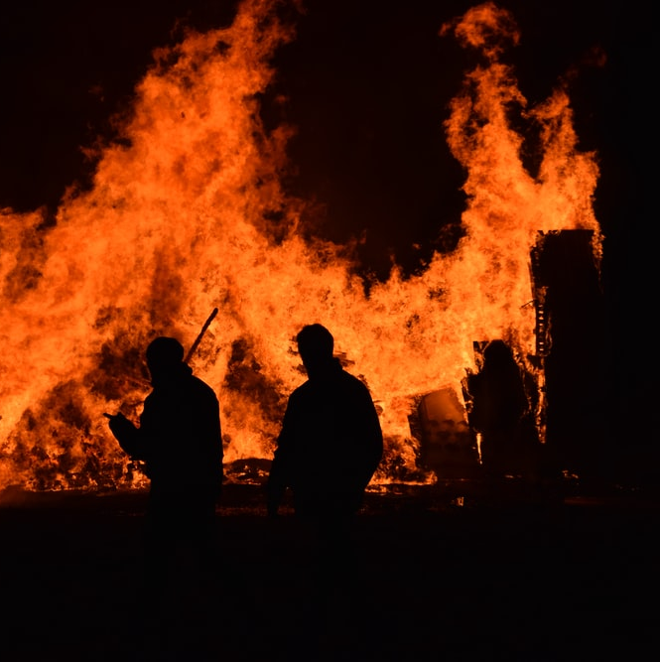
VOCABULARY
harm (n)
/hɑː(r)m/
damage or injury that is caused by a person or an event

Slide 9

VOCABULARY
expert (adj)
/ˈekspɜːrt/
having or involving great knowledge or skills

Slide 10

VOCABULARY
investor (n)
/ɪnˈvestə(r)/
a person or an organisation that invests money in something

Slide 11
VOCABULARY
form (v)
/fɔːm/
Hiep Hoa High School No3 was formed in 1999

Slide 12
VOCABULARY
Form | Pronunciation | Meaning
1. peacekeeping (adj) | /ˈpiːskiːpɪŋ/ | Giữ gìn hoà bình
2. harm (n) | /hɑː(r)m/ | Tác hại
3. expert (adj) | /ˈekspɜːrt/ | Chuyên gia
4. investor (n) | /ɪnˈvestə(r)/ | Nhà đầu tư
5. form (v) | /fɔːm/ | Thành lập

Slide 13
VOCABULARY
1.
Chuyên gia
Thành lập
Giữ gìn
hòa bình
Nghiệp dư

Slide 14
VOCABULARY
2.
Chuyên gia
Nhà đầu tư
Tác hại
Thành lập

Slide 15
VOCABULARY
3.
Chuyên gia
Tổ chức
Giữ gìn
hòa bình
Thành lập

Slide 16
VOCABULARY
4.
Tham gia
Nhà đầu tư
Nghiên cứu
Giữ gìn

Slide 17




II. PRACTICE

Slide 18
1
Listen and read.
Do You Know…?
A. The United Nations (UN) was created in 1945. It is an organisation of most of the world’s countries. Its main goal is world peace. It also works to reduce poverty and improve people’s lives in other ways. Viet Nam joined the organisation in 1977. Since then, our country has become more active and has participated in many UN activities including peacekeeping.
B. UNICEF was formed in 1946. It works in over 190 countries to help improve health and education of children. It particularly aims to support the most disadvantaged children all over the world. UNICEF’s aim in Viet Nam is to protect children and make sure they are healthy, educated and safe from harm.
C. UNDP was formed in 1965 as part of the UN. It provides technical support, expert advice and training to help people in developing countries have a better life. In Viet Nam, UNDP works closely with the government to reduce poverty and improve people’s lives.
D. The WTO was formed in 1995. It is the world’s largest international economic organisation. Viet Nam became a WTO member in 2007. Since then, our economy has achieved a high growth level. Viet Nam has also become more attractive to foreign investors.

Slide 19
2
Read the texts again and choose the correct answers.
1. Which organisation was formed in 1945?
A. The UN B. UNICEF C. The WTO
2. What is the main goal of the United Nations (UN)?
A. World peace B. Economic growth C. Environmental protection
3. Which organisation aims to help improve children’s health and education?
A. UNDP B. UNICEF C. The WTO
4. Which of the following is the largest international economic organisation?
A.The UN B. UNDP C. The WTO
5. What happened to Viet Nam's economy after joining the WTO?
A. It declined
B. It achieved high growth and became more attractive to foreign investors
C. It remained the same

Slide 20
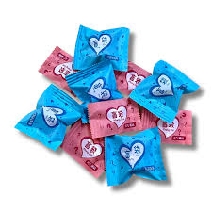
BLIND BOX

Slide 21
2
Read the texts again and choose the correct answers.
1. Which organisation was formed in 1945?
A. The UN B. UNICEF C. The WTO
2. What is the main goal of the United Nations (UN)?
A. World peace B. Economic growth C. Environmental protection
3. Which organisation aims to help improve children’s health and education?
A. UNDP B. UNICEF C. The WTO
4. Which of the following is the largest international economic organisation?
A.The UN B. UNDP C. The WTO
5. What happened to Viet Nam's economy after joining the WTO?
A. It declined
B. It achieved high growth and became more attractive to foreign investors
C. It remained the same

Slide 22
3
Complete the sentences with the words and phrases from Task 1.
1. Since joining the UN, Viet Nam has become _____________ and has participated in many UN activities including peacekeeping.
2. UNICEF particularly aims to support _____________________ children all over the world.
3. UNDP helps people in developing countries have a __________ life.
4. The WTO is the world's __________ international economic organisation.
more active
the most disadvantaged
better
largest

Slide 23
CONSOLIDATION
1
Wrap-up
Some words and phrases related to international organisations
Reading for specific information
Scanning skills

Slide 24
CONSOLIDATION
2
Homework
Do exercises in the workbook
Project preparation

