Slide 1

Unit 9: SOCIAL ISSUES
Period 90: LOOKING BACK AND PROJECT
Class: 11A2
ENGLISH 11 GLOBAL SUCCESS
Teacher: Nguyen Thi Hong Van
School Year: 2024-2025

Slide 2


Slide 3
LOOKING BACK AND PROJECT
Unit
9
SOCIAL ISSUES
Unit
FAMILY LIFE
11TH GRADE
Lesson 8

Slide 4


1. A friend encourages you to try out for the basketball team.
This is which type of pressure?
Positive peer pressure
A
Negative peer pressure
B

Slide 5
2. What qualities can help a person to resist negative peer pressure?
Speed and Coordination
A
A nice Smile
B
Self-Confidence & Assertiveness
C
Nice Hair
D

Slide 6
3. When you are under pressure you should...
Stay Calm & Be Confident
A
Leave the situation if your friend persists
B
Make Eye-Contact & Repeat "NO"!
C
All of the above
D

Slide 7
4. Which is NOT an effective way to handle peer pressure?
Avoid or leave the unsafe situation
A
Give reasons for your refusal
B
Talk to an adult you trust
C
Give in and join in the same unsafe activity
D

Slide 8
5. What is ‘guilt’?
Telling a person something nice about himself/herself
A
Making someone feel bad if they do not do something
B

Slide 9


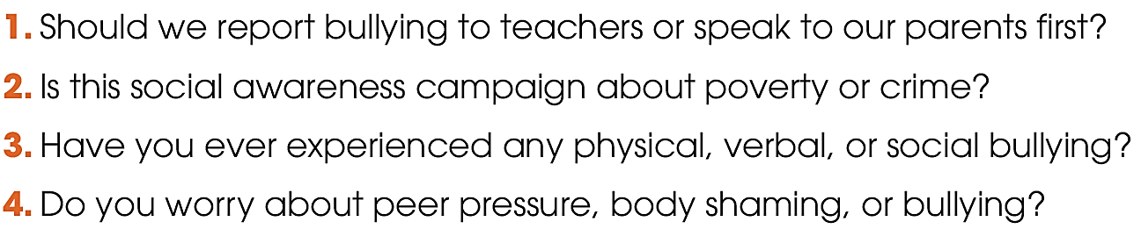

LOOKING BACK
1
Mark the intonation in these questions, using (rising intonation) or (falling intonation). Listen and check. Then practise saying them.

Slide 10
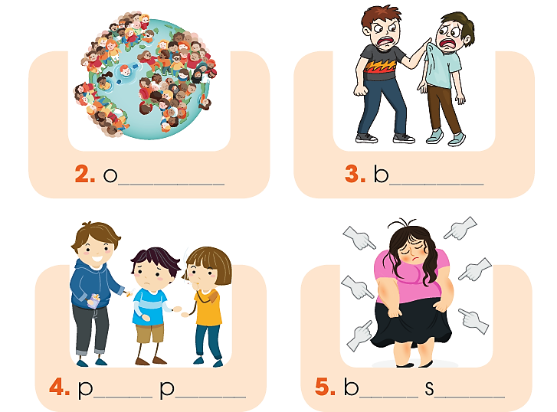
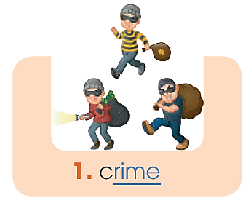
Find five social issues in 1. Use the pictures and hints below to help you.
verpopulation
ullying
eer
ressure
ody
haming

Slide 11

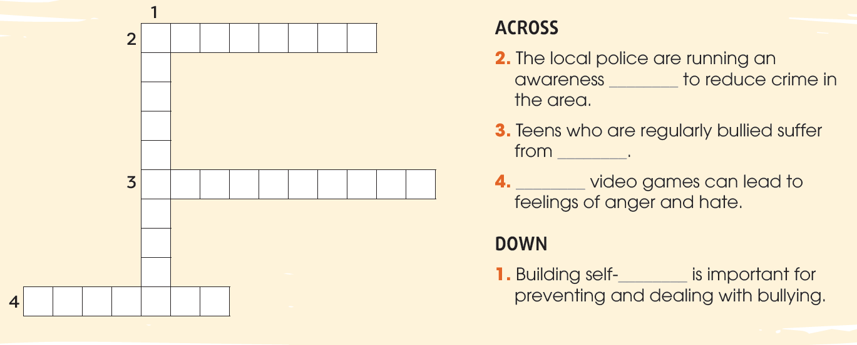
LOOKING BACK
2
Solve the crossword. Use the words you have learnt in this unit.
C
A
M
P
A
I
G
N
O
campaign
N
F
I
depression
D
E
P
R
E
S
S
I
O
N
Violent
E
N
C
confidence
V
I
O
L
E
N
T

Slide 12
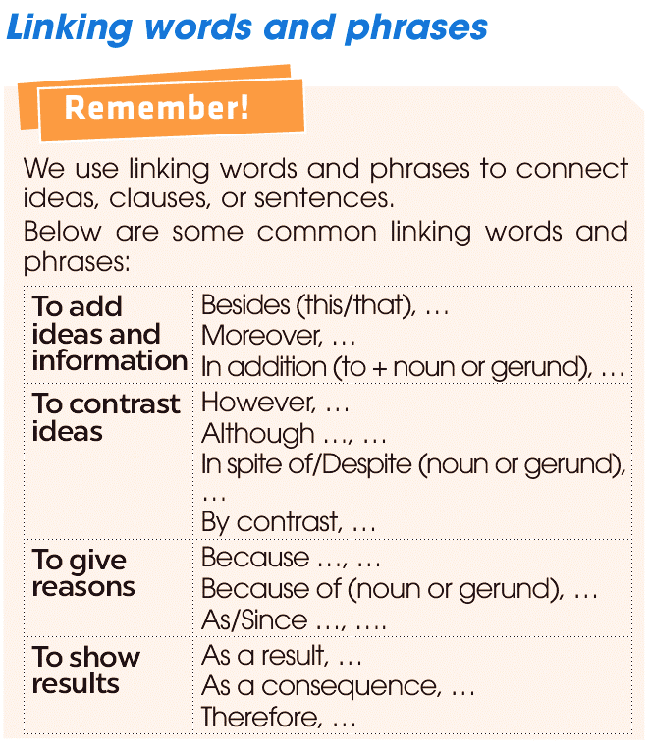
GRAMMAR

Slide 13

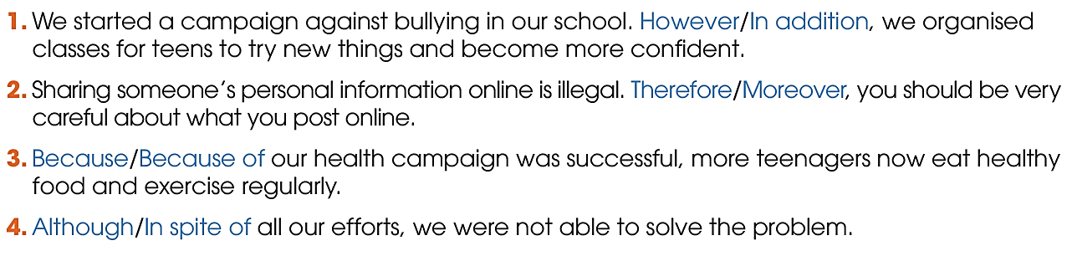
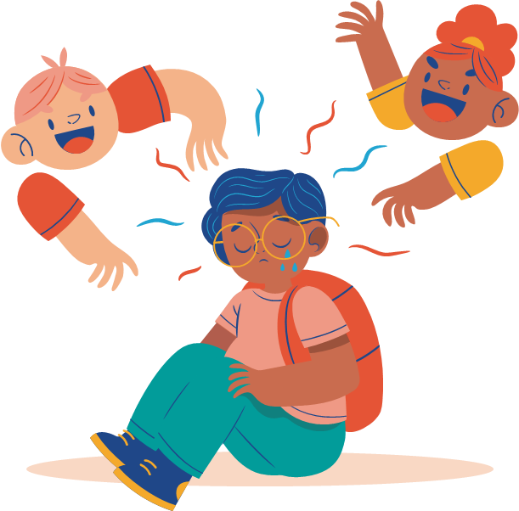

LOOKING BACK
3
Choose the best answer to complete each sentence below.

Slide 14
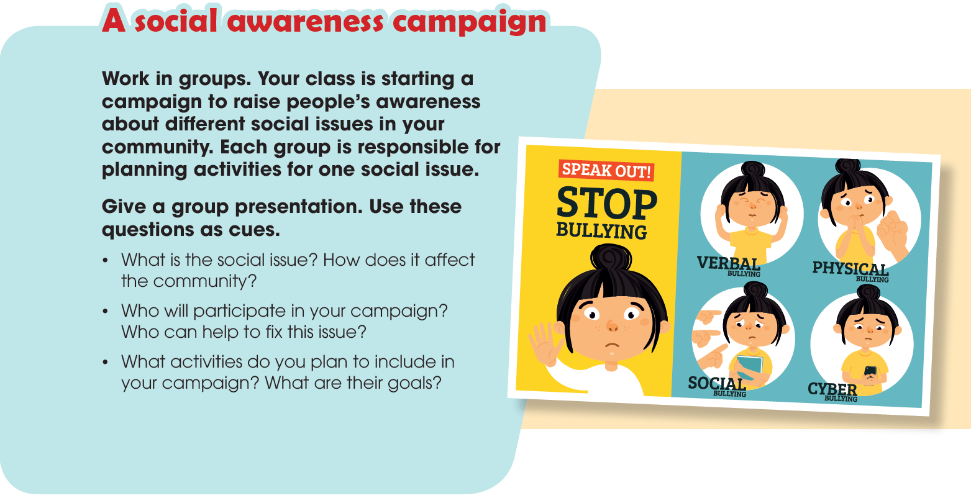
PROJECT

Slide 15
Activity 3: Groupwork:
Group 1: BULLYING
Group 2: POVERTY
Group 3: PEER PRESSURE
Group 4: BODY SHAMING

Slide 16
CONTENT:
interesting/ relevant
Mine
Pace/ rhythm
Presentation
criteria
Facial expression
Gestures
Eye contact
Engagement with audience
Impressive voice

Slide 17

Activity 4: Group presentation:

Slide 18


CONSOLIDATION
Review the vocabulary and grammar of Unit 9.
Understand some of the social problems facing teens in the US today.
Give an oral presentation about a social issue in your community.
Plan activities for a campaign to raise people's awareness about a social issue and give a group presentation about it.

Slide 19

Do exercises in the workbook.
Prepare for Unit 10.

Slide 20

Thank you for your attention.

