Slide 1
SỞ GIÁO DỤC VÀ ĐÀO TẠO BÌNH ĐỊNH
TRƯỜNG THPT LÝ TỰ TRỌNG
MÔN TIẾNG ANH 12
HỆ 10 NĂM
GIÁO VIÊN THỰC HIỆN: NGUYỄN HỮU PHƯỜNG

Slide 2
Wednesday, September 15th, 2022
UNIT 1: LIFE STORIES
Lesson 3: Reading

Slide 3
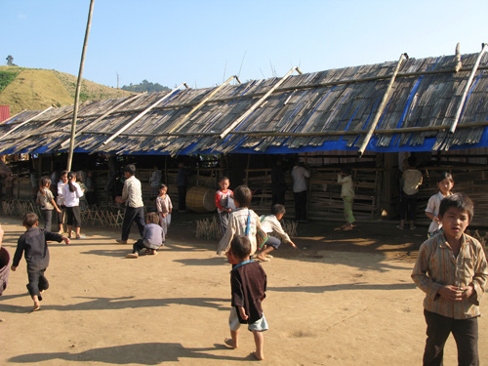
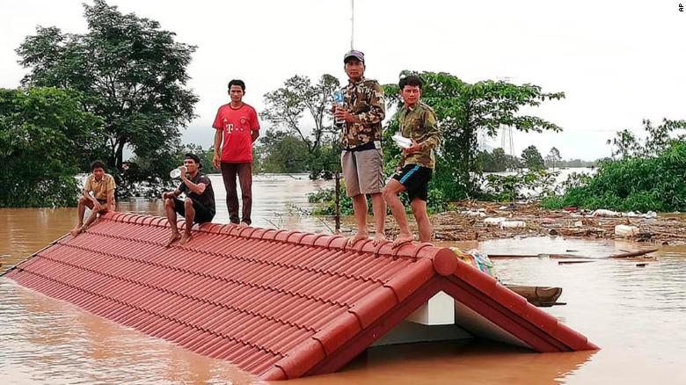
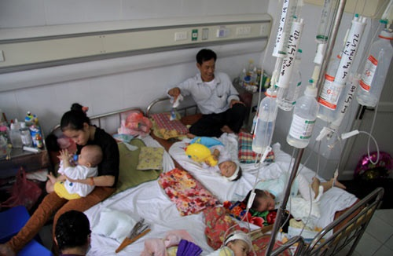
I. Pre - reading
shabby (a)
B
study equipment
1. Describe the pictures and answer the questions: What do the people in the pictures need? What can you do to help them?
shelter = a place giving temporary protection from bad weather or danger
= in poor condition through long = hư hỏng, xấu, tồi tàn
A
a. These flood victims need food and shelter.
b. These students are studying in a shabby classroom. They need study equipment and a decent (socially acceptable or good) place to study.
c. These young cancer patients need care and comfort.
We can donate money, rice, and old clothes.
food/shelter
We can donate books and money.
C
care/comfort
We can visit them, give them gifts, and organise different fun activities

Slide 4
Giving back to the community

Slide 5
Vocabulary

Slide 6
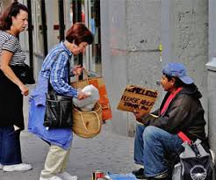
humble
Thấp kém,tầm thường
/ˈhʌmbl/

Slide 7
_{bring up (phr)}
Nuôi dưỡng

Slide 8
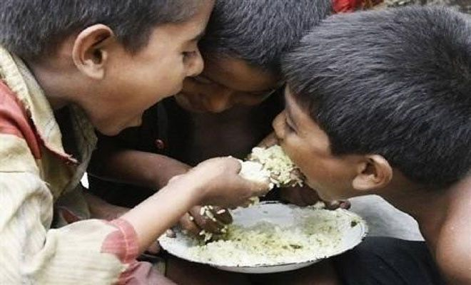
Starving (adj)
very hungry

Slide 9
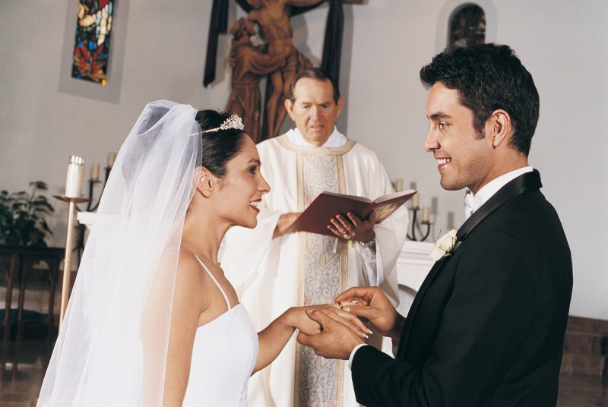
Vow to (phr verb)
thề nguyện, hứa hẹn

Slide 10
fortunate (adj)
/ˈfɔːtʃənət/
lucky (adj)

Slide 11
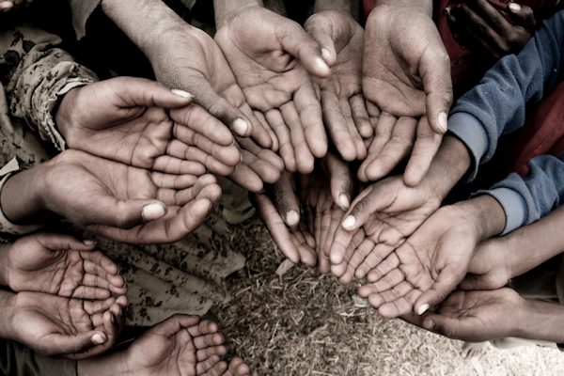
the needy (n) =
the poor, people in need

Slide 12
diagnose with (phr. v )
Kiểm tra, khám, chuẩn đoán

Slide 13
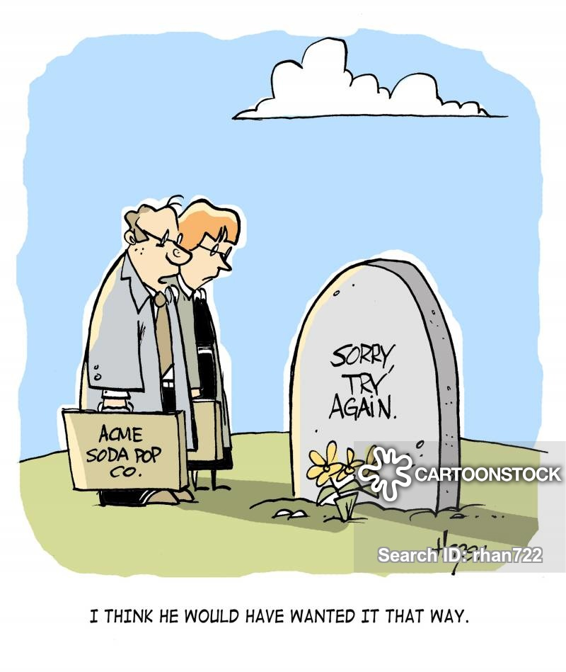
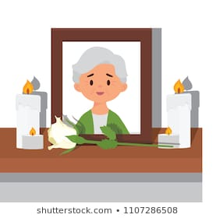
pass away (phr. v )
= die

Slide 14
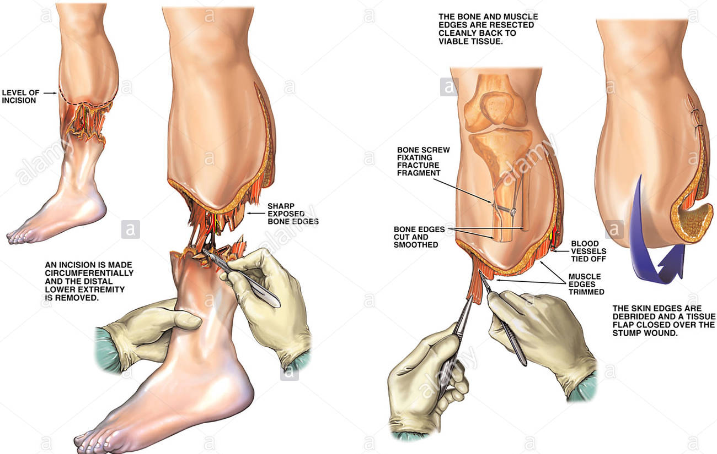
amputate (v)
Cut off/ remove

Slide 15
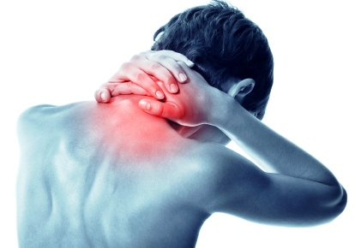
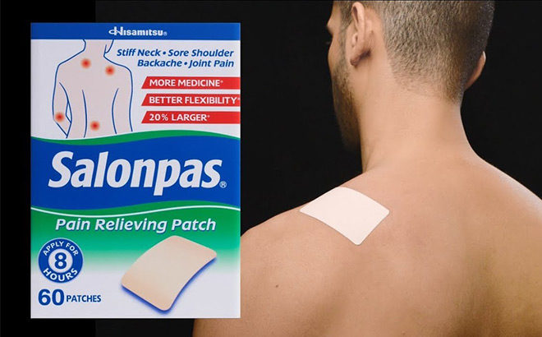
relieve pain
Giảm cơn đau

Slide 16
- to emerge from (phr. V)
= turn up, show, famous
/ɪˈmɜːdʒ/
- to reveal one’s identity (phr)
= để lộ ra danh tính
- generosity /ˌdʒenəˈrɒsəti/(adj)
= sự rộng lượng/ hào phóng
- anonymous /əˈnɒnɪməs/(adj)
= dấu tên, ẩn danh

Slide 17
2. Vocabulary
11. relieve pain
12. to emerge from (phr. v) = turn up,
show, famous, develop
13. to reveal one’s identity
14. generosity (adj) /ˌdʒenəˈrɒsəti/
15. hospitalization /,hɔspitəlai'zeiʃn/ (n) thời kỳ nằm viện
17. Memory 'meməri/ (n) trí nhớ, sự tưởng nhớ
18. Anonymous /ə'nɔniməs/ (adj) giấu tên,
ẩn danh
19. relive (v) hồi sinh, sống lại
20. initiate /i'niʃiit/ (v) bắt đầu, khởi xướng
21. diagnose ( v) chẩn đoán
1. humble /ˈhʌmbl/ (adj)
2. to bring (someone) up (phr)
3. starving (adj)
4. to vow to (phr verb)
5. fortunate (adj)/ˈfɔːtʃənət/= luck
6. to diagnose with (phr. v )
7. to pass away (phr. v ) = die
8. The needy (n) = the poor,
people in need, poverty
10. amputate /'æmpjuteit/ (v) cắt cụt

Slide 18
II. While reading
2. Read two people’s life stories and complete the table with facts about them
Name | Larry Stewart | Le Thanh Thuy
Born
Died
Nationality
Health problem
Dedicated life to
1948
1988
2007
2007
American
Vietnamese
Cancer
Bone cancer
The needy
Young cancer patients

Slide 19
3. Find the words or expressions in the text that have the following meanings.
1. People who do not have enough food or money.
2. Make some thing known to someone
3. Unknown to other people
4. Remove a body part in a medical operation
5. start, make something important begin
6. Something remembered from the past
The needy
reveal
anonymous
amputate
Initiate
memory

Slide 20
4. Read the stories again. Answer the questions
Every Christmas, Larry Stewart handed out thousands of dollars to needy people in public places.
What did Larry Stewart do to help those in need ?
Why was he called ‘ Secret Santa’ ?
How has his act of kindness influenced other people since his death ?
What did Thanh Thuy do to help other people ?
What title was Thuy awarded?
How does The Tuoi Tre manage Thuy’s Dream Programme?
Because he gave money to people during the festive season of December while his identity was hidden.
People have been inspired to continue his mission of kindness and charitable work.
Thuy organised charity activities to relieve young cancer patients’ pain.
She was awarded the title ‘ Ho Chi Minh City Outstanding Young Citizen.
The newspaper holds annual events to support her programme. One of them is the Sunflower Festival, where children and their families get together and have fun. Gifts are given to the young patients, and the memory of Thuy is kept alive by her story about love and sharing

Slide 21
5. DISCUSSION:
Have you ever taken part in any charity programme?
YES | NO
When? With whom? What did you do? | Would you like to do it in the future? Who would you like to help? Why? How would you help?

Slide 22
HOMEWORK
- Write a short paragraph about what you will you do to help needy people around you ?
- Prepare the lesson speaking

Slide 23
Thank you for your attention!

