Slide 1
SỞ GIÁO DỤC VÀ ĐÀO TẠO BÌNH ĐỊNH
TRƯỜNG THPT LÝ TỰ TRỌNG
MÔN TIẾNG ANH 10
GLOBAL SUCCESS
GIÁO VIÊN THỰC HIỆN: NGUYỄN HỮU PHƯỜNG

Slide 2
Unit
1
1
Unit
FAMILY LIFE
FAMILY LIFE
LESSON 2
LANGUAGE

Slide 3
Unit
1
1
OBJECTIVES
To pronounce the consonant blends /br/, /kr/, and /tr/ correctly in words and in sentences;
To understand and use some lexical items about family life;
To distinguish and use present simple and present continuous.

Slide 4
LESSON 2
LANGUAGE
WARM-UP
GAME: Guess the words
GETTING STARTED
Task 1: Listen and repeat.
Task 2: Listen and circle.
PRONUNCIATION
VOCABULARY
Task 1: Match the words with their meanings.
Task 2: Complete the sentences.
GRAMMAR
Task 1: Choose the correct forms.
Task 2: Read and complete the text.
EXTRA
ACTIVITY
GAME: 20 questions
CONSOLIDATION
Wrap-up
Homework

Slide 5
LESSON 2
LANGUAGE
WARM-UP
GAME: Guess the words
GETTING STARTED

Slide 6
WARM-UP
GUESS THE WORD!
There are 8 pictures related to the topic “Family life”.
You have 5 seconds to think, then guess the word corresponding to the picture.
Correct answer → +1
Wrong answer → -1

Slide 7
Split (v)

Slide 8
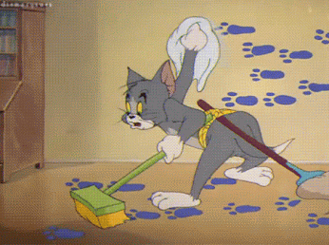
Chore (n)

Slide 9
Groceries (n)

Slide 10
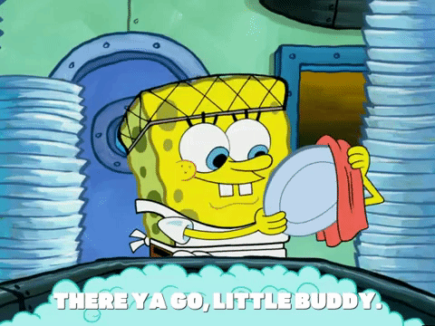
Washing-up (n)

Slide 11
Breadwinner (n)

Slide 12
Laundry (n)

Slide 13
Homemaker (n)

Slide 14
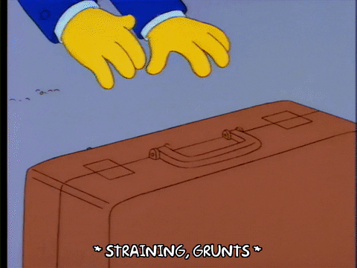
Heavy lifting (n)

Slide 15
LESSON 2
LANGUAGE
WARM-UP
GAME: Guess the words
GETTING STARTED
PRONUNCIATION
Task 1: Listen and repeat.
Task 2: Listen and circle.

Slide 16
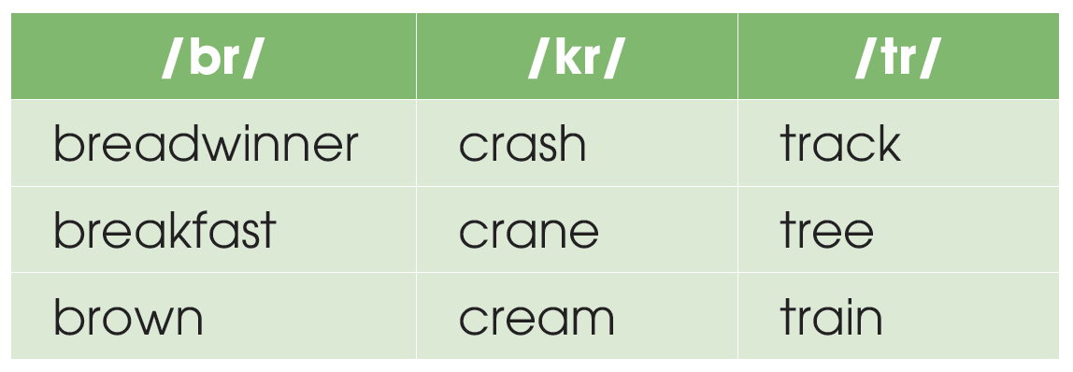
PRONUNCIATION
1
Listen and repeat. Pay attention to the consonant blends /br/, /kr/, and /tr/.

Slide 17
PRONUNCIATION
2
Listen to the sentences and circle the words you hear.

Slide 18
LESSON 2
LANGUAGE
WARM-UP
GAME: Guess the words
GETTING STARTED
PRONUNCIATION
Task 1: Listen and repeat.
Task 2: Listen and circle.
VOCABULARY
Task 1: Match the words with their meanings.
Task 2: Complete the sentences.

Slide 19
VOCABULARY
1
Match the words with their meanings.
a. person who manages a home and often raises children instead of earning money
b. someone who earns money to support their family
c. picking up and carrying heavy objects
d. work around the house such as cooking, cleaning or washing clothes
e. food and other goods sold at a shop or a supermarket

Slide 20
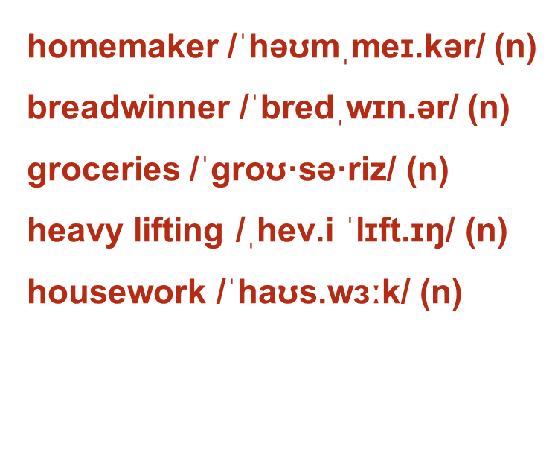
VOCABULARY
người nội trợ
trụ cột gia đình
thực phẩm và tạp hóa
mang vác nặng
việc nhà

Slide 21
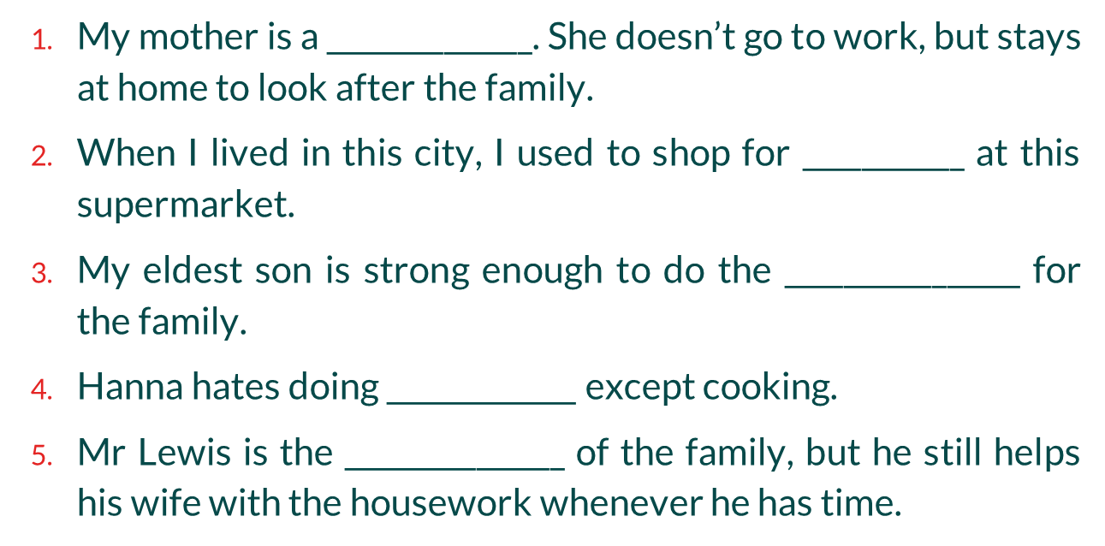
VOCABULARY
2
Complete the sentences with the words in Task 1.

Slide 22
LESSON 2
LANGUAGE
WARM-UP
GAME: Guess the words
GETTING STARTED
PRONUNCIATION
Task 1: Listen and repeat.
Task 2: Listen and circle.
VOCABULARY
Task 1: Match the words with their meanings.
Task 2: Complete the sentences.
GRAMMAR
Task 1: Choose the correct forms.
Task 2: Read and complete the text.

Slide 23
GRAMMAR
Present continuous
to talk about things which are happening at the moment of speaking.
Example: My mother isn’t cooking now. She’s working in her office.
Present simple
to talk about habits or things we do regularly.
Example: My mother cooks every day.

Slide 24
Present simple vs. Present continuous
GRAMMAR
 | Present simple | Present continuous
Signal words | usually, always, every day, often, never, seldom… → adverbs of frequency | now, at the moment, at present, presently,…
Example | I listen to music every day. He never eats cheese. She is always cheerful. | I am listening to music now. He isn’t eating cheese at the moment.

Slide 25
Remember!
GRAMMAR

Slide 26
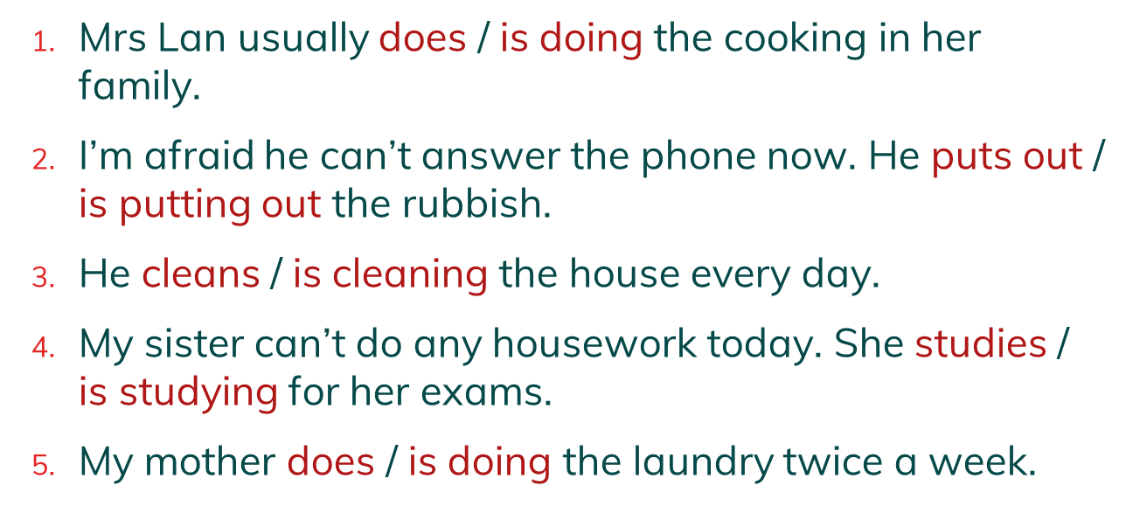
GRAMMAR
1
Choose the correct form of the verb in each sentence.

Slide 27
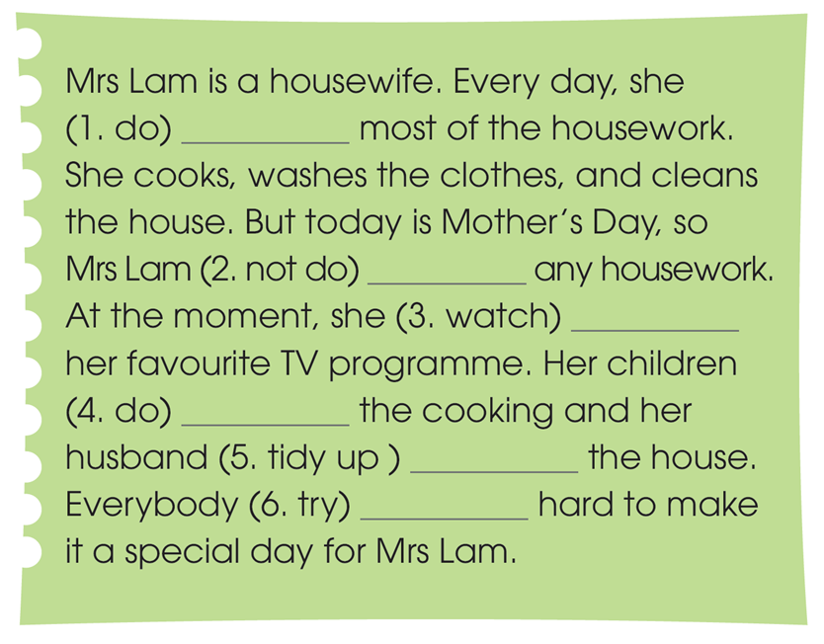
GRAMMAR
2
Read the text and put the verbs in brackets in the present simple or present continuous.
does
isn‘t doing
is watching
are doing
is tidying up
is trying

Slide 28
LESSON 2
LANGUAGE
WARM-UP
GAME: Guess the words
GETTING STARTED
PRONUNCIATION
Task 1: Listen and repeat.
Task 2: Listen and circle.
VOCABULARY
Task 1: Match the words with their meanings.
Task 2: Complete the sentences.
GRAMMAR
Task 1: Choose the correct forms.
Task 2: Read and complete the text.
EXTRA
ACTIVITY
GAME: 20 questions

Slide 29
GAME: 20 QUESTIONS
EXTRA ACTIVITY

Slide 30
LESSON 2
LANGUAGE
WARM-UP
GAME: Guess the words
GETTING STARTED
Task 1: Listen and repeat.
Task 2: Listen and circle.
PRONUNCIATION
VOCABULARY
Task 1: Match the words with their meanings.
Task 2: Complete the sentences.
GRAMMAR
Task 1: Choose the correct forms.
Task 2: Read and complete the text.
EXTRA
ACTIVITY
GAME: 20 questions
CONSOLIDATION
Wrap-up
Homework

Slide 31
CONSOLIDATION
1
Wrap-up
What have you learnt today?
- consonant blends /br/, /kr/, and /tr/
- some lexical items about household chores;
- present simple vs. present continuous

Slide 32
CONSOLIDATION
2
Homework
- Do exercises in the workbook.
- Prepare for Lesson 3 - Unit 1.

Slide 33
Website: hoclieu.vn
Fanpage: facebook.com/www.tienganhglobalsuccess.vn

