Slide 1
Ly Tu Trong High school
WELCOME TO OUR CLASS 10A8
Teacher : Tran Thi Minh Nguyet
UNIT 4- LESSON: GETTING STARTED
TIẾNG ANH 10- GS

Slide 2
CHECK- UP : Choose the best answer to complete the following sentences
Question 1: My parents decided _________ a taxi because it was late.
A. take B. to take C. taking D. took
Question 2: It began _________ when I was in London last Saturday.
A. rain B. to rain C. rained D. rains
Question 3: I saw her _________ the street.
A. to cross B. crossed C. crosses D. cross
Question 4: We managed _________ their first album on social media.
A. found B. founded C. finding D. to find
Question 5: Don't let him _________ about his mother's illness now.
A. know B. knowing C. to know D. known
Question 6: It's dangerous _________ out alone late at night.
A. gone B. going C. go D. to go
Question 7: My mother made me __________at home at night.
A. staying B. to stay C. stayed D. stay
Question 8: I’m happy _________ that you’ve passed your driving test.
A. not hearing B. hear C. hearing D. to hear

Slide 3
ANSWER
Question 1: My parents decided _________ a taxi because it was late.
A. take B. to take C. taking D. took
Question 2: It began _________ when I was in London last Saturday.
A. rain B. to rain C. rained D. rains
Question 3: I saw her _________ the street.
A. to cross B. crossed C. crosses D. cross
Question 4: We managed _________ their first album on social media.
A. found B. founded C. finding D. to find
Question 5: Don't let him _________ about his mother's illness now.
A. know B. knowing C. to know D. known
Question 6: It's dangerous _________ out alone late at night.
A. gone B. going C. go D. to go
Question 7: My mother made me __________at home at night.
A. staying B. to stay C. stayed D. stay
Question 8: I’m happy _________ that you’ve passed your driving test.
A. not hearing B. hear C. hearing D. to hear

Slide 4
WARM-UP
LOOK AT THE PICTURES AND MATCH THEM WITH THE CORRECT ACTIVITIES
( work in 2 groups in 3’)

Slide 5
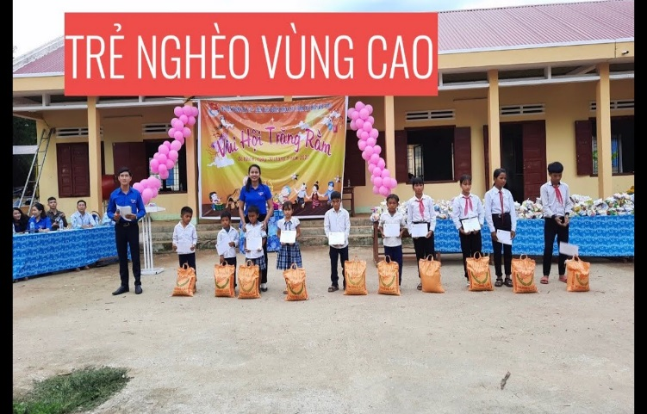
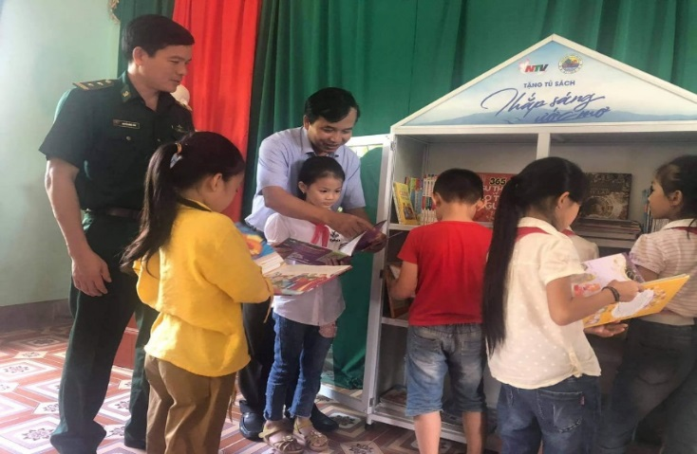
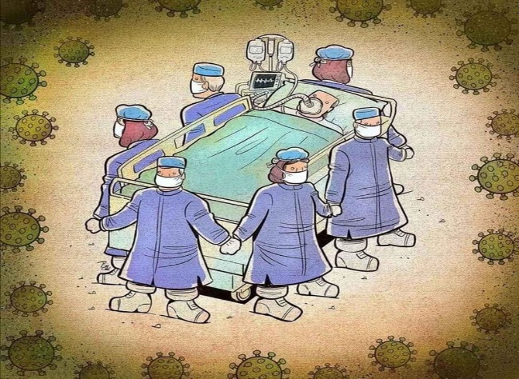
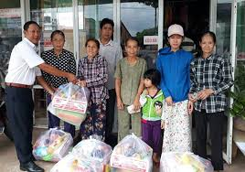
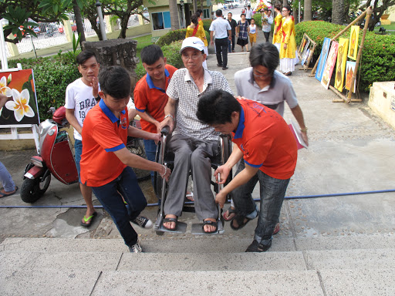
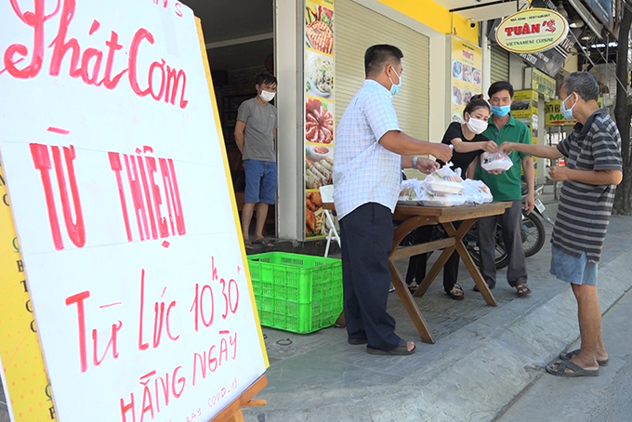
e.
e.
1
2
3
4
5
6
a. Help the disabled
b. Help the poor
c. Give presents for the children in mountainous areas
d. Donate food
e. Donate books
f. Join hands to help Covid patients

Slide 6
e.
e.
1
2
3
4
5
6
a. Help the disabled
b. Help the poor
c. Give presents for the children in mountainous areas
d. Donate food
e. Donate books
f. Join hands to help Covid patients

Slide 7
e.
e.
QUESTION:
What are these activities ?
FOR A BETTER COMMUNITY
Why do many people do volunteer work ?

Slide 8
Unit
4
1
Unit
FAMILY LIFE
FOR A BETTER COMMUNITY
LESSON 1
GETTING STARTED
Volunteering in the community

Slide 9
Unit
1
1
FAMILY LIFE
Family Life
Unit
OBJECTIVES
By the end of this lesson, students will be able to gain:
an overview about the topic For a better community
vocabulary to talk about voluntary work

Slide 10
CHECK -UP
LESSON 1
GETTING STARTED
Unit
GETTING STARTED
WARM-UP
Matching
PRESENTATION
Vocabulary
Task 1: Listen and read.
Task 2: Read the conversation and answer the questions.
Task 3: Find the adjectives.
Task 4: Complete the sentences.
PRACTICE
PRODUCTION
Self-reflection
PRACTICE
Wrap-up
Homework

Slide 11
CHECK -UP
LESSON 1
GETTING STARTED
Unit
GETTING STARTED
WARM-UP
Matching

Slide 12
CHECK -UP
LESSON 1
GETTING STARTED
Unit
GETTING STARTED
WARM-UP
Matching
PRESENTATION
Vocabulary

Slide 13
PRESENTATION
volunteer (n)
/ˌvɒlənˈtɪə(r)/
a person who does a job without being paid for it
Tình nguyện viên

Slide 14
PRESENTATION
advertisement (n)
/ədˈvɜːtɪsmənt/
a notice, picture or film telling people about a product, job or service
Quảng cáo

Slide 15
PRESENTATION
community (n)
/kəˈmjuːnəti/
all the people who live in a particular area, country, etc. when talked about as a group
Cộng đồng

Slide 16
PRESENTATION
boost (v)
/buːst/
Thúc đẩy
to make something increase, or become better or more successful

Slide 17
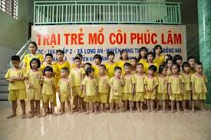
PRESENTATION
orphanage (n)
/ˈɔːfənɪdʒ/
a home for children whose parents are dead
Trại mồ côi

Slide 18
PRESENTATION
New words | Pronunciation | Meaning
1. volunteer (n) | /ˌvɒlənˈtɪə(r)/ | Tình nguyện viên
2. Advertisement (n) | /ədˈvɜːtɪsmənt/ | quảng cáo
3. community (n) | /kəˈmjuːnəti/ | cộng đồng
4. boost (v) | /buːst/ | Tăng cường, đẩy mạnh
5. orphanage (n) | /ˈɔːfənɪdʒ/ | Trại mồ côi
6. Apply (v) | /əˈplaɪ/ | Áp dụng / nộp đơn

Slide 19
CHECK -UP
LESSON 1
GETTING STARTED
Unit
GETTING STARTED
WARM-UP
Matching
PRESENTATION
Vocabulary
Task 1: Listen and read.
Task 2: Read the conversation and answer the questions.
Task 3: Find the adjectives.
Task 4: Complete the sentences.
PRACTICE

Slide 20
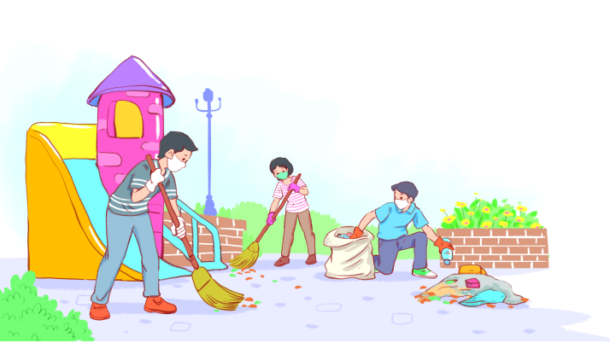
PRACTICE
1
Listen and read.
Volunteering in the community

Slide 21
PRACTICE
Kim: Hi, Tam. I went to your house at 9 a.m., but you weren’t there. Tam: Oh, when you came, I was working as a volunteer at our local centre for community development. Kim: Ah, I see. How did you become a volunteer there? Tam: Just by chance. Last summer, while I was visiting the centre, I saw an advertisement for volunteers. I applied and my application was successful. Kim: I also want to be a volunteer. I find community work very interesting. Tam: I agree. Community service not only benefits the local area, but can also boost our confidence and help us learn many useful skills. | Kim: What are the regular activities organised by the centre? Tam: Oh, there are endless opportunities for getting involved. For example, you can join a local environmental group to clean up the park once a week or volunteer at an orphanage. Kim: Sounds good. How can I apply? Tam: I’ll email you the form. You just fill it in and send it in. Kim: Thanks so much. I’m so excited about volunteering at the centre. Tam: No problem. Good luck. Hope your application is successful and you enjoy the work.
1
Listen and read.
Volunteering in the community

Slide 22
PRACTICE
PRACTICE
2
Kim: Hi, Tam. I went to your house at 9 a.m., but you weren’t there. Tam: Oh, when you came, I was working as a volunteer at our local centre for community development. Kim: Ah, I see. How did you become a volunteer there? Tam: Just by chance. Last summer, while I was visiting the centre, I saw an advertisement for volunteers. I applied and my application was successful. Kim: I also want to be a volunteer. I find community work very interesting. Tam: I agree. Community service not only benefits the local area, but can also boost our confidence and help us learn many useful skills. | Kim: What are the regular activities organised by the centre? Tam: Oh, there are endless opportunities for getting involved. For example, you can join a local environmental group to clean up the park once a week or volunteer at an orphanage. Kim: Sounds good. How can I apply? Tam: I’ll email you the form. You just fill it in and send it in. Kim: Thanks so much. I’m so excited about volunteering at the centre. Tam: No problem. Good luck. Hope your application is successful and you enjoy the work.
Read the conversation again and answer the questions.
( Pairwork in 4’ )
1. What was Tam doing when Kim went to her house?
She was working as a volunteer at the local centre for community development.
2. What are some regular activities at the centre for community development?
Cleaning up the park or volunteering at the orphanage.
3. How can Kim apply for volunteer work at the centre?
She needs to fill in the form, then send it in.

Slide 23
PRACTICE
3
Find the adjectives with the following suffixes in the conversation and write them below.
suffixes | adjectives
-ed
-ing
-ful
-less
excited
interesting
useful, successful
endless

Slide 24
PRACTICE
- ful: full of or having the qualities of ….
- less : without or lacking ….
- ed: describing how people are made to feel
- ing : describing things or people causing the feeling
Example: exciting interested
useless meaningful

Slide 25
PRACTICE
4
Find a verb phrase in the conversation to complete each sentence.
1. Oh, when you came, I____________ as a volunteer at our local centre for community development.
2. Last summer, while I was visiting the centre, I_____ an advertisement for volunteers.
was working
saw
Structure:
When + S+ V-2/ed , S+ was/were + V-ing .
While + S+ was/were + V-ing , S+ V-2/ed .

Slide 26
CHECK -UP
LESSON 1
GETTING STARTED
Unit
GETTING STARTED
WARM-UP
Matching
PRESENTATION
Vocabulary
Task 1: Listen and read.
Task 2: Read the conversation and answer the questions.
Task 3: Find the adjectives.
Task 4: Complete the sentences.
PRACTICE
PRODUCTION
Self-reflection

Slide 27
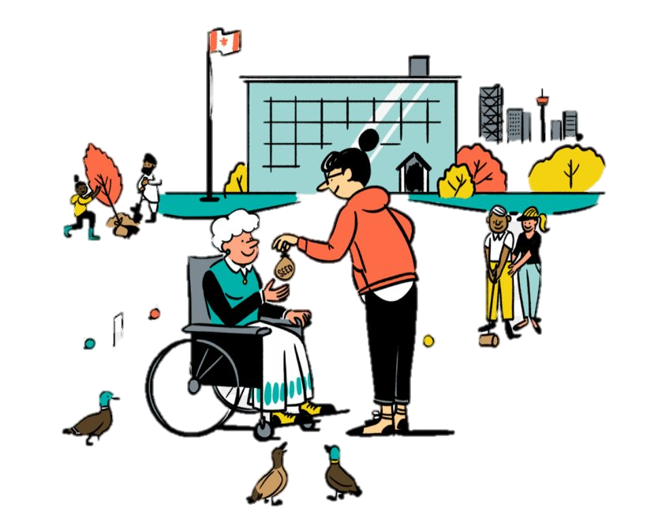
PRODUCTION
SELF-REFLECTION
Decide which of the following activities are volunteer works.
• 1. Taking part in an excursion
• 2. Helping people in remote or mountainous areas
•3. Giving care and comfort to the poor and the sick
• 4. Participating in an English speaking club
• 5. Providing education for disadvantaged children
• 6. Joining the Green Saturday Movement

Slide 28
PRODUCTION
SELF-REFLECTION
Decide which of the following activities are volunteer works.
• 1. Taking part in an excursion
• 2. Helping people in remote or mountainous areas
•3. Giving care and comfort to the poor and the sick
• 4. Participating in an English speaking club
• 5. Providing education for disadvantaged children
• 6. Joining the Green Saturday Movement

Slide 29
PRODUCTION
QUESTION:
Do you often help the others by doing these activities ?
Do you like doing these activities ? Why ?
Who do you do with?
PRODUCTION

Slide 30
CHECK -UP
LESSON 1
GETTING STARTED
Unit
GETTING STARTED
WARM-UP
Matching
PRESENTATION
Vocabulary
Task 1: Listen and read.
Task 2: Read the conversation and answer the questions.
Task 3: Find the adjectives.
Task 4: Complete the sentences.
PRACTICE
PRODUCTION
Self-reflection
PRACTICE
Wrap-up
Homework

Slide 31
CONSOLIDATION
1
Wrap-up
Gain an overview about the topic For a better community
Gain vocabulary to talk about voluntary work

Slide 32
CONSOLIDATION
2
Homework
1. Do exercises in the workbook
2. Prepare for the next lesson: LANGUAGE
3. Prepare for the Project

Slide 33
Thank you for your attention!!!
See you again !!!

