Slide 2
Unit
9
1
Unit
FAMILY LIFE
Protecting The Environment
LESSON 3
READING
Environmental problems

Slide 3
Unit
1
1
FAMILY LIFE
Family Life
Unit
OBJECTIVES
Practise reading for the main idea and specific information in a text about Environmental problems

Slide 4
LESSON 3
READING
WARM-UP
Slap the board game
PRE-READING
Task 1: Look at the pictures and answer the question.
Task 2: Choose the best title for it.
Task 3: Read the text again and decide which paragraph contains the following information.
Task 4: Complete the sentences.
WHILE-READING
POST-READING
Task 5: Discuss the question.
WHILE-READING
Wrap-up
Home work

Slide 5
LESSON 3
READING
WARM-UP
Slap the board game

Slide 6
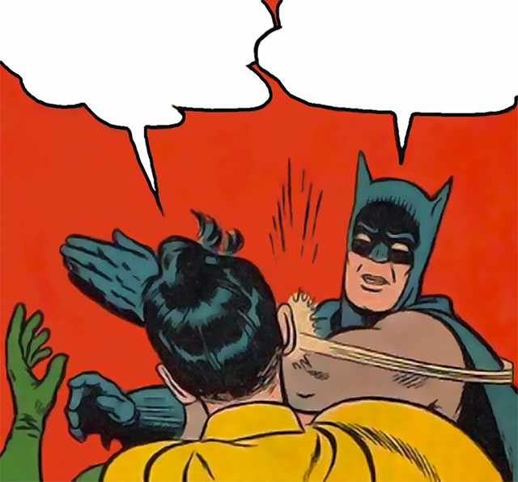
Slap the board game
Unit

Slide 7
SLAP THE BOARD GAME
- There are 12 pictures of environmental issues on the board.
- Teacher will say the name of one environmental issue and students will have to slap their hands on the appropriate picture.

Slide 8
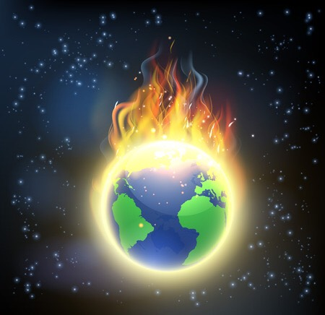
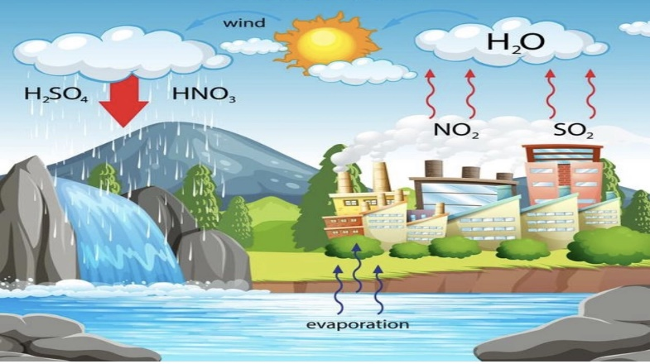
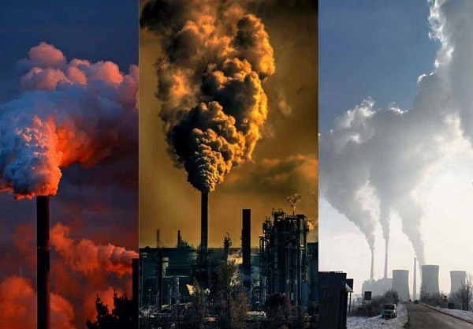
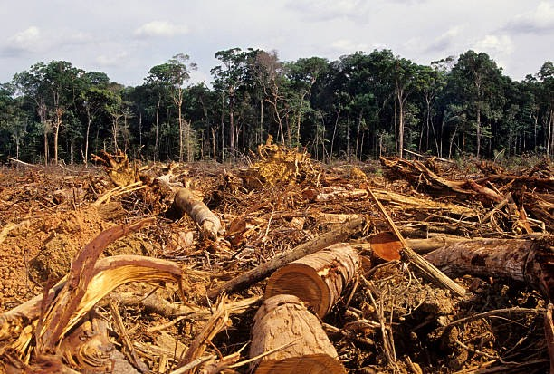
SLAP THE BOARD GAME
1
2
3
4

Slide 9
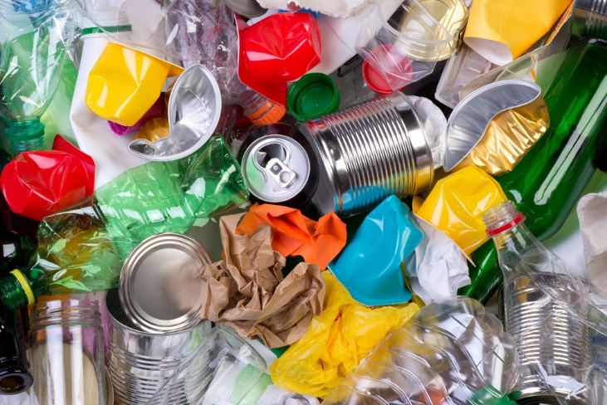
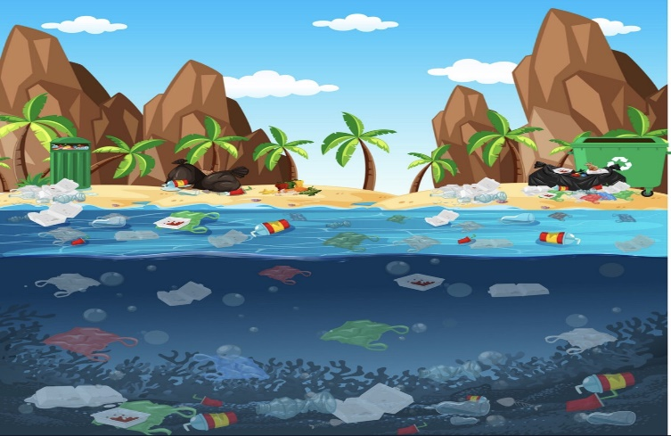
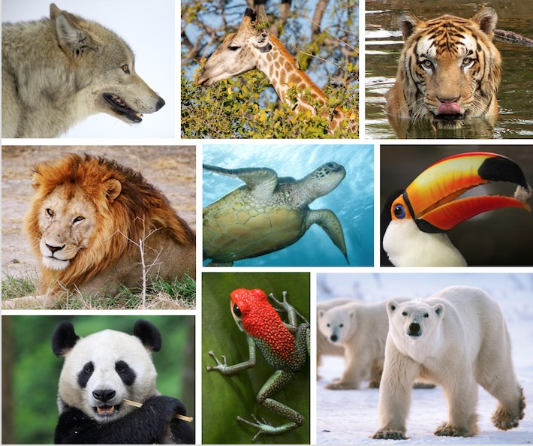
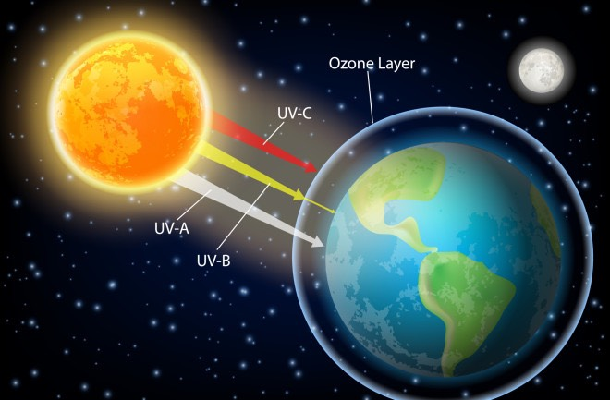
SLAP THE BOARD GAME
5
6
7
8

Slide 10
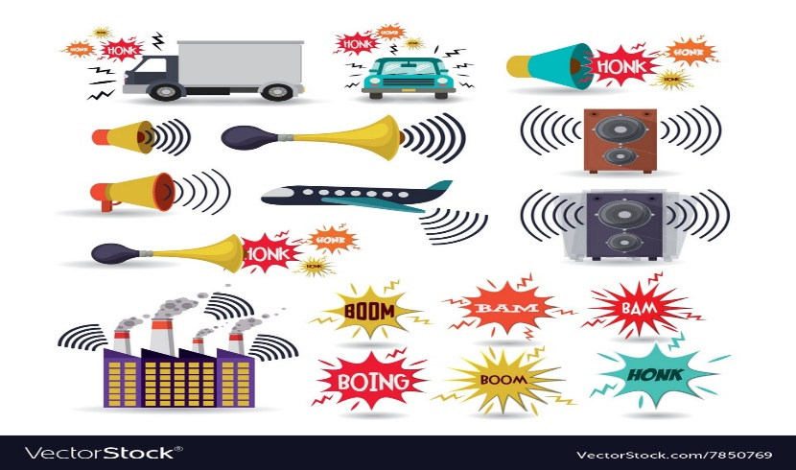
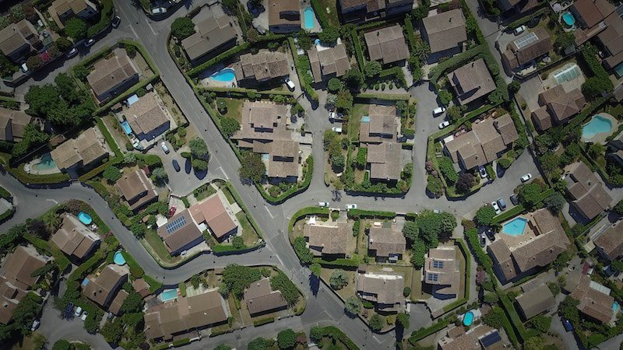
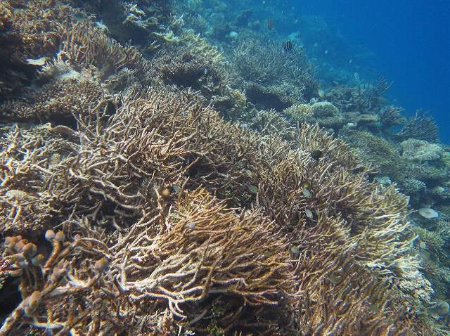
SLAP THE BOARD GAME
9
10
11
12

Slide 11
SLAP THE BOARD GAME
1. Global warming | 2. Acid rain
3. Air pollution | 4. Deforestation
5. Rubbish | 6. Water pollution
7. Endangered animals | 8. Ozone layer depletion
9. Noise pollution | 10. Urban sprawl
11. Pesticide | 12. Ocean acidification

Slide 12
LESSON 3
READING
WARM-UP
Slap the board game
PRE-READING
Task 1: Look at the pictures and answer the question.

Slide 13
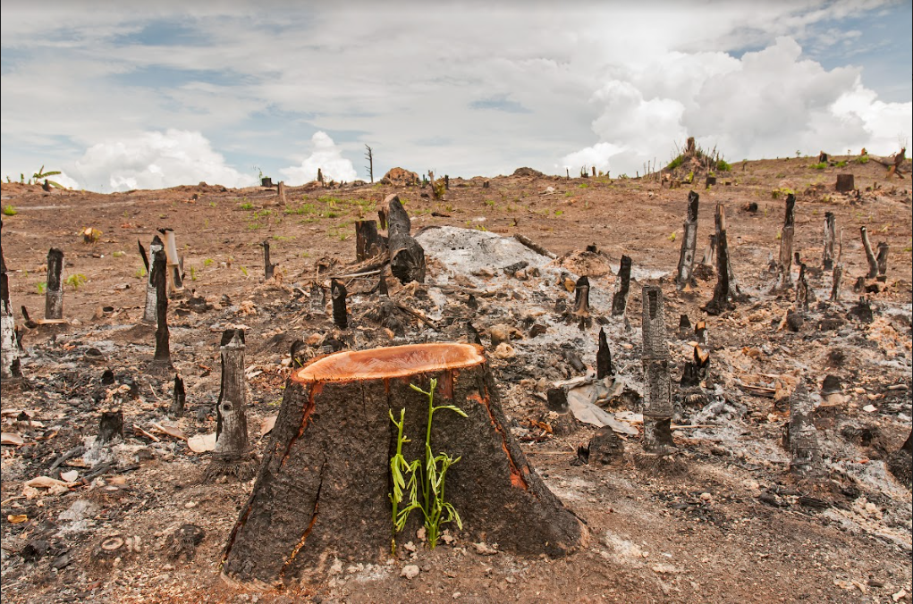
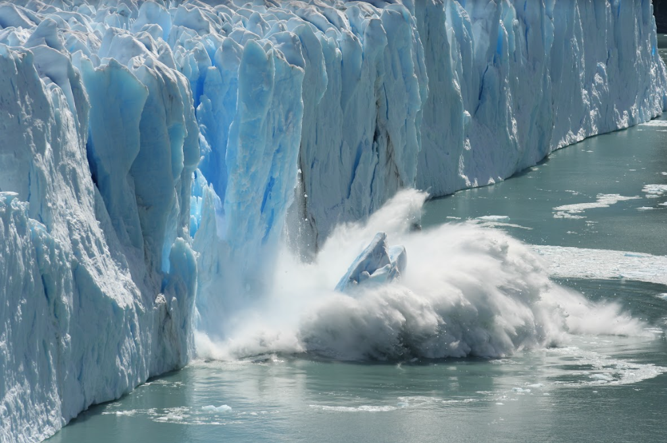
PRE-READING
1
Look at the pictures and answer the question:
What environmental problems do you see in the pictures?
a. Cutting of forests
b. Global warming

Slide 14
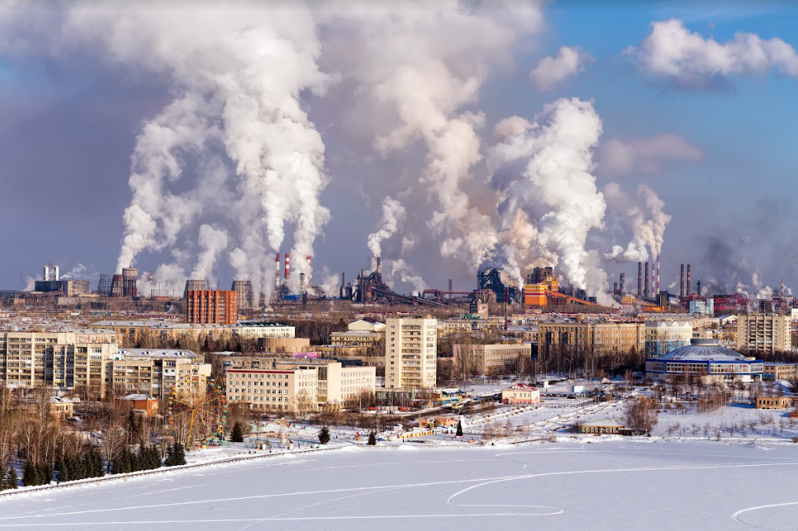
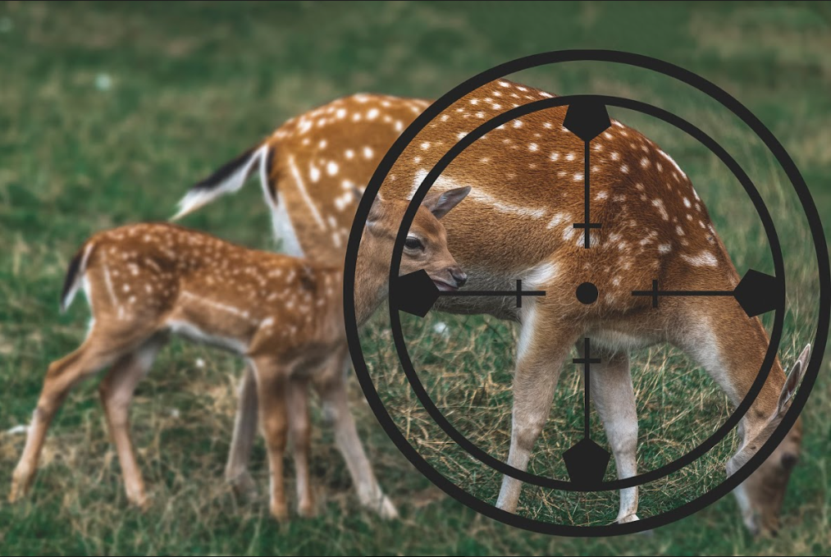
PRE-READING
1
Look at the pictures and answer the question:
What environmental problems do you see in the pictures?
c. Air pollution
d. Endangered animals

Slide 15
LESSON 3
READING
WARM-UP
Slap the board game
PRE-READING
Task 1: Look at the pictures and answer the question.
Task 2: Choose the best title for it.
Task 3: Read the text again and decide which paragraph contains the following information.
Task 4: Complete the sentences.
WHILE-READING

Slide 16
WHILE-READING
2
Read the text and choose the best title for it.
1
a. Environmental problems: What are they?
b. Environmental protection: How important is it?
c. Environmental solutions: How practical are they?

Slide 17
WHILE-READING
3
Read the text again and decide which paragraph contains the following information.
Information | Paragraph
1. an example of harmful substances in the air and water | C
2. one of the reasons for destroying wildlife habitats | B
3. an increase in the level of the world’s oceans | A
4. an effect of illegal hunting on the ecosystem | D

Slide 18
WHILE-READING
PRACTICE
4
Complete the sentences with information from the text. Use no more than TWO words for each answer.
1. Global warming can cause extreme ______________ such as floods or heatwaves.
2. The natural ___________ of many animals can be destroyed in the process of cutting down forests.
3. One of the main causes of air pollution is ___________ produced by machines and factories.
4. When many animals disappear, this damages the natural balance of ___________.
weather events
habitats
waste gases
ecosystem

Slide 19
LESSON 3
READING
WARM-UP
Slap the board game
PRE-READING
Task 1: Look at the pictures and answer the question.
Task 2: Choose the best title for it.
Task 3: Read the text again and decide which paragraph contains the following information.
Task 4: Complete the sentences.
WHILE-READING
POST-READING
Task 5: Discuss the question.

Slide 20
POST-READING
PRACTICE
5
Discuss the question.
Which of the problems mentioned in the text do you think is the most serious in Vietnam?
1. Global warming
2. Cutting of forests
3. Air pollution
4. Endangered animals
Each group prepares a 3-minute talk on the very question.

Slide 21
POST-READING
PRACTICE
Two group leaders take turns giving their talks to the whole class

Slide 22
LESSON 3
READING
WARM-UP
Slap the board game
PRE-READING
Task 1: Look at the pictures and answer the question.
Task 2: Choose the best title for it.
Task 3: Read the text again and decide which paragraph contains the following information.
Task 4: Complete the sentences.
WHILE-READING
POST-READING
Task 5: Discuss the question.
WHILE-READING
Wrap-up
Home work

Slide 23
CONSOLIDATION
1
Wrap-up
Develop such reading skills as reading for the main idea and specific information in a text about Environmental problems

Slide 24
CONSOLIDATION
2
Homework
Do exercises in the workbook

Slide 25
Website: sachmem.vn
Fanpage: facebook.com/sachmem.vn/

